Slide 1


Slide 2
Exploratory Data Analysis
Exploratory Data Analysis(EDA) is the first step in your data analysis process.
EDA refers to the process of performing initial investigations on data so as to discover patterns, to spot anomalies, to test hypothesis and to check assumptions with the help of summary statistics and graphical representations.

Slide 3
Count Plot
Count Plot is a graphical display to show the number of occurrences or frequency for each categorical data using bars.

Slide 4
Heatmap
The heatmap is a way of representing the data in a 2-dimensional form.
The data values are represented as colors in the graph.
The goal of the heatmap is to provide a colored visual summary of information.

Slide 5
Heatmap
The values in the x axis and y axis for each block in the heatmap are called tick labels.
The tick labels are added by default. If we want to remove the tick labels, we can set the xticklabels or yticklabels attribute of seaborn heatmap to False

Slide 6
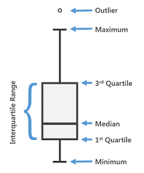
Boxplot
Box Plot is the visual representation statistical five number summary of a given data set.

Slide 7
Data Wrangling
Data Wrangling means clean the data by removing the NAN values and unnecessary columns in the dataset.

Slide 8
For more information please contact:
T+ 33 1 98765432
F+ 33 1 88888888
M+ 33 6 44445678
firstname.lastname@atos.net

