Slide 1


Sentiment Analysis of Social Media Reviews to Improve Canada Post Services using NLP
Team Members:
1. Krishan Chawla
2. Rushanthi Baskaran
3. Sandeep Sudesh
4. Shyam Kishore
5. Vivek Anandham Narayanan

Slide 2


Content
Problem Statement & Objectives
Data Collection & Analysis
Data Cleaning & Feature Engineering
Sentiment Analysis with Competitors
Key Findings
Recommendations
Limitations and Future Work

Slide 3
Problem Statement & Objectives
For Canada Post, analyzing massive volumes of social media data is time-consuming and difficult.
The objective is to create an automated sentiment analysis model to better analyze client feedback provided in tweets.
Objective: -
Create a sentiment analysis model that can identify twitter tweets as positive, negative, or neutral.
Extract crucial information to discover common consumer concerns and complaints.
For a competitive study, compare Canada Post's performance to that of other postal systems (UPS, Purolator).
Notes:
Despite its prominence in Canada, Canada Post confronts issues in maintaining high levels of customer satisfaction. On social media networks such as Yelp, Google Reviews, Twitter, and Facebook, the firm receives a substantial quantity of feedback and reviews. However, manually analyzing this massive quantity of data to uncover repeating themes, sentiment patterns, and areas for improvement takes time and effort.
The task at hand is to create an automated sentiment analysis model capable of effectively processing and analyzing social media messages on Canada Post. The model should properly characterize each post's emotion as good, negative, or neutral, providing for a thorough insight of client attitudes towards the postal service.
Furthermore, the sentiment analysis model should go beyond polarity categorization to detect concerns and complaints raised often by consumers. The approach should help Canada Post to identify areas that require immediate attention, such as delivery delays, package mishandling, and customer service difficulties, by extracting essential insights from the data.
To make the initiative more meaningful, the sentiment analysis model should be able to compare Canada Post's performance against that of other postal systems in Canada or across the world. This comparison will throw light on Canada Post's relative strengths and shortcomings in contrast to its competitors, allowing for focused adjustments to gain a competitive edge.
The effective adoption of the sentiment analysis model will enable Canada Post to address customer complaints proactively, improve service quality, and increase customer happiness. Finally, this automated method will assist the corporation in making data-driven choices, optimising operations, and maintaining its position as Canada's trusted and reliable postal service.

Slide 4
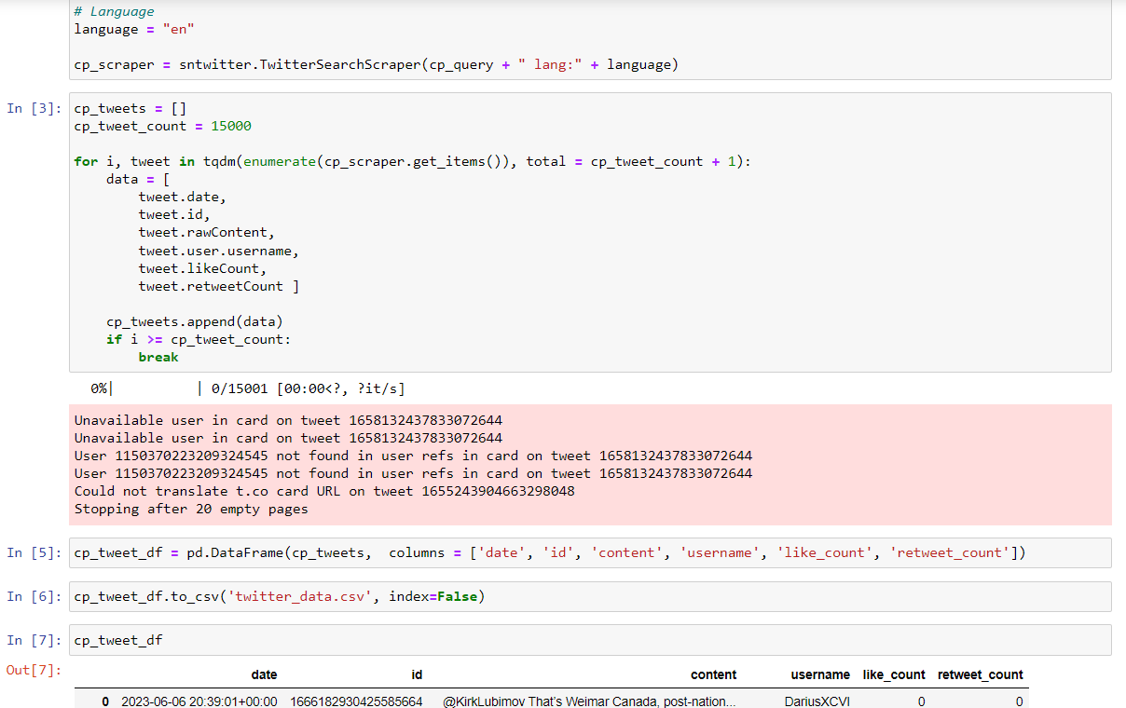
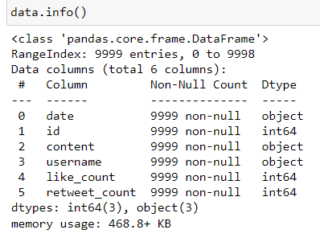
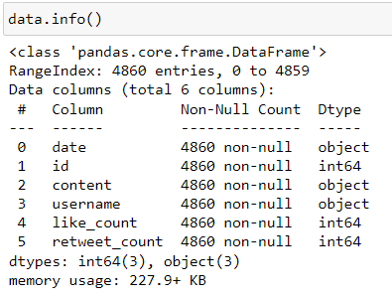
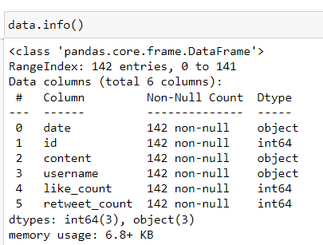
Data Collection & Analysis
Data Collection: -
Web Scrapping of Twitter “English” tweets for Canada Post, Purolator and UPS.
Date, Tweet, ID, Username, Like Count and Retweet Counts were extracted.
Data Analysis: -
Loading of all 3 Postal Tweets, then performing Data Information and Description.
Canada Post – contains 4860 tweets, UPS – contains 9999 tweets and, Purolator – contains 142 tweets.

Slide 5




Data Cleaning & Feature Engineering
Process | Before | After
Handling usernames, links and emoticons
Dropping unwanted columns and lowercasing tweets
Tokening and removing punctuation marks
Removing stop words
Lemmatization and handling acronyms
Fixing typos and removal of user and http words

Slide 6
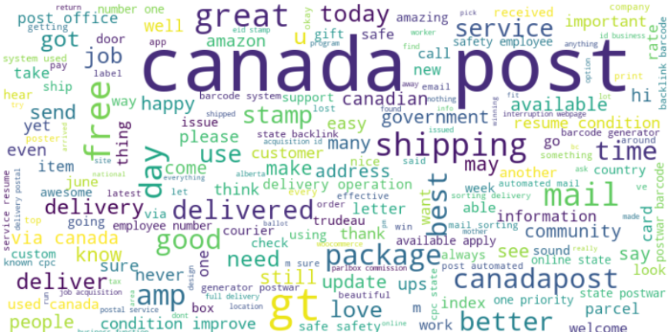
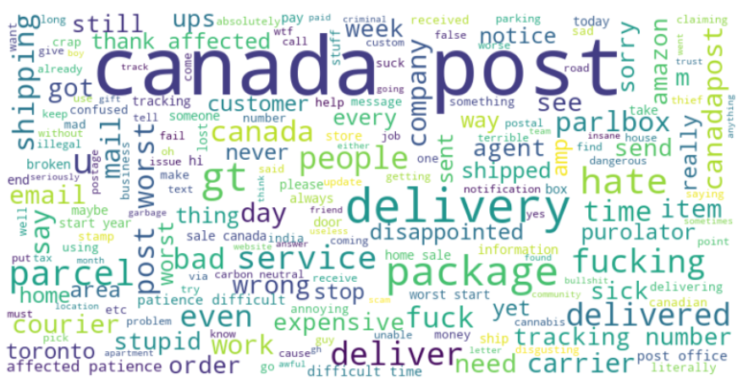
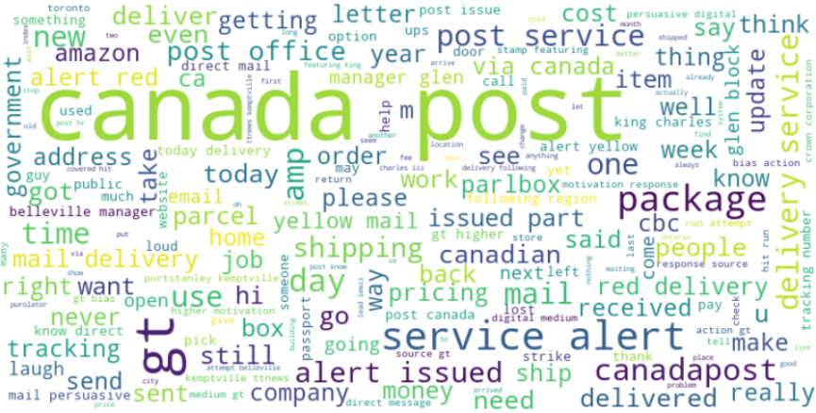
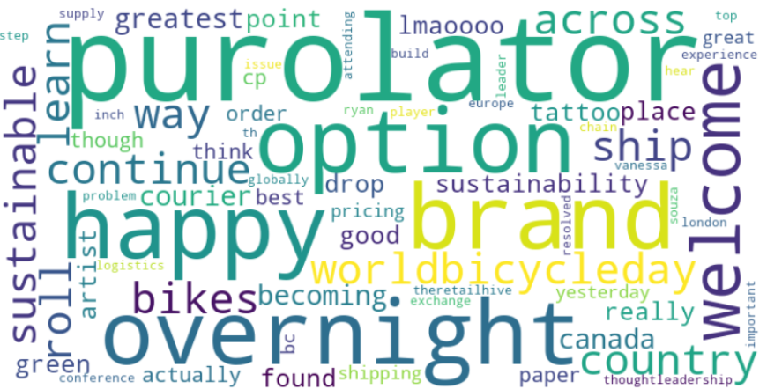

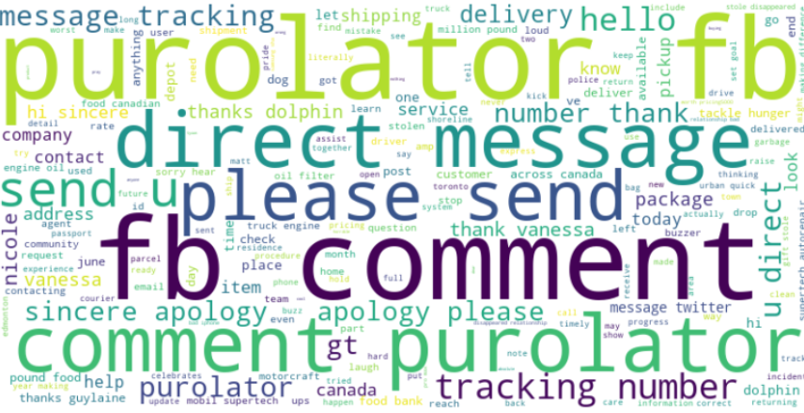

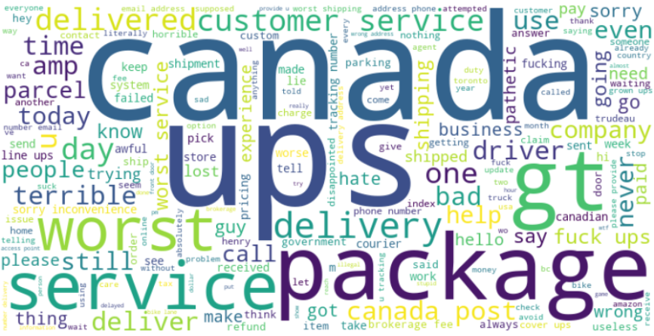
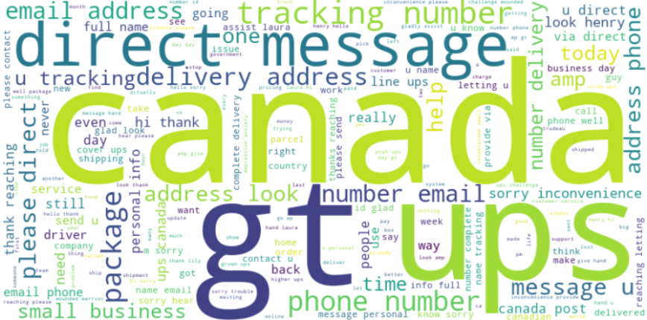
Sentiment Analysis with Competitors
Postal | Positive | Negative | Neutral
Canada Post
Purolator
UPS

Slide 7


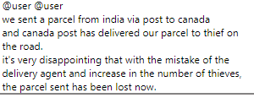

Key Findings
Overall Sentiment: majority of tweets about Canada Post were neutral, with a slight positive skew. However, there was a significant number of negative sentiments, pointing to areas where improvement is needed.
Positive Aspects: customers appreciated Canada Post's extensive coverage, particularly in distant places, as well as its ability to deliver to difficult situations.
Common Complaints: delayed deliveries, package mishandling, and poor customer service experiences.

Slide 8
Recommendations
Improve client Service: Improving response times, communicating delays effectively, and improving the entire customer service experience,
Improve Package Tracking: Invest in technology that will allow to track packages in real time and offer precise delivery predictions.
Address Delivery Delays: Develop measures to reduce delivery delays, particularly during peak periods.
Competitors may teach you a lot: Examine best practices of rival postal systems that perform in areas where Canada Post struggles.

Slide 9
Limitations
Data from social media may be biased.
Due to platform-specific use, client input is not fully represented.
Language barriers prevent non-English posts from being understood.
Customers who do not utilize social media sites provide little insights.
Develop API restrictions in scrapping data from social media like Facebook.

Slide 10
Future Work
Include information from other sources, such as email feedback or customer support records.
Conduct consumer surveys to get direct input from a larger group of people.
Enhance language processing skills in order to accommodate multilingual posts.
Investigate sentiment analysis on various sorts of user-generated content, such as online forums or review sites.
Implement sentiment analysis in various languages to reach a broader audience.
Integrate consumer demographic data for a more complete picture of sentiment variances.

Slide 11



Thank you

