Slide 1


Sentiment Analysis of Social Media Reviews to Improve Canada Post Services using NLP
Team Members:
1. Krishan Chawla
2. Rushanthi Baskaran
3. Sandeep Sudesh
4. Shyam Kishore
5. Vivek Anandham Narayanan

Slide 2


Content
Problem Statement & Objectives
Data Collection
Data Analysis
Data Cleaning & Feature Engineering
Data Cleaning & Feature Engineering Results
Sentiment Analysis
Sentiment Analysis with Competitors
Key Findings
Recommendations
Limitations and Future Work

Slide 3
Problem Statement & Objectives
For Canada Post, analyzing massive volumes of social media data is time-consuming and difficult.
The objective is to create an automated sentiment analysis model to better analyze client feedback provided in tweets.
Objective: -
Create a sentiment analysis model that can identify twitter tweets as positive, negative, or neutral.
Extract crucial information to discover common consumer concerns and complaints.
For a competitive study, compare Canada Post's performance to that of other postal systems (UPS, Purolator).
Notes:
Despite its prominence in Canada, Canada Post confronts issues in maintaining high levels of customer satisfaction. On social media networks such as Yelp, Google Reviews, Twitter, and Facebook, the firm receives a substantial quantity of feedback and reviews. However, manually analyzing this massive quantity of data to uncover repeating themes, sentiment patterns, and areas for improvement takes time and effort.
The task at hand is to create an automated sentiment analysis model capable of effectively processing and analyzing social media messages on Canada Post. The model should properly characterize each post's emotion as good, negative, or neutral, providing for a thorough insight of client attitudes towards the postal service.
Furthermore, the sentiment analysis model should go beyond polarity categorization to detect concerns and complaints raised often by consumers. The approach should help Canada Post to identify areas that require immediate attention, such as delivery delays, package mishandling, and customer service difficulties, by extracting essential insights from the data.
To make the initiative more meaningful, the sentiment analysis model should be able to compare Canada Post's performance against that of other postal systems in Canada or across the world. This comparison will throw light on Canada Post's relative strengths and shortcomings in contrast to its competitors, allowing for focused adjustments to gain a competitive edge.
The effective adoption of the sentiment analysis model will enable Canada Post to address customer complaints proactively, improve service quality, and increase customer happiness. Finally, this automated method will assist the corporation in making data-driven choices, optimizing operations, and maintaining its position as Canada's trusted and reliable postal service.

Slide 4
Data Collection
To access and gather tweets from Twitter's platform, a Python package named "snscrape" was used. This library makes it simple to fetch public tweets based on defined criteria such as keywords or users.
Web Scrapping of Twitter was limited to only “English” tweets for Canada Post, Purolator and UPS.
Date, Tweet, ID, Username, Like Count and Retweet Counts were the key factors extracted.
The threshold for extraction of tweets were set to 15,000.

Slide 5
Data Analysis
As initial step all 3 Postal tweets were loaded as a DataFrame in individual scripts.
The EDA was performed by applying functions such as; Data Information and Description to analyze the extracted data.
It was then derived that Canada Post – contains 4860 tweets, UPS – contains 9999 tweets and, Purolator – contains 142 tweets respectively.

Slide 6
Data Cleaning & Feature Engineering -1
The first step in data cleaning was to handle emoticons, links and usernames in the tweets. This was done by mapping emoticons with customized dictionary words and links were mapped with ‘http’, username with ‘user’ tags, respectively.
Next, unnecessary features like date, id, username, like_count, retweet_count, were dropped from the DataFrame.
Lowercasing was done on the content feature (tweets).
A new feature ‘tokenized_content’ was created by using word_tokenize from the the nltk.tokenize library.

Slide 7
Data Cleaning & Feature Engineering - 2
For the new feature, further preprocessing of data was done.
First, removal of punctuations.
Then removal of stop words by using ‘stopwords’ from nltk.corpus library.
Application of lemmatization using ‘WordNetLemmatizer’ from nltk.stem library.
Handling of Acronyms and Slang words as was done by mapping it with defined words.
Typos were fixed by using ‘Speller’ from ‘autocorrect’ library.
As the final step, defined ‘user’ and ‘http’ words were removed as they aren’t needed during the sentiment analysis stage.

Slide 8




Data Cleaning & Feature Engineering Results
Process | Before | After
Handling usernames, links and emoticons
Dropping unwanted columns and lowercasing tweets
Tokening and removing punctuation marks
Removing stop words
Lemmatization and handling acronyms
Fixing typos and removal of user and http words

Slide 9
Sentiment Analysis
The ‘TextBlob’ class from the ‘textblob’ library, a prominent Python package for textual data processing, including sentiment analysis was used for the sentiment analysis process.
For the tokenized_content, sentiment analysis was done, and a new feature was created named as ‘sentiment’ which consists of the polarity scores for the each respective tokenized_content.
Using the WordCloud class from wordcloud library, 3 various word clouds were generated to analyze negative, neutral and positive sentiments of the tweets.
The polarity ranges were set as, >=0.3 for positive, >-0.3 & <0.3 for neutral and, <=-0.3 as negative tweets.

Slide 10
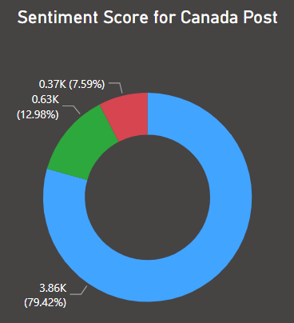
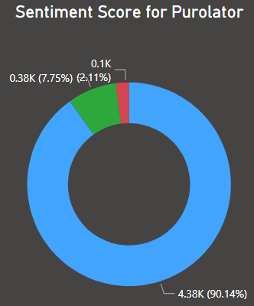
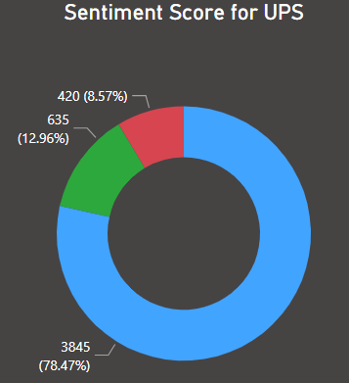
Sentiment Analysis with Competitors
Canada Post | Purolator | UPS
Around 7.59% were negative and 12.98% were positive tweets. | Around 2.11% were negative and 7.75% were positive tweets. | Around 8.57% were negative and 12.96% were positive tweets.
Note: All tweets were generalized with relative to Canada Post ratios. For instance, Ratio of Canada Post to UPS = 4860 / 9999 = 0.49; Count of UPS * 0.49

Slide 11
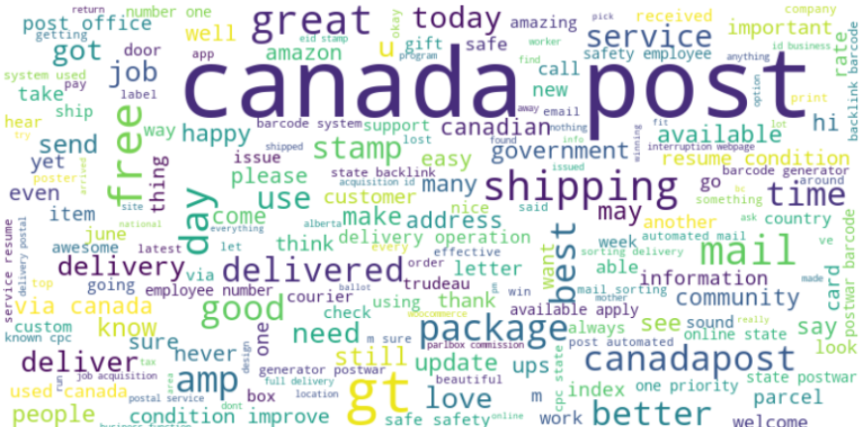
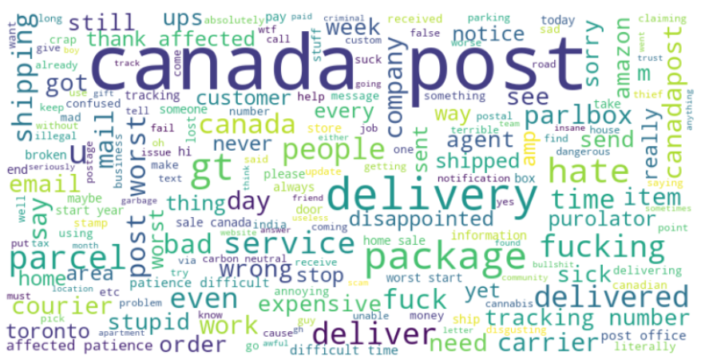
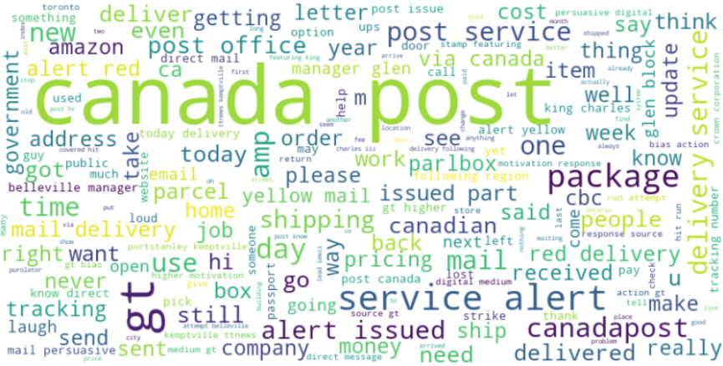
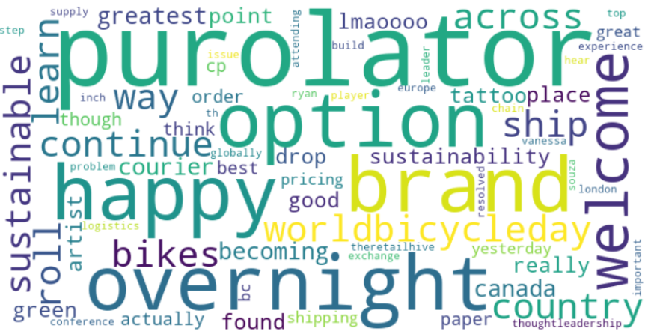

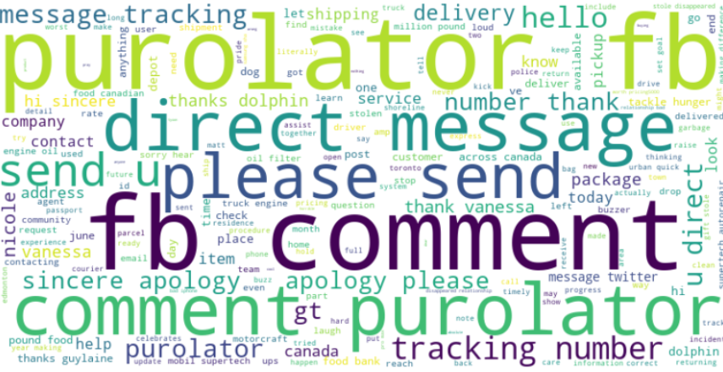
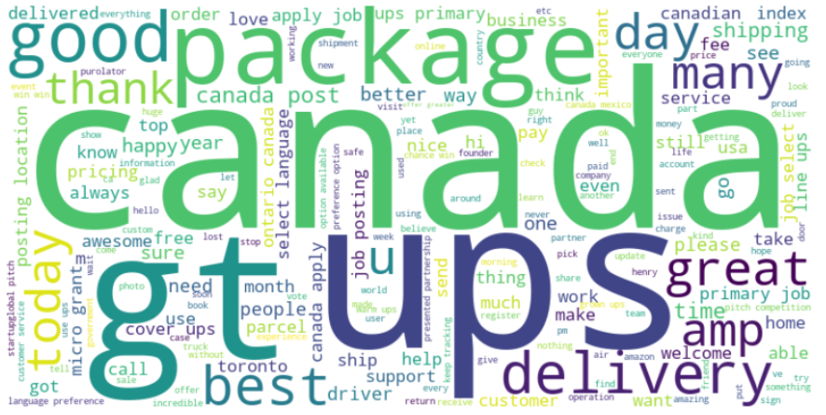
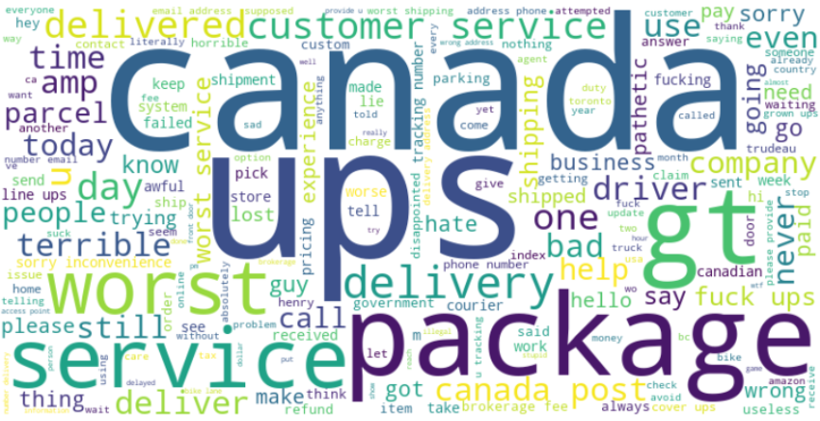
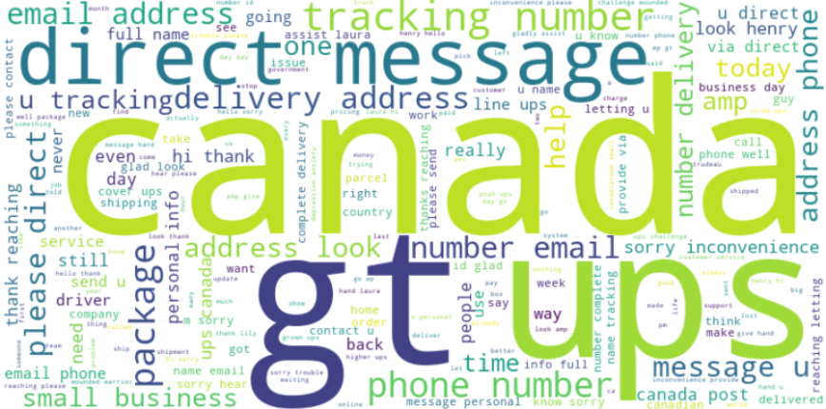
Sentiment Analysis with Competitors
Postal | Positive | Negative | Neutral
Canada Post
Purolator
UPS

Slide 12

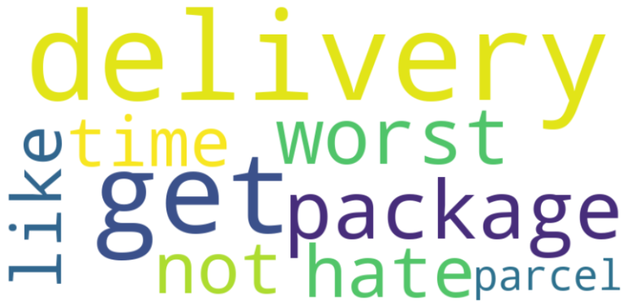
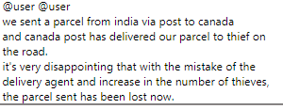

Key Findings
Overall Sentiment: majority of tweets about Canada Post were neutral, with a slight positive skew. However, there was a significant number of negative sentiments, pointing to areas where improvement is needed.
Positive Aspects: customers appreciated Canada Post's extensive coverage, particularly in distant places, as well as its ability to deliver to difficult situations.
Common Complaints: delayed deliveries, package mishandling, and poor customer service experiences.

Slide 13
Recommendations
Improve client Service: Improving response times, communicating delays effectively, and improving the entire customer service experience,
Improve Package Tracking: Invest in technology that will allow to track packages in real time and offer precise delivery predictions.
Address Delivery Delays: Develop measures to reduce delivery delays, particularly during peak periods.
Competitors may teach you a lot: Examine best practices of rival postal systems that perform in areas where Canada Post struggles.

Slide 14
Limitations
Data from social media may be biased.
Due to platform-specific use, client input is not fully represented.
Language barriers prevent non-English posts from being understood.
Customers who do not utilize social media sites provide little insights.
Develop API restrictions in scrapping data from social media like Facebook.

Slide 15
Future Work
Include information from other sources, such as email feedback or customer support records.
Conduct consumer surveys to get direct input from a larger group of people.
Enhance language processing skills in order to accommodate multilingual posts.
Investigate sentiment analysis on various sorts of user-generated content, such as online forums or review sites.
Implement sentiment analysis in various languages to reach a broader audience.
Integrate consumer demographic data for a more complete picture of sentiment variances.

Slide 16
References
https://www.datacamp.com/tutorial/text-analytics-beginners-nltk
https://towardsdatascience.com/step-by-step-twitter-sentiment-analysis-in-python-d6f650ade58d
https://medium.com/@ka2612/effortlessly-scraping-massive-twitter-data-with-snscrape-a-guide-to-scraping-1000-000-tweets-in-d01c38e82d18
https://medium.com/@ka2612/the-chatgpt-phenomenon-unraveling-insights-from-500-000-tweets-using-nlp-8ec0ad8ffd37
https://www.analyticsvidhya.com/blog/2021/06/twitter-sentiment-analysis-a-nlp-use-case-for-beginners/

Slide 17



Thank you

