Slide 1

Foetal ECG extraction using Blind Source Separation Under the Guidance of
Supervisor : Prof. Vikram M Gadre Mentor : Nithin Lakshmisha
Presented by
Rushikesh J. Metkar 19D070034

Slide 2
Contents
Introduction
Background
NI-fECG Extraction Algorithms
Pre-processing
Principal Component Analysis
Addressed Problem 1
Addressed Problem 2
Conclusion

Slide 3
Introduction
In India, there are approximately 28 million pregnancies each year. However, only an estimate of 26 million live births occur, with about 35,000 maternal deaths.
Congenital heart disease (CHD) affects an estimated 1.35 million newborns annually worldwide, with India accounting for about 240,000 of these cases.
Continuous FHR monitoring is expected for better diagnosis of CHD
Electronic foetal monitoring provides accurate estimation of the foetal heart rate.
Also additional information related to the electrical activity of the foetal heart can be extracted
Foetal Scalp Electrode
Non-invasive foetal electrocardiography

Slide 4
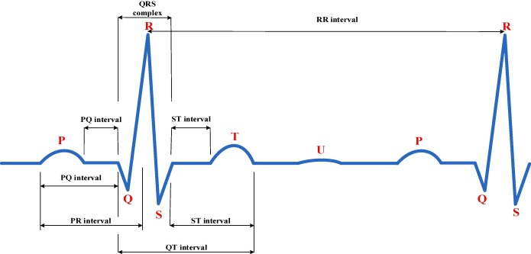
Background
Source - https://ars.els-cdn.com/content/image/1-s2.0-S0306987719312381-gr1.jpg
ECG Signal
ECG consists of three characteristic waves - P, QRS, and T-waves, which represent atrial and ventricular contraction due to the propagation of electrical activity through the heart.
P-wave represents the depolarization of the atria
QRS complex represents the depolarization of the ventricles
T-wave represents the repolarization of the ventricles.
Information must be collected along different leads, or directions, such that this three-dimensional activity can be viewed.

Slide 5
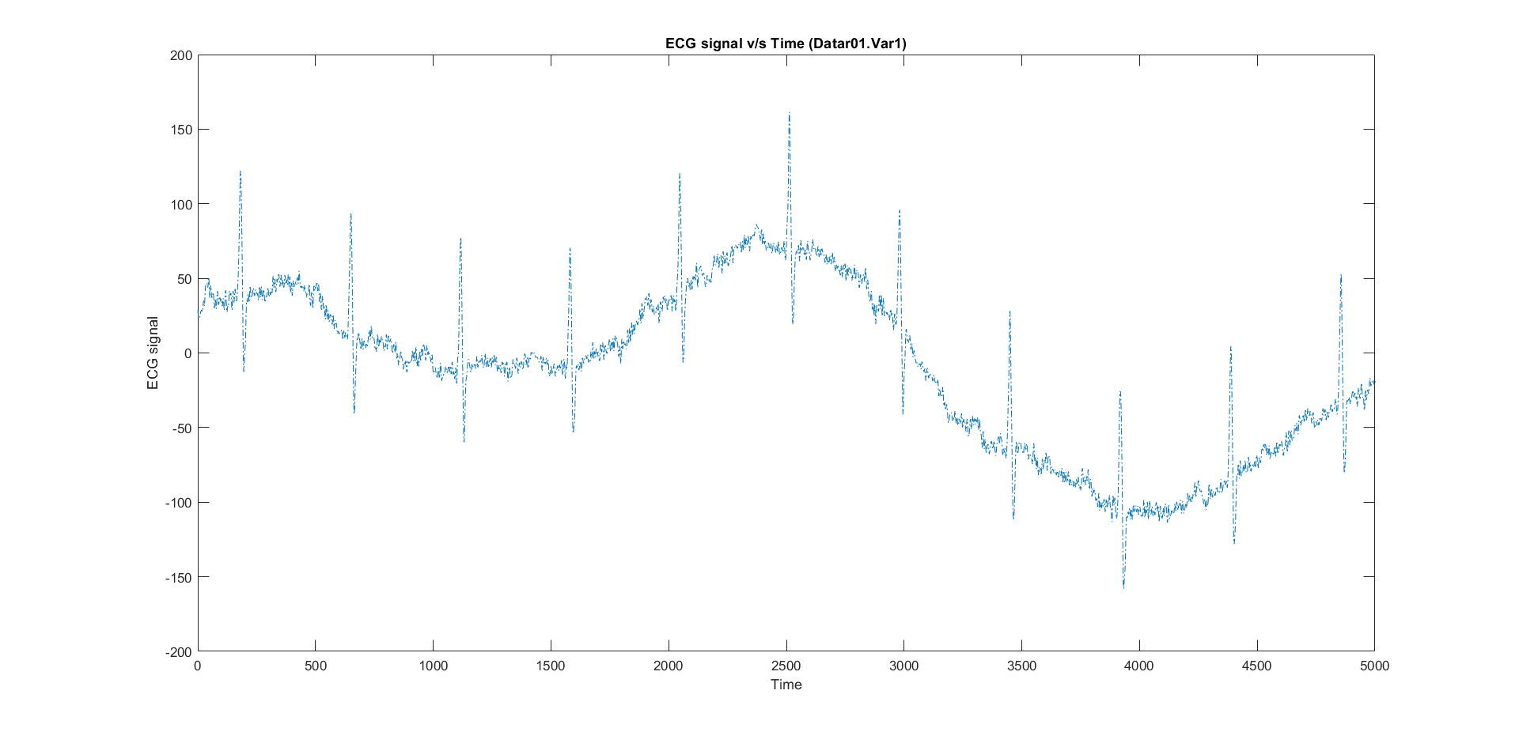
Clinical relevance of fECG
The foetal heart rate (FHR) can be accurately and continuously monitored with fECG.
A diagnosis resembling an adult ECG may be possible using morphological traits that can be deduced from the fECG.
These features provide important information regarding the electrical activity of the foetal heart.
fECG can be extracted by two ways :–
1. Scalp of the baby
2. Non-invasive methods
Foetal ECG signal taken from scalp of the baby

Slide 6
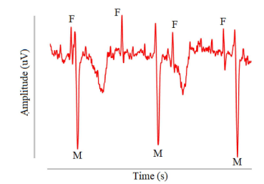
NI-fECG Extraction Algorithms
ABDOMINAL SIGNAL
The abdominal signals are collected through electrodes placed on the mother’s abdomen as this is the closest one can get (non-invasively) to the foetal heart.
The recorded signal contains the weak electrical activity of the foetal heart, along with the component of the maternal electrical cardiac activity in the recording direction, and noise.
The amplitude of the maternal component is typically several times larger than the foetal component, with a strong overlap in frequency content, which makes it difficult to separate these mixtures in time and frequency.
Abdominal signal = mECG + fECG + Noise

Slide 7
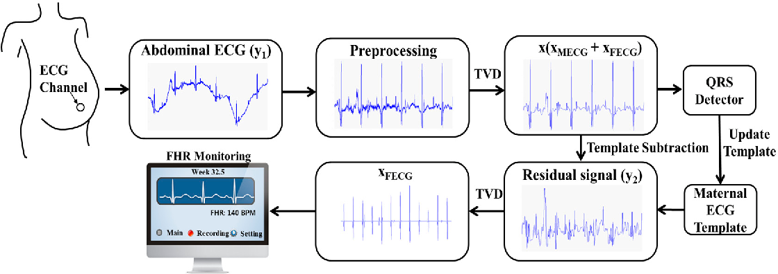
Template Subtraction
Template subtraction algorithms are based on the construction of an MECG template cycle which is subtracted from each subsequent MECG cycle of the AECG mixture to get the FECG signal.
The mECG template must be constructed correctly in the time domain in order for the abdominal signal to be removed using temporal approaches.
Source - https://d3i71xaburhd42.cloudfront.net/0ff92623fe3190cc54c94306dfb590d2448bb142/3-Figure1-1.png

Slide 8
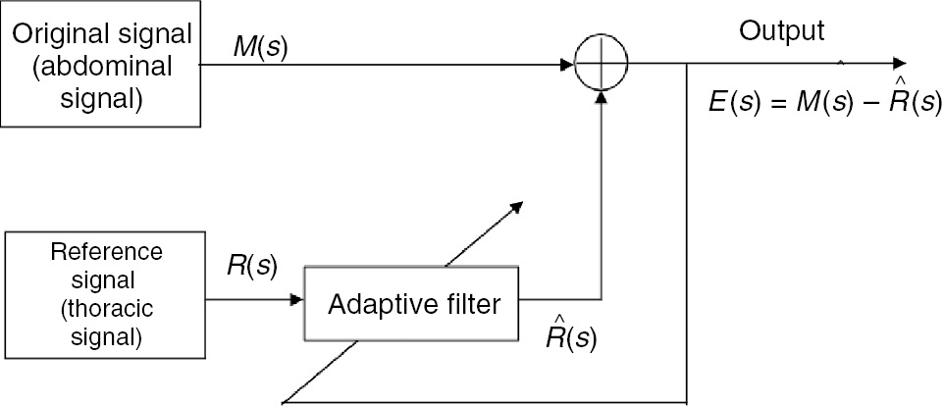
Adaptive Filtering
Adaptive filters feature parameters that can be changed to modify the filter’s transfer function.
A FIR filter is made up of the adaptive filter’s coefficients, which are trained to minimise errors.
The least mean square (LMS) and recursive least squares (RLS) adaptive filters have been used in NI-fECG more frequently.

Slide 9
Blind Source Separation
We now know that abdominal signal consists of mECG, fECG, and noise.
The blind source separation (BSS) method assumes that the abdominal signal is a linear and instantaneous mixing of these sources.
From the measured signal y, the main goal of BSS algorithms is to retrieve the source set.
These techniques are known as ”blind” techniques since they normally don’t require any knowledge of the sources or the mixing procedure
Two major BSS techniques used are :-
Principal Component Analysis
Independent Component Analysis

Slide 10
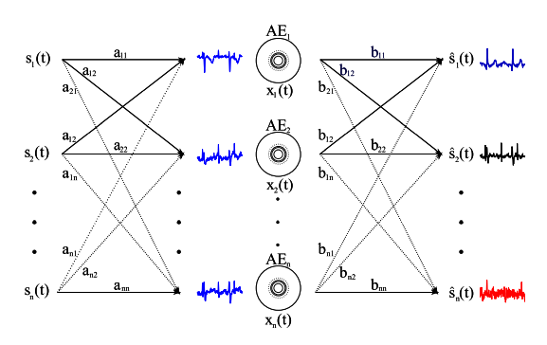
Principal component analysis
PCA decomposes the original signal into their source components.
It finds the principal components, i.e. the statistically most significant components in the input signal.
PCA builds a covariance matrix and the eigenvectors are essentially the principal components and corresponding eigenvalues determine the variance
The first principal component has the largest possible
Source - A Review of Signal Processing Techniques for Non-Invasive Fetal Electrocardiography

Slide 11
Independent component analysis
ICA relies on the assumption that the source signals are statistically independent and non-Gaussian
It uses higher order statistics unlike PCA to separate the multivariate signal into its additive sub-components.
Classical ICA algorithms include JADE and FastICA.

Slide 12
Dataset
A sizable annotated dataset made up of real and/or synthetic data is needed to evaluate the effectiveness of NI-fECG extraction techniques.
I have used the following datasets given below:
Abdominal and Direct Foetal ECG Database (ADFECGDB) –
There are five recordings in this database that were made by five different ladies.
Each recording of the signals, which were captured during labour (between 38 and 41 weeks of gestation), consists of four abdominal channels and an SECG channel sampled at 1 KHz for five minutes.
Using the SECG, reference annotations for the QRS have been added.
Foetal ECG Synthetic Database (FECGSYNDB) –
The signals in this database are entirely artificial and simulate 10 distinct pregnancies.
For each sample, five distinct SNR levels totaling 1750 recordings are available.
Each record has 32 abdominal channels and 2 thoracic channels, and it is sampled at a rate of 250 Hz.
There are reference annotations available.

Slide 13
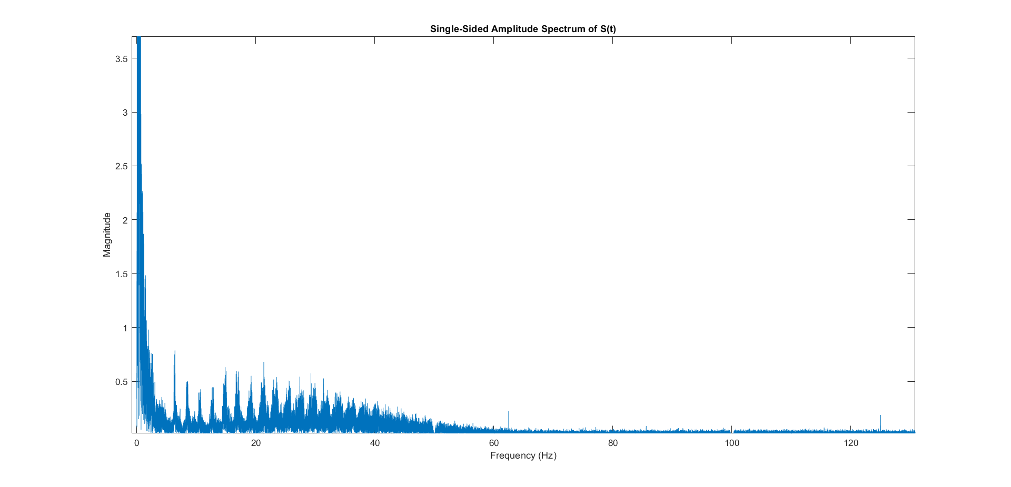
Pre-processing
Notch Filtering
Low-pass filtering
High-pass filtering
Original ECG signal from ADFECGDB dataset
FFT of the ECG signal

Slide 14
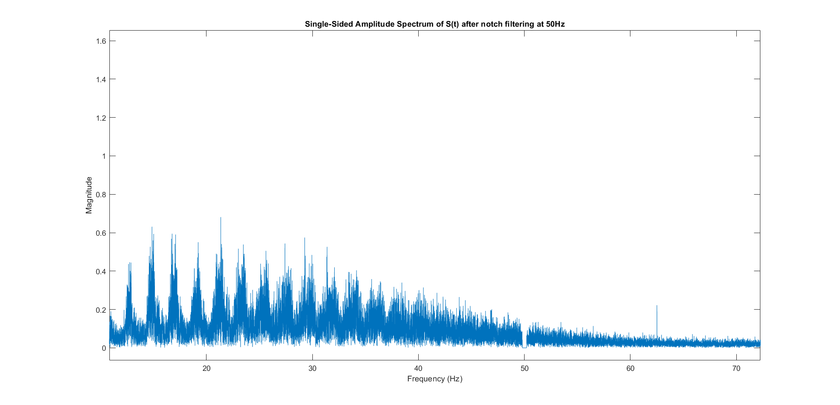
Notch Filtering
Power line interference at 50/60 Hz(depending on the country) is the main cause of noise in signal.
There may also be harmonics of the fundamental 50/60 Hz frequency.
The simplest method to cancel out PLI is by using a notch filter.
I have designed a notch filter in MATLAB to remove the frequency content from 49.8Hz to 50.2Hz
Notch filtered Spectrum of ECG signal

Slide 15
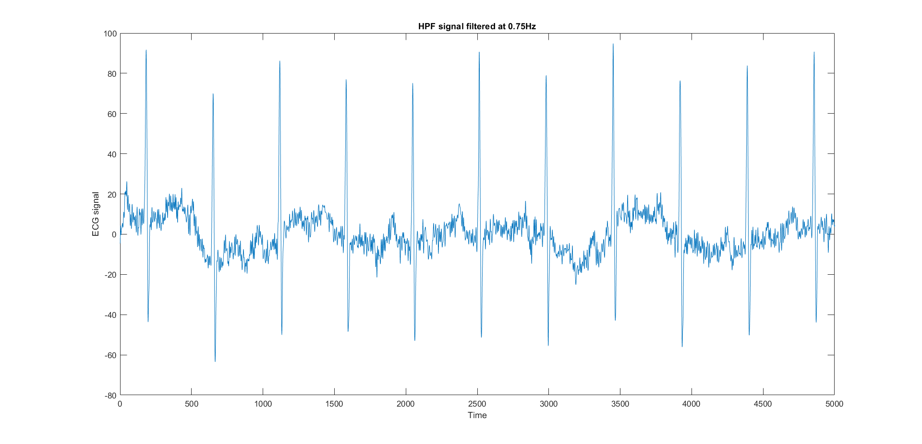
High-pass Filtering
Baseline wander or baseline drift is the effect where the base axis (x-axis) of a signal appears to ‘wander’ or move up and down rather than be straight.
In ECG signal, the baseline wander is caused due to improper electrodes, patient’s movement and breathing.
Baseline wander is a low-frequency noise of around 0.5 to 0.6 Hz.
The foetus heart gives signal at around 1-2Hz. If we remove the signal by HPF, we will essentially remove the foetus heart component.
High pass filtered signal at 0.75Hz
Cutoff frequency for HPF- 0.75Hz
FIR filter with order 1000

Slide 16
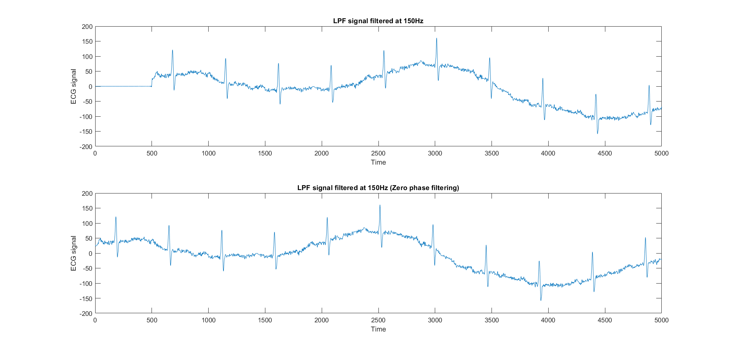
Low-pass Filtering
Frequency content above 250Hz is not because of the electrical activity of the heart in the ECG signal. It consists of noise components.
As a result a low pass FIR filter of order 1000 was used with a cutoff frequency of 250Hz to remove the frequency content above that.
Zero phase filtering is done with the help of MATLAB
Zero phase low pass filtered ECG signal

Slide 17
Principal component analysis
Principal component analysis (PCA) is a statistical technique whose purpose is to condense the information of a set of correlated variables into uncorrelated variables (“principal components”).
The principal components are derived as a linear combination of the variables of the data set, with weights chosen so that the principal components become mutually uncorrelated.
Each component contains new information about the data set, and is ordered so that the first few components account for most of the variability.
In signal processing applications, PCA is performed on a set of time samples rather than on a data set of variables.
Source - A Review of Signal Processing Techniques for Non-Invasive Fetal Electrocardiography

Slide 18
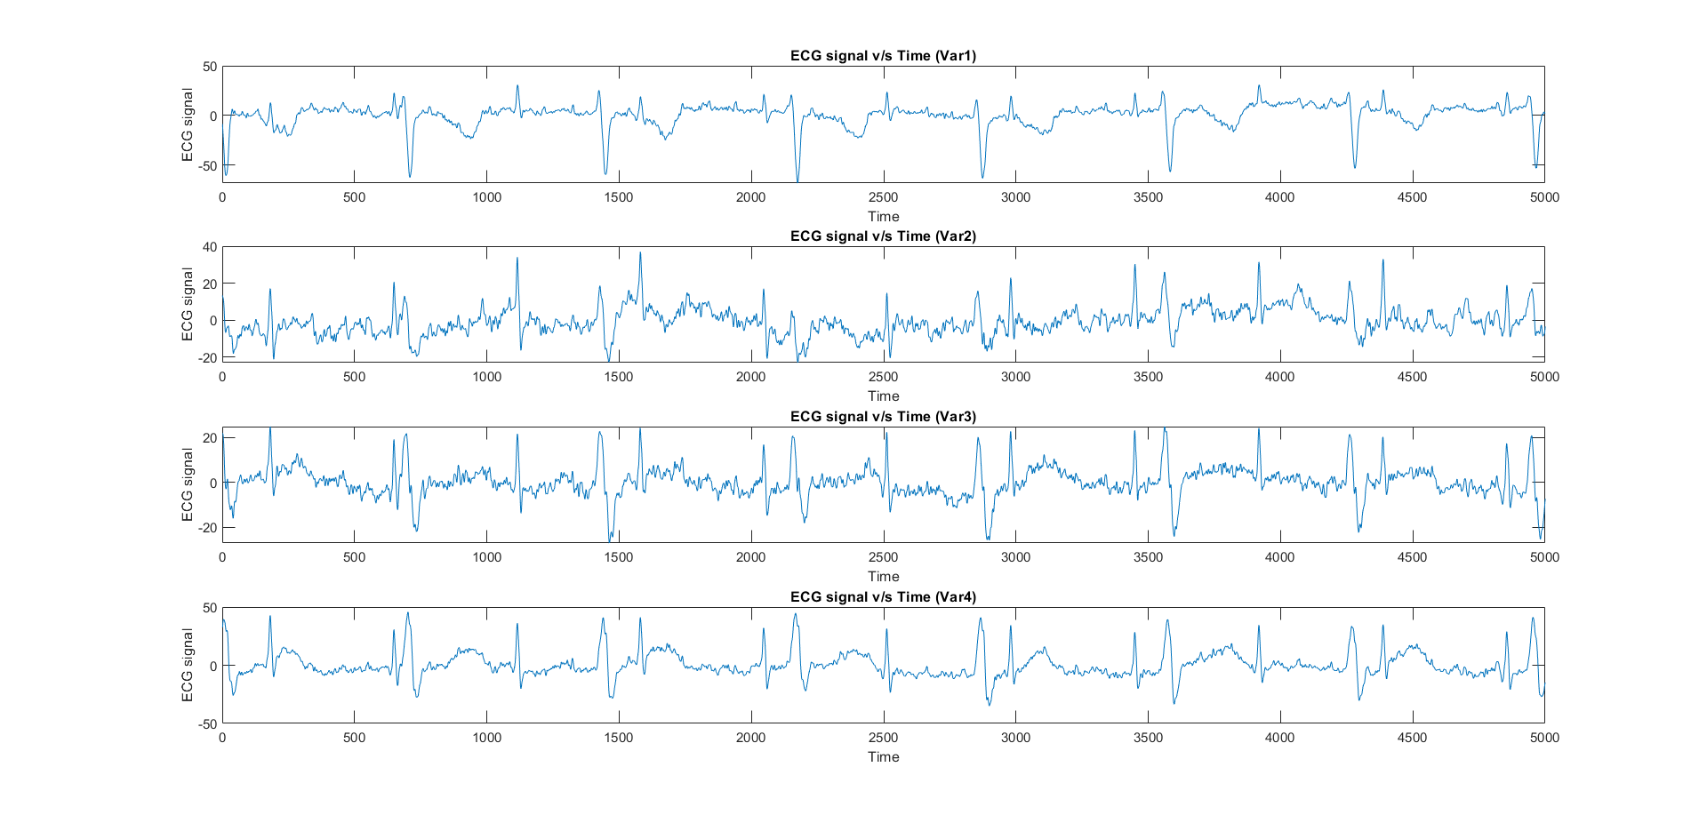
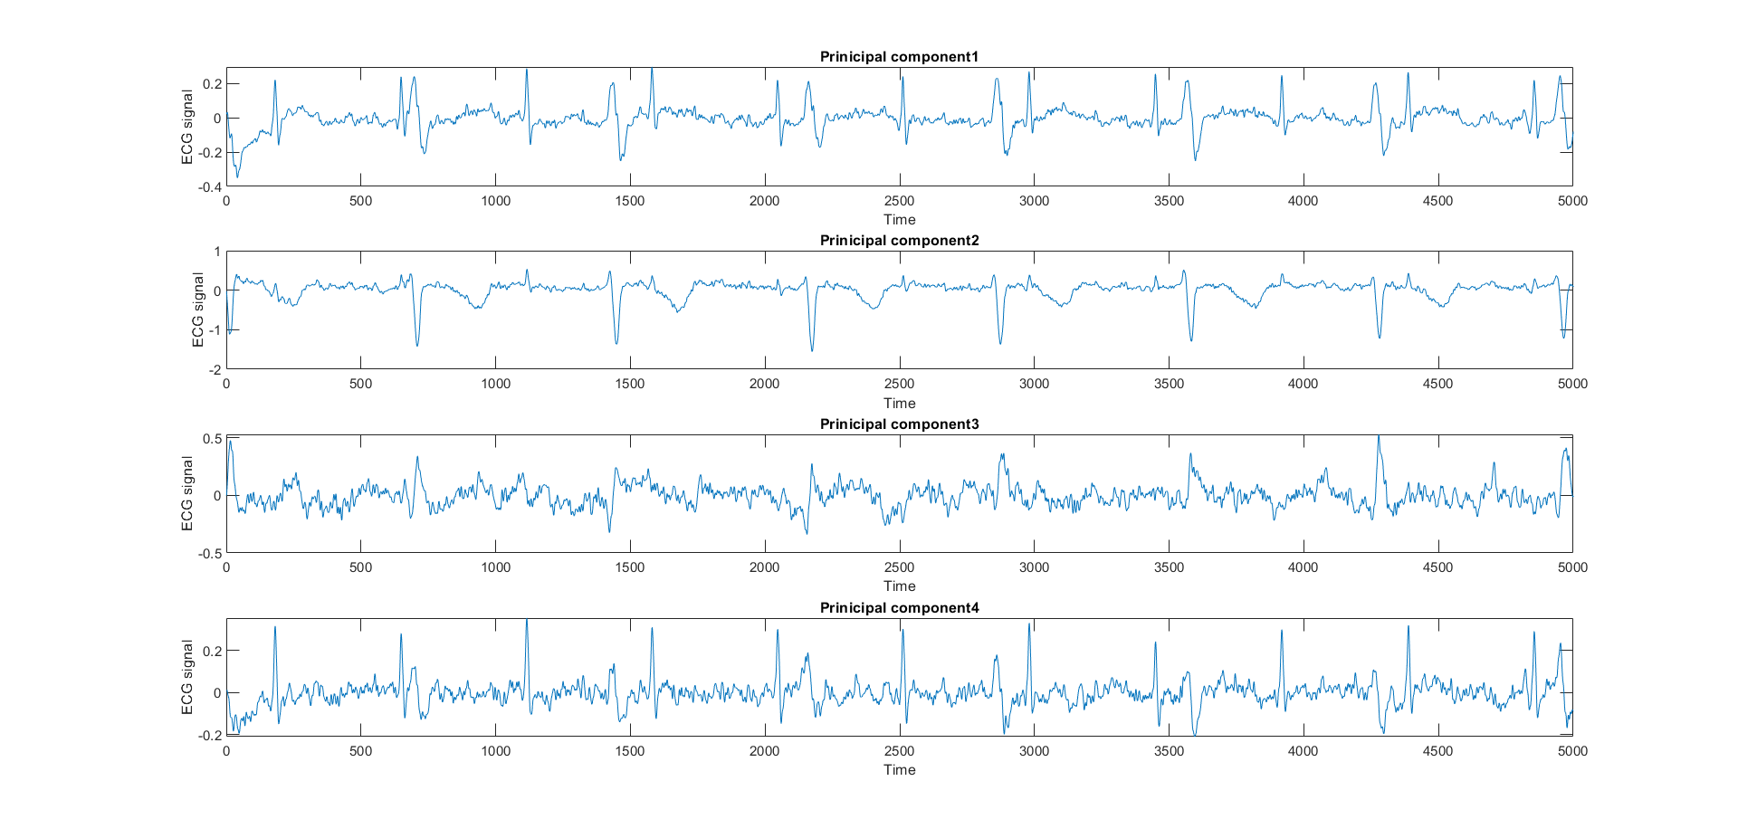
Results
ECG signal representing data taken from 4 electrodes
Principal components extracted by PCA algorithm

Slide 19
Addressed problems
In principal component analysis I have addressed two main problems
Problem 1 – Does PCA extract signals of larger amplitude signals such as mECG better as compared to weaker signals such as fECG?
Problem 2 – Does PCA perform better by increasing the number of electrode channels used for ECG measurement?

Slide 20
Problem 1
PCA algorithm tries to separate the MECG and FECG. But which signal does it learn better?
Template subtraction approach - Subtracted the principal components showing MECG with the original ECG signal to get the FECG signal for various channels.
Compared these FECG signals with the FECG signals extracted by PCA algorithm.
This gives an idea about whether PCA extracts stronger signals such as MECG better or weak signals such as FECG.

Slide 21
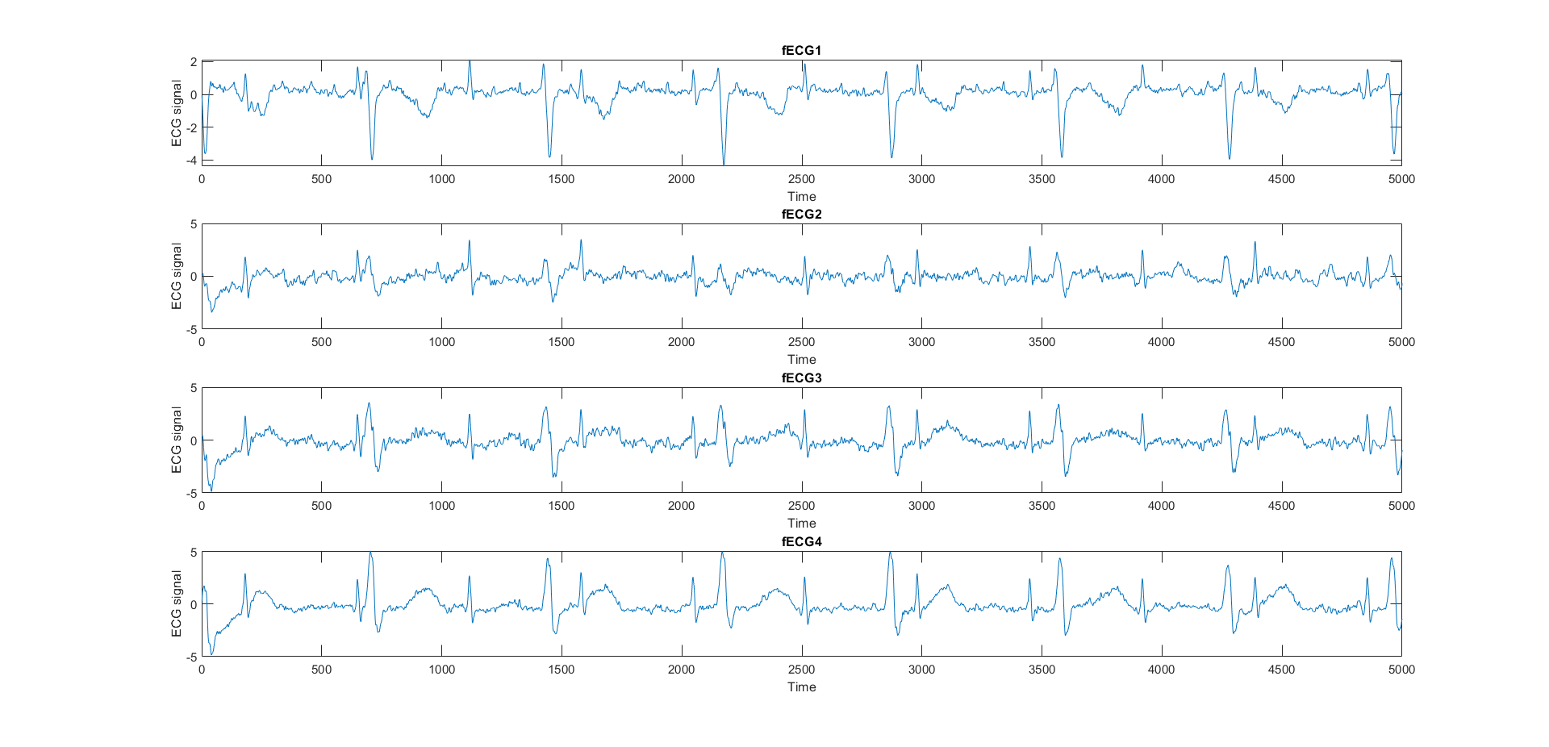
fECG extracted after template subtraction

Slide 22
Pan-Tompkins algorithm
The Pan-Tompkins algorithm is the most widely used algorithm for the detection of QRS complexes from an ECG signal.
It detects correctly more than 95% of the QRS complexes.
Used the Pan-Tompkins algorithm to compare the fECG extracted by PCA and fECG extracted after template subtraction.
This algorithm was also helpful in determining the accuracy of PCA with varying number of electrodes.

Slide 23



Problem 2
Using Pan-Tompkins algorithm, I detected the R waves in the extracted FECG components by PCA.
From the original QRS data from the dataset and this extracted R waves, computed the positive prediction value (PPV), sensitivity (Se) and hence the F1 score varying the number of channels.
The F1 measure is an harmonic mean which is one of the several average techniques and provides a good summary metric
TP - True positive (correctly identified FQRS)
FP - False positive (extra falsely detected FQRS)
FN - False negative (missed FQRS detections)

Slide 24
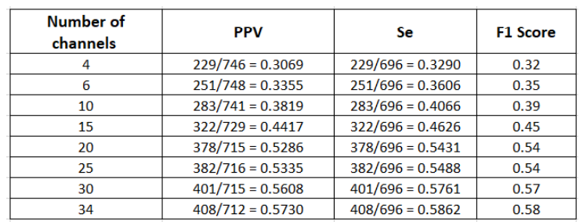
Results
PPV, Se and F1 Scores for different number of channels
When you have high dimensionality with high correlated variable of one another, the PCA can improve the accuracy of classification model.
Similarly, in this case as the number of channels increases, the correlation between the variables increase with each other.
However, a large number of electrodes is clinically difficult to use and they are unpleasant for the patient.

Slide 25
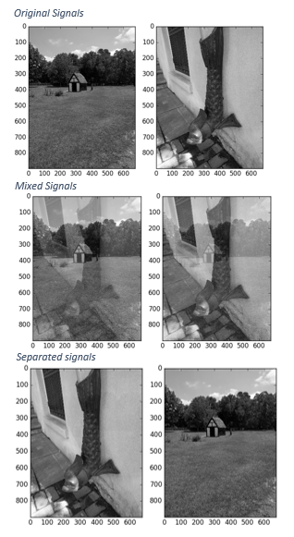
Application of BSS
Image processing –
BSS is used to separate the mixed signals with only knowing mixed signals and nothing about original signal or how they were mixed.
Source -https://upload.wikimedia.org/ wikipedia/commons/5/5d/BSS-example.png

Slide 26
Application of BSS
Cocktail Party problem –
At a cocktail party, there is a group of people talking at the same time.
You have multiple microphones picking up mixed signals, but you want to isolate the speech of a single person.
Music –
For a stereo mix of relatively simple signals it is now possible to make a fairly accurate separation, although some artifacts remain.
Medical imaging –
One of the practical applications being researched in this area is medical imaging of the brain with magnetoencephalography (MEG).
This kind of imaging involves careful measurements of magnetic fields outside the head which yield an accurate 3D-picture of the interior of the head.

Slide 27
Drawbacks of PCA
PCA looks for new orthogonal axes but there is no reason for the FECG and MECG sources to be orthogonal.
The range of the input signal plays an important role; PCA is sensitive to the scaling of the variables. As a consequence, it was important to ensure that the AECG channels were normalized
PCA aims to decorrelate the data i.e. remove second-order dependencies. However, it is still under investigation whether this is the best way of revealing the underlying FECG
The method assumes that there exists a linear relationship between the variables. However, this assumption may be inaccurate in the context of NI-FECG extraction.

Slide 28
Conclusion
Reviewed a wide variety of standard and state-of-the-art methods used for NI-FECG extraction
Studied about the effect of the preprocessing on the algorithms’ outcomes
Evaluated Blind source separation technique of PCA for fECG extraction
Showed that improvement can be obtained by increasing the number of electrode channels used for ECG measurement
Observed that PCA works better in the extraction of larger amplitude signals such as mECG as compared to weaker signals such as fECG.

Slide 29
References
[1] Behar, J., Oster, J., Clifford, G. D. (2014). Combining and benchmarking methods of foetal ECG extraction without maternal or scalp electrode data. Physiological measurement, 35(8), 1569.
[2] Kahankova R, Martinek R, Jaros R, Behbehani K, Matonia A, Jezewski M, Behar JA. A Review of Signal Processing Techniques for Non-Invasive Fetal Electrocardiography. IEEE Rev Biomed Eng. 2020;13:51-73. doi: 10.1109/RBME.2019.2938061. Epub 2019 Aug 29. PMID: 31478873.
[3] Lester Mackey. 2008. Deflation methods for sparse PCA. In Proceedings of the 21st International Conference on Neural Information Processing Systems (NIPS’08). Curran Associates Inc., Red Hook, NY, USA, 1017–1024.
[4] First APS Report on Extraction of the Foetal Electrocardiogram frorm Non-Invasive Abdominal Recordings submitted by Nithin Lakshmisha (194304001)
[5] https://en.wikipedia.org/wiki/Signalseparation

Slide 30
Thank You!

