Slide 1














Credit Card Default Prediction
Rushi Daulatkar
IBM Intern
RD
College Name : St.Vincent Pallotti College Of Engineering And Technology
Branch : Computer Science And Business Systems

Slide 2

OUTLINE OF PROJECT
Problem Statement : Credit Card Default Prediction.
Proposed System/Solution : Logistic Regression, Decision Trees, Random Forests, Kolmogorov-Smirnov (K-S) chart.
System Development Approach : The development process will include data preprocessing, model training, and validation.

Slide 3
OUTLINE OF PROJECT
Algorithm and Deployment : Deployment will involve integrating the trained model into a scalable and accessible platform, potentially using cloud services like IBM Cloud ,AWS or Azure.

Slide 4


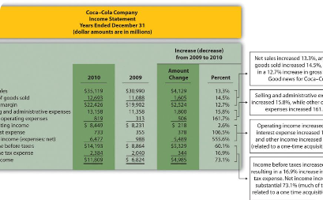
Credit Card Default Prediction
Exploring Financial Patterns
Data-Driven Insights
Fostering Financial Stability
Utilize cutting-edge machine learning algorithms to gain valuable insights into credit card default patterns. Leverage the power of predictive models to analyze historical data and forecast future financial behaviors.
Uncover the intricacies of credit card default prediction through insightful data analysis and machine learning techniques. Understand the complex patterns that govern financial behaviors and identify key indicators for predicting defaults.
Through data-driven approaches, drive initiatives to enhance financial stability by accurately predicting credit card defaults. Discover the potential for informed decision-making in mitigating financial risks.

Slide 5

Importance of Predicting Financial Behavior
Managing Financial Risks
Customer-Centric Solutions
By proactively predicting financial behaviors, organizations can effectively manage potential risks related to credit card defaults and make informed decisions to mitigate adverse impacts.
Enhance customer experiences by developing tailored solutions through the analysis of financial behaviors, fostering trust, and ensuring better financial outcomes for all stakeholders.
Economic Stability
Contribute to economic stability by accurately forecasting financial patterns, fostering a robust financial ecosystem and sustainable growth in the financial sector.

Slide 6

Data Collection and Preprocessing
1
Data Sources
Identify and collect diverse data sources related to credit card transactions, payment history, user demographics, and other relevant financial parameters.
2
Data Cleaning
Implement rigorous data cleaning techniques to ensure the accuracy and consistency of the collected data, preparing it for further analysis.
3
Feature Extraction
Extract meaningful features from the preprocessed data to uncover key attributes influencing credit card default behaviors.

Slide 7
PROBLEM STATEMENT
Credit Card Default Prediction
This project is aimed at predicting the case of customers' default payments in Taiwan. From the perspective of risk management, the result of predictive accuracy of the estimated probability of default will be more valuable than the binary result of classification - credible or not credible clients. We can use the K-S chart to evaluate which customers will default on their credit card payments.
The Kolmogorov-Smirnov (K-S) chart, as part of credit risk modeling and predictive analytics, finds applications in various real-life scenarios, particularly in the financial and banking sectors. Here are some practical use cases: Credit Risk Assessment Loan Approval and Pricing Portfolio Management Marketing and Customer Segmentation
Healthcare Risk Models Fraud Prevention in E-commerce Supply Chain and Inventory Management

Slide 8

Tech Solutions Development
Exploring various aspects of tech solutions development, including proposed systems, system development approaches, and deployment algorithms.
Problem Statement :-
Credit Card Default Prediction
Proposed System/Solution :-
The proposed system involves implementing a machine learning-based credit card default prediction model. Utilizing historical customer data, features such as income, credit history, and payment behavior will be analyzed. The system aims to provide a reliable tool for financial institutions to categorize customers based on their likelihood of default, allowing for more informed decision-making in risk management.
RD
by Rushi Daulatkar

Slide 9
Tech Solutions Development
Exploring various aspects of tech solutions development, including proposed systems, system development approaches, and deployment algorithms.
System Development Approach (Technology Used):-
The system development approach involves using a supervised learning approach, with machine learning algorithms such as Logistic Regression, Decision Trees, or Ensemble methods (e.g., Random Forests). Python will be the primary programming language, leveraging libraries like scikit-learn and pandas for model development and data manipulation. The development process will include data preprocessing, model training, and validation.
RD
by Rushi Daulatkar

Slide 10
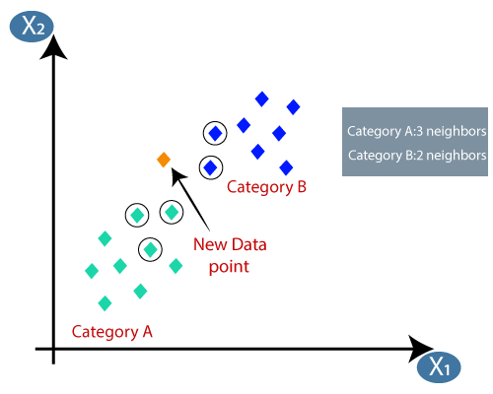
Tech Solutions Development
Exploring various aspects of tech solutions development, including proposed systems, system development approaches, and deployment algorithms.
Algorithm & Deployment :-
K-Nearest Neighbors (KNN):-
K-Nearest Neighbors is a simple yet effective algorithm for classification and regression tasks. In KNN, predictions are made based on the majority class of the k-nearest data points to a given instance in the feature space. The algorithm relies on the assumption that similar instances share similar outcomes. KNN is intuitive and easy to understand, making it suitable for both binary and multi-class classification problems. However, it can be sensitive to outliers and is computationally expensive for large datasets, as it requires calculating distances between the target point and all other points.
RD
by Rushi Daulatkar

Slide 11
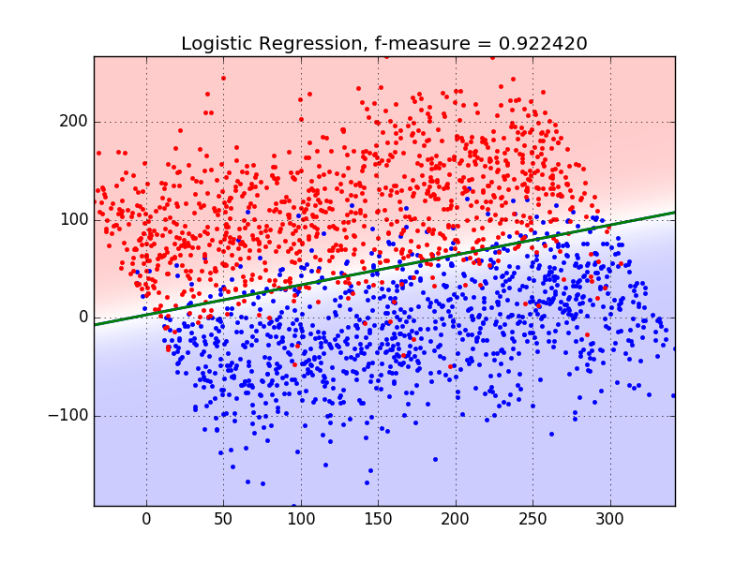
Tech Solutions Development
Exploring various aspects of tech solutions development, including proposed systems, system development approaches, and deployment algorithms.
Algorithm & Deployment :-
Logistic Regression:-
Logistic Regression is a widely used algorithm for binary classification problems, particularly in the context of predicting credit card defaults. Despite its name, logistic regression is used for classification, not regression. It models the relationship between the independent variables and the probability of a particular outcome using the logistic function. Logistic regression provides interpretable results, and the coefficients indicate the impact of each feature on the log-odds of the outcome. It is computationally efficient, handles linear relationships well, and is less prone to overfitting compared to more complex models.
by Rushi Daulatkar

Slide 12
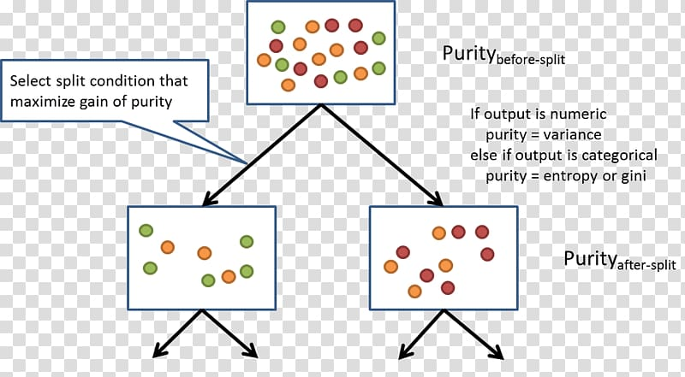
Tech Solutions Development
Exploring various aspects of tech solutions development, including proposed systems, system development approaches, and deployment algorithms.
Algorithm & Deployment :-
Decision Trees:
Decision Trees are versatile and interpretable algorithms used for both classification and regression tasks. In credit card default prediction, a decision tree recursively splits the data based on feature conditions to create a tree-like structure. Each leaf node represents a class or a regression value. Decision Trees capture complex relationships in the data, including non-linear patterns. However, they are susceptible to overfitting, especially when the tree is deep. To address this, ensemble methods like Random Forests or pruning techniques can be employed. Decision Trees are valuable for feature importance analysis, providing insights into the factors influencing credit card default predictions.
RD
by Rushi Daulatkar

Slide 13
Tech Solutions Development
Exploring various aspects of tech solutions development, including proposed systems, system development approaches, and deployment algorithms.
Result:-
The results will be evaluated using metrics like precision, recall, and ROC-AUC to assess the model's predictive performance. A detailed analysis of the model's ability to discriminate between default and non-default cases will be presented, possibly through a K-S chart. The system's effectiveness will be demonstrated by comparing predictions against actual credit card defaults.
RD
by Rushi Daulatkar

Slide 14
Tech Solutions Development
Exploring various aspects of tech solutions development, including proposed systems, system development approaches, and deployment algorithms.
Future Scope:-
Future scope includes refining the model with additional data, exploring advanced algorithms, and adapting to evolving patterns in credit behavior. Integration with real-time data sources and continuous monitoring will be considered for ongoing model improvement. Exploring the use of deep learning and AI techniques for more intricate pattern recognition is also within the future scope.
RD
by Rushi Daulatkar

Slide 15
Tech Solutions Development
Exploring various aspects of tech solutions development, including proposed systems, system development approaches, and deployment algorithms.
References :-
Cite relevant literature, research papers, and resources that have contributed to the development of the credit card default prediction system. This section acknowledges the foundation on which the proposed system is built.
RD
by Rushi Daulatkar

Slide 16
Results and Analysis
1
Insightful Predictions
2
Performance Comparison
Analyze the model's predictions to gain valuable insights into the patterns and trends of credit card default behaviors, facilitating informed decision-making processes.
Compare the performance of different models and evaluate their effectiveness in predicting credit card defaults based on predefined metrics and criteria.
3
Impact and Implications
Assess the impact of accurate credit card default predictions on mitigating financial risks and fostering a secure financial environment for businesses and consumers.

Slide 17
Conclusion and Future Work
Accurate Predictions
Advanced model algorithms ensure precise predictions for credit card defaults, minimizing financial risks.
Future Innovations
Explore potential enhancements in predictive models and data analysis techniques for more robust financial predictions.
Societal Impact
Discuss the broader implications of accurate financial predictions on economic stability and consumer well-being.

Slide 18
Conclusion and Future Work
Procedure
k-Nearest Neighbors
The k-NN algorithm is arguably the simplest machine learning algorithm. Building the model consists only of storing the training data set. To make a prediction for a new data point, the algorithm finds the closest data points in the training data set — its “nearest neighbors.”

Slide 19
Follow Me on Social Media
1
LinkedIn :-https://www.linkedin.com/in/rushi-daulatkar-43669b299/
2
Git-Hub:-https://github.com/Rushi-Daulatkar
Explore visual content and behind-the-scenes stories.

Slide 20
Thank You for Your Time

