Slide 1



Empowering Creativity: An Introduction to Arduino for Innovative Electronics Projects

Slide 2
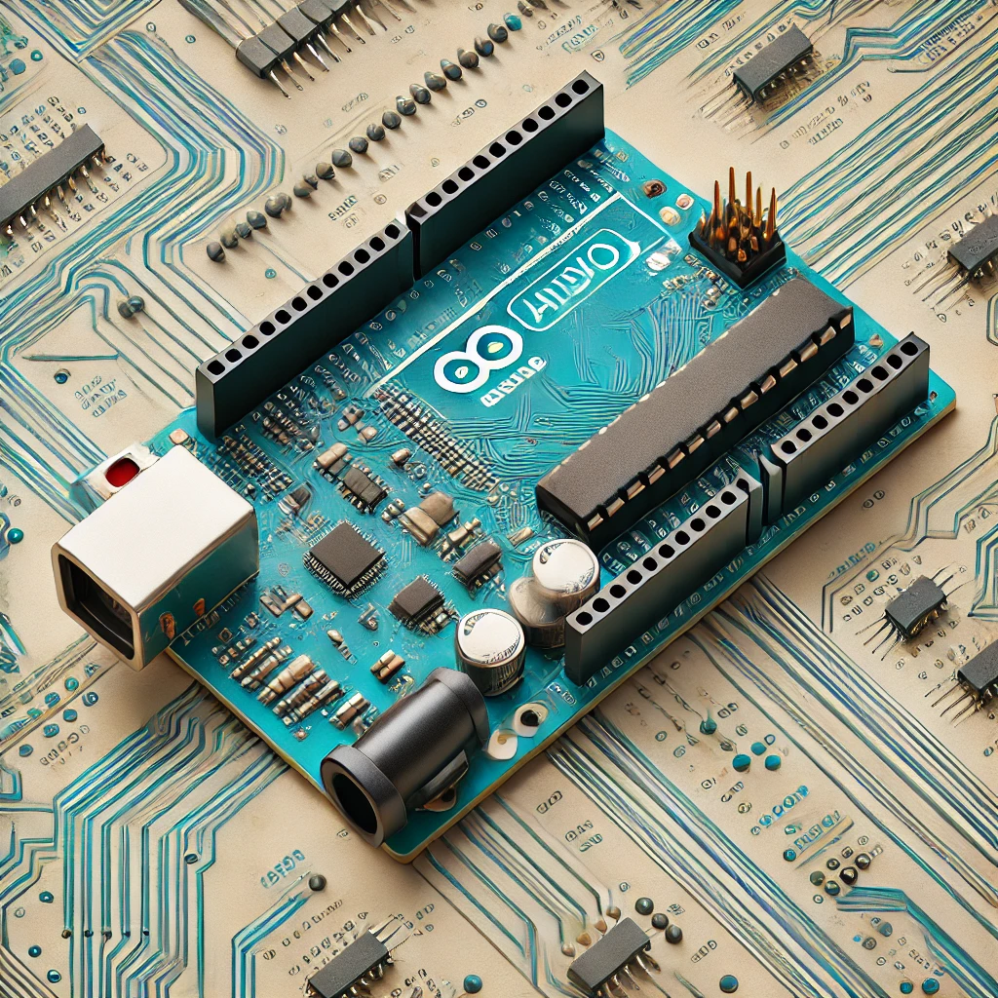



Slide 3

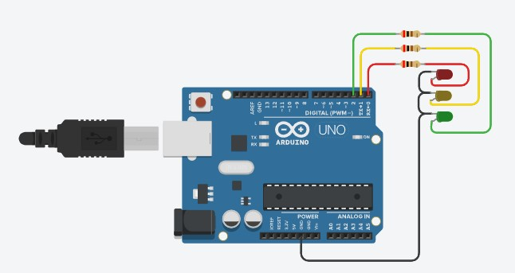
EXAMPLE 1
Traffic light Simulation
digitalWrite(led_red, HIGH);
digitalWrite(led_yellow, LOW);
digitalWrite(led_green, LOW);
delay(5000);
digitalWrite(led_red, LOW);
digitalWrite(led_yellow, HIGH);
digitalWrite(led_green, LOW);
delay(1000);
digitalWrite(led_red, LOW);
digitalWrite(led_yellow, LOW);
digitalWrite(led_green, HIGH);
delay(8000);
}
int led_red = 0;
int led_yellow = 1;
int led_green = 2;
void setup() {
pinMode(led_red, OUTPUT);
pinMode(led_yellow, OUTPUT);
pinMode(led_green, OUTPUT);
}
void loop() {

Slide 4
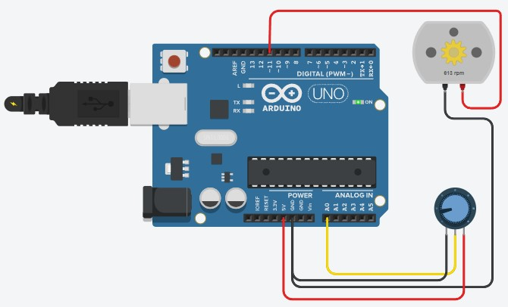
MOTOR SIMULATION
void loop() {
// Read the value from the potentiometer (0 to 1023)
int potValue = analogRead(potPin);
// Map the potentiometer value to a range suitable for PWM (0 to 255)
int motorSpeed = map(potValue, 0, 1023, 0, 255);
// Write the mapped value to the motorPin (PWM control)
analogWrite(motorPin, motorSpeed);
// Add a small delay to avoid rapid changes
delay(10);
}
EXAMPLE 2
const int motorPin = 11; // PWM output pin connected to the motor
const int potPin = A0; // Analog input pin connected to the potentiometer
void setup() {
// Set motorPin as an OUTPUT
pinMode(motorPin, OUTPUT);
}

Slide 5

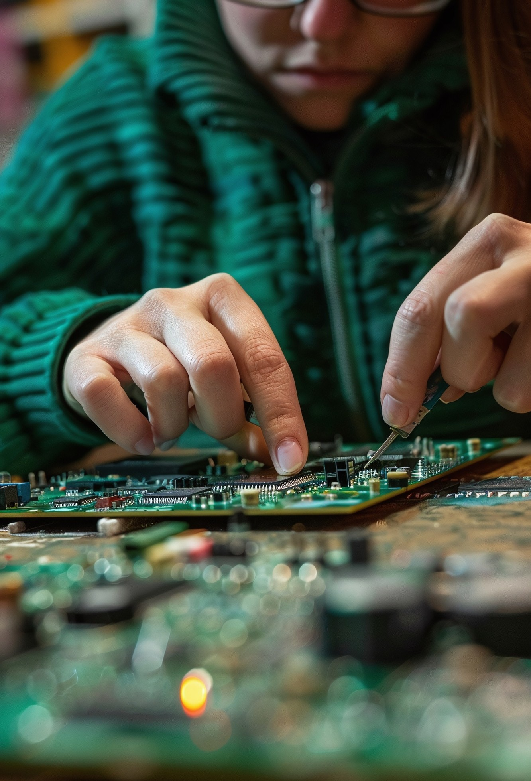
Basic Components Overview
Key components of an Arduino project include resistors, LEDs, sensors, and motors.
Understanding these components is crucial for
creating eﬀective projects. Each plays a unique role in how your Arduino interacts with the physical world.
Programming Arduino
Programming Arduino involves writing code in C/C++ within the Arduino IDE. Basic commands control inputs and outputs, enabling you to create responsive projects. Learning to code is essential for unlocking the full potential of your Arduino.

Slide 6


Arduino is a powerful tool for creativity in electronics projects. Its accessibility and vast resources make it an excellent choice for anyone looking to innovate. Start your Arduino journey today and unleash your creativity!

Slide 7
THANK YOU !
PPT MADE BY : RUSHI DAULATKAR

