Slide 1
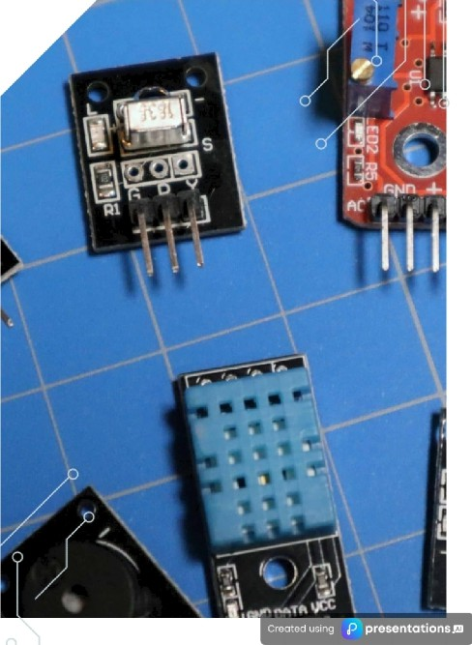
IN—DEPTH EXPLORATION OF ARDUINO SENSORS AND THEIR APPLICATIONS

Slide 2


VERSATILITY INAPPLICATIONS
Arduino sensors can be employed in a multitude of applications ranging from home automation, weather stations, to robotics and environmental monitoring. This versatility allows hobbyists and professionals alike to utilize them in innovative ways, enhancing project capabilities significantly.

Slide 3






COMPREHENSIVE OVERVIEW OF TEMPERATURE SENSORS
Exploring Types and Their Unique Advantages
UNDERSTANDING TEMPERATURE SENSORS
Temperature sensors play a crucial role in various industries and applications by accurately measuring tne temperature of an object or environment. They are essential for maintaining optimal conditions in processes ranging from weather monitoring to industrial production, ensuring afety, efficiency, and reliability in
m to r-\tio xc
THER/\/IIS’I'ORS: HIGH SENSI’I'fVITY
Thermistors are temperature- sensitive resistors that exhibit significant cnanges in resistance with temperature variations. They are known for their high sensitivity and are commonly used in applications requiring precise temperature control, such as medical devices and HVAC systems, providing accurate readings for critical processes.
RESISTANCE TEMPERATURE DETECTORS (RTDS): ACCURACY AND
RTDs are temperature sensors that provide highly accurate and stable temperature readings over a wide range. They operate on the principle that the resistance of metals changes with temperature. RTDs are preferred in laboratories and industrial applications where
precise temperature measurements are essential for process control and

Slide 4





APPLICATIONS OF TEMPERATURE SENSORS
Understanding Their Role in Various Fields
WZA‘I'HER S’I'A1IONS
Temperature sensors play a crucial role in weather stations by accurately monitoring atmospheric conditions, such as temperature, humidity, and pressure. This data is essential for
HOME AUTOMATION
In home automation systems, temperature sensors are utilized to control heating, ventilation, and air conditioning (HVAC) systems. By monitoring indoor temperatures, these sensors
01
INDUSTRIAL PROCESSES
Temperature sensors are integral to industrial processes, where they ensure optimal operating conditions. They help monitor and control temperatures in manufacturing, chemical
MEDICAL DEVICES
In the medical field, temperature sensors are vital for monitoring patient body temperature. They are used in devices like thermometers and patient monitoring systems, ensuring
04

Slide 5
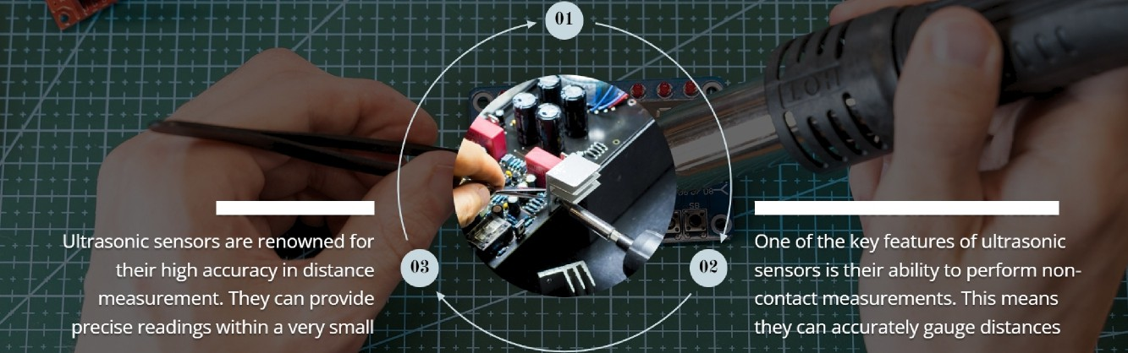
Ultrasonic sensors are devices that utilize sound waves to
WHATARE ULTRASONIC SENSORS?
determine the distance to an object. They operate by
emitting sound waves and measuring the time it takes for
HIGH ACCURACY
NON—CONTACT MEASUREMENT

Slide 6
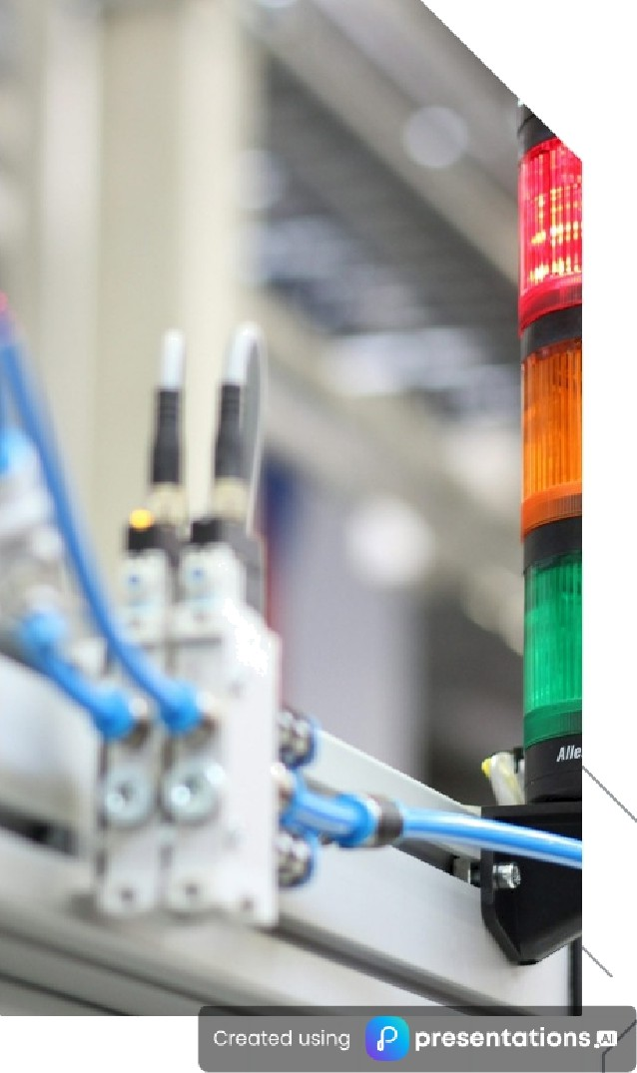
DIVERSE APPLICATIONS OF ULTRASONIC SENSORS
Exploring the vital roles of ultrasonic sensors
OBSTACLE DETECTION
Ultrasonic sensors are extensively utilized for obstacle detection in various robotics applications. By emitting ultrasonic waves and measuring the time it takes for tne echoes to return, these sensors can accurately identify the presence of obstacles. This capability is crucial for autonomous vehicles and robotic systems to navigate safely and efficiently, thereby reducing the risk of collisions and enhancing operational reliability.
LEVEL MEASUREMENT
In industrial settings, ultrasonic sensors play a pivotal role in level measurement. They are employed to monitor the liquid levels witnin tanks or reservoirs by sending ultrasonic pulses that reflect off the surface of the liquid. This non-contact measurement technique ensures precise readings without the risk of contamination, making it an ideal solution for industries such as water treatment, chemicals, and oil.

Slide 7
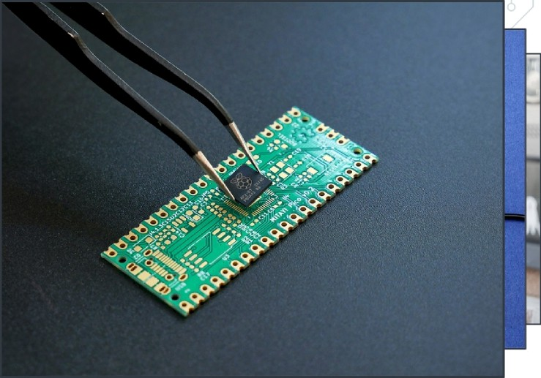
WHAT ARE INFRARED SENSORS/
01
Infrared sensors are devices that detect infrared radiation emitted from objects, which enables them to measure temperature and detect motion. This ability to sense heat makes them essential in various applications, including security systems, environmental monitoring, and automation in smart homes.

Slide 8
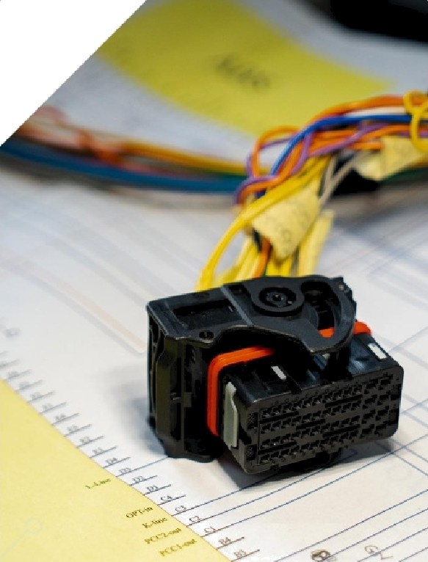
KEYAPPLICATIONS OF INFRARED SENSORS
Exploring Their Versatile Uses
MOTIOi'4 DETECTION
Infrared sensors are widely utilized in home security systems to detect movement. By sensing changes in infrared radiation emitted by objects, these sensors can alert homeowners of any potential intruders, enhancing safety and security in residential areas.

Slide 9

UNDERSTANDING BLUETOOTH SENSORS AND THEIR IMPACT
WHATARE BLUETOOTH SENSORS?
Bluetooth sensors are devices that facilitate wireless communication between various electronic devices over short distances, typically within a range of 10 to 100 meters. This technology plays a crucial role in the Internet of Things (IoT) ecosystem by enabling devices to share data seamlessly without the need for physical connections, thus enhancing connectivity and interactivity.
KEY FEATURE: LOW POWER CONSUMPTION
One of the standout features of Bluetooth sensors is their low power consumption, which allows for prolonged battery life. This is essential for devices that rely on battery power, as it enables them to operate efficiently over extended periods without frequent recharging. This attribute makes Bluetooth sensors ideal for applications in remote or hard-to-reach locations.
HOW BLUETOOTH SENSORS WORK
Bluetooth sensors operate using radio frequency signals to transmit data between devices. When a Bluetooth-enabled device, such as a smartphone or a smart device, is within range, it can connect to the sensor to receive or send information. This process involves pairing devices, ensuring secure and efficient data transfer while minimizing interference from other wireless signals.
FUTURE OF BLUETOOTH SENSORS
The future of Bluetooth sensors looks promising, with advancements in technology paving the way for more sophisticated applications. Innovations such as Bluetooth 5.0 and beyond are set to enhance data transfer speeds, increase range, and improve energy efficiency. This will open new opportunities for developers and businesses to create smarter, more connected solutions in various fields.

Slide 10
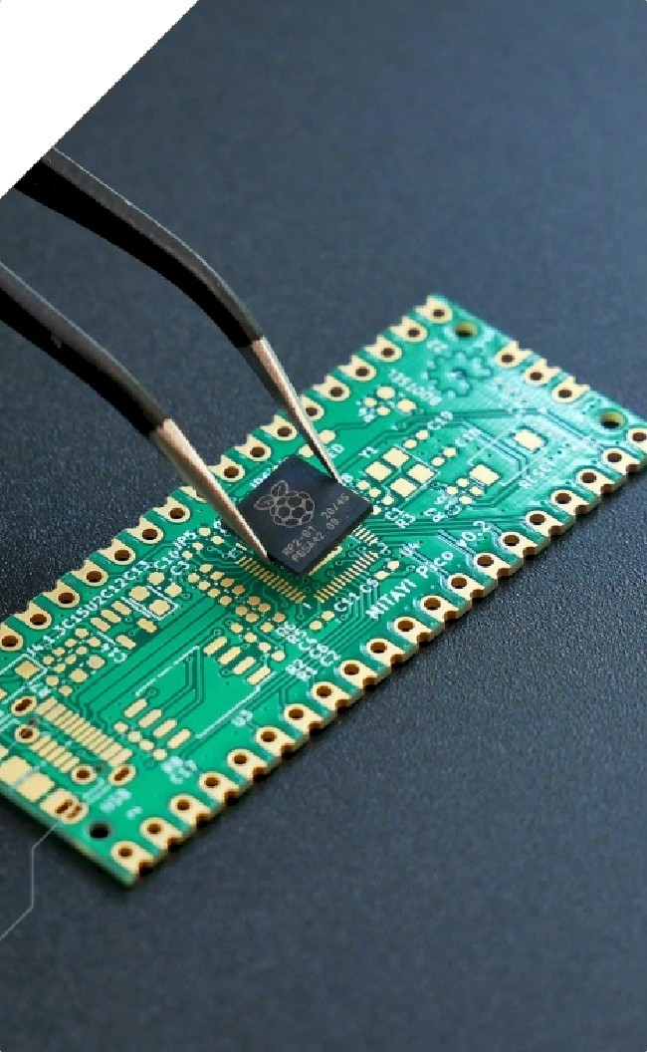

APPLICATIONS OF BLUETOOTH SENSORS
Exploring Key Areas of Impact
WEARABLE DEVICES
Bluetooth sensors have revolutionized wearable devices by enabling real-time health monitoring and fitness tracking. This technology allows users to track their heart rate, sleep patterns, and physical activity levels seamlessly, leading to improved health outcomes and personalized fitness experiences.
SMART HOME DEVICES
In the realm of smart home technology, Bluetooth sensors facilitate the remote control of various household appliances, such as lights, thermostats, and security systems. This enhances convenience and energy efficiency, allowing users to manage their home environment from their smartphones or voice-activated assistants.
^œn'ea 1°nç preseutotions

Slide 11
UMPORTANCEOFAORIflNG
ENHANCING FLINCTIONALI'I’Y
DIVERSE SENSOR TYï'ES
PRINCIPLES
AND INTERACTIVITY
Understanding the
SAFETYAND
As you delve into
Arduino sensors
SENSORS IN AU'IOMA3’ION
ENVIRONMEN’fAL
MONITORING
encom|pass a wide
working principles of
these sensors is crucial
Arduino projects,
consider how these
range of types,
including temperature,
Sensors are integral
Many sensors play a
pivotal role in safety
for thefr effective
components of
sensors can
im | plementation in
 | various projects.
Whether it's knowing
know a temperature
ensor measures Iheat
or how an ultrasonic
automation systems.
hey enable machines
and devices to collect
 | data from their
and environmental
significantly enhance
Bl an | ultrasonic, infrared,
 | uetooth, moisture,
 | d gas sensors. Each
of | these sensors has its
T
monitoring. For
functionality and
ins1rance, gas sensors
interactivity. By
can detect harmful
integrating various
s
environment, leading
gases, ensuring safety
sensors, you can create
own unique
to smarter olecision-
in industrial settings,
responsive systems
characteristics, making
them suitable for
sehsor dletects
making processes that
while moisture sensors
that adapt tò user
different applications,
from environmental
distance, this
enhance efficiency and
safer across various
can help in agriculture
inputs and
knowledge provides a
by monitoring soil
conditions to optimize
environmental
monitoring to smart
solid foundation for
industries.
changes, enriching the
overall user experience.
home automation.
successful project
crop growth.
execution.
@ p resen to tions ai

Slide 12
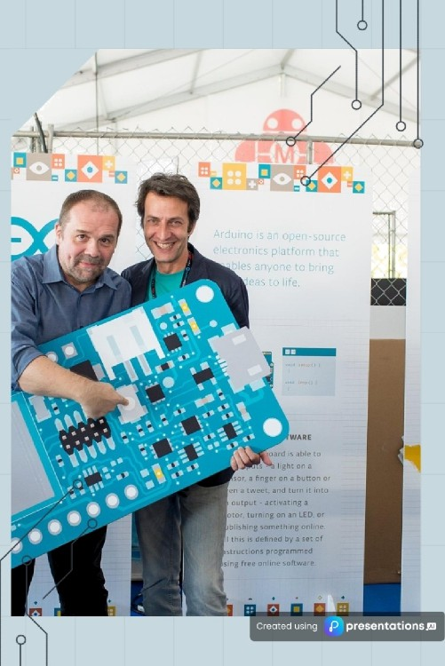
THANKS !

