Slide 1



Empowering Creativity: An Introduction to Arduino for Innovative Electronics Projects

Slide 2
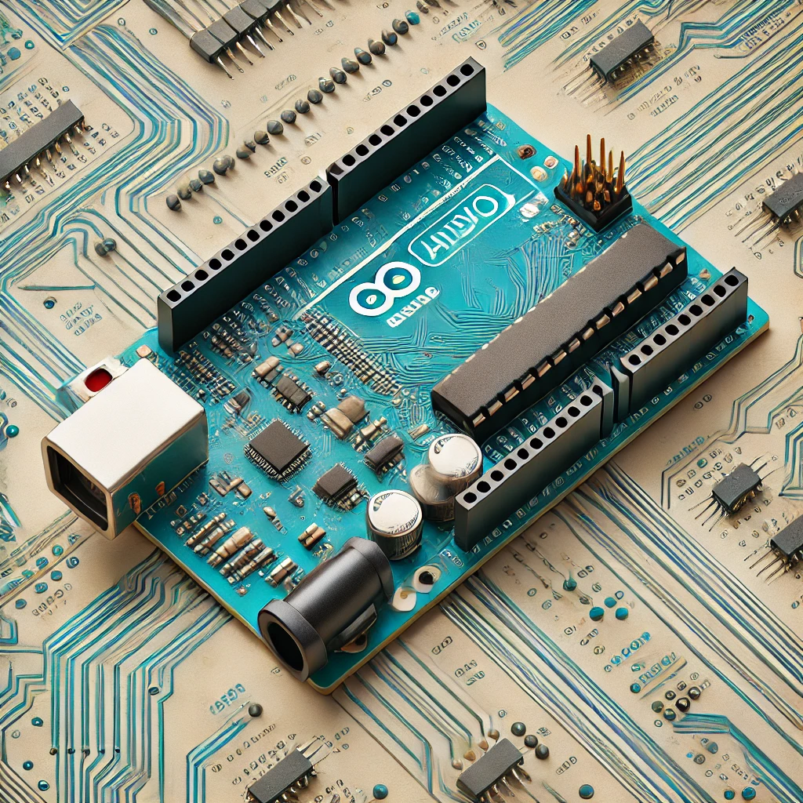



Slide 3

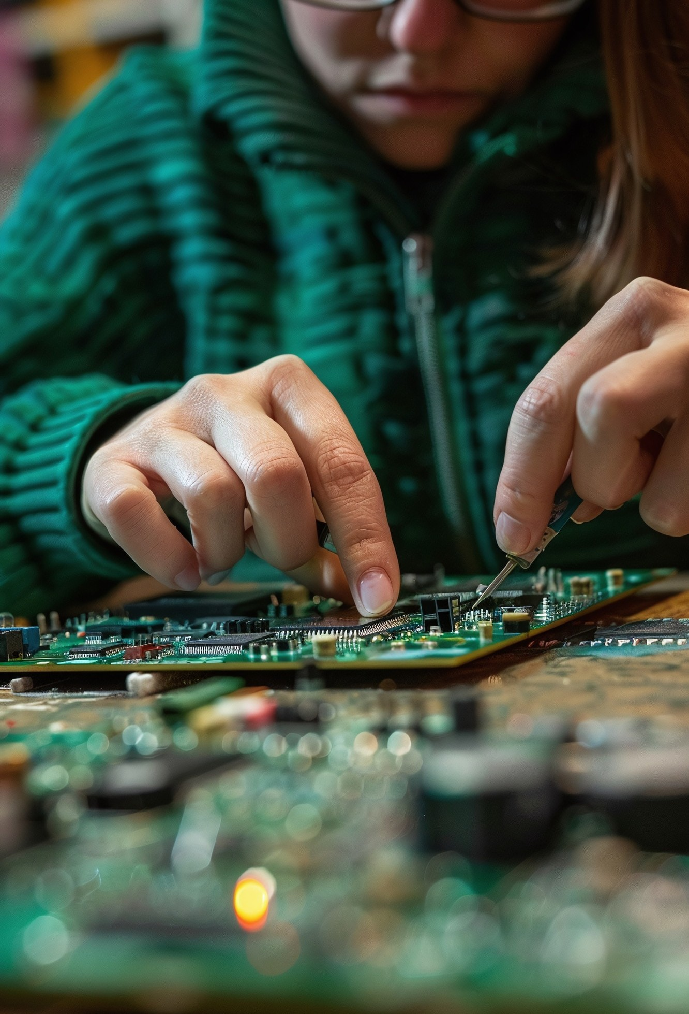
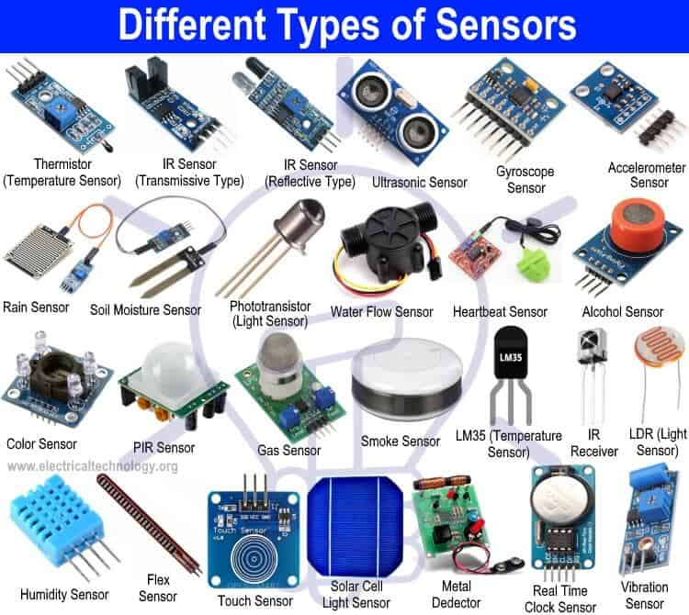
Sensor
A sensor is a device that detects changes in the environment and converts them into a signal that can be processed by a machine.

Slide 4
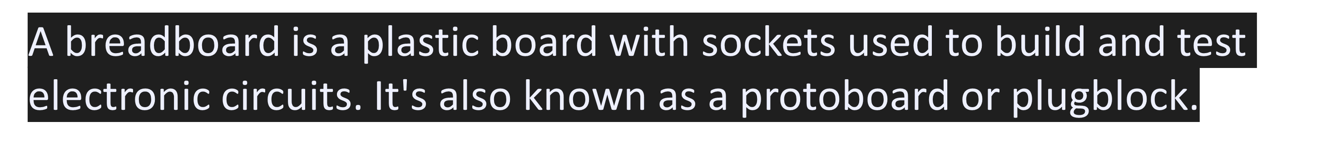
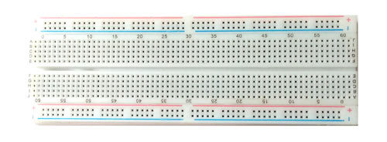
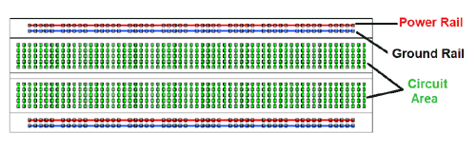
Pinout Diagram
Breadboard
Overview

Slide 5
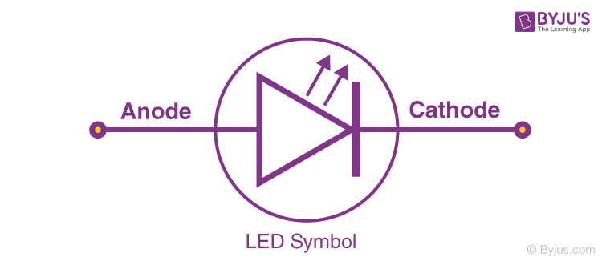
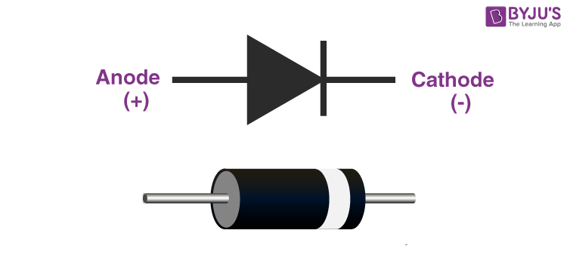
Some More Sensors….
LED (Light Emitting Diode) : Emits light when current flows through it. Commonly used in displays, indicators, and lighting. Advantages include low power consumption, long lifespan, and compact size.
Diode : Allows current to flow in one direction only. Used in rectification and signal demodulation. Types include standard diodes, Zener diodes for voltage regulation, and Schottky diodes for fast switching. Advantages are simplicity, reliability, and essential functionality in circuits.

Slide 6

About Tinkercad
Tinkercad is a free, user-friendly online platform designed for 3D design, electronics simulation, and coding. It enables users to create 3D models using simple shapes and tools, making it ideal for beginners and educators. Tinkercad also offers features for simulating circuits and programming Arduino projects, allowing users to experiment with electronics in a virtual environment. With its intuitive interface and collaborative capabilities, Tinkercad is widely used in education and for prototyping ideas.

Slide 7
Basic Components Overview
Key components of an Arduino project include resistors, LEDs, sensors, and motors.
Understanding these components is crucial for creating eﬀective projects. Each plays a unique role in how your Arduino interacts with the physical world.
Programming Arduino
Programming Arduino involves writing code in C/C++ within the Arduino IDE. Basic commands control inputs and outputs, enabling you to create responsive projects. Learning to code is essential for unlocking the full potential of your Arduino.

Slide 8


Arduino is a powerful tool for creativity in electronics projects. Its accessibility and vast resources make it an excellent choice for anyone looking to innovate. Start your Arduino journey today and unleash your creativity!

Slide 9
THANK YOU !
PPT DESIGNED BY : RUSHI DAULATKAR

