Slide 1

An Exploration of Transistors: Functionality, Symbols, and Diagrams of Transistors as Switches

Slide 2
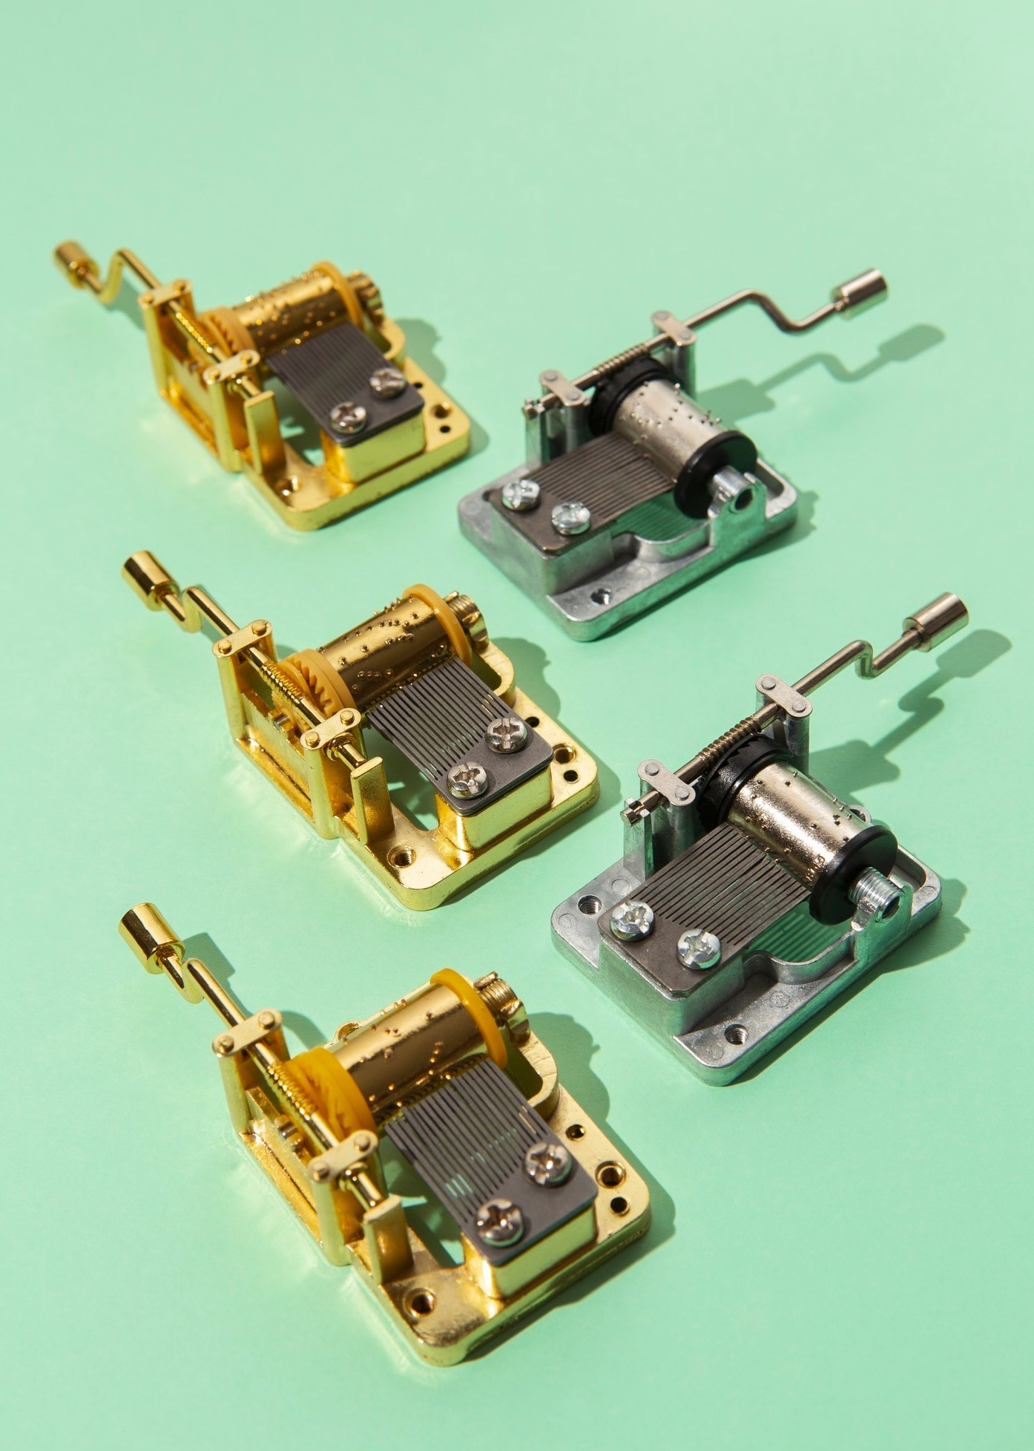



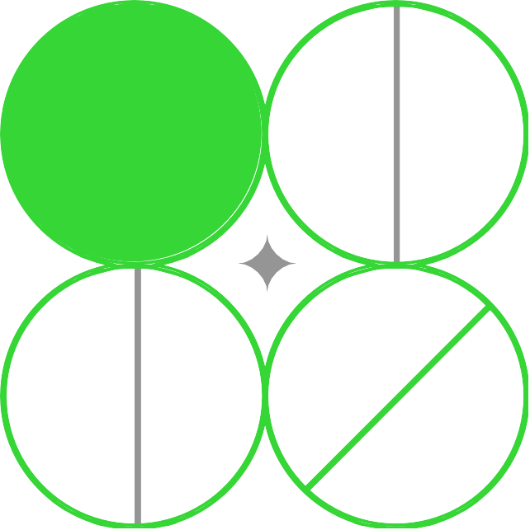
Introduction to Transistors
are fundamental components in modern electronics. They act as or ampliﬁers, enabling control over electrical signals. This presentation will delve into their , symbols, and how they operate as switches, providing a comprehensive understanding of their signiﬁcance in technology.

Slide 3
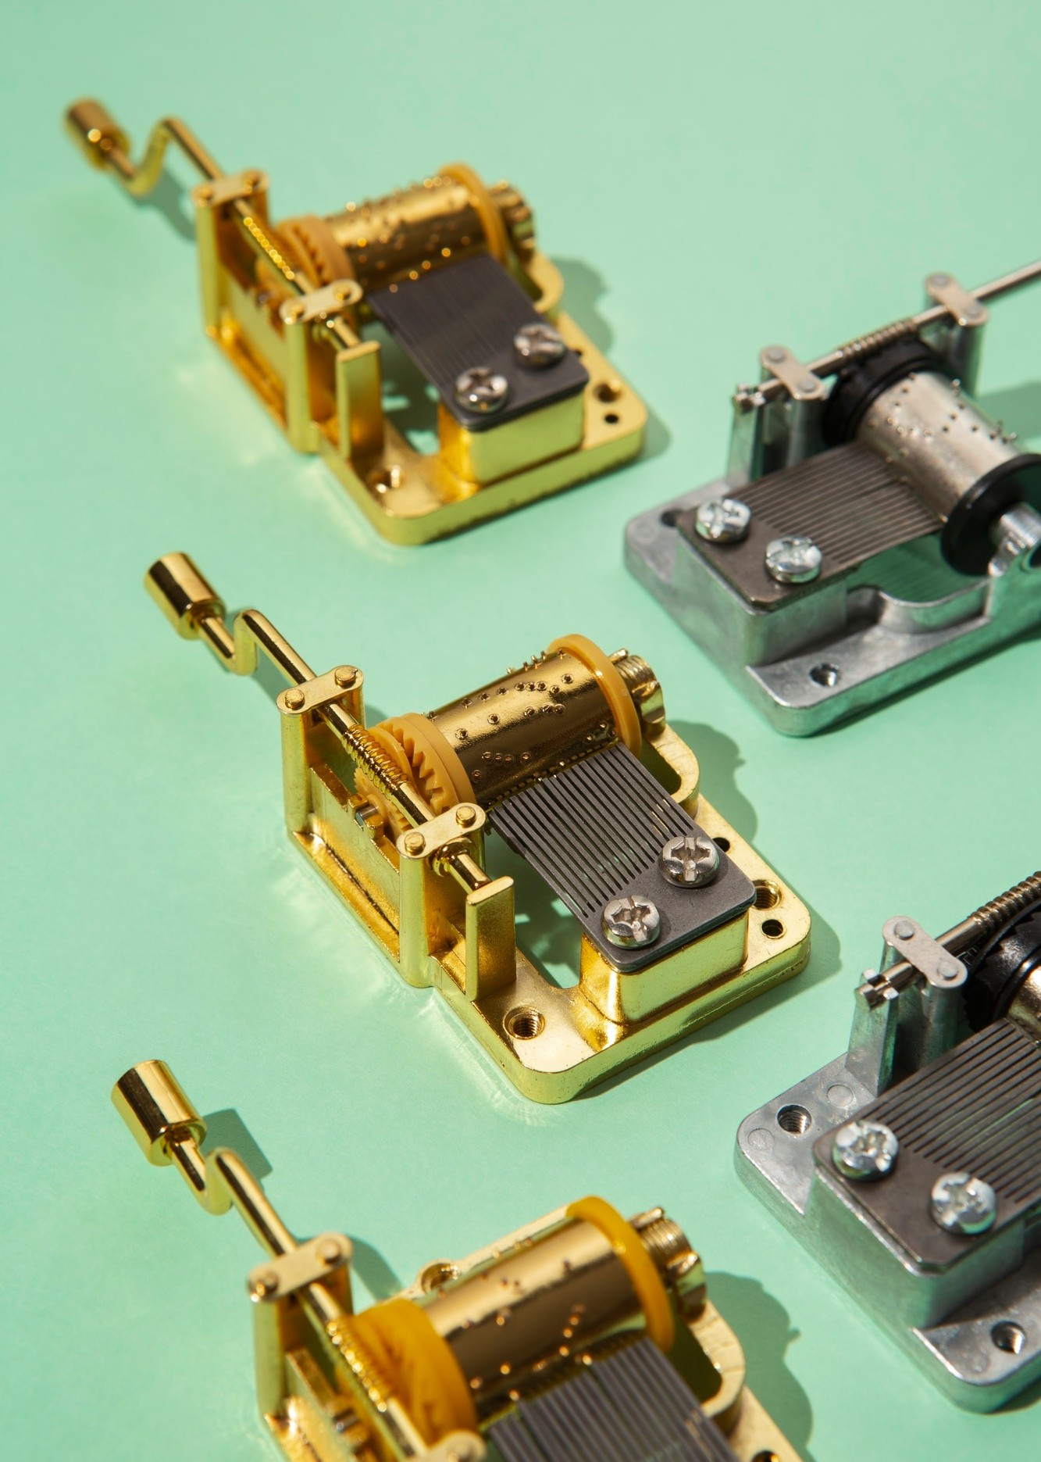


What is a Transistor?
A is a semiconductor device that can electrical current. It consists of three layers
of semiconductor material, typically , and
can function as a or an ampliﬁer, making it
essential in numerous electronic applications.
Types of Transistors
There are two main types of transistors: Bipolar Junction Transistors (BJTs) and Field Effect Transistors (FETs). Each type has unique characteristics and applications, influencing their use in various electronic circuits and systems.

Slide 4
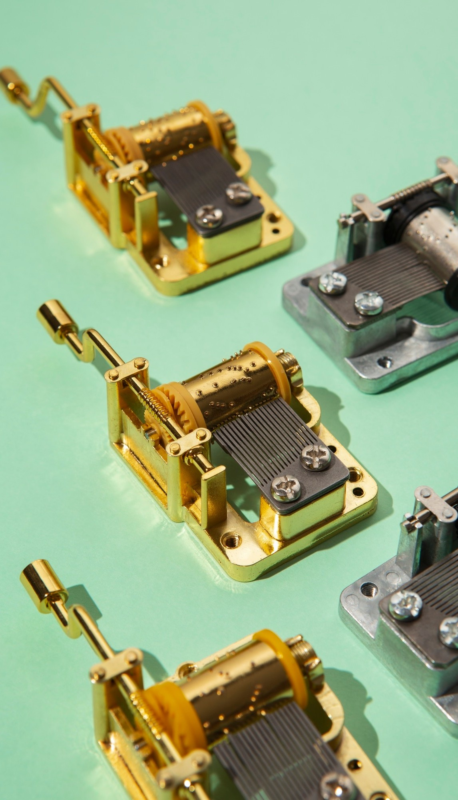

Transistor as a Switch
When used as a , a transistor can either allow or block the ﬂow of current. This ability to control current makes
transistors vital in
they represent binary states of
, where and .

Slide 5
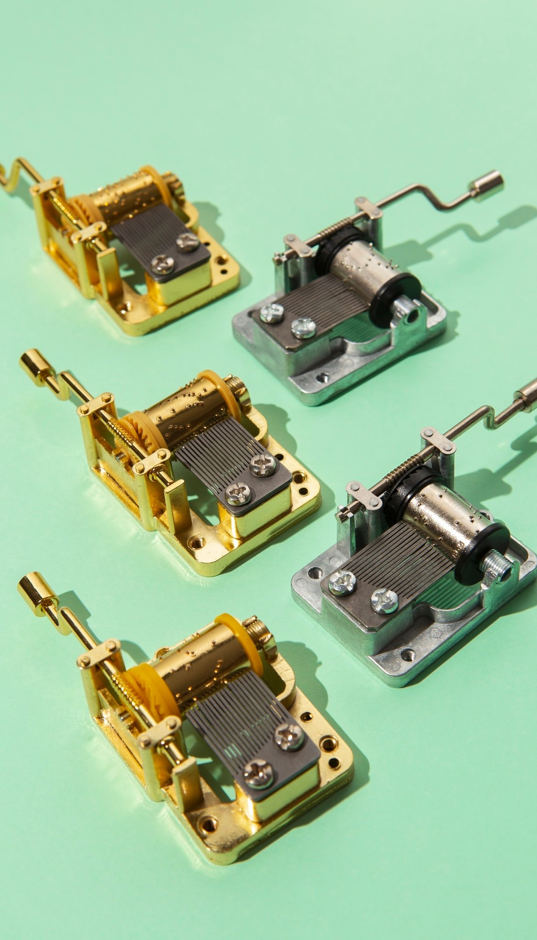


Advantages of Transistors
Transistors offer numerous advantages over traditional electronic components, including
, , and
. These beneﬁts have led to their dominance in modern electronic design.

Slide 6


Challenges in Transistor Design
Despite their advantages, designing transistors poses challenges such as ,
, and . Addressing
these issues is critical for advancing technology and improving performance.

Slide 7



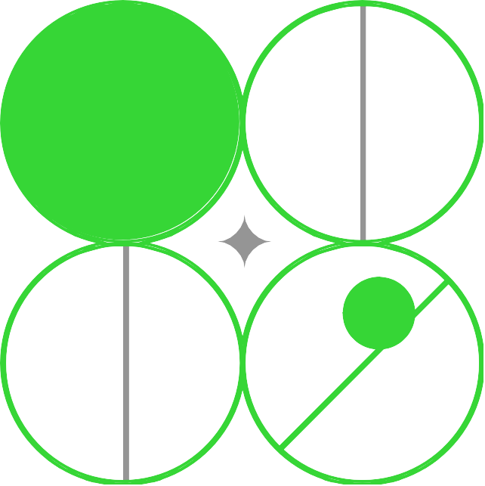
CONCLUSION
In conclusion, are essential components in electronics, functioning as switches and ampliﬁers.
Understanding their , symbols, and applications is crucial for anyone involved in electronic design and innovation.

Slide 8

Thanks!

