Slide 1
SOFTWARE PROJECT
PROJECT PARTNER :-
Rushi Hansora : - IT042
Vraj Donga : - IT028

Slide 2
ONLINE SHOPPING WEBSITE

Slide 3
PROBLEM :-
LIMITED CHOICES
HIGHER PRICES
LAKE OF REVIEWS
LIMITED PAYMENT OPTIONS
SOLUTION :-
ONLINE SHOPPING

Slide 4
BENIFITS
WIDE SELECTION
COST EFFECTIVE
REVIEW & RATINGS
24/7 AVAILABILITY
BEST OFFERS & DISCOUNTS
DOORSTEP DELIVERY
EASY TO PAYMENT
TIME SAVING

Slide 5
USED LANGUAGES IN THIS WEBSITE
HTML
CSS
JAVASCRIPT

Slide 6

HTML
HTML stands for HyperText Markup Language. It is the standard markup language for creating web pages and web applications.

Slide 7

CSS
CSS stands for Cascading Style Sheets. It describes how HTML elements are to be displayed on screen, paper, or in other media.

Slide 8

JAVASCRIPT
JavaScript is a programming language that enables interactive web pages. It is used for creating dynamic and interactive user experiences.

Slide 9
PRODUCT CATEGORY
CLOTHES :-
JEANS
SHIRT
T-SHIRT
PERFUME
WATCH
SHOES

Slide 10
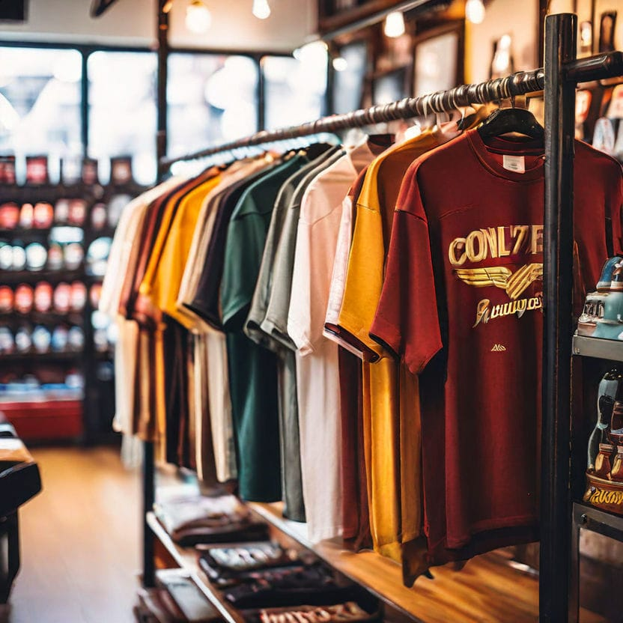






Slide 11
Thank you

