Slide 1
JavaScript
By Sangita M. Jaybhaye

Slide 2
JavaScript
JavaScript is the world's most popular programming language.
JavaScript is the programming language of the Web.
JavaScript is easy to learn.
This tutorial will teach you JavaScript from basic to advanced.

Slide 3
JavaScript
JavaScript is a front-end scripting language developed by Netscape for dynamic content
Lightweight, but with limited capabilities
Can be used as object-oriented language
Client-side technology
Embedded in your HTML page
Interpreted by the Web browser
Simple and flexible

Slide 4
JavaScript Advantages
JavaScript allows interactivity such as:
Implementing form validation
React to user actions, e.g. handle keys
Changing an image on moving mouse over it
Sections of a page appearing and disappearing
Content loading and changing dynamically
Performing complex calculations
Custom HTML controls, e.g. scrollable table
Implementing AJAX functionality

Slide 5
JavaScript Syntax
JavaScript can be implemented using <script>... </script> HTML tags in a web page.
Place the <script> tags, within the <head> tags.
Syntax:
<script language="javascript" type="text/javascript">
JavaScript code
</script>

Slide 6
JavaScript Syntax
Example:
<html>
<body>
<script >
document.write("Hello World!");
</script>
</body>
</html>
Output
Hello World!

Slide 7
JavaScript Editor and Extension
Use Notepad to write the code
Save the document using .html (if embedded JavaScript)
Save document with .js (if external JavaScript)
Run the code in brower

Slide 8
JavaScript - Placement in HTML File
There is a flexibility given to include JavaScript code anywhere in an HTML document.
However the most preferred ways to include JavaScript in an HTML file are as follows −
Script in <head>...</head> section.
Script in <body>...</body> section.
Script in <body>...</body> and <head>...</head> sections.
Script in an external file and then include in <head>...</head> section.

Slide 9
First Program
<!DOCTYPE html>
<html>
<body>
<h2>My First JavaScript</h2>
<button type="button"
onclick="document.getElementById('demo').innerHTML = Date()">
Click me to display Date and Time.</button>
<p id="demo"></p>
</body>
</html>

Slide 10
One of many JavaScript HTML methods is getElementById().
The example below "finds" an HTML element (with id="demo"), and changes the element content (innerHTML) to "Hello JavaScript":
<!DOCTYPE html>
<html>
<body>
<h2>What Can JavaScript Do?</h2>
<p id="demo">JavaScript can change HTML content.</p>
<button type="button" onclick='document.getElementById("demo").innerHTML = "Hello JavaScript!"'>Click Me!</button>
</body>
</html>
<!DOCTYPE html>
<html>
<body>
<h2>What Can JavaScript Do?</h2>
<p id="demo">JavaScript can change HTML content.</p>
<button type="button" onclick="document.getElementById('demo').innerHTML = 'Hello JavaScript!'">Click Me!</button>
</body>
</html>

Slide 11
JavaScript Where To
The< script> Tag
In HTML, JavaScript code is nested between <script> and </script>
<!DOCTYPE html>
<html>
<body>
<h2>JavaScript in Body</h2>
<p id="demo"></p>
<script>
document.getElementById("demo").innerHTML = "My First JavaScript";
</script>
</body>
</html>

Slide 12
JavaScript Functions and Events
A JavaScript function is a block of JavaScript code, that can be executed when "called" for.
For example, a function can be called when an event occurs, like when the user clicks a button..

Slide 13
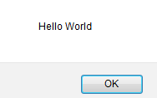
JavaScript in <head>...</head> section
<html>
<head>
<script >
function sayHello()
{ alert("Hello World") }
</script>
</head>
<body>
<input type="button" onclick="sayHello()" value="Say Hello" />
</body>
</html>
This code will produce the following results −

Slide 14
<!DOCTYPE html>
<html>
<head>
<script>
function myFunction() {
document.getElementById("demo").innerHTML = "Paragraph changed.";
}
</script>
</head>
<body>
<h2>Demo JavaScript in Head</h2>
<p id="demo">A Paragraph.</p>
<button type="button" onclick="myFunction()">Try it</button>
</body>
</html>

Slide 15
JavaScript in <body>
In this example, a JavaScript function is placed in the <body> section of an HTML page.
The function is invoked (called) when a button is clicked:
<!DOCTYPE html>
<html>
<body>
<h2>Demo JavaScript in Body</h2>
<p id="demo">A Paragraph.</p>
<button type="button" onclick="myFunction()">Try it</button>
<script>
function myFunction() {
document.getElementById("demo").innerHTML = "Paragraph changed.";
}
</script>
</body>
</html>

Slide 16
JavaScript in External File
HTML File
<html>
<head>
<script type="text/javascript" src="filename.js" >
</script>
</head>
<body> ....... </body>
</html>
JavaScript File – filename.js
function sayHello()
{ alert("Hello World") }

Slide 17
JavaScript in External File
External file: myScript.js
function myFunction() { document.getElementById("demo").innerHTML = "Paragraph changed."; }
External scripts are practical when the same code is used in many different web pages.
JavaScript files have the file extension .js.
To use an external script, put the name of the script file in the src (source) attribute of a <script> tag:
Example
<script src="myScript.js"></script>

Slide 18
External JavaScript Advantages
Placing scripts in external files has some advantages:
It separates HTML and code
It makes HTML and JavaScript easier to read and maintain
Cached JavaScript files can speed up page loads
To add several script files to one page - use several script tags:
Example
<script src="myScript1.js"></script> <script src="myScript2.js"></script>

Slide 19
External References
An external script can be referenced in 3 different ways:
With a full URL (a full web address)
With a file path (like /js/)
Without any path
1.This example uses a full URL to link to myScript.js:
<script src="https://www.w3schools.com/js/myScript.js"></script>
2. This example uses a file path to link to myScript.js:
Example
<script src="/js/myScript.js"></script>
3. This example uses no path to link to myScript.js:
Example
<script src="myScript.js"></script>

Slide 20
JavaScript Output
JavaScript Display Possibilities
JavaScript can "display" data in different ways:
Writing into an HTML element, using innerHTML.
Writing into the HTML output using document.write().
Writing into an alert box, using window.alert().
Writing into the browser console, using console.log().

Slide 21
1.Using innerHTML
To access an HTML element, JavaScript can use the document.getElementById(id) method.
The id attribute defines the HTML element. The innerHTML property defi nes the HTML content:
<!DOCTYPE html>
<html>
<body>
<h2>My First Web Page</h2>
<p>My First Paragraph.</p>
<p id="demo"></p>
<script>
document.getElementById("demo").innerHTML = 5 + 6;
</script>
</body>
</html>

Slide 22
2.Using document.write()
For testing purposes, it is convenient to use document.write():
<!DOCTYPE html>
<html>
<body>
<h2>My First Web Page</h2>
<p>My first paragraph.</p>
<p>Never call document.write after the document has finished loading.
It will overwrite the whole document.</p>
<script>
document.write(5 + 6);
</script>
</body>
</html>
Using document.write() after an HTML document is loaded, will delete all existing HTML:

Slide 23
<!DOCTYPE html>
<html>
<body>
<h1>My First Web Page</h1>
<p>My first paragraph.</p>
<button type="button" onclick="document.write(5 + 6)">Try it</button>
</body>
</html>
The document.write() method should only be used for testing.

Slide 24
<!DOCTYPE html>
<html>
<body>
<h2>My First Web Page</h2>
<p>My first paragraph.</p>
<script>
alert(5 + 6);
</script>
</body>
</html>

Slide 25
Using console.log()
For debugging purposes, you can call the console.log() method in the browser to display data.
<!DOCTYPE html>
<html>
<body>
<h2>Activate Debugging</h2>
<p>F12 on your keyboard will activate debugging.</p>
<p>Then select "Console" in the debugger menu.</p>
<p>Then click Run again.</p>
<script>
console.log(5 + 6);
</script>
</body>
</html>

Slide 26
Standard Popup Boxes
Alert box with text and [OK] button
Just a message shown in a dialog box:
Confirmation box
Contains text, [OK] button and [Cancel] button:
Prompt box
Contains text, input field with default value:
alert("Some text here");
confirm("Are you sure?");
prompt ("enter amount", 10);

Slide 27
JavaScript Variables
<script type="text/javascript">
<!--
var name = "Ali";
var money;
money = 2000.50;
//-->
</script>

Slide 28
Sum of Numbers – Example
sum-of-numbers.html
<html>
<head>
<title>JavaScript Demo</title>
<script type="text/javascript">
function calcSum() {
value1 =
parseInt(document.mainForm.textBox1.value);
value2 =
parseInt(document.mainForm.textBox2.value);
sum = value1 + value2;
document.mainForm.textBoxSum.value = sum;
}
</script>
</head>

Slide 29
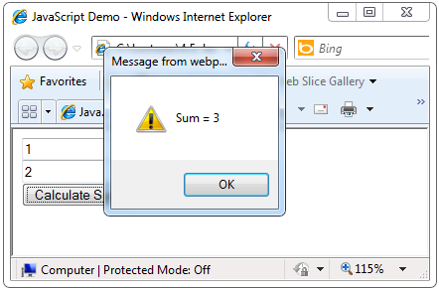
Sum of Numbers – Example (2)
sum-of-numbers.html (cont.)
<body>
<form name="mainForm">
<input type="text" name="textBox1" /> <br/>
<input type="text" name="textBox2" /> <br/>
<input type="button" value="Process"
onclick="javascript: calcSum()" />
<input type="text" name="textBoxSum"
readonly="readonly"/>
</form>
</body>
</html>

Slide 30
HTML Form Validation using JS: Regular Expression- helps in pattern matching
. : Matches any single character except a new line
+ : Matches the preceding character or repeated character.
$ : Matches character at the end of the line.
^ : Matches the beginning of a line or string.
- : Range indicator. [a-z, A-Z]
[0-9] : It matches digital number from 0-9.
[a-z] : It matches characters from lowercase ‘a’ to lowercase ‘z’.
[A-Z] : It matches characters from uppercase ‘A’ to lowercase ‘Z’.
w: Matches a word character and underscore. (a-z, A-Z, 0-9, _).
W: Matches a non word character (%, #, @, !).
{M, N} : Donates minimum M and maximum N value.

Slide 31
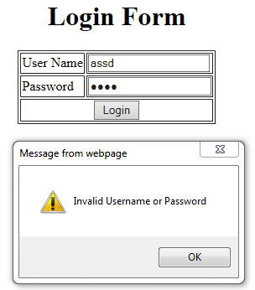
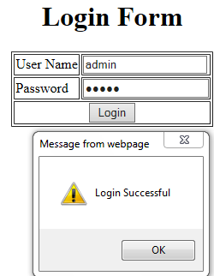
HTML Form Validation using JS: Login Form
<html>
<head>
<script>
function Login1(){
var a=document.f1.t1.value;
var b=document.f1.t2.value;
if(a == 'admin' && b == 'admin'){
alert("Login Successful");
window.location="EnquiryForm.html“ }
Else {
alert("Invalid Username or Password");
document.f1.t1.value='';
document.f1.t2.value='';
document.f1.t1.focus();
return false;}}
</script>
</head>

Slide 32
HTML Form Validation using JS: Login Form
<body>
<form name="f1" >
<table border=1 align=center>
<caption><h1> Login Form </h1></caption>
<tr> <td>User Name </td>
<td> <input type="text" name="t1" required></td></tr>
<tr><td> Password </td>
<td> <input type="Password" name="t2" required></td></tr>
<tr > <td colspan=2 align=center>
<input type="button" value="Login" onclick="return Login1()" ></td> </tr>
</table>
</form>
</body>
</html>

Slide 33
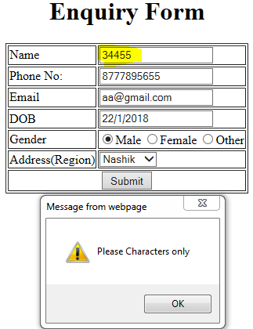
HTML Form Validation using JS: Student Registration Form (Required Field and accepting characters only in Name text box and digits only in Phone text box)
<html> <head>
<script>
function validateForm() {
if(document.myForm.name.value.match(/^[A-Za-z]+$/)) { }
else {
alert("Please Characters only");
document.myForm.name.focus();
return false; }
if(document.myForm.phone.value.match(/^[0-9]+$/)) {
message = "<br>NAME:" + document.myForm.name.value;
message += "<br>ADDRESS: " + document.myForm.address.value;
message += "<br>GENDER: " + document.myForm.G.value ;
message += "<br>PHONE: " + document.myForm.phone.value ;
message += "<br>DOB: " + document.myForm.DOB.value ;
message += "<br>EMail-Id: " + document.myForm.email.value ;
document.write(message); }
else {
alert('Please input numeric characters only');
document.myForm.phone.focus();
return false; } }
</script> </head>

Slide 34
HTML Form Validation using JS: Student Registration Form (Required Field and accepting characters only in Name text box and digits only in Phone text box)
<body>
<form name="myForm" onsubmit="return validateForm()">
<table border=1 align=center>
<caption><h1> Enquiry Form </h1></caption>
<tr><td>Name</td>
<td><input type="text" name="name" required></td></tr>
<tr><td>Phone No:</td>
<td><input type="text" name="phone" maxlength=10 required></td></tr>
<tr><td>Email</td>
<td><input type="Email" name="email" required></td></tr>
<tr><td>DOB</td>
<td><input type="date" name="DOB" required></td></tr>
<tr><td>Gender</td>
<td><input type="radio" name="G" value="Male" checked>Male
<input type="radio" name="G" value="Female" >Female</td></tr>
<tr><td>Address(Region)</td>
<td><select name="address">
<option> Nashik </option>
<option> Pune </option></select></td></tr>
<tr><td colspan=2 align=center><input type="submit" value="Submit"></td></tr>
</table></form></body></html>

Slide 35
<!DOCTYPE html>
<html>
<body>
<h1>Display a Telephone Input Field</h1>
<form action="/action_page.php">
<label for="phone">Enter a phone number:</label><br><br>
<input type="tel" id="phone" name="phone" placeholder="123-45-678" pattern="[0-9]{3}-[0-9]{2}-[0-9]{3}" required><br><br>
<small>Format: 123-45-678</small><br><br>
<input type="submit">
</form>
</body>
</html>

Slide 36
<!DOCTYPE html>
<html>
<head>
<script>
function validateForm() {
let x = document.forms["myForm"]["fname"].value;
if (x == "") {
alert("Name must be filled out");
return false;
}
}
</script>
</head>
<body>
<h2>JavaScript Validation</h2>
<form name="myForm" action="/action_page.php" onsubmit="return validateForm()" method="post">
Name: <input type="text" name="fname">
<input type="submit" value="Submit">
</form>
</body>
</html>

Slide 37
What is Validation?
Validation refers to the process of examining the values that the user inputs. It plays a crucial role in creating applications and enhances the user experience. Many fields, such as mobile numbers, emails, dates, and passwords, are validated through this process.
JavaScript makes the validation process faster due to its faster processing of data than other server-side validation. Now let’s have a look at the implementation of the email validation in JavaScript.

Slide 38
Email Validation in JavaScript
Email validation is one of the vital parts of authenticating an HTML form. Email is a subset or a string of ASCII characters, divided into two parts using @ symbol. Its first part consists of private information, and the second one contains the domain name in which an email gets registered.
Special characters such as # * + & ’ ! % @ ? { ^ } ”
Numeric characters (0 to 9)
Full stop, dot, etc., having a condition that it can’t be the email’s last or the very first letter and can’t be repeated after another.
Uppercase alphabets (A to Z) and Lowercase (a to z) alphabets
The second part includes the following:
Dots
Digits
Hyphens
Letters

Slide 39
Email Validation in JavaScript
Special characters such as # * + & ' ! % @ ? { ^ } ”
Numeric characters (0 to 9)
Full stop, dot, etc., having a condition that it can't be the email's last or the very first letter and can't be repeated after another.
Uppercase alphabets (A to Z) and Lowercase (a to z) alphabets.

Slide 40
Example of regular expression
/^[a-zA-Z0-9._-]+@[a-zA-Z0-9.-]+\.[a-zA-Z]{2,6}$/
/^[a-zA-Z0-9.!#$%&'*+/=?^_`{|}~-]+@[a-zA-Z0-9-]+(?:\.[a-zA-Z0-9-]+)*$/;
('[a-z0-9]+@[a-z]+\.[a-z]{2,3}

Slide 41
Valid and Invalid examples
Some of the examples of valid email id:
Own.minesite@myuniverse.org
Siteowner@up.down.net
Siteofmine@myuniverse.com
Some Other Examples of Invalid Email Id
Owner.me..7080@abcd.com (one on another dots are not allowed)
Inownzsite()&@abcd.com (only characters, dash, underscore, and digits are allowed in the regular expression.)
Ourwebsiteismne.azbyz.com (here @ symbol is not there)
yourminewebsite@.com.you (Here top-level domain can’t begin with a dot)
@youmenandwe.we.net (here it can’t start with @ symbol)
Younourmetd345@abcd.b (“.b” is not a valid top-level domain)email.js

Slide 42
Checkpoints for efficient email validation in JavaScript code:
Describe a regular expression to validate an email address
If an input value matches regular expressions
If it matches, sends the alert saying “email address is valid.”
If it does not match, send the alert saying, “email address is invalid.”

Slide 43
Email validation
Validating email is a very important point while validating an HTML form. In this page we have discussed how to validate an email using JavaScript : An email is a string (a subset of ASCII characters) separated into two parts by @ symbol. a "personal_info" and a domain, that is personal_info@domain. The length of the personal_info part may be up to 64 characters long and domain name may be up to 253 characters.
The personal_info part contains the following ASCII characters.
Uppercase (A-Z) and lowercase (a-z) English letters.
Digits (0-9).
Characters ! # $ % & ' * + - / = ? ^ _ ` { | } ~
Character . ( period, dot or fullstop) provided that it is not the first or last character and it will not come one after the other.
The domain name [for example com, org, net, in, us, info] part contains letters, digits, hyphens, and dots.

Slide 44
Example of valid email id
mysite@ourearth.com
my.ownsite@ourearth.org
mysite@you.me.net

Slide 45
Example of invalid email id
mysite.ourearth.com [@ is not present] mysite@.com.my [ tld (Top Level domain) can not start with dot "." ]
@you.me.net [ No character before @ ]
mysite123@gmail.b [ ".b" is not a valid tld ]
mysite@.org.org [ tld can not start with dot "." ]
.mysite@mysite.org [ an email should not be start with "." ]
mysite()*@gmail.com [ here the regular expression only allows character, digit, underscore, and dash ]
mysite..1234@yahoo.com [double dots are not allowed]

Slide 46
JavaScript code to validate an email id
function ValidateEmail(mail)
{ if (/^\w+([\.-]?\w+)*@\w+([\.-]?\w+)*(\.\w{2,3})+$/.test(myForm.emailAddr.value))
{
return (true)
}
alert("You have entered an invalid email address!")
return
(false)
}

Slide 47
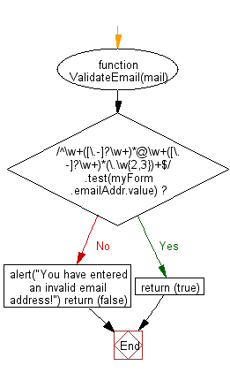

Slide 48
HTML Code
<!DOCTYPE html>
<html lang="en">
<head>
<meta charset="utf-8">
<title>JavaScript form validation - checking email</title>
<link rel='stylesheet' href='form-style.css' type='text/css' />
</head>
<body onload='document.form1.text1.focus()'>
<div class="mail">
<h2>Input an email and Submit</h2>
<form name="form1" action="#">
<ul>
<li><input type='text' name='text1'/></li>
<li>&nbsp;</li>
<li class="submit"><input type="submit" name="submit" value="Submit" onclick="ValidateEmail(document.form1.text1)"/></li>
<li>&nbsp;</li>
</ul>
</form>
</div>
<script src="email-validation.js"></script>
</body>
</html>

Slide 49
JavaScript Code
function ValidateEmail(inputText)
{
var mailformat = /^\w+([\.-]?\w+)*@\w+([\.-]?\w+)*(\.\w{2,3})+$/;
if(inputText.value.match(mailformat))
{
alert("Valid email address!"); document.form1.text1.focus(); return true;
}
else
{ alert("You have entered an invalid email address!");
document.form1.text1.focus(); return false;
}
}

Slide 50
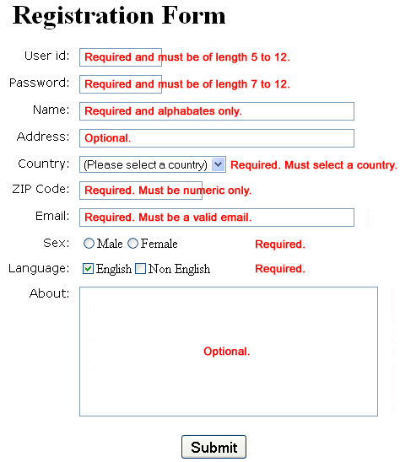

Slide 52
References
https://www.w3schools.com/js
https://www.w3schools.com/js/js_htmldom.asp
https://www.slideshare.net/rakhithota/js-ppt
https://www.tutorialspoint.com/javascript/javascript_quick_guide.htm

