Slide 1
UNIVERSITY RECOMMENDATION SYSTYM
USING K NEAREST NEIGHBOR ALGORITHM

Slide 2
INDEX
Proposed System
System Flowchart
Insights & Inference
Analytical Information
Visualization

Slide 3
Proposed System
The task is to create a model that recommends a list of universities based on the new data.
Model trains on the dataset of universities.
Model works on k nearest neighbour algorithm of supervised machine learning.

Slide 4
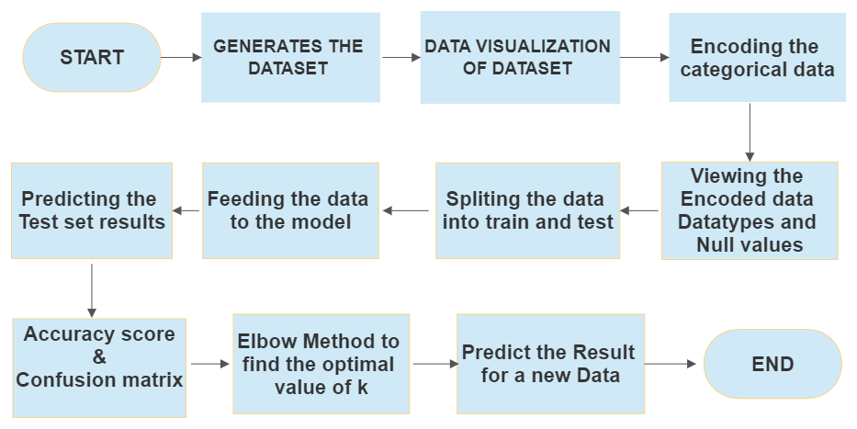
System Flowchart

Slide 5
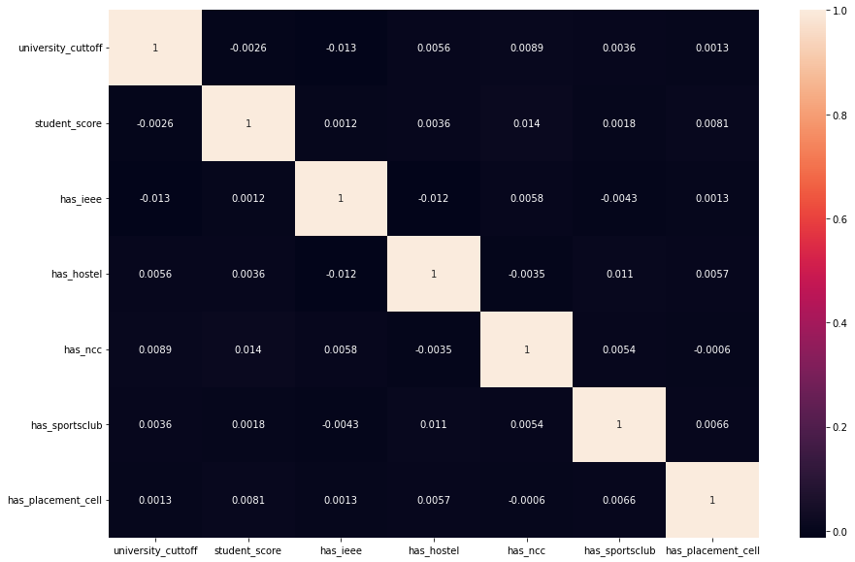
Analytical Information
Correlation of Attributes in the Dataset

Slide 6
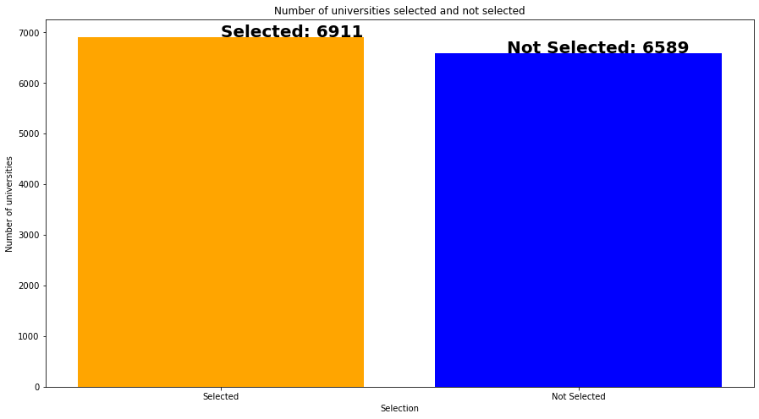
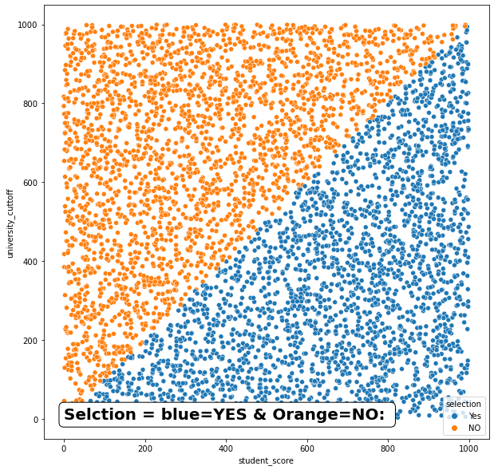
Visualization number of university selected and not selected

Slide 7
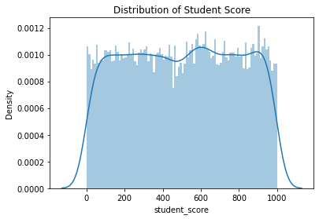
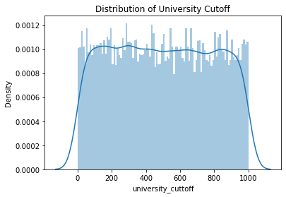
Visualization distplot using seaborn library

Slide 8
Inference & insights
Model works on KNN classification algorithm.
The First step is to encode the categorical data into integers
The Second step is to split the data into train and test and have to select the features and label from the dataset
Mostly the splitting is done in the ratio of 70:30 % or 80:20%(i.e train and test data)
Then feed the splitted data into the model with the help of classifier and neighbors
The main job is to choose the number of k values (i.e. nearest neighbors), and the Elbow method is used to obtain the optimal K value.
Now predict test set results from the model and find the Accuracy Score, F1 Score, Precision & Recall Score and confusion matrix.
The final step is to enter the new data into the model, after which the model will recommend the best universities based on the new data.

Slide 9
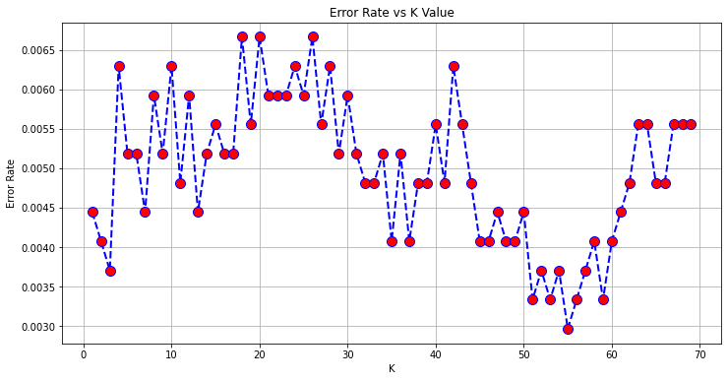
Elbow method for finding the best k value(nearest neighbors) the marker closest to the x axis has least error rate so that marker is best suitable value for k

Slide 10
Accuracy Score of the model is 99.74074075%
Classification Report of the model
precision recall f1-score support
0 1.00 1.00 1.00 1334
1 1.00 1.00 1.00 1366
accuracy 1.00 2700
macro avg 1.00 1.00 1.00 2700
weighted avg 1.00 1.00 1.00 2700

Slide 11
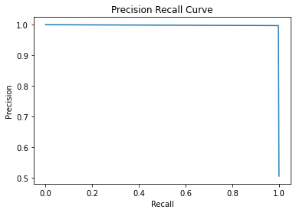
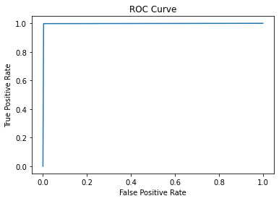
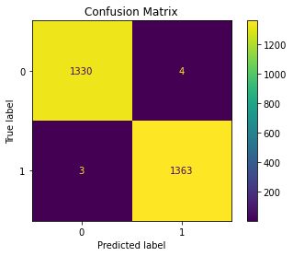
.

Slide 12
THANK YOU!
PROJECT BY
RUSHI HITESH PRAJAPATI

