Slide 1


RANI CHANNAMMA UNIVERSITY,BELAGAVI
B.L.D.E. Association’s Commerce, B.H.S. Arts &T.G.P. Science College, JAMKHANDI
NAAC 3rd Cycle Accredited ‘A’ Grade With CGPA 3.3

Slide 2
Bca PROGRAME
A PROJECT ON i-notes:
Submitted By:
Linganagouda .R. patil(M1816428)
Harish kalyani(m1816416)
Rohit shirol(m1816439)

Slide 3
Project Title:
i-Notes
Objectives Of Project:
iNotes is a web application where users can add and save their notes. It performs CRUD (Create Read Update Delete) operations. Nowadays students carrying bags and books is too heavy. For that we are made a web application called iNotes.
Time reducing.
Free of Cost.
Reduce paper Work.
Handling is easy.

Slide 4
Project Category: Web Application
Why to choose this project:
iNote is one of the web application.
This web application helps us in making self notes, it reduces the carrying bags and books, iNotes is very easy to save the notes and we can fetch it anywhere using internet. It requires user must be registered after that he should login then he can insert notes and access his notes anywhere using this web application.

Slide 5
Existing System:
In this existing system It provides
Creating the Notes and Taking the notes, and it provides Delete, and Updating the notes. It won’t give any service until registering the application. And user must save his notes and all.
Drawbacks:
In The Emergency Situation, You may didn’t get any books and cheats in your hand.
Some people are have less memory power.
At any time we won’t write things somewhere we should remember the things.

Slide 6
Proposed System:
Note taking is an essential learning skill for college students to implement during and outside of class time. The notes recorded during a class lecture should be compiled of the important facts or ideas presented by the professor. Implementing a system of note taking is important for several reasons. First, the faculty member may be presenting supplemental material not found in your text book but critical for you to learn in order to make a connection to prior knowledge or introduce new material within your textbook. Secondly, the information presented within a lecture may be used for future assessments (quizzes, exams, reflection papers).

Slide 7
Benefits:
Date your notes
Keep the objective/theme of the class in mind
Record notes in your own words
Make your notes brief
Features:
Add the note
Edit the previous note
Delete the note
Search the note
Save the note

Slide 8
Modules of the project:
User Module:
Users simply have to register and then have to login. After successful login they will be redirected to a new page where they can insert notes. And this application provides user to:
Add the note
Edit the previous note
Delete the note
Search the note
Save the note

Slide 9
USE CASE DIAGRAMS:
It is the representation of a user’s interaction with the system that shows the relationship between the user and the different use cases in which the user is involved.
Two use modules are there in “i-Notes”
User Model.

Slide 10
Use Case Diagram for User Module.
Register
Login
Create Note
User
Read
Note
Update note
Delete Note
Logout

Slide 11
Data Flow Diagram:
Most organization do not have documentation of the function performed by the user in enough detail to the use of the analyst. Usually all the analyst starts documenting the process using Data Flow Diagram. Views the process from the point of view of the data. As data progressed through the system process transform them.
The analysis stage is actually a learning process in which the analyst tries to gain. An understanding of what the user does. The data flow diagram is an intermediate product that allows the analyst & the user to communicate unambiguously. Data Flow Diagram has a notation for each of the components of the system. They also have a notation for representing different levels in hierarchy of the detail used to describe the system. This notation makes it possible to represent an overall view of large complex system and a detailed view part of the system using same notation.

Slide 12
DATA FLOW DIAGRAMS ARE CONSTRUCTED FROM 4 BASIC
BULIDING BLOCKS:
Terminator Data flow Process File
Terminator : A terminator is an external or source of information or an external sink for information.
Data flow : Files Stores data at later time by another process or in different place and normally corresponds to table or views.
Process: Data flow arrow carries data in the direction of arrow. It can carry data from a terminal on file to a process & from a process to a file.
File:The process box transforms one or more incoming data flows in to one or more outgoing data flows.

Slide 13
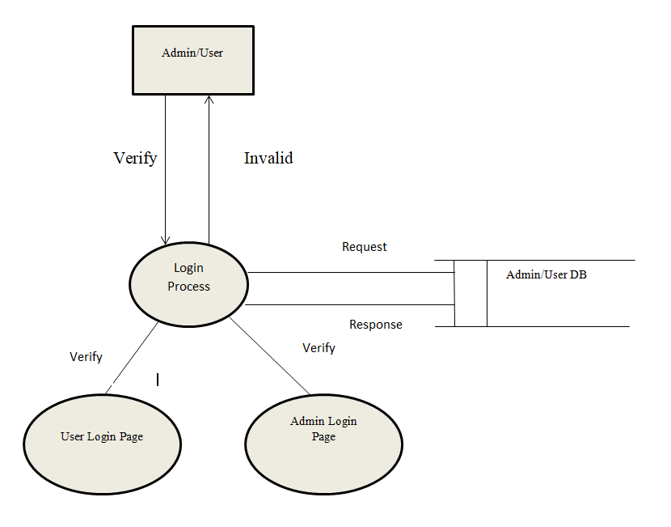
USER DATA FLOW DIAGRAM:

Slide 14
For database application, the entity relationship approach can be used effectively for modelling some part of the problem. The ER modelling approach is used to help design information system. The main focus of ER modelling is the data items in the system and relationship between them. It aims to create a conceptual schema for the data from the user perspective. The model created is the high-level data model.
The following of an ERD are:
Entitles.
Relationships.
Attributes.

Slide 15
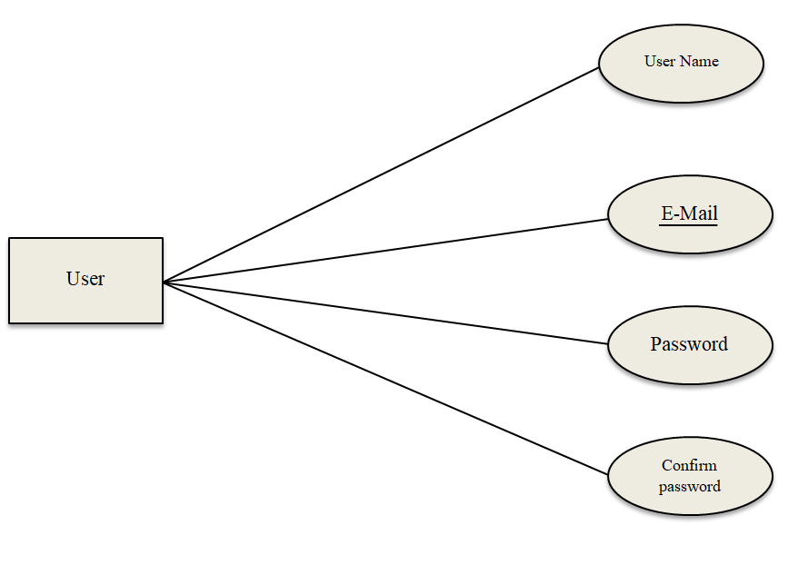
ER Diagram of Register:

Slide 16
ER Diagram:
E-mail
Password
Login
Slno
Title
Add
Note
Description
TimeStamp
nemail-id

Slide 17
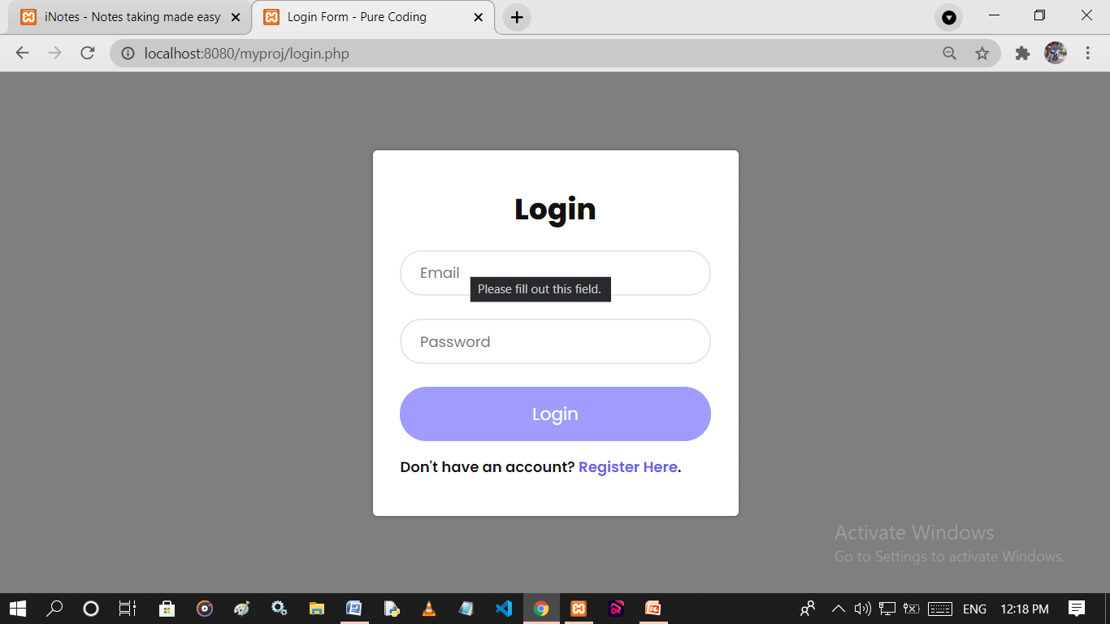
User login page:

Slide 18
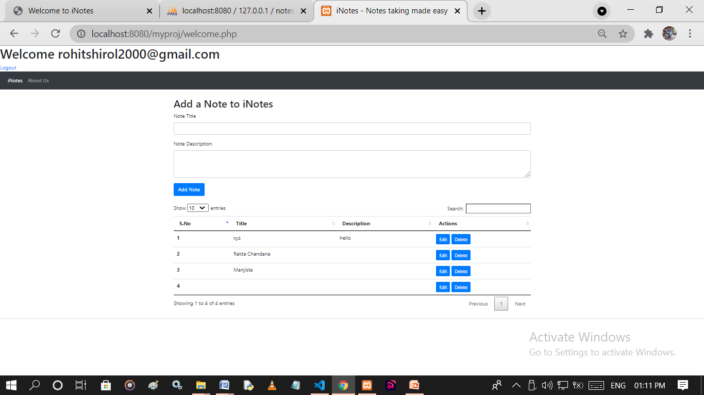
User Home Page:

Slide 19
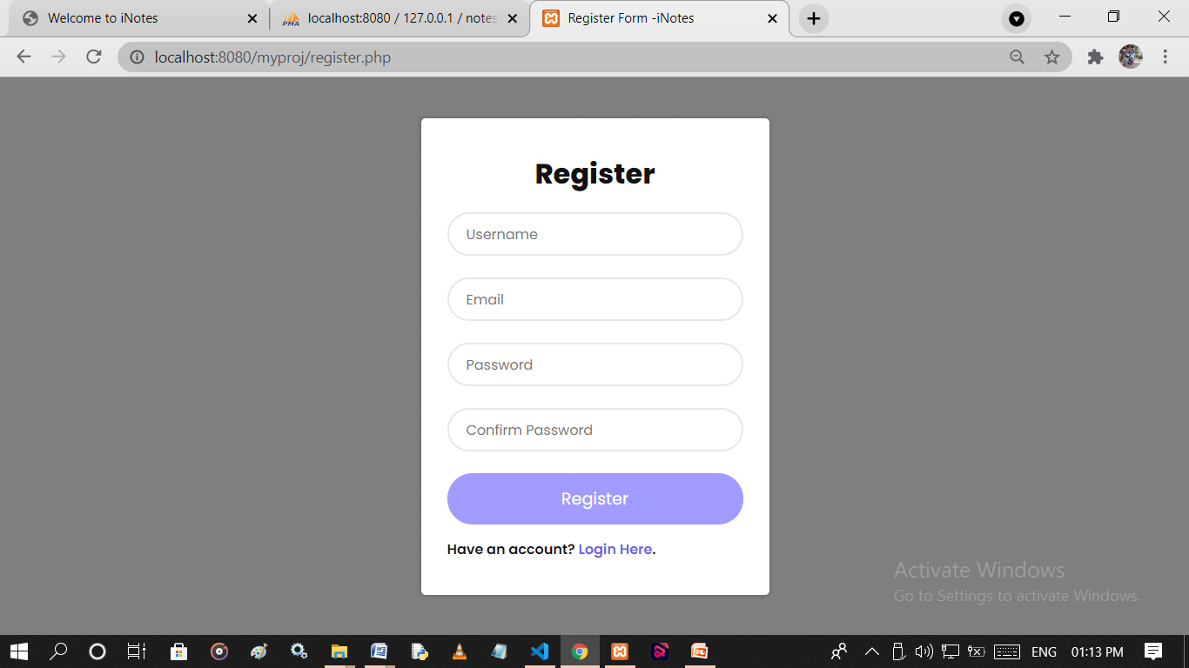
User Registration Page:

Slide 20
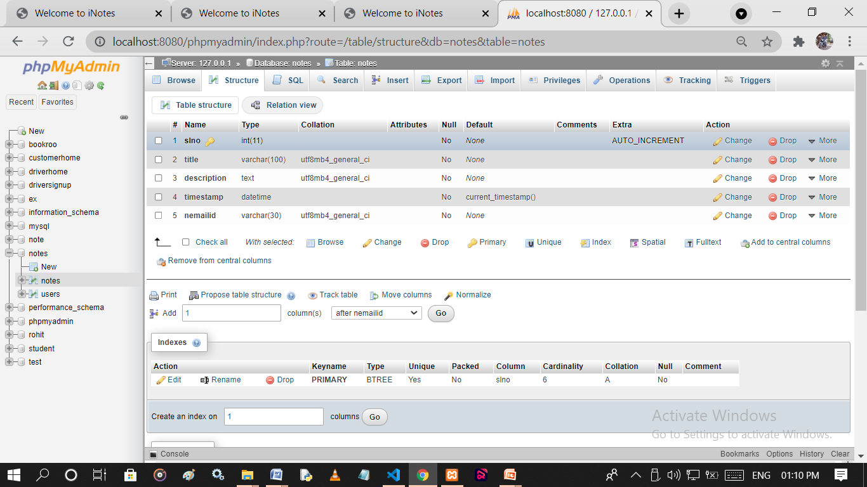
Notes DB:

Slide 21
Test Conducted of the USER module for login:
Test Case No | 1
Module | User
User Form | Login Form
Input | Enter E-mail and password Admin E-mail Admin Password Correct Correct
Excepted Result | Login Successfull
Test Result | Tested-Ok

Slide 22
Test Case No | 2
Module | User
User Form | Login Form
Input | Enter E-mail and password Admin E-mail Admin Password wrong Correct
Excepted Result | Email-id or password were wrong
Test Result | Tested-Ok
Test Case No | 2
Module | User
User Form | Login Form
Input | Enter E-mail and password Admin E-mail Admin Password Correct wrong
Excepted Result | Email-id or password were wrong
Test Result | Tested-Ok

Slide 23
System Requirements:
Software Requirement:
TOOLS:
Code Editors | Visual Studio Code
Output Software | Google Chrome Firefox
Server software | XAMPP
FRONTEND:
Layout Languages | HTML
Designing Languages | CSS
Browser Scripting Languages | Java Script

Slide 24
Backend:
Backend Database used for this project is MySQL and PHP. It is an open source relational database management system. It is combination of ‘My’ which is name of co-founder and the ‘SQL’ stands for the Structured Query Language.
Harware Requirement:
Processor : Intel CORE i3
RAM: 4GB
Space: 500GB and above
CPU
MONITER
MOUSE
KEYBOARD

Slide 25
Thank you

