Slide 1

PG DAI GROUP 4
Hindi Spam Mail Detection: Safeguarding Against Unwanted Communication.
Project title -
Project Guide - Dr. Krishnanjan Bhattacharjee
(Joint Director at Centre for Development of Advanced Computing )
Group members -
Dhanashri Kolekar (230340128010)
Sohan Gaikwad (230340128011)
Parth Sevak (230340128017)
Rushikesh Kumbhakarn (230340128021)
Samruddhi Ubhe (230340128028)

Slide 2
INTRODUCTION
To test a system capable of recognizing Hindi Email content.
To have better understanding of different classification algorithm.
To study identify spam detection using machine learning and deep learning algorithms as Spam fills inbox with number of ridiculous emails.
The number of spam emails is rapidly increasing in marketing, chain communications, stock market tips, politics, and education.

Slide 3
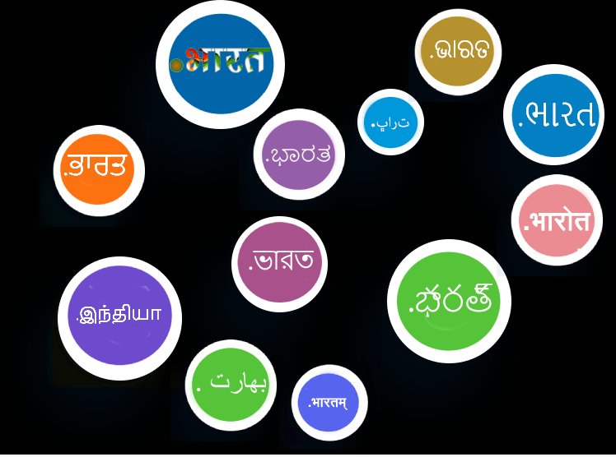
भाषानेट
एक बहुभाषी इंटरनेट और वैश्विक स्वीकार्यता पहल नागरिकों को भाषा की रुकावट के बिना डिजिटल माध्यम में आसानी से सूचना बनाने, संवाद करने, आदान-प्रदान करने, संसाधित करने और जानकारी प्राप्त करने में सक्षम बनाने के लिए एक पारिस्थितिकी तंत्र प्रदान करता है।
To provide a truly multilingual internet, where local language website name and local language email id, work everywhere seamlessly.

Slide 4
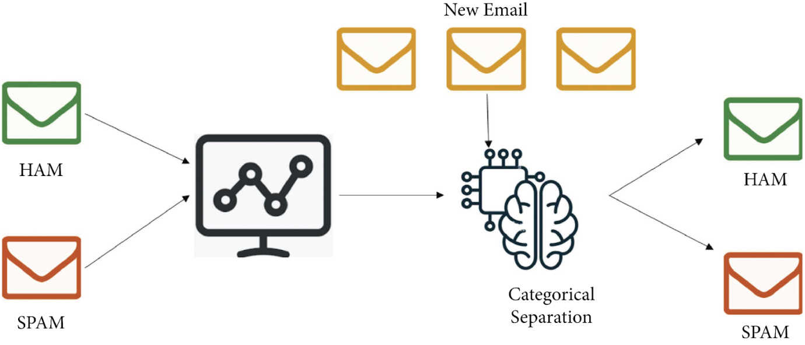
Methodology & Preprocessing Techniques
Import Dataset
Data Cleaning
Data Preprocessing
Tokenization
TF-IDF Vectorizer
Count Vectorizer

Slide 5
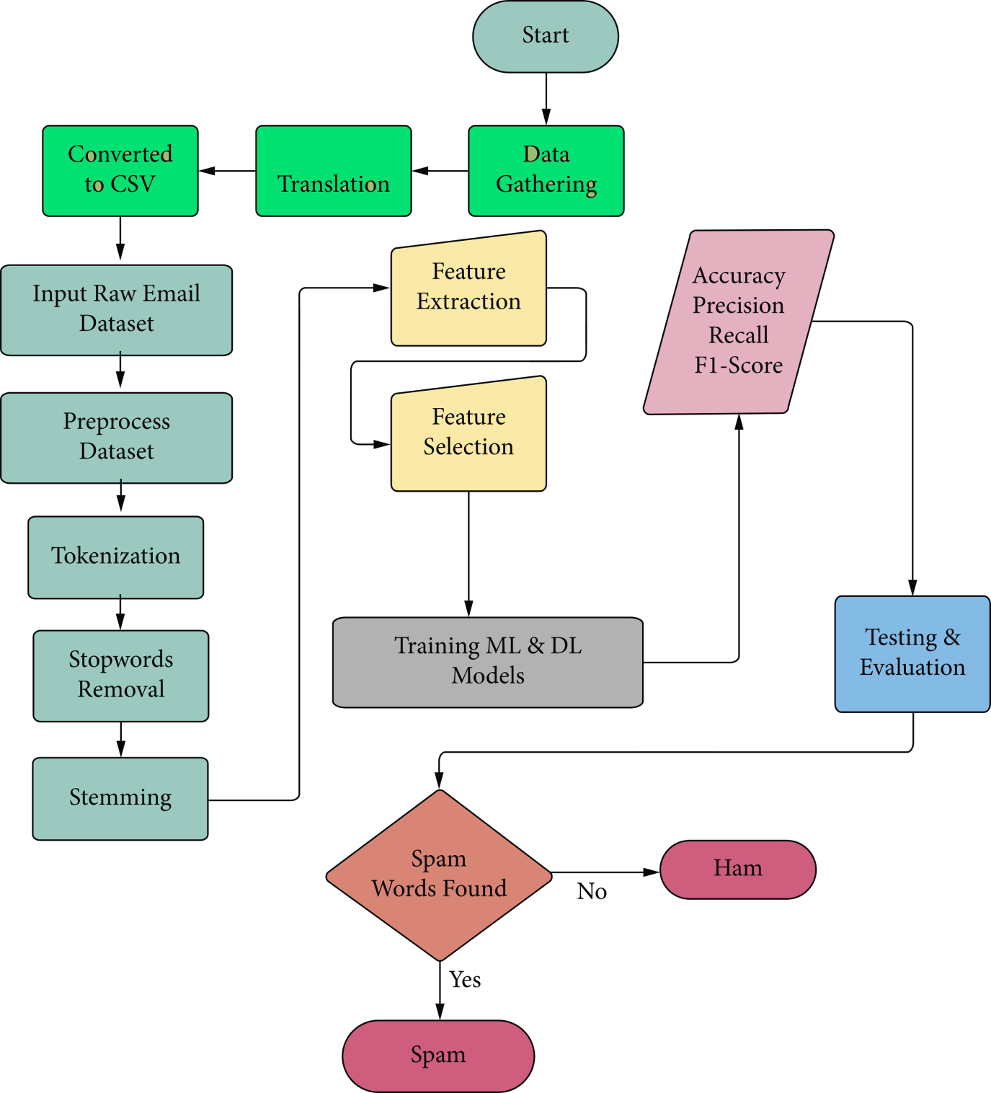
Flowchart
Preprocessing Diagram:
1. SMOTE
(Synthetic Minority Oversampling Technique)
2. ADASYN
(Adaptive Synthetic Sampling Approach)

Slide 6
Model Description
Model Building
Machine Learning
1. Support Vector Machine
2. Naive Bayes Algorithm
Transfer Learning
1. BERT (monsoon – nlp/hindi - bert)
Deep Learning
1. Recurrent Neural Networks (RNN)
2. Gated Recurrent Unit (GRU)
3. Long Short Term Memory (LSTM)

Slide 7
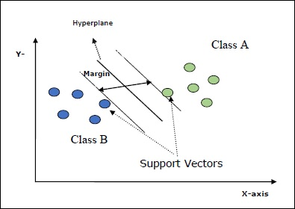
Support Vector Classifier
Support Vectors − They may be defined as the data-points which are closest to the hyperplane. Support vectors help in deciding the separating line.
Hyperplane − The decision plane or space that divides set of objects having different classes.
Margin − The gap between two lines on the closet data points of different classes is called margin.
Evaluation Parameters: Accuracy, Precision, F1-Score, Recall

Slide 8
Model Deployment using Streamlit
Open source python library.
Simplicity - It is used to convert data strips into interactive web applications.
Interactive Visualisations – It can be integrated with various popular data visualisation libraries like Matplotlib, plotly etc.
It supports Markdown, Dataframes and Charts.

Slide 9
Structure of Streamlit
Widgets – Buttons, text inputs, checkboxes, sliders, dropdown menus, images.
Markdown – used for text formatting
Dataframes – Streamlit can incorporate dataframes
St.write(), St.title(), st.buttons() – commands used to display content, titles and add buttons.

Slide 10
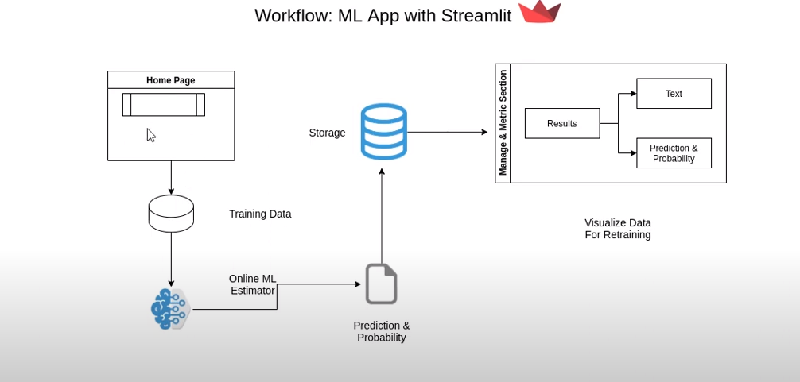
Workflow

Slide 11
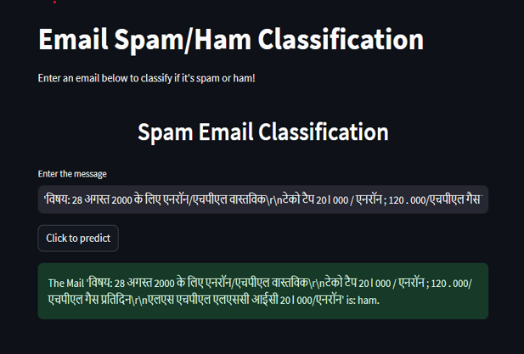

Slide 12
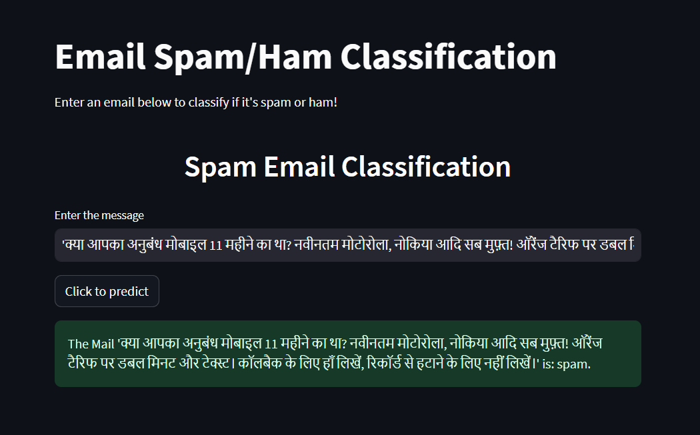

Slide 13
Future scope
Reduce the time of processing.
Extension for various Document Classification application.
Scope to integrate various contextual features.
Multi-category Classification.
Inbox Classification as well as Email Filteration.

Slide 14
Conclusion
In conclusion, the "Hindi Spam Mail Detection" project exemplifies the potential of advanced
technologies in safeguarding digital communication realms.
By empowering users to interact confidently and authentically online, the project pioneers a safer and more reliable digital experience for Hindi-speaking individuals.

Slide 15
Thank you!

