Slide 1
Heart Disease Diagnostic Analysis

Slide 2
Introduction
Heart disease, also known as cardiovascular disease (CVD), encompasses various conditions affecting the heart and blood vessels.
It is a leading cause of death globally, emphasizing the importance of awareness and prevention.

Slide 3
Details of Data
Age
Sex
Chest pain type (4 values)
Resting blood pressure
Serum cholestoral in mg/dl
Fasting blood sugar > 120 mg/dl
Resting electrocardiographic results (values 0,1,2)
Maximum heart rate achieved
Exercise induced angina
Oldpeak = ST depression induced by exercise relative to rest
The slope of the peak exercise ST segment
Number of major vessels (0-3) colored by flourosopy
thal: 0 = normal; 1 = fixed defect; 2 = reversable defect

Slide 4
Main KPIs
Cp-chest pain type (4 values)
Trestbps-resting blood pressure
Chol-serum cholestoral in mg/dl
Fbs-fasting blood sugar > 120 mg/dl
Restecg-resting electrocardiographic results (values 0,1,2)
Thalach-maximum heart rate achieved
Exang-exercise induced angina
Oldpeak-ST depression induced by exercise relative to rest
Ca-number of major vessels (0-3) colored by flourosopy

Slide 5
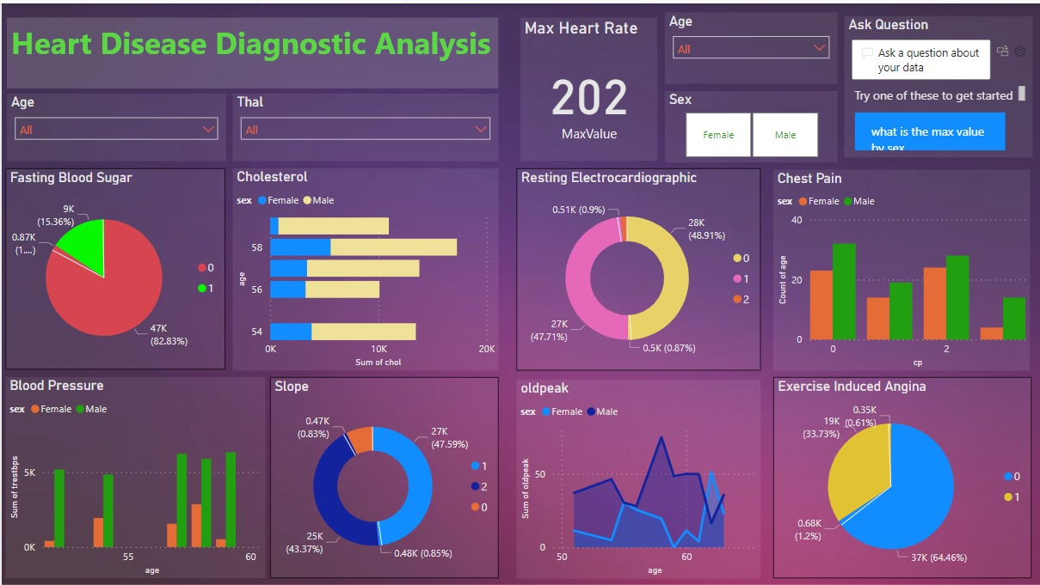
My Design

Slide 6
Thank you

