Slide 1


Smart Meet: Seamless Video Conferencing
Smart Meet is a next-generation, browser-based video calling platform designed for secure and efficient team collaboration. Powered by WebRTC, it facilitates real-time communication, addressing the evolving demands of the global video conferencing market, which reached $9.4 billion in 2023.

Slide 2



Introduction
Project Overview
Purpose
technologies Used
This is a browser-based real-time video meeting app.It allows users to connect using video, audio, screen sharing, and chat.
The goal is to create a simple, lightweight platform for virtual communication.Ideal for online meetings, remote learning, and quick team discussions.
Built with ReactJS (UI), WebRTC (media stream), and Socket.IO (signaling).Material UI is used for responsive and modern interface design.

Slide 3
Features
1
2
Real-time Chat
Dynamic Screen Sharing
Exchange instant messages seamlessly alongside your live video stream, keeping discussions organized.
Effortlessly share your entire desktop or specific applications for dynamic presentations and collaboration.
3
4
Meeting History
Toggle Camera, Mic, and End Call
Access a comprehensive history of past meetings, including details, links, and shared files, for easy reference.
Users can easily mute/unmute their mic, turn camera on/off, or end the call with a single click.

Slide 4
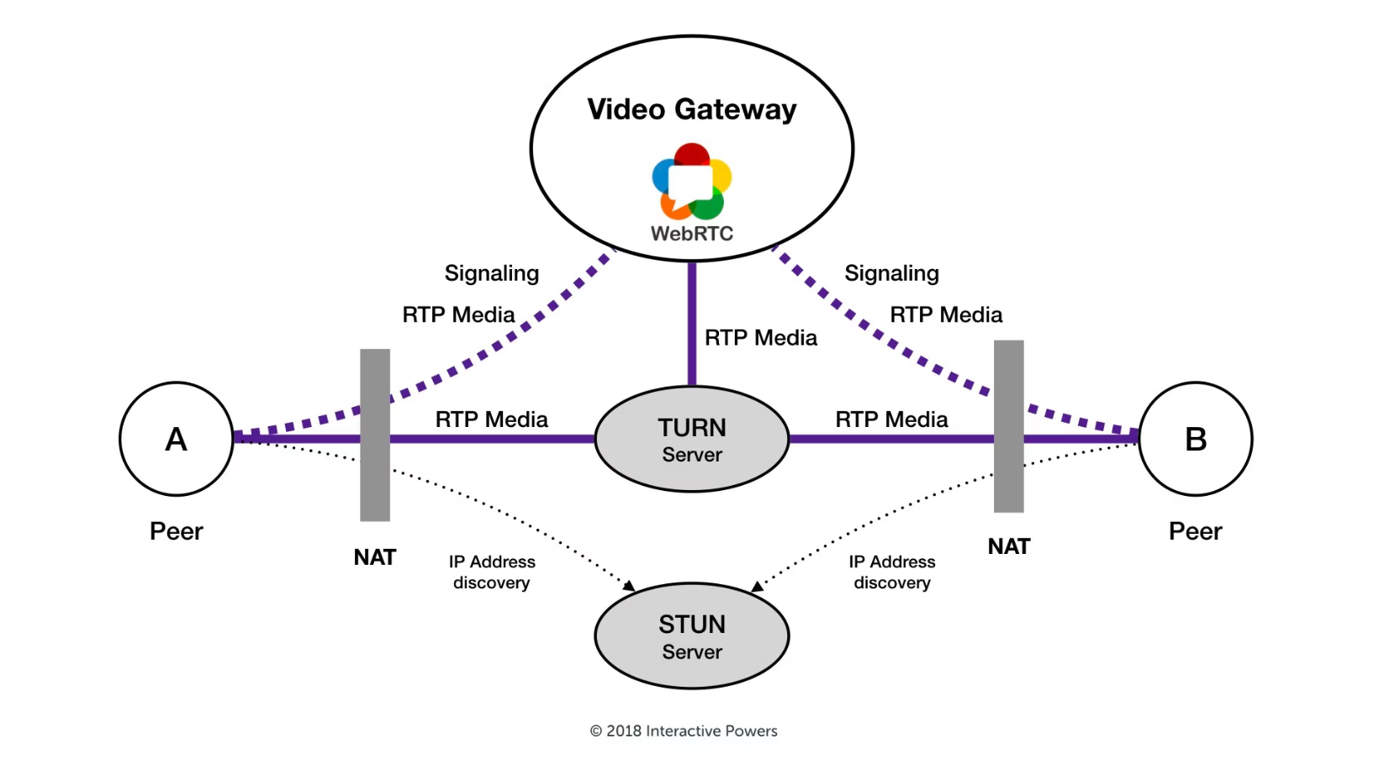
Why Web-rtc protocol is used ?
Peer-to-Peer Media Streaming: WebRTC enables direct video and audio streaming between users.This avoids server load and ensures smooth, real-time communication..
RTCPeerConnection Setup: Each user creates a RTCPeerConnection for managing media and connection.SDP offers, answers, and ICE candidates are shared via Socket.IO.
Dynamic Media Control : WebRTC allows adding/removing media tracks like video, audio, and screen.This lets users toggle mic, camera, or share screen during the call

Slide 5
The Working
This project is a real-time video meeting app built using React, WebRTC, and Socket.IO.It allows users to join a room, connect with others via peer-to-peer video/audio, and chat instantly.
01
02
03
Media Access and Initialization
Socket.IO Signaling and Peer Connection
Real-Time Features and UI Handling
The app first requests camera and microphone permissions from the user.If granted, it shows the local video stream and checks for screen sharing availability.This stream is prepared to be sent to peers via WebRTC.
When a user joins, a Socket.IO connection is created to handle signaling.WebRTC uses this to exchange offers, answers, and ICE candidates for peer-to-peer setup.Once connected, users stream their media directly without routing through the server.
Users can toggle mic/camera, share their screen, or send chat messages during the call.React state manages video/audio/screen toggles and incoming streams.Remote streams are displayed dynamically using refs and updated in real-time.

Slide 6




Future Innovations & Expansion
AI-Powered Insights
Deep fake detection
Implement intelligent features like AI-driven summaries, real-time transcription, and actionable meeting highlights for enhanced productivity.
An integration of deep fake detection ai model that
detectes any fake video feed is present in the call or not .
Immersive Experiences
Global Scalability
Introduce advanced virtual backgrounds, augmented reality filters, and spatial audio to create more engaging and personalized meeting environments.
Expand our robust infrastructure worldwide to ensure ultra-low latency and reliable connections for users in every corner of the globe.

Slide 7
Thank You
prepared by - Rushi Joshi
class - C5

