Slide 1

Smart Indoor Parking System

Slide 2
Team Name: The Tech Sense
Project Name: Smart Indoor Parking System
Group Number: 10
Student Names and IDs:
Kunal Dhiman (N01540952)
Raghav Sharma (N01537255)
NisargKumar Pareshbhai Joshi (N01545986)
Rushi Manojkumar Patel (N01539144)

Slide 3
Project Overview
App Purpose: Our smart parking app helps drivers find parking faster in busy city areas by guiding them to the nearest available spot. It improves vehicle security, saves time, and provides real-time alerts. This makes parking easier, reduces traffic, and helps cities manage parking better.
Key Features:
Real-Time Parking Spot Navigation
Personalized User Profiles
Parking History and Analytics
Real-Time Alerts and Notifications

Slide 4
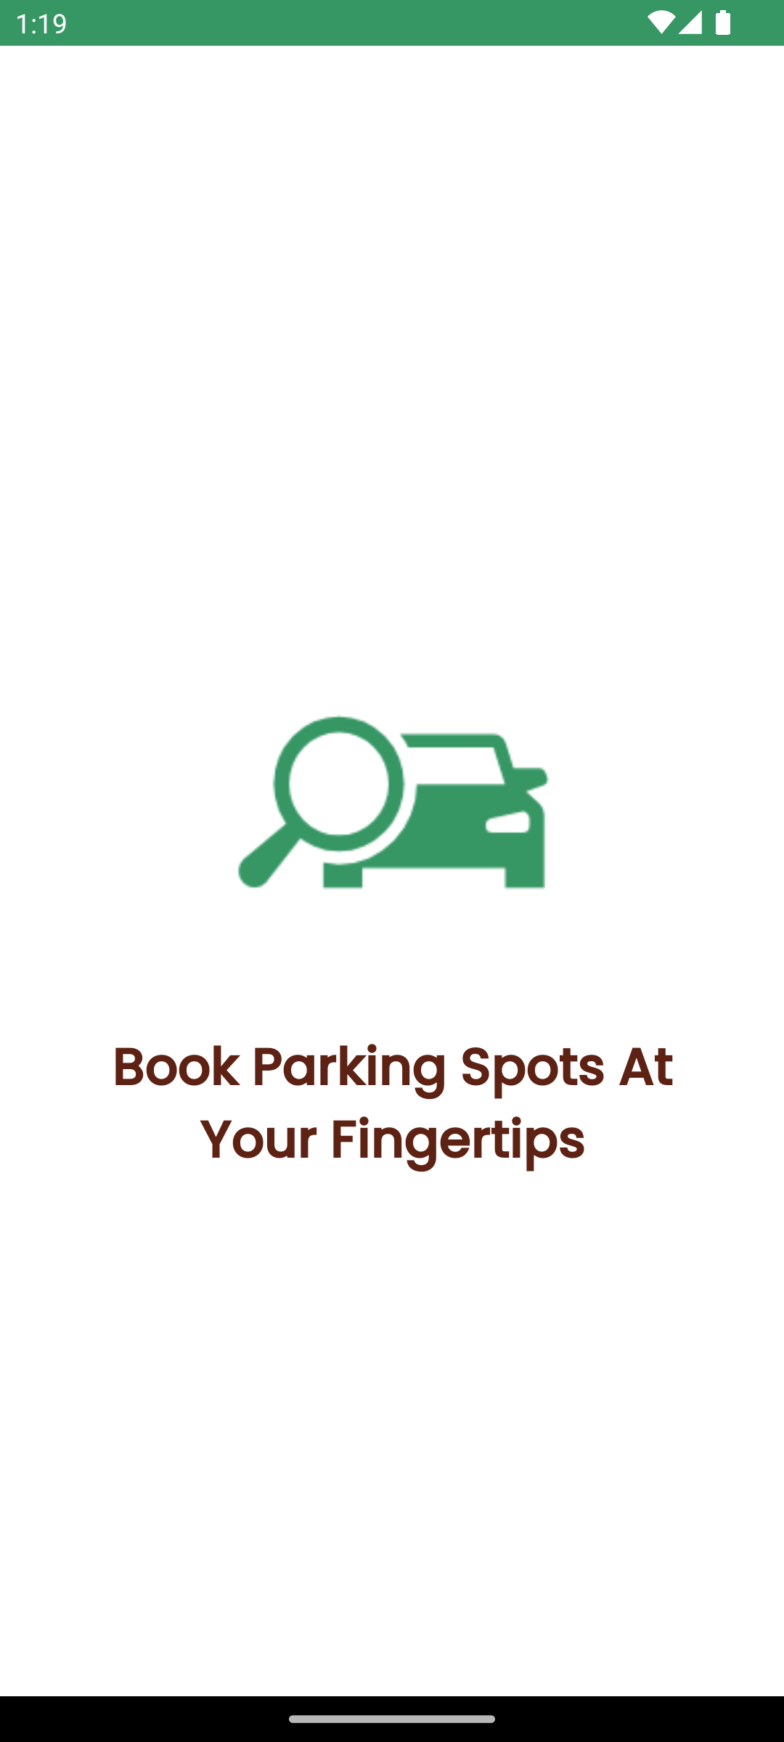
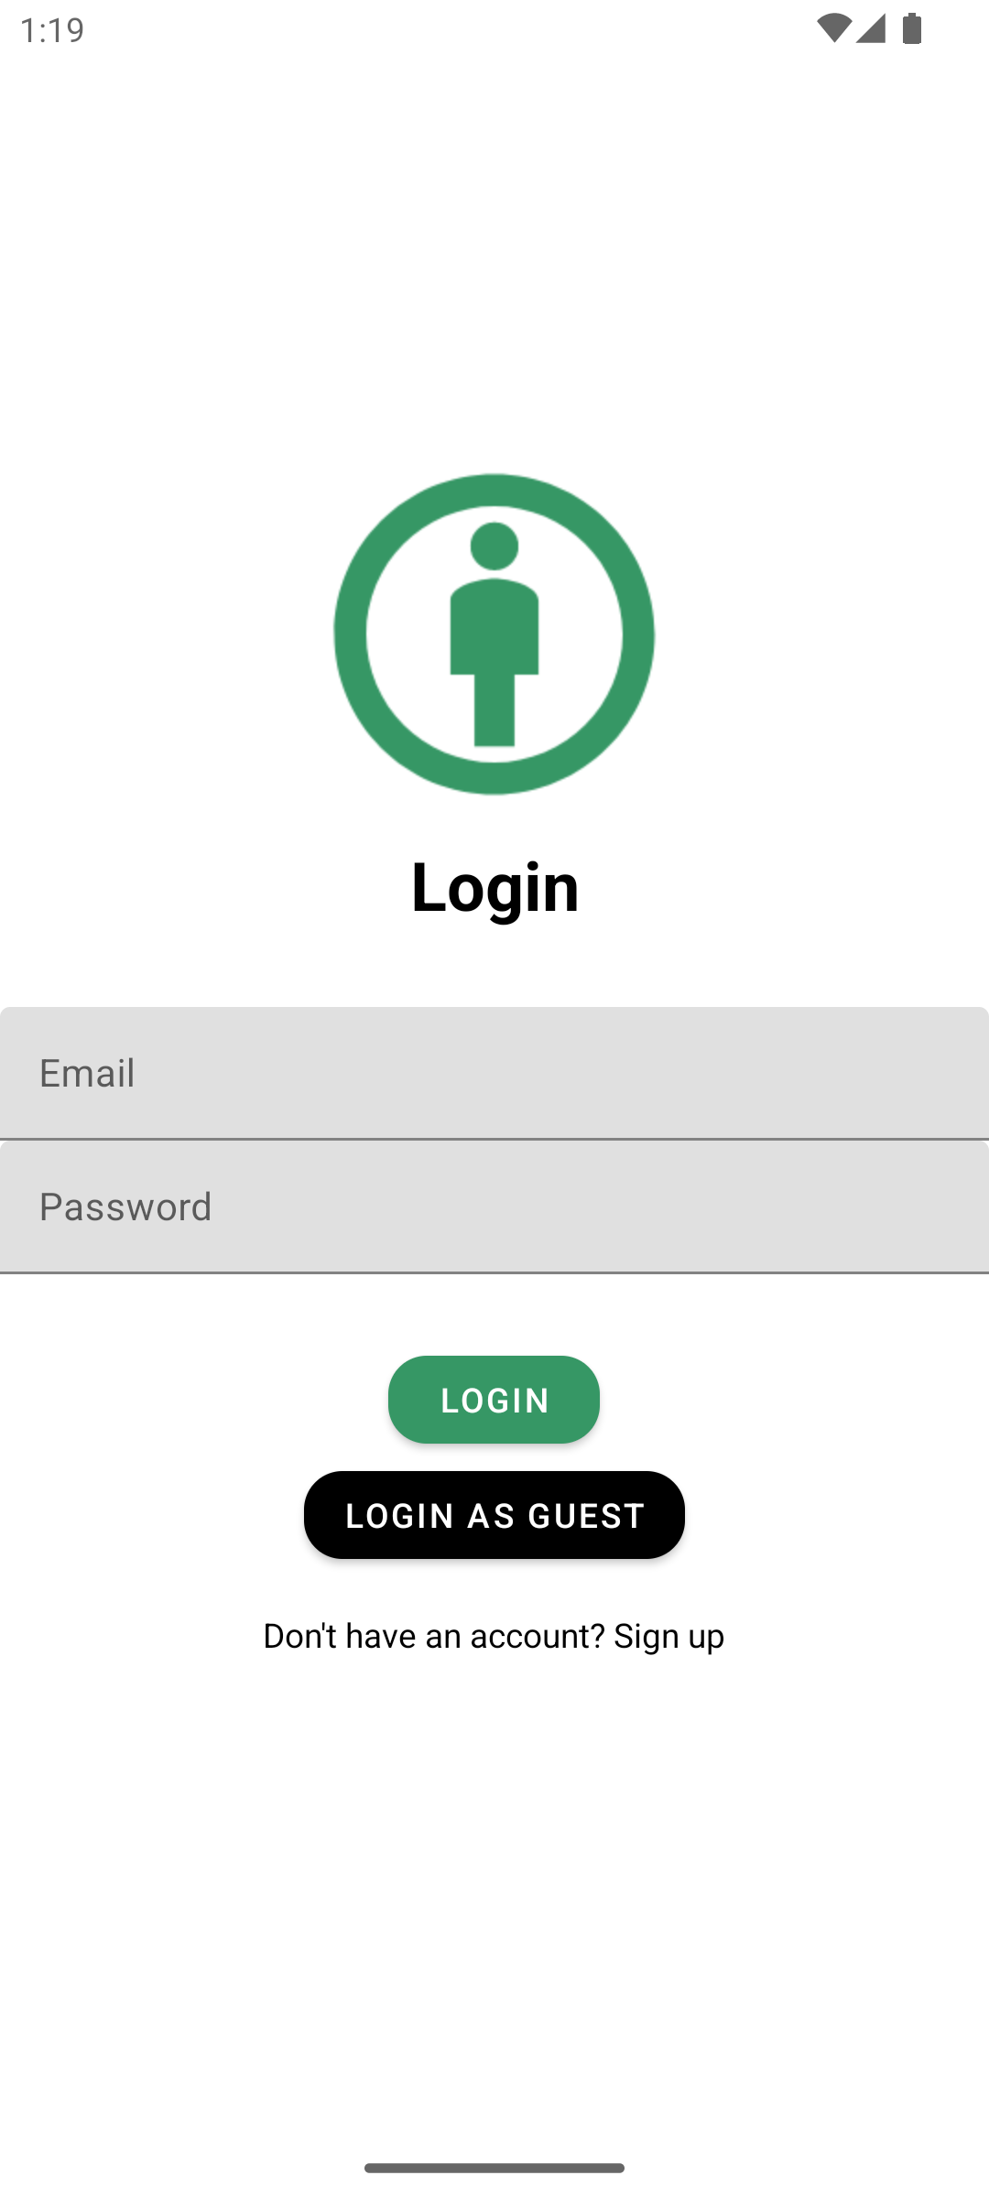
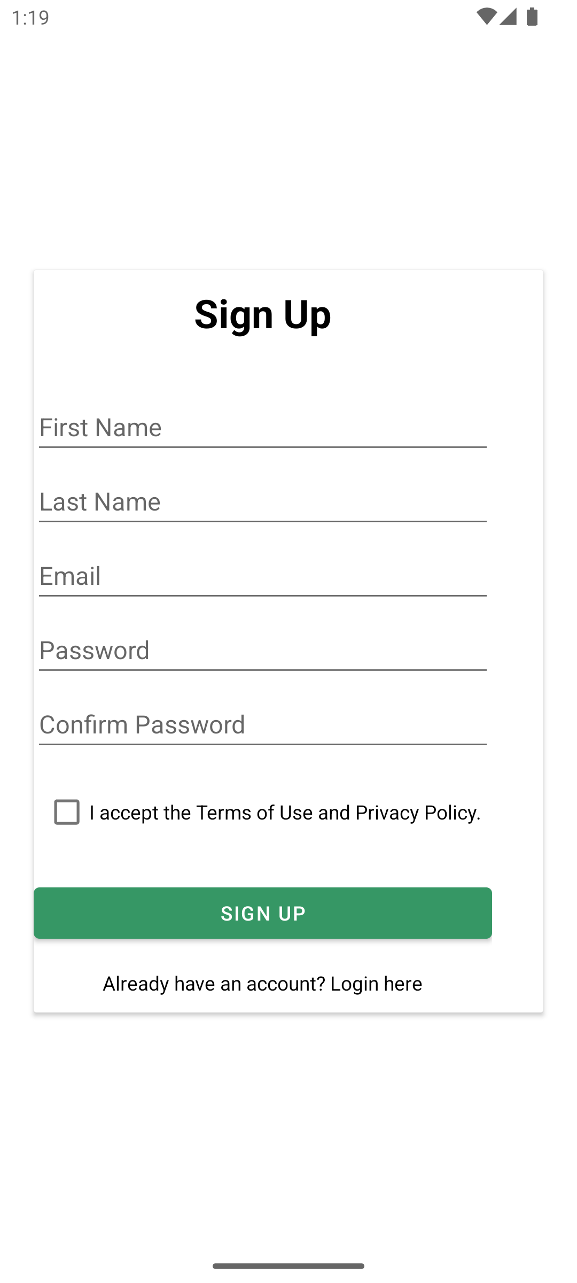
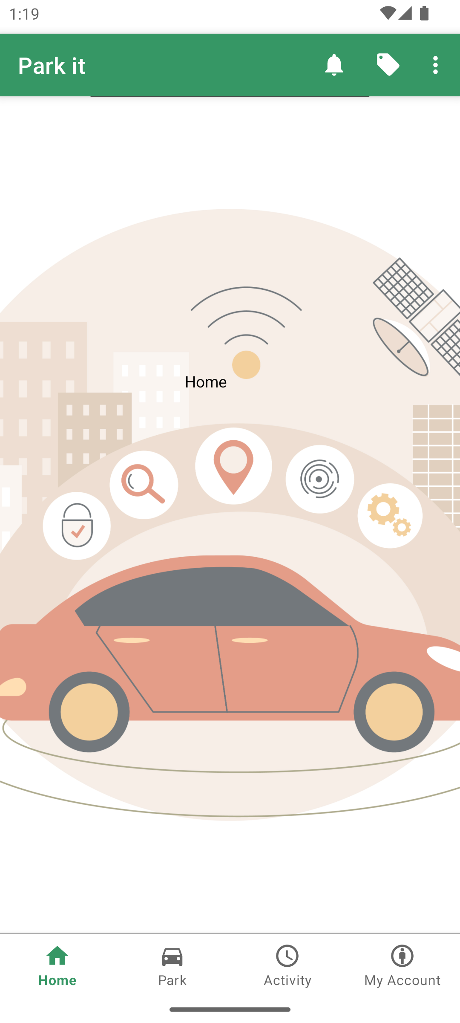
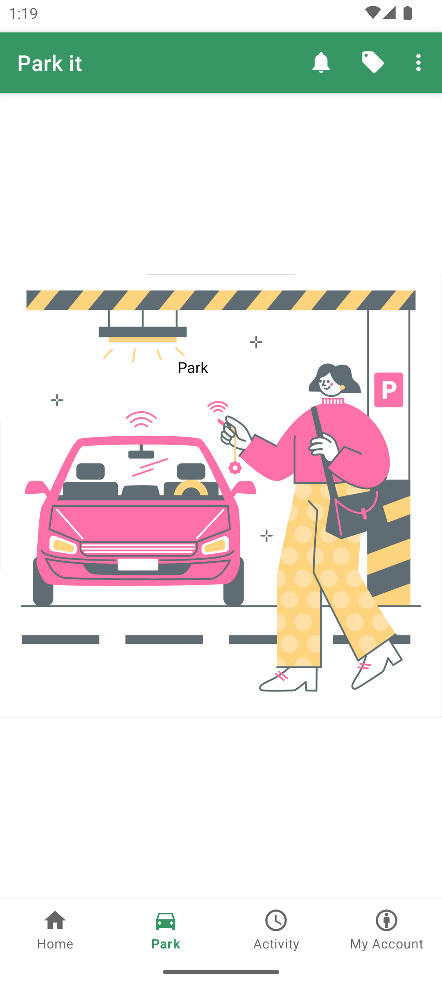
Demo of the App

Slide 5
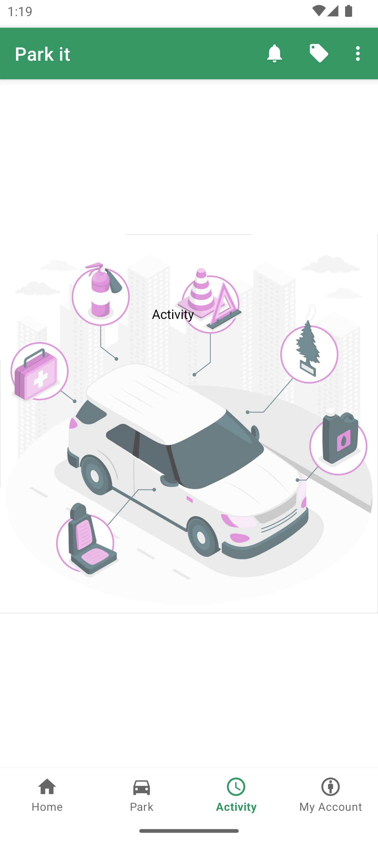
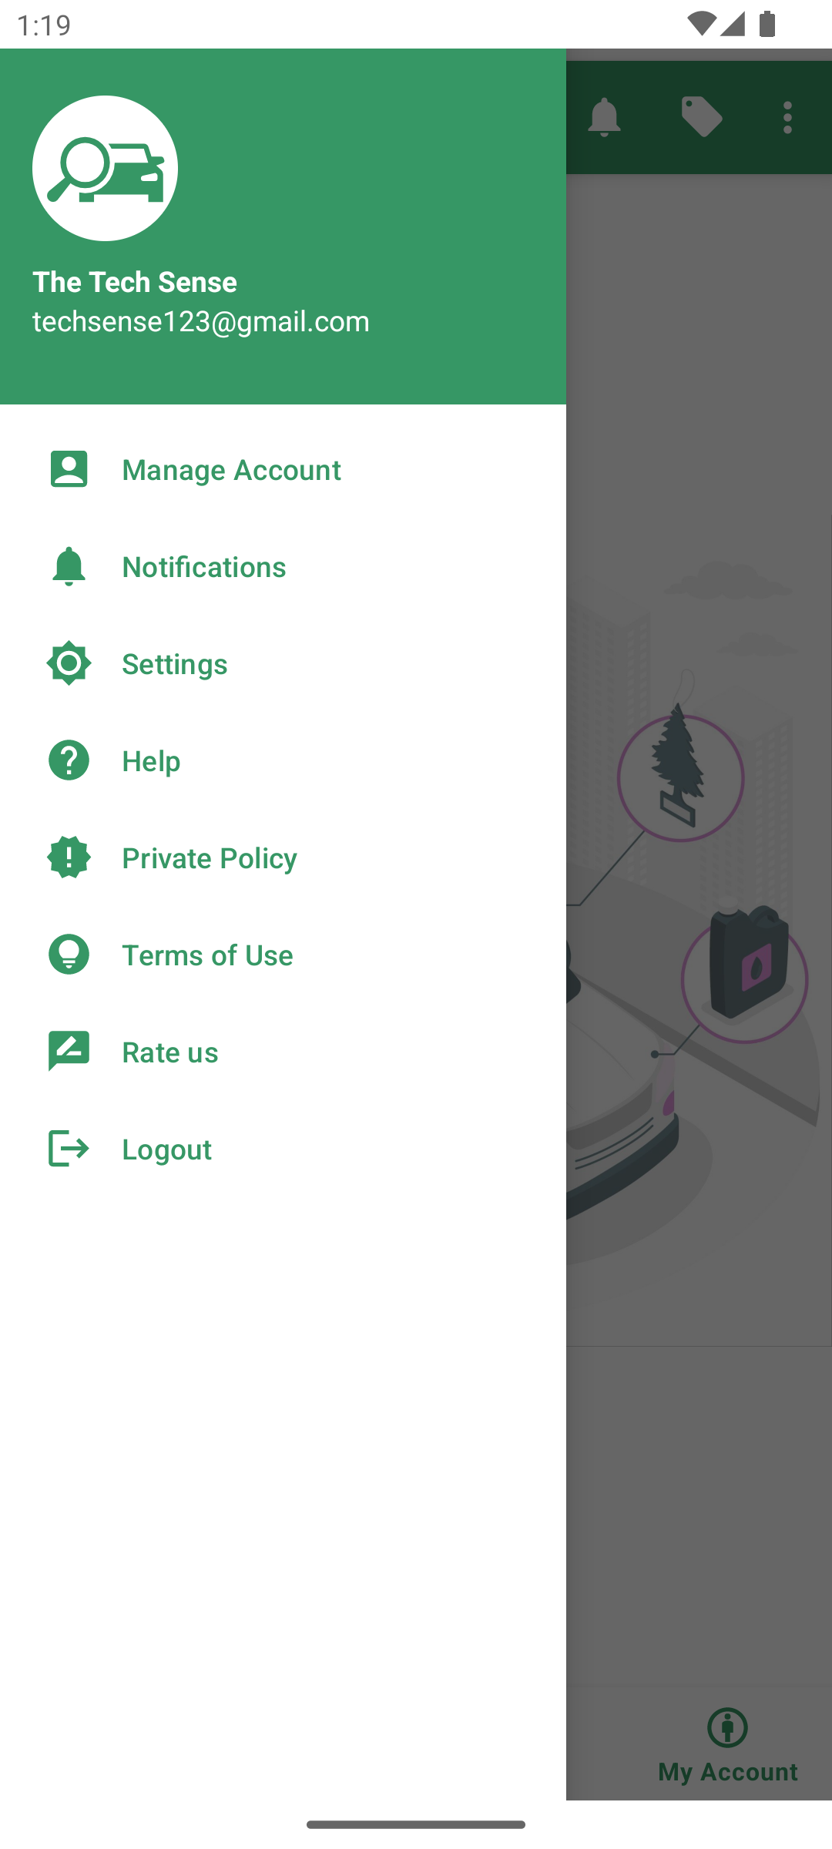
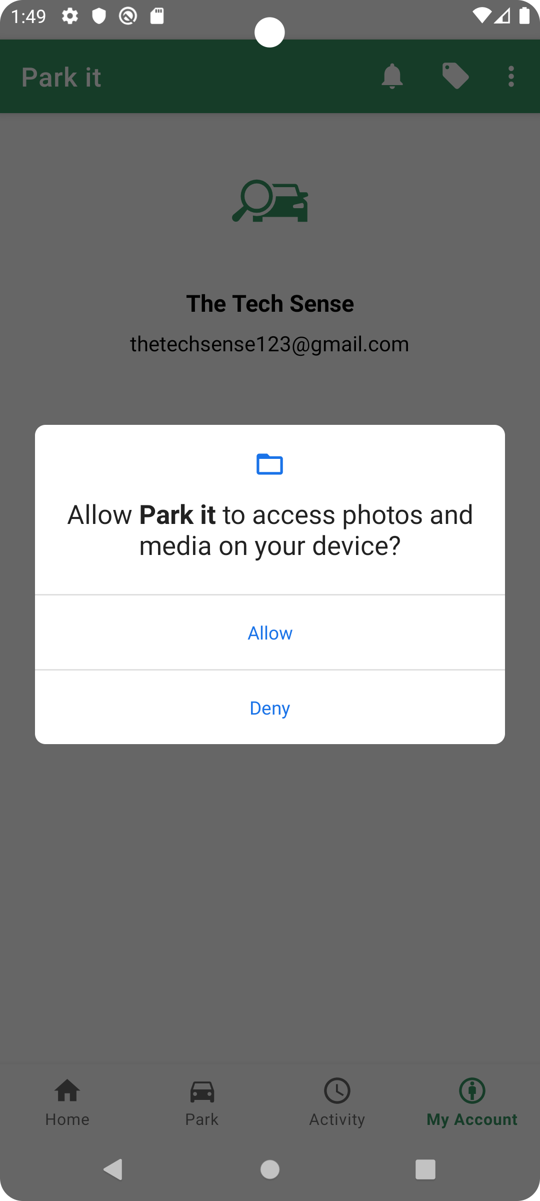
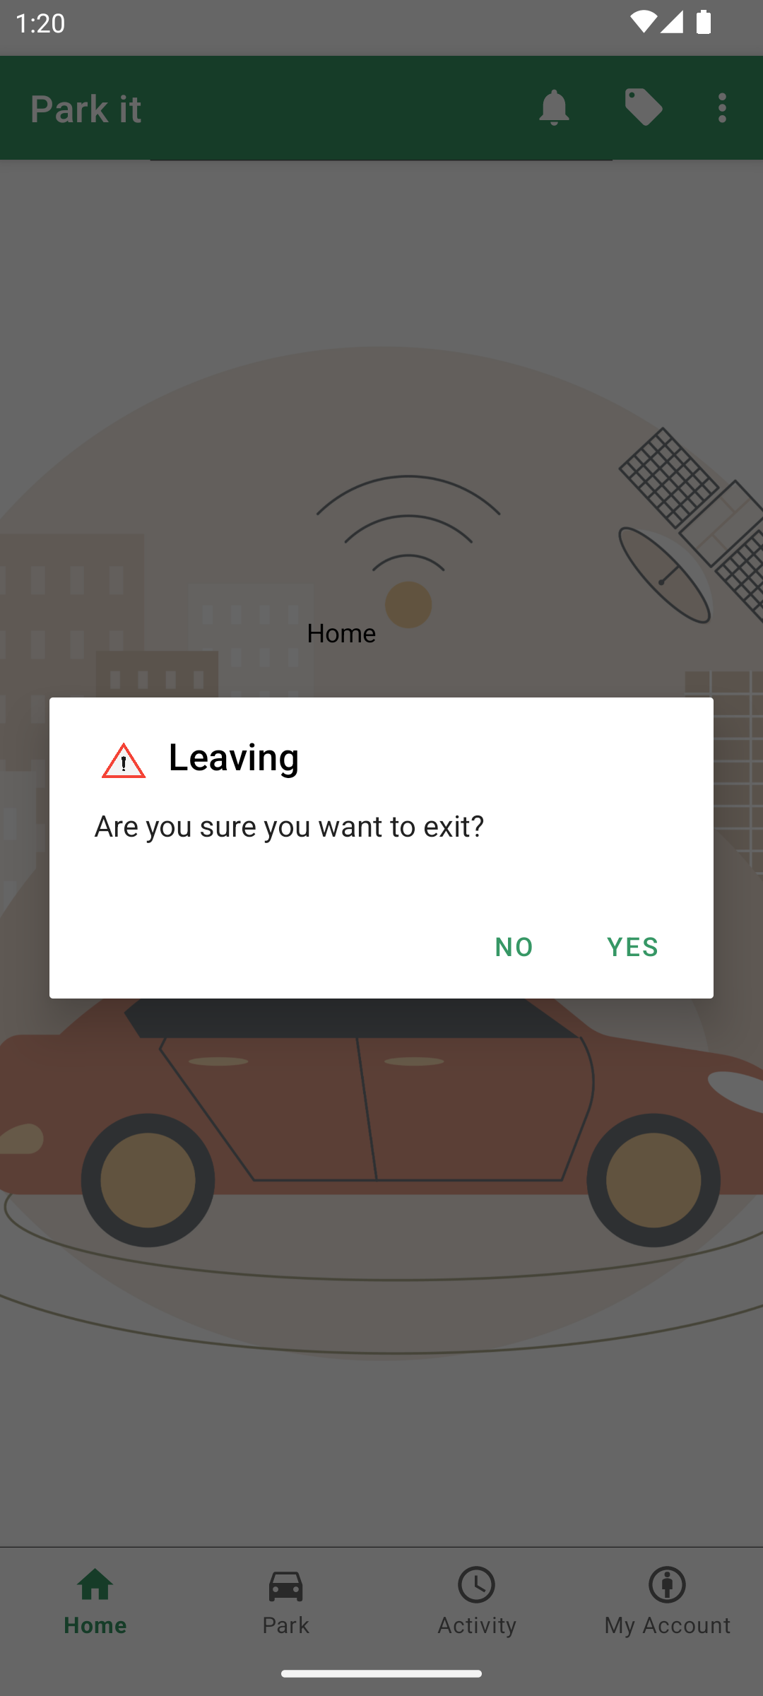

Slide 6
Screen Flow
If user logged in before
Splash Screen
If user not logged before
Log in
If already signed up
Home Screen
If not signed up
Pick Parking Location
Sign up
Pay and Reserve
Pick Parking Spot
Select Parking Duration

Slide 7
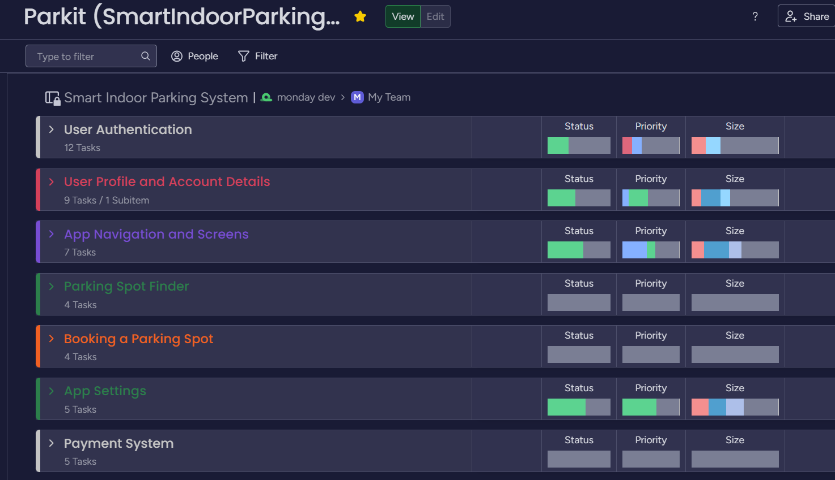
Sprint Dashboard

Slide 8
GitHub and How we used it.
Branches
Collaborators
Forks
Pull Requests
Project – KanBan
Vision - GitFlow Strategy

Slide 9
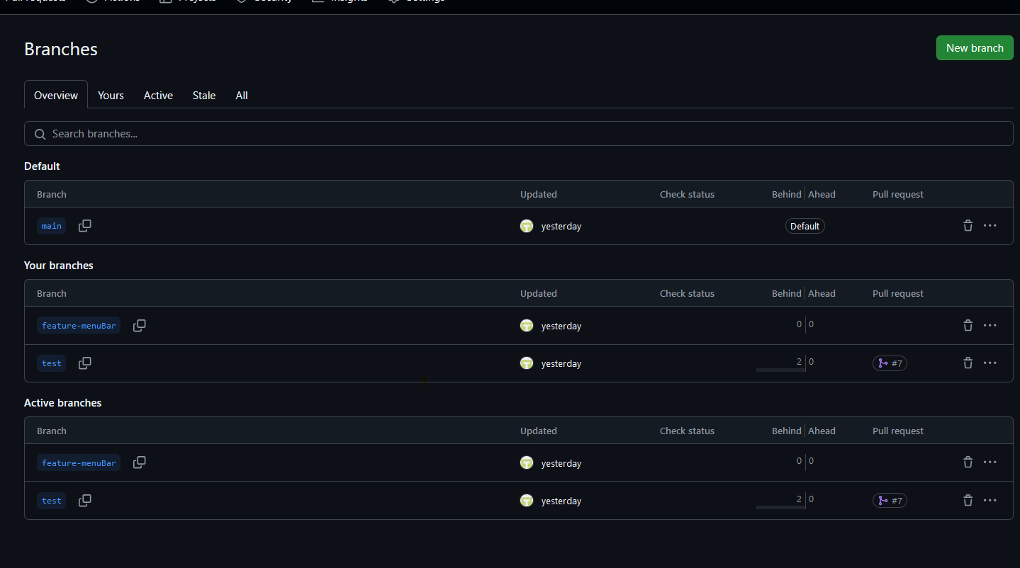
Branches – main ,test and feature.

Slide 10
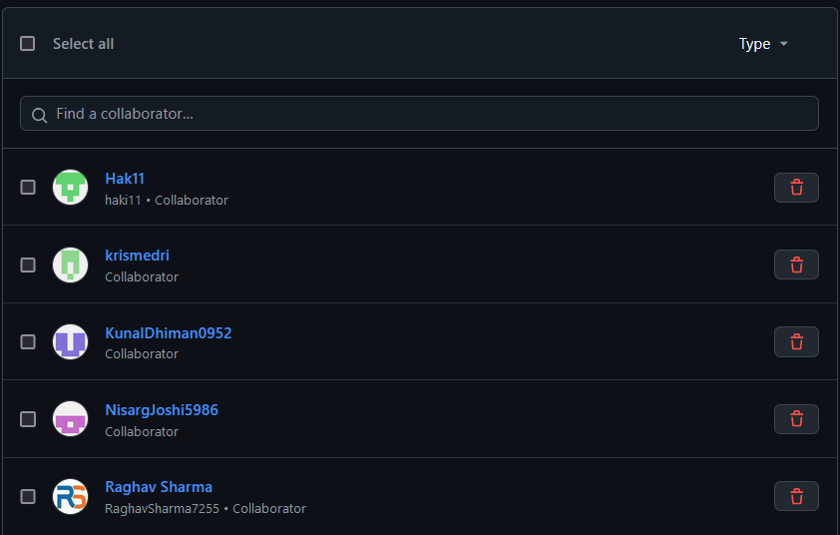
Collaborators

Slide 11
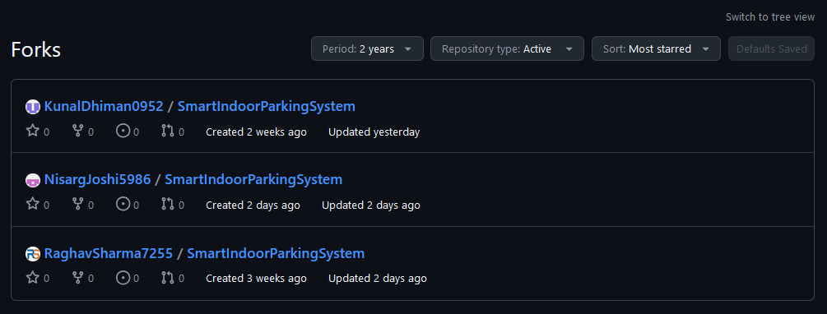
Forks
Each member has forked the repository and works in their respective fork to reduce problems

Slide 12
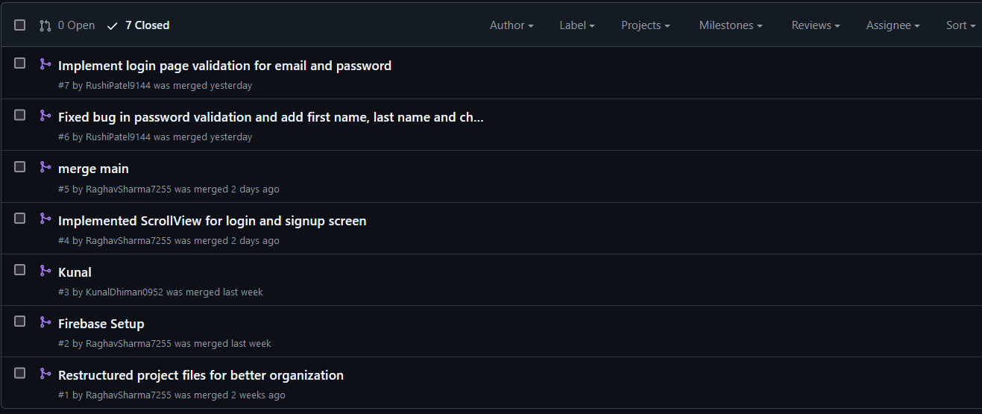
Pull requests
Primary use of PRs in our project is to update main branch with recent changes in test and feature branches

Slide 13
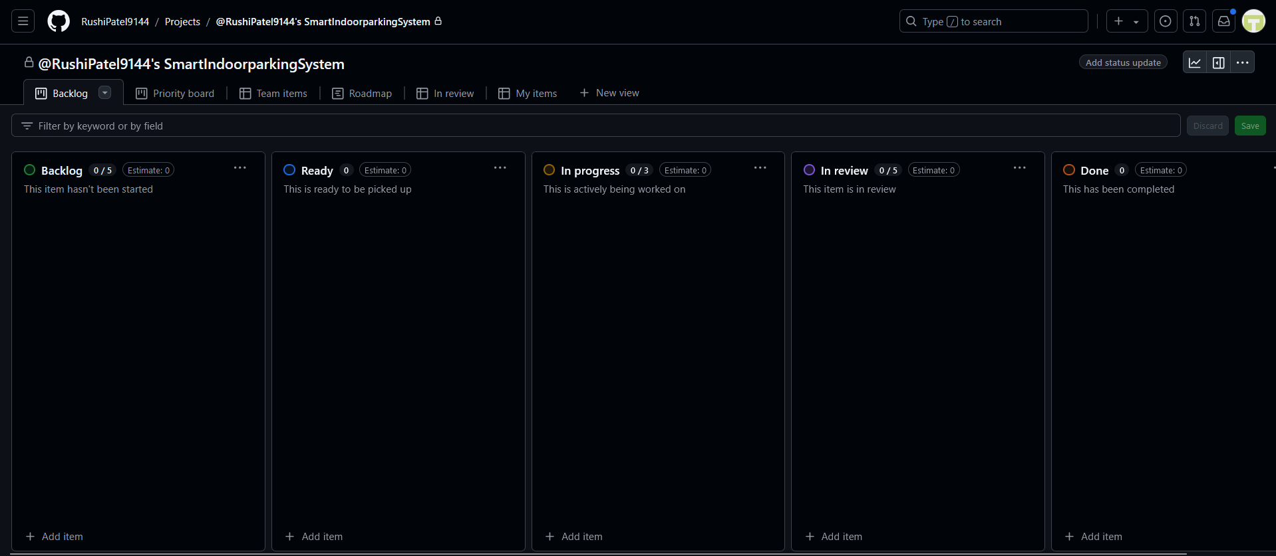
GitHub kanban integration
We have decided in recent sprint that going forward we'll also be using GitHub KanBan

Slide 14

GitFlow strategy
As we move forward with our production, we are trying to achieve a version control model like this with release branch and hotfix branch.
Reference: a-successful-git-branching-model
Github Flow

Slide 15
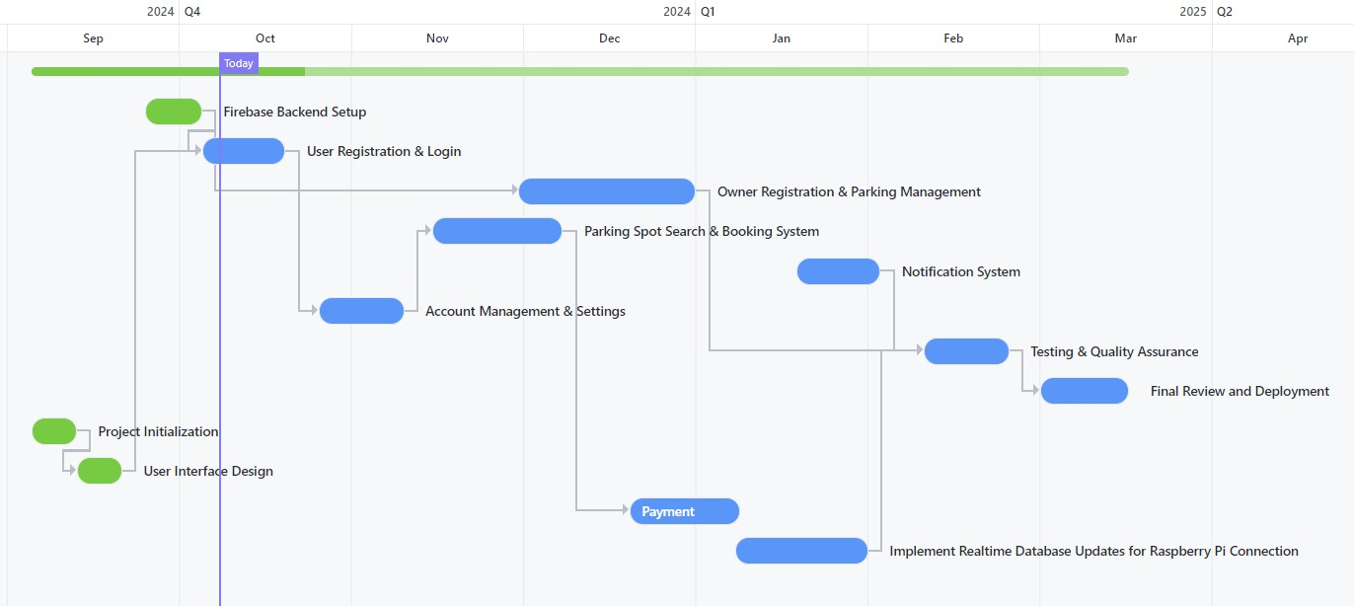
Gantt Chart

Slide 16








Business Model Canvas
Key Partners Parking Lot Owners Local Businesses Event Venues | Key Activities Real-Time Security Features Real-Time Security Features User Interface Development System Maintenance | Value Propositions Convenience Time Savings Enhanced Safety Real-Time Updates Flexible Payment Options Reservation Features |  | Customer Relationships Customer Support Feedback Mechanisms | Customer Segments Vehicle Owners Shopping Malls Airports Business Complexes
 | Key Resources Proprietary Hardware Network with Parking Lot Owners: Development Team |  |  | Channels Social Media Marketing Google Ads Partnerships with Venues
Cost Structure Development and Maintenance Marketing Expenses Database and Authentication Costs Staff Salaries Regular Expense |  |  | Revenue Streams Parking Fees Subscriptions Advertising Revenues EV Charging Fees

