Slide 1
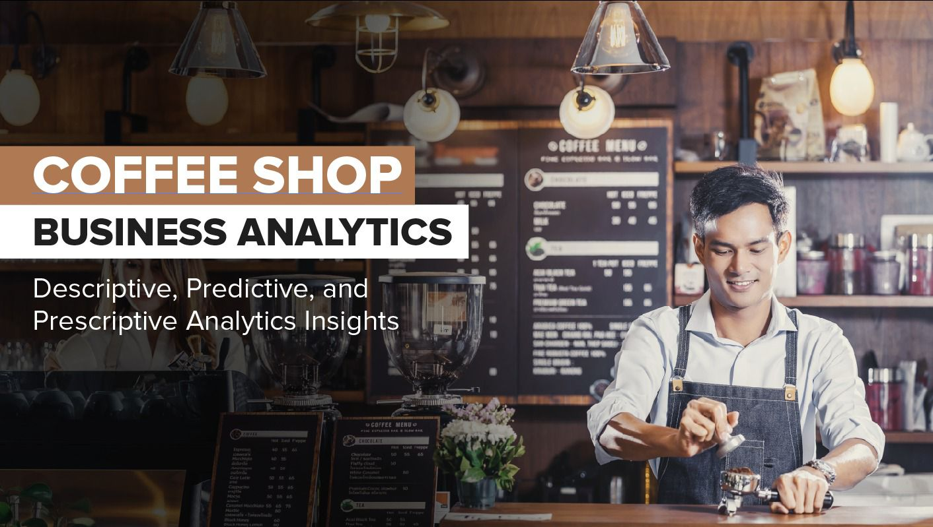
RUSHIAL MALHOTRA
23224739
Submitted on : 25th Oct 2024

Slide 2

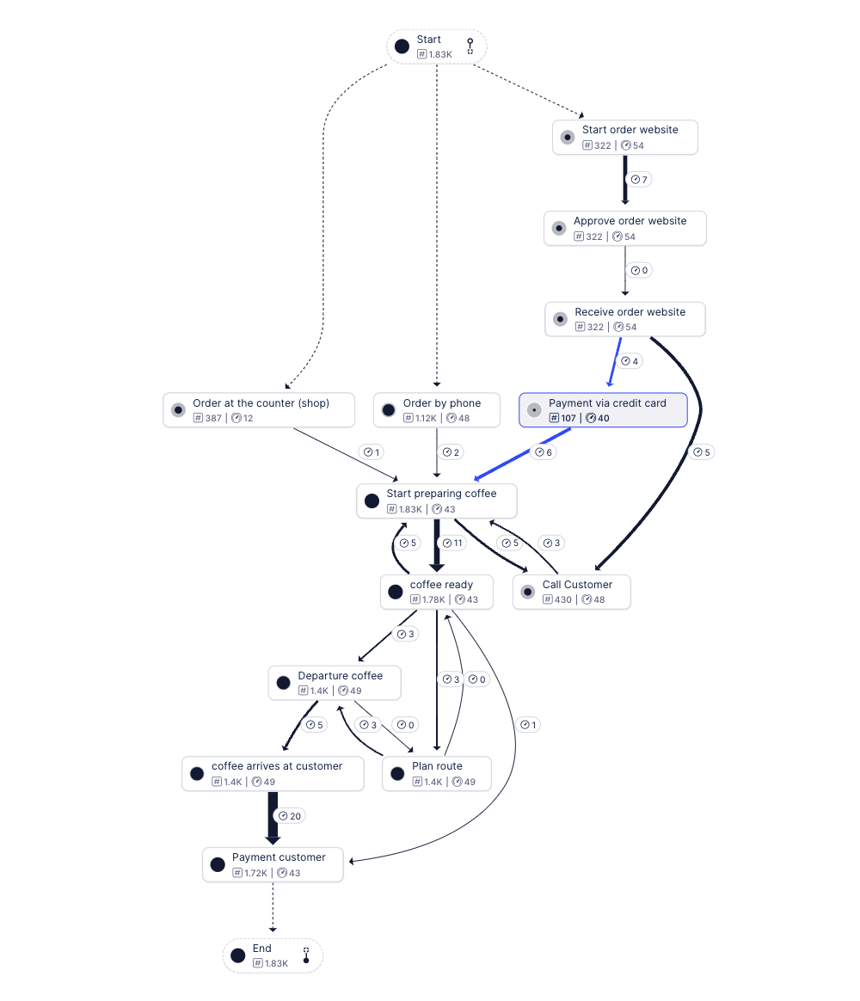
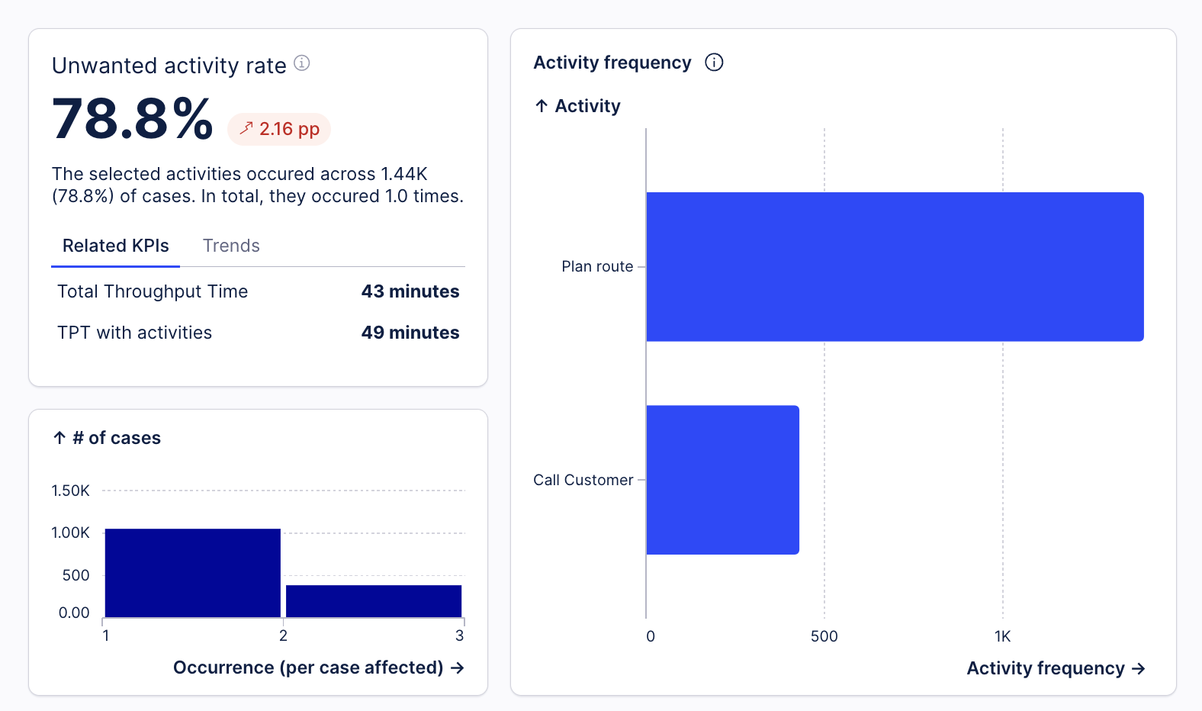

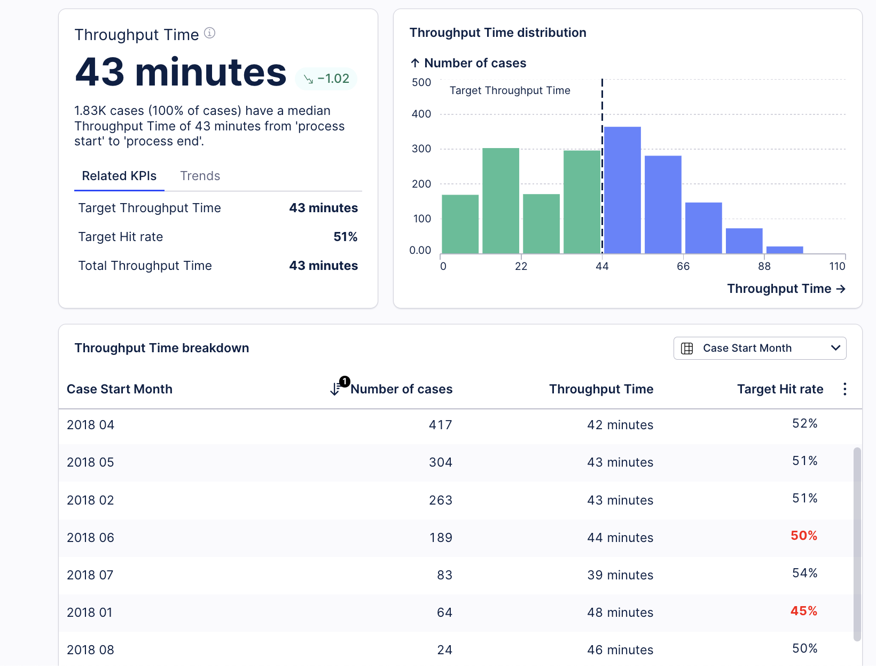
Process Flow - Current process insights
Median Throughput Time: The median time for all 1.83K cases is 43 minutes from start to end.
The cases are evenly spread around the target of 43 minutes with most cases taking between 22 to 66 minutes.
Key inefficiencies:
- Calling customers after coffee is ready.
- Manual route planning for deliveries.
78.8% of cases involve unwanted steps, increasing throughput time to 49 minutes due to time-consuming, unnecessary activities
April 2018: Highest number of cases (417) with 42 minutes throughput time and 52% hit rate.
July 2018: Lowest throughput time of 39 minutes with a 54% hit rate.
June 2018: Highest throughput time at 44 minutes, with a 50% hit rate.
April and May performed close to the target, but there is a need to improve the throughput time and target hit rate, especially in months like June and January (which have lower hit rates of 50% and 45%, respectively).
Bottlenecks
From preparation to coffee being ready, it takes 10 minutes, but delays occur afterward.
Hit rate is 51%, with only 45% in June, below target performance

Slide 3
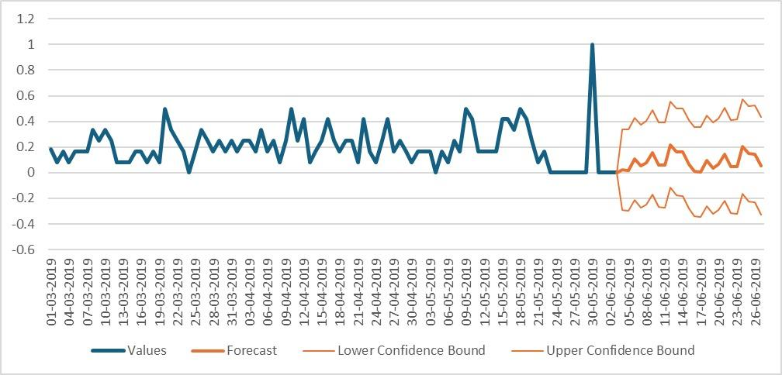
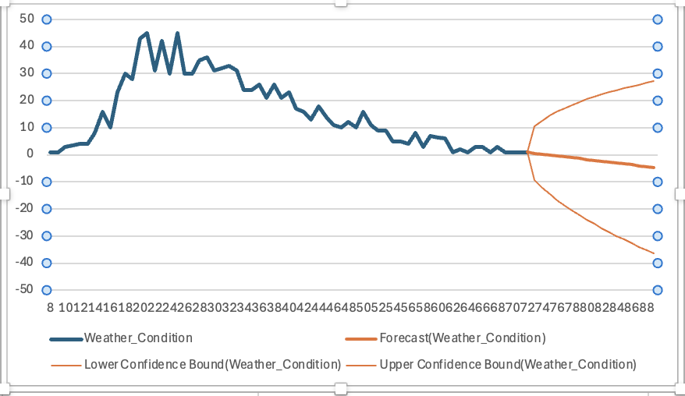
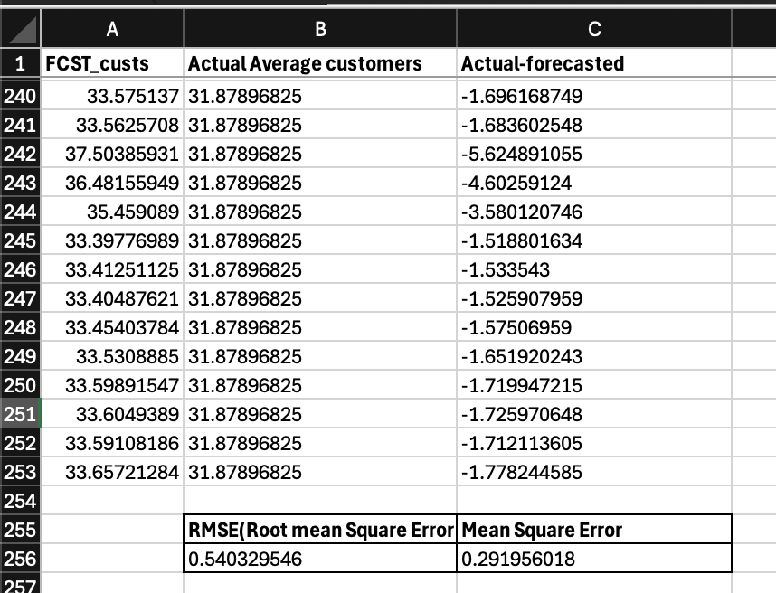
Predictive Analysis
12 weeks of historical customer order data from the coffee shop and created forecasts for the next three weeks to know how many customers to expect each hour helps in planning staff shifts, inventory, and overall preparation to meet demand.
Identifying busy and slow periods on basis of weather on the day:
Busy Days : Sharp upward trends in the forecasted data (spikes).
Slow Days: Sharp downward trends in the forecasted data (spikes).
Prediction : Foot traffic increases on sunny days as customers are more willing to travel, while it decreases during rainy weather
Confidence intervals: The shaded area around the forecast(two orange lines above and below) showing max and min deviation possible in forecasted values.
Identifying busy and slow periods on basis of hour of the day:
Busy Days : Sharp upward trends in the forecasted data (spikes).
Slow Days: Sharp downward trends in the forecasted data (spikes).
Prediction : Foot traffic is at peak at around 7-8am, and becomes relatively low post the rush hours from 10am-1pm
Confidence intervals: The shaded area around the forecast(two orange lines above and below) showing max and min deviation possible in forecasted values.
Business Implications
Operational efficiency: By identifying high and low customer periods, you can staff appropriately, reducing overstaffing or understaffing.
Inventory management: Plan stock based on expected demand to reduce waste or shortages.
Improved customer experience: With better preparation, service can be faster and more efficient during peak hours.
An RMSE of 0.54 means our forecast is quite accurate, with only a small error margin difference of 0.54 customers per day. Keeping this in mind you can confidently plan staff and inventory, knowing the predictions are close to reality

Slide 4
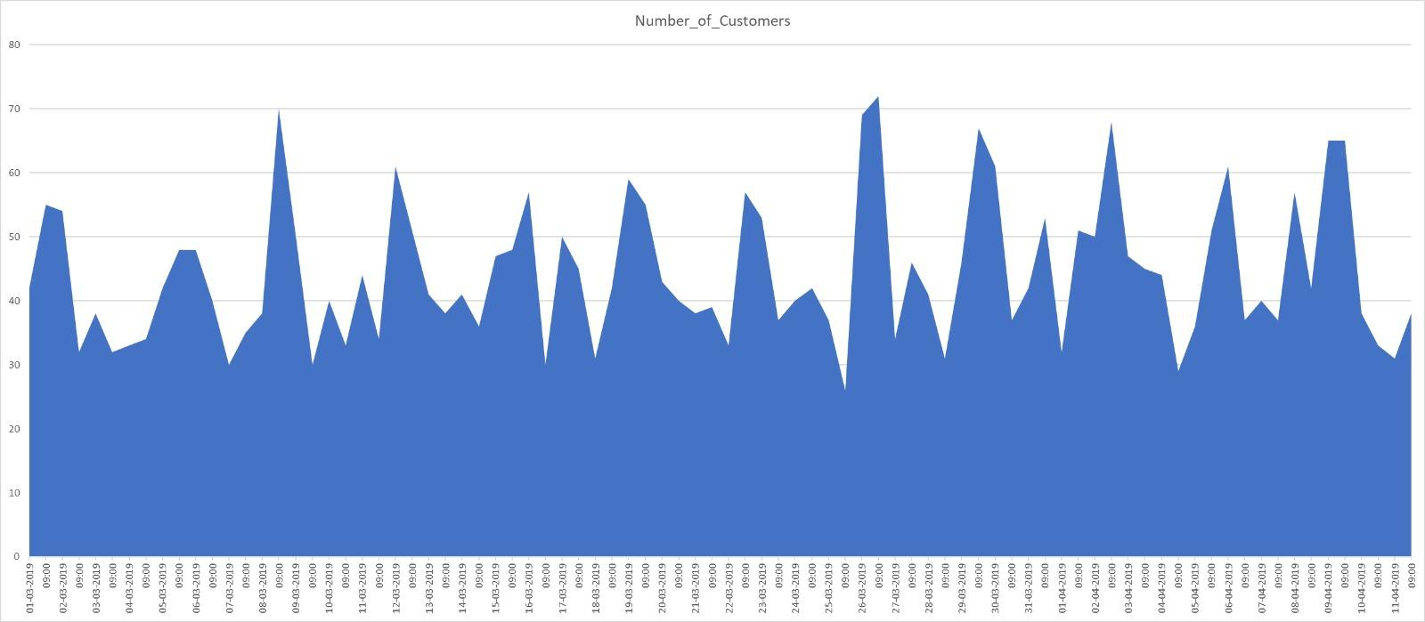
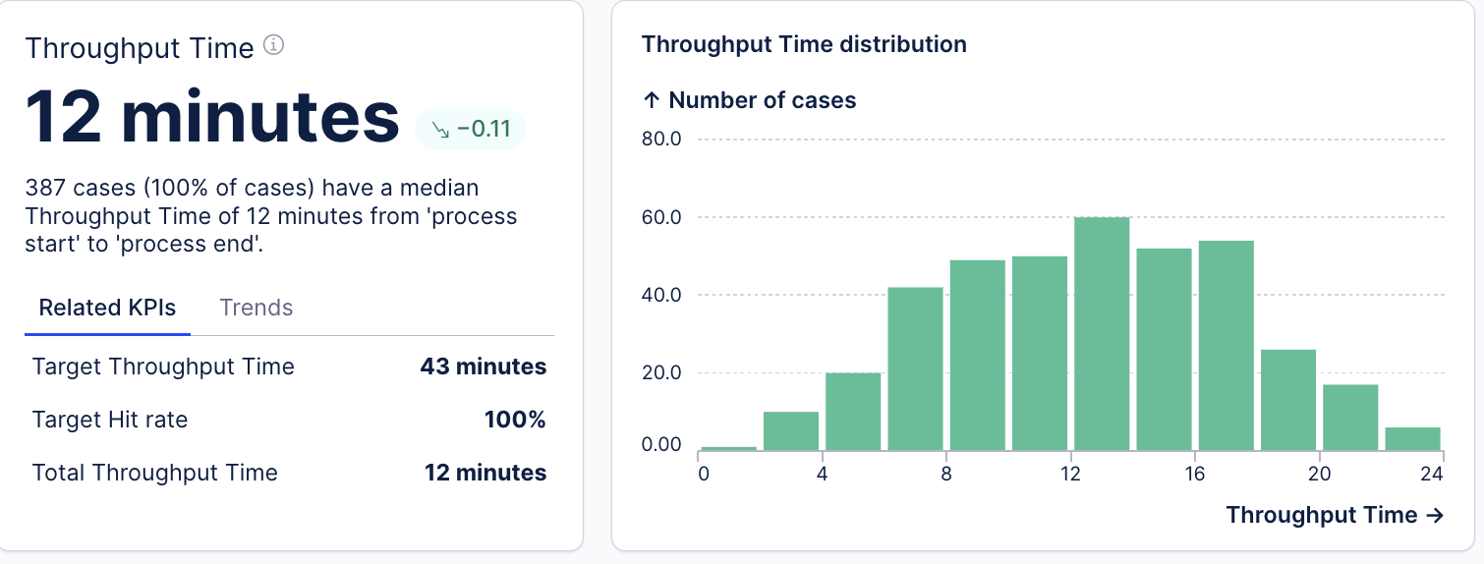
Prescriptive Analysis
Optimising our courier requirement: Will be needing only 6 couriers from 7am-10am as more customers are coming in store.From 10am-18:00 pm we will need more couriers and less in-store staff with needing minimum 10 couriers to fulfil the demand. Further the couriers can be made more efficient by : Using tech like maps for automatically calculating the most optimal and fastest route for delivery.
Rather than hiring couriers throughout the day, hire them by the hour as per the provided calculational requirement.
Couriers can carry pamphlets aboud offers for customers to increase the loyalty factor and chances of reordering.
Objective: Minimize the total daily courier cost, given each courier charges €15 per hour.
Constraints:
Couriers cover a maximum of 25 miles per hour.
Total delivery distance required each hour must be met.
A maximum of 10 couriers per hour.
Decision Variable: Number of couriers needed per hour.
Max distance couriers can cover per hour: 250 miles (10 couriers * 25 miles per courier).
Optimized total couriers needed: 116 couriers (total across all hours)(Min)
Optimized cost: €1,740 (total cost across all hours)(Min)
New throughput time will reduce by 12 minutes increasing our target hit rate to 100%

Slide 5
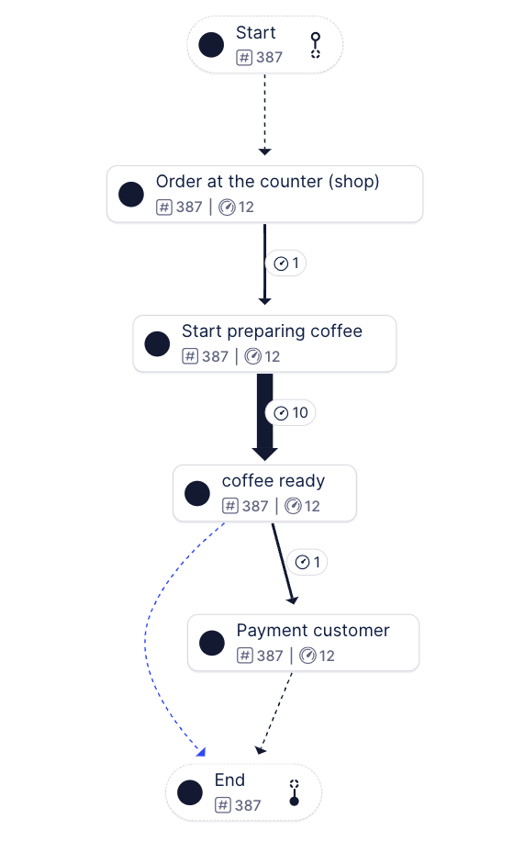
Summary
Putting Descriptive, Predictive and Prescriptive Analysis to use
Descriptive | Predictive | Prescriptive
Historical data shows that the coffee shop experiences fluctuations in customer orders depending on the time of day and external factors like weather. | Based on 12 weeks of historical data, forecasts for the next three weeks predict customer footfall patterns. | By optimizing courier routes and staffing, the model suggests reducing delivery times and operational costs.
Key inefficiencies were identified, including manual processes and delays, with a focus on improving throughput times and hit rates. | Trends highlight peak and slow hours (e.g., 7-8 AM), allowing for better planning of staff and inventory.The forecast model includes a RMSE of 0.540 | Specific strategies include adjusting courier numbers per hour, using technology to plan routes, and implementing targeted promotions to increase customer retention during low-traffic periods.
Business Recommendations
Focus on Peak Days: The data reveals that the in-store customer’s peak at 7-8am on a sunny day so we can capitalize on these high-demand days by running promotions or events to maximize sales when footfall is highest."
Customer Retention: During slow hours including 10am-1pm, we can focus on grouping of orders to minimise cost of delivery by optimising the process and further increasing demand by effective marketing through pamphlet distribution through couriers, offers and delivery coupons to maintain at home client base
Operational efficiency:: Further we can optimise the delay between the coffee preparation and coffee ready stage by training staff better or adding equipment.
Ideal flow without bottlenecks

Slide 6


