Slide 1
Exact Space
Abnormal Periods of Cyclone Preheater
Created by:
Rushik Patel

Slide 2
Data Preparation
After importing dataset, two major steps were taken for data preparation.
Datatype Conversion
All features except time were incorrectly classified. Therefore converted all the features to numeric datatype using to_numeric() function. This basically sets features to float64.
The reason behind changing to this format is for further analysis. For example, for plotting points on charts as well as building model it requires specific datatype.
Handling missing values.
There were null/ missing values in dataset. Dropping all such rows using dropna() function.
The reason behind handling missing values is because many machine learning algorithms do not accept missing values.

Slide 3
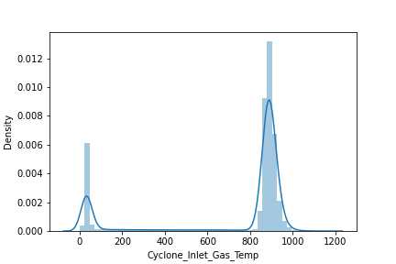
Data Analysis
To easily find anomalies in dataset we need to visualize the dataset and can be done in various ways:
sns.distplot():
Seaborn distplot is basically a histogram with kernel density plot. It helps in visualizing outliers as well as about skewness and distribution of the feature in dataset.
2) plt.boxplot():
Matplotlib.pyplot boxplot divides data into sections or quartile. They provide visual summary of data about mean and extreme outliers.
For example: distplot of Inlet gas Temperature.
- Here as hot air is blown in cyclone preheater its value cannot be 0. This implies that the spike on left are data points that are outliers.

Slide 4
Insights about data
This data has no dependent variable and so can be solved using unsupervised machine learning algorithm. There are two steps:
PCA (Principal Component Analysis):
It is unsupervised ML Algorithm for dimensionality reduction. As in this dataset there are six features so reducing them into one feature help to visualize outliers easily.
IQR (Interquartile Range)
It is a learning algorithm to detect anomalies/outliers.
Outliers are those data points that fall outside Upper bounds and Lower bounds which are calculated using Interquartile Range(IQR).
Plotting these outliers with original data to visualize abnormal periods of Cyclone Preheater.

