Slide 1


M.Tech/MCA Program
Advanced Industry Integrated Programs
Jointly offered by University and LTIMindTree
Review III
QualitySentinel AI
Multimodal Construction Quality Investigation & Prevention Platform
Rushikesh Nirmal
25MML0016 · M.Tech AI & ML, VIT Vellore
Knowledge partner | Implementation partner
Notes:
QualitySentinel AI takes a construction site photograph through to a probable cause and a ranked set of preventive actions for the next pour.

Slide 2
QualitySentinel AI
Introduction
A site photo finds the crack. Nobody finds why — so the same defect returns.
Where inspection stops today
What QualitySentinel AI adds
What happened?
Defect located on the site photo
DETECTION
How serious?
Risk scored from the pour record
RISK ASSESSMENT
Why?
Probable cause from three specialists
INVESTIGATION
How to prevent it?
Fixes ranked for the next pour
PREVENTION
Built on public defect imagery and a pour-record dataset generated from documented concrete behaviour.
Notes:
Detection is where inspection stops today. The project adds the next three questions: how serious, why, and how to prevent it.

Slide 3
QualitySentinel AI
Objective
From site photograph to preventive action — every number computed, never generated.
Detect
Five defect classes located on a site photo
Score
Risk level, with the factors that drove it
Investigate
Specialist agents, each on its own evidence
Prevent
Fixes ranked by the risk each one removes
Deliver
One dashboard that shows its own uncertainty
1
2
3
4
5
Notes:
Five objectives, one per stage. The rule throughout: models compute every number, language models only reason over that evidence.

Slide 4
QualitySentinel AI
Module 1 — Data Acquisition & Preparation
Clean, audited data before any model sees it
Three Roboflow sources merged and remapped to five classes
Audit dropped a greyscale class (Rust) and near-full-frame boxes
4,000 pour records generated from Abrams' law and IS 456, seeded
9,278
site images
21,685
labelled defect boxes
5
defect classes
4,000
pour records
Notes:
Three public Roboflow datasets were merged and audited before training. The audit removed a greyscale class and near-full-frame boxes. Pour records are synthetic, generated from Abrams' law and IS 456, because linked supplier data is not public.

Slide 5
QualitySentinel AI
Module 2 — Construction Defect Detection
What is wrong, and where
YOLOv8 locates five defect classes on a site photo
The most severe defect, and its area, feeds the risk model
Pipeline validated on a 300-image run (mAP@50 0.438); full GPU training is the open item
Severity order — the worst defect drives risk
Rebar exposed reinforcement
1
Spalling concrete broken away
2
Crack surface or through crack
3
Scaling surface flaking
4
Efflorescence salt deposits on the surface
5
Notes:
YOLOv8 finds five defect classes. The most severe defect found is passed to the risk model. Current weights are a 300-image validation run; full GPU training is the open item.

Slide 6
QualitySentinel AI
Module 3 — Quality Risk Assessment
Severity, and the reasons behind it
XGBoost scores the pour record as Low, Medium or High
Exact TreeSHAP explains every score, always toward High
Blank fields are scored at the median but shown as ‘not recorded’
74.5% held-out accuracy · baseline 44.4%
What drove a High score — SHAP contribution
Notes:
XGBoost reaches 74.5% against a 44.4% majority baseline. TreeSHAP explains each score toward the High class, so the sign never flips. A blank field is shown as not recorded, never as a measured value.

Slide 7
QualitySentinel AI
Module 4 — Multi-Agent Root-Cause Investigation
Three slices of evidence, one chair
Three specialists run in parallel, each blind to the others’ evidence
Evidence is supplied, never recalled: IS 456 values and retrieved statistics
‘Insufficient evidence’ is a valid verdict — no data, no blame
Materials
mix · supply · cover
Pour record
+ defect
Site execution
curing · heat · age
Chair
probable cause · gaps
History
matched past pours
Notes:
Three specialists each see only their own slice of the evidence and run in parallel. They are given IS 456 values and retrieved statistics instead of recalling them. A chair weighs their findings.

Slide 8
QualitySentinel AI
Module 5 — Preventive Action
Fixes ranked by the risk each one removes
Every off-target field becomes a fix with its IS 456 basis and owner
The risk model re-scores the pour with the fixes applied
Shapley values share the credit — alone, each fix reads near zero
High → Medium all six fixes
Share of the risk removed
Notes:
Every off-target field becomes a candidate fix. The risk model re-scores the pour with fixes applied, and Shapley values share the reduction fairly, because one fix alone barely moves a pour failing on several fronts.

Slide 9
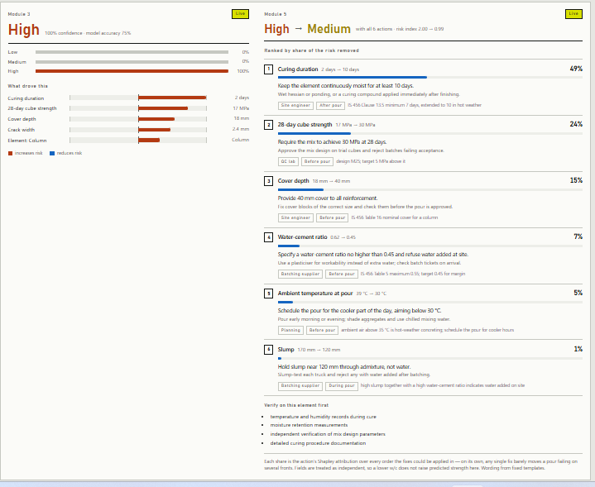
QualitySentinel AI
Module 6 — Dashboard & Deployment
One photograph in, every stage on one screen
FastAPI serves /detect, /assess, /prevent and /investigate
React dashboard fills each panel as its stage finishes
Detection, risk and fixes in about a second; agents in about five
Live run on the demo pour — risk on the left, ranked fixes on the right
Notes:
FastAPI serves four endpoints; the React dashboard fills each panel as its stage finishes. The screenshot is a live run on the demo pour.

Slide 10
QualitySentinel AI
Problem Statement
Inspection stops at detection — cause and prevention are left to memory.
Today
Photo logged, record closed
Mix, curing and cube tests in separate systems
Cause decided from recollection
Same defect on the next pour
Needed
One record across photo and pour data
A probable cause backed by evidence
Fixes ranked by the risk they remove
Honest about what was not measured
Notes:
Defect records close at detection. Mix, curing and test data live in separate systems, so the cause is decided from memory and the same defect returns.

Slide 11
QualitySentinel AI
Methodology
Models compute every number; language models only reason over the evidence.
Prevent
counterfactual + Shapley
Site photo
+ pour record
Detect
YOLOv8
Score
XGBoost + SHAP
Dashboard
FastAPI + React
Investigate
3 specialists + chair
Imagery 3 public datasets, CC BY 4.0
Pour records synthetic, from Abrams' law and IS 456
Schema real fields — site data drops in unchanged
Notes:
Detection, then risk scoring, then prevention and investigation in parallel, then the dashboard. Imagery is public; pour records are synthetic but use the real schema.

Slide 12
QualitySentinel AI
Approach / Algorithms / Tools
Each layer uses the simplest method whose output can be checked.
Detection
YOLOv8 object detection
Ultralytics · OpenCV · Pillow
Risk scoring
Gradient-boosted trees + exact TreeSHAP
XGBoost · scikit-learn · joblib
Prevention
Counterfactual re-scoring + Shapley values
Python on the trained risk model
Investigation
Parallel specialist agents + a chair
gpt-oss-120b on Groq · JSON output
Service
Typed REST API
FastAPI · Pydantic · Uvicorn
Dashboard
Progressive single-page app
React · Vite · hand-built SVG charts
Notes:
Each layer uses the simplest method whose output can be checked: an object detector, gradient-boosted trees with exact SHAP, Shapley attribution, and agents constrained to JSON.

Slide 13
QualitySentinel AI
Findings and Results
Each specialist blamed its own slice only when that slice was at fault.
74.5%
risk accuracy · baseline 44.4%
Case | Materials | Site execution | History | Chair
Bad mix, good site | Primary 0.95 | Not a factor | Contributing | Cover depth · 0.92
Good mix, bad site | Not a factor 0.95 | Primary 0.95 | Primary | Curing · 0.88
All within spec | Not a factor | Not a factor | Not a factor | No cause · 0.20
3 / 3
separation cases passed
0.20
confidence on a compliant pour
Notes:
The separation test uses three constructed cases with known answers. Each specialist claimed the cause only when its own slice was at fault, and on a compliant pour the chair returned no cause at 0.20.

Slide 14
QualitySentinel AI
Findings and Results
Testing exposed four failures — each one fixed, not hidden.
Invented code limits
Found Agent cited 20 mm column cover; IS 456 says 40 mm
Fixed IS 456 values supplied; only those may be cited
Language-model wording drift
Found Wrong site methods — ‘add sand’ to cut slump
Fixed Fixed templates; the model removed from Module 5
Evidence leak between agents
Found Shared factor list let Materials see curing days
Fixed Per-slice factors; Materials now stands down
Guesses shown as measurements
Found Blank fields shown at their dataset median
Fixed Marked ‘not recorded’; never used as evidence
Notes:
Testing found four failures, and each fix is part of the result: invented code limits, language-model wording drift, an evidence leak between agents, and guesses shown as measurements.

Slide 15
QualitySentinel AI
Conclusion
All six modules run end to end from one site photograph.
Delivered
Photo → risk → cause → fixes on one screen
Every number computed by a model, not generated
Missing data stated, never guessed
Limitations
Pour records are synthetic
Detector trained on a 300-image run
Fields treated as independent in the counterfactual
Next steps
Full-dataset GPU training of the detector
Crack size from the crack, not its box
Persist inspections; verify the IS 456 table
Containerise for deployment
Notes:
All six modules run end to end. The main limitations are synthetic pour data and the subset-trained detector; the next steps follow directly from them.

Slide 16
QualitySentinel AI
Acknowledgement
Thank you to everyone who made this project possible.
VIT Vellore & LTIMindtree
for the Advanced Industry Integrated Program that made this project possible
Faculty guide & industry mentor
for guidance, honest feedback and reviews at every stage
L&T EduTech & open source
for programme support, and the public datasets and tools this work builds on
Notes:
Thanks to the program partners, my guide and mentor, and the open-source and dataset authors.

Slide 17
QualitySentinel AI
References
[1] G. Jocher, A. Chaurasia, J. Qiu, “Ultralytics YOLOv8,” 2023. github.com/ultralytics/ultralytics
[2] T. Chen, C. Guestrin, “XGBoost: A Scalable Tree Boosting System,” Proc. ACM SIGKDD, pp. 785–794, 2016.
[3] S. M. Lundberg, S.-I. Lee, “A Unified Approach to Interpreting Model Predictions,” NeurIPS, 2017.
[4] S. M. Lundberg et al., “From local explanations to global understanding with explainable AI for trees,” Nature Machine Intelligence, 2, pp. 56–67, 2020.
[5] L. S. Shapley, “A Value for n-Person Games,” Contributions to the Theory of Games II, Princeton Univ. Press, pp. 307–317, 1953.
[6] P. Lewis et al., “Retrieval-Augmented Generation for Knowledge-Intensive NLP Tasks,” NeurIPS, 2020.
[7] OpenAI, “gpt-oss-120b & gpt-oss-20b Model Card,” 2025.
[8] Bureau of Indian Standards, IS 456:2000 — Plain and Reinforced Concrete, Code of Practice (Fourth Revision).
[9] D. A. Abrams, “Design of Concrete Mixtures,” Bulletin 1, Structural Materials Research Laboratory, Lewis Institute, 1918.
[10] Chow et al., Automation in Construction, 2021 — construction defect detection.
[11] Wang & El-Gohary, Automation in Construction, 2024 — construction-site visual compliance.
[12] Roboflow Universe — public concrete crack, spalling and defect datasets, CC BY 4.0.
Notes:
Key references for the methods used.

