Slide 1


M.Tech/MCA Program
Advanced Industry Integrated Programs
Jointly offered by University and LTIMindTree
Review III
QualitySentinel AI
Multimodal Construction Quality Investigation & Prevention Platform
Rushikesh Nirmal
T9932 · M.Tech AI & ML, VIT Vellore
Knowledge partner | Implementation partner
Notes:
QualitySentinel AI takes a construction site photograph through to a probable cause and a ranked set of preventive actions for the next pour.

Slide 2
QualitySentinel AI
Introduction
Construction defects are often identified through site observations or photographs, but identifying a defect is only the first step.
The major challenge is to determine:
What happened? → How serious is it? → Why did it happen? → How can it be prevented?
QualitySentinel AI is proposed as a multimodal AI platform that combines:
Site photographs
Supplier / material information
Quality test measurements
Historical project records
Notes:
Detection is where inspection stops today. The project adds the next three questions: how serious, why, and how to prevent it.

Slide 3
QualitySentinel AI
Objective
To build a multimodal AI platform that detects construction defects from site
photos, assesses quality risk, investigates root causes using multi-agent LLMs, and recommends preventive actions.
Key Objectives
1. Defect Detection
2. Risk Assessment
3. Root-Cause Investigation
4. Prevention Recommendation
Notes:
Five objectives, one per stage. The rule throughout: models compute every number, language models only reason over that evidence.

Slide 4
QualitySentinel AI
Module 1 — Data Acquisition & Preparation
Clean, audited data before any model sees it
Three Roboflow sources merged and remapped to five classes
Audit dropped a greyscale class (Rust) and near-full-frame boxes
4,000 pour records generated from Abrams' law and IS 456, seeded
9,278
site images
21,685
labelled defect boxes
5
defect classes
4,000
pour records
Notes:
Three public Roboflow datasets were merged and audited before training. The audit removed a greyscale class and near-full-frame boxes. Pour records are synthetic, generated from Abrams' law and IS 456, because linked supplier data is not public.

Slide 5
QualitySentinel AI
Module 2 — Construction Defect Detection
What is wrong, and where
YOLOv8 locates five defect classes on a site photo
The most severe defect, and its area, feeds the risk model
Pipeline validated on a 300-image run (mAP@50 0.438); full GPU training is the open item
Severity order — the worst defect drives risk
Rebar exposed reinforcement
1
Spalling concrete broken away
2
Crack surface or through crack
3
Scaling surface flaking
4
Efflorescence salt deposits on the surface
5
Notes:
YOLOv8 finds five defect classes. The most severe defect found is passed to the risk model. Current weights are a 300-image validation run; full GPU training is the open item.

Slide 6
QualitySentinel AI
Module 3 — Quality Risk Assessment
Severity, and the reasons behind it
XGBoost scores the pour record as Low, Medium or High
Exact TreeSHAP explains every score, always toward High
Blank fields are scored at the median but shown as ‘not recorded’
74.5% held-out accuracy · baseline 44.4%
What drove a High score — SHAP contribution
Notes:
XGBoost reaches 74.5% against a 44.4% majority baseline. TreeSHAP explains each score toward the High class, so the sign never flips. A blank field is shown as not recorded, never as a measured value.

Slide 7
QualitySentinel AI
Module 4 — Multi-Agent Root-Cause Investigation
Three slices of evidence, one chair
Three specialists run in parallel, each blind to the others’ evidence
Evidence is supplied, never recalled: IS 456 values and retrieved statistics
‘Insufficient evidence’ is a valid verdict — no data, no blame
Materials
mix · supply · cover
Pour record
+ defect
Site execution
curing · heat · age
Chair
probable cause · gaps
History
matched past pours
Notes:
Three specialists each see only their own slice of the evidence and run in parallel. They are given IS 456 values and retrieved statistics instead of recalling them. A chair weighs their findings.

Slide 8
QualitySentinel AI
Module 5 — Preventive Action
Fixes ranked by the risk each one removes
Every off-target field becomes a fix with its IS 456 basis and owner
The risk model re-scores the pour with the fixes applied
Shapley values share the credit — alone, each fix reads near zero
High → Medium all six fixes
Share of the risk removed
Notes:
Every off-target field becomes a candidate fix. The risk model re-scores the pour with fixes applied, and Shapley values share the reduction fairly, because one fix alone barely moves a pour failing on several fronts.

Slide 9
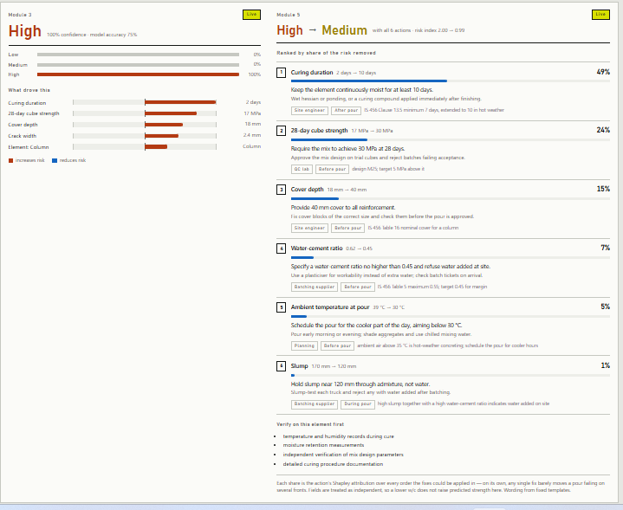
QualitySentinel AI
Module 6 — Dashboard & Deployment
One photograph in, every stage on one screen
FastAPI serves /detect, /assess, /prevent and /investigate
React dashboard fills each panel as its stage finishes
Detection, risk and fixes in about a second; agents in about five
Live run on the demo pour — risk on the left, ranked fixes on the right
Notes:
FastAPI serves four endpoints; the React dashboard fills each panel as its stage finishes. The screenshot is a live run on the demo pour.

Slide 10
QualitySentinel AI
Methodology
Models compute every number; language models only reason over the evidence.
Prevent
counterfactual + Shapley
Site photo
+ pour record
Detect
YOLOv8
Score
XGBoost + SHAP
Dashboard
FastAPI + React
Investigate
3 specialists + chair
Imagery 3 public datasets, CC BY 4.0
Pour records synthetic, from Abrams' law and IS 456
Schema real fields — site data drops in unchanged
Notes:
Detection, then risk scoring, then prevention and investigation in parallel, then the dashboard. Imagery is public; pour records are synthetic but use the real schema.

Slide 11
QualitySentinel AI
Approach / Algorithms / Tools
Each layer uses the simplest method whose output can be checked.
Detection
YOLOv8 object detection
Ultralytics · OpenCV · Pillow
Risk scoring
Gradient-boosted trees + exact TreeSHAP
XGBoost · scikit-learn · joblib
Prevention
Counterfactual re-scoring + Shapley values
Python on the trained risk model
Investigation
Parallel specialist agents + a chair
gpt-oss-120b on Groq · JSON output
Service
Typed REST API
FastAPI · Pydantic · Uvicorn
Dashboard
Progressive single-page app
React · Vite · hand-built SVG charts
Notes:
Each layer uses the simplest method whose output can be checked: an object detector, gradient-boosted trees with exact SHAP, Shapley attribution, and agents constrained to JSON.

Slide 12
QualitySentinel AI
Findings and Results
Each specialist blamed its own slice only when that slice was at fault.
74.5%
risk accuracy · baseline 44.4%
Case | Materials | Site execution | History | Chair
Bad mix, good site | Primary 0.95 | Not a factor | Contributing | Cover depth · 0.92
Good mix, bad site | Not a factor 0.95 | Primary 0.95 | Primary | Curing · 0.88
All within spec | Not a factor | Not a factor | Not a factor | No cause · 0.20
3 / 3
separation cases passed
0.20
confidence on a compliant pour
Notes:
The separation test uses three constructed cases with known answers. Each specialist claimed the cause only when its own slice was at fault, and on a compliant pour the chair returned no cause at 0.20.

Slide 13
QualitySentinel AI
Conclusion
All six modules run end to end from one site photograph.
Delivered
Photo → risk → cause → fixes on one screen
Every number computed by a model, not generated
Missing data stated, never guessed
Limitations
Pour records are synthetic
Detector trained on a 300-image run
Fields treated as independent in the counterfactual
Next steps
Full-dataset GPU training of the detector
Crack size from the crack, not its box
Persist inspections; verify the IS 456 table
Containerise for deployment
Notes:
All six modules run end to end. The main limitations are synthetic pour data and the subset-trained detector; the next steps follow directly from them.

Slide 14
QualitySentinel AI
References
[1] G. Jocher, A. Chaurasia, J. Qiu, “Ultralytics YOLOv8,” 2023. github.com/ultralytics/ultralytics
[2] T. Chen, C. Guestrin, “XGBoost: A Scalable Tree Boosting System,” Proc. ACM SIGKDD, pp. 785–794, 2016.
[3] S. M. Lundberg, S.-I. Lee, “A Unified Approach to Interpreting Model Predictions,” NeurIPS, 2017.
[4] S. M. Lundberg et al., “From local explanations to global understanding with explainable AI for trees,” Nature Machine Intelligence, 2, pp. 56–67, 2020.
[5] L. S. Shapley, “A Value for n-Person Games,” Contributions to the Theory of Games II, Princeton Univ. Press, pp. 307–317, 1953.
[6] P. Lewis et al., “Retrieval-Augmented Generation for Knowledge-Intensive NLP Tasks,” NeurIPS, 2020.
[7] OpenAI, “gpt-oss-120b & gpt-oss-20b Model Card,” 2025.
[8] Bureau of Indian Standards, IS 456:2000 — Plain and Reinforced Concrete, Code of Practice (Fourth Revision).
[9] D. A. Abrams, “Design of Concrete Mixtures,” Bulletin 1, Structural Materials Research Laboratory, Lewis Institute, 1918.
[10] Chow et al., Automation in Construction, 2021 — construction defect detection.
[11] Wang & El-Gohary, Automation in Construction, 2024 — construction-site visual compliance.
[12] Roboflow Universe — public concrete crack, spalling and defect datasets, CC BY 4.0.
Notes:
Key references for the methods used.

Slide 15
M.Tech/MCA Program
Advanced Industry Integrated Programs
Jointly offered by University and LTIMindTree
Review III
GridRecoveryIQ
Agentic Outage Risk Prediction & Self-Healing Restoration Platform
Rushikesh Nirmal
T9932 · M.Tech AI & ML, VIT Vellore
Knowledge partner | Implementation partner
Notes:
GridRecoveryIQ predicts which line sections of a distribution network are about to fail and, when one does, restores most affected customers by automatic switching before crews are scheduled for the rest.

Slide 16
GridRecoveryIQ
Introduction
Power-grid outages can occur due to multiple interacting factors such as weather conditions, electricity demand, and the condition of grid assets.
For a utility, identifying an outage is only the beginning. The important questions are:
What caused the outage? → How critical is it? → Which constraints exist? → Which crew should be dispatched first?
GridRecoveryIQ is a proposed agentic AI platform designed to support outage prediction, outage assessment and optimized restoration.
Notes:
Today a fault drops the whole feeder and restoration waits for a crew to find it. The project adds three steps: predict where faults will happen, switch healthy load back in seconds, and send crews where they save the most customer-minutes.

Slide 17
GridRecoveryIQ
Objective
From storm forecast to restored supply — every number computed, never generated.
Predict
Failure risk for all 187 line sections
Isolate
Smallest switchable zone around a fault
Restore
Healthy load moved onto neighbouring feeders
Dispatch
Crews sequenced to cut customer-minutes
Explain
Agents narrate; a live control room shows it
1
2
3
4
5
Notes:
Five objectives, one per stage. Every figure on the dashboard comes from the trained model or an optimisation solver, never from the language model.

Slide 18
GridRecoveryIQ
Module 1 — Synthetic Network & Outage History
A realistic grid, with a hazard kept hidden
11 kV grid over Vellore — 4 substations, 11 feeders, 25 tie switches
Outages drawn from a hidden physical hazard the model never sees
Seasonal storms swept across the map, so faults cluster in space and time
187
switchable line sections
64,309
customers served
1.64 M
3-hourly history rows
2,550
outage events in 3 years
Notes:
The network and the three-year history are synthetic but physically reasoned. Outages come from a hidden hazard function the model never sees, which lets the model be measured against the true achievable ceiling.

Slide 19
GridRecoveryIQ
Module 2 — Outage Risk Prediction
Which sections fail next, and why
LightGBM on weather, asset and load features, time-ordered split
Isotonic calibration fitted on the validation slice only
Exact TreeSHAP gives every section its own risk drivers
0.804 ROC-AUC · oracle ceiling 0.841
What drives outage risk — share of model gain
Notes:
LightGBM with a strict time-ordered split and isotonic calibration fitted on validation only. ROC-AUC 0.804 against an oracle ceiling of 0.841, about 89% of the achievable skill. TreeSHAP explains each section's score.

Slide 20
GridRecoveryIQ
Module 3 — Self-Healing Restoration (FLISR)
Power back by switching, before any crew
Walks the feeder tree to the smallest switchable zone around the fault
CP-SAT picks tie switches, keeping each donor feeder under 92% loading
66% of affected customers restored on average, in a median of 75 s
Five steps on every fault — about a minute, no crew
Locate faulted section from the trip
1
Isolate nearest sectionalising switches open
2
Reclose breaker restores everything upstream
3
Transfer tie switches pick up stranded islands
4
Shed lowest-value branch, if a donor is short
5
Notes:
The engine isolates the smallest zone, recloses the breaker for upstream load, and uses CP-SAT to move stranded islands onto neighbouring feeders within a 92% loading margin. Across all 187 fault locations it restores 66% of affected customers on average (median 77%) in a median of 75 seconds.

Slide 21
GridRecoveryIQ
Module 4 — Crew Dispatch Optimisation
Minimise customer-minutes, not kilometres
Objective: Σ weight × finish time, weight = customers out × criticality
CP-SAT routes every crew with skill matching and travel-time precedence
Never worse than nearest-job-first — a test enforces it
59.6 M → 34.1 M customer-minutes
Gain over the nearest-job-first rule
Notes:
Dispatch minimises criticality-weighted customer-minutes, not distance. In the live cyclone run it cut weighted customer-minutes from 59.6 M to 34.1 M, 42.8% better than nearest-job-first. On a 16-job instance CP-SAT proves the optimum in 4.9 seconds.

Slide 22
GridRecoveryIQ
Module 5 — Agentic Reasoning Layer
Engines compute, agents explain
RiskSentinel watches exposure; three agents act on every fault
The LLM never produces a number — every figure comes from a model or solver
No API key needed: Groq, Gemini or Ollama only add the narration
Fault Diagnosis
cause · confidence
Fault event
+ live risk
Self-Heal Agent
switching plan
Summary
incident commander
Dispatch Agent
crew sequence
Notes:
Five agents each own one decision. The deterministic engine computes, the agent frames the result, and the LLM only narrates, so the platform runs identically with no API key.

Slide 23
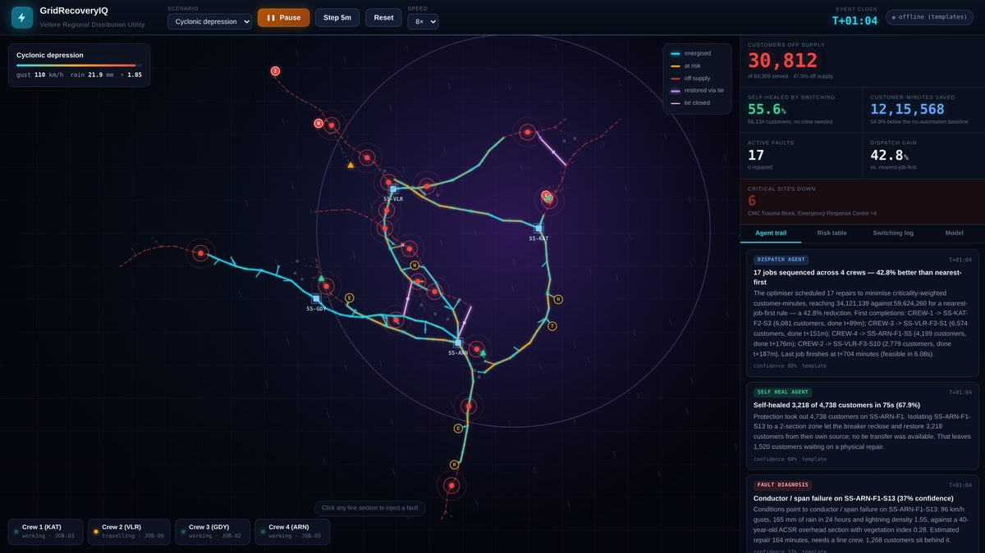
GridRecoveryIQ
Module 6 — Live Control Room & Deployment
One click, the whole loop on screen
FastAPI streams live state to the browser over server-sent events
Canvas map with no tile service: power flow, storm front, crew trucks
Click any line section to inject a fault and watch the loop run
Cyclone scenario at T+01:04 — 55.6% self-healed, 42.8% dispatch gain
Notes:
The control room streams live state over server-sent events to a canvas map. Clicking any line section injects a fault and runs the full loop: diagnosis, self-healing and dispatch.

Slide 24
GridRecoveryIQ
Problem Statement
A feeder trips whole — and restoration waits for a crew.
Today
Protection drops the entire feeder
Healthy load stays dark until a crew arrives
Crews sent to the nearest job first
Risk tracked as static asset lists
Needed
Risk scored per section, live with weather
Healthy load switched back in seconds
Crews ranked by customer-minutes saved
Every number traceable to a model or solver
Notes:
Protection drops the whole feeder even when only a short stretch is damaged, and crews are usually sent nearest-first. The needed system scores risk live, restores healthy load by switching, and ranks crew work by customers affected.

Slide 25
GridRecoveryIQ
Methodology
Engines compute every number; language models only narrate the result.
Self-heal
tie transfer · CP-SAT
Weather
+ asset · load
Predict
LightGBM + SHAP
Isolate
fault zone · reclose
Control room
FastAPI + SSE
Dispatch
crew routing · CP-SAT
Network synthetic 11 kV, Vellore, seeded
History 3 years, 3-hourly, hidden hazard
Benchmark oracle ceiling on every metric
Notes:
Weather, asset and load data feed the risk model. On a fault the engine isolates it, then self-healing and crew dispatch work from the same plan, and the control room shows the result.

Slide 26
GridRecoveryIQ
Approach / Algorithms / Tools
Each layer uses a method whose output can be checked and reproduced.
Data generation
Seeded hidden-hazard simulation
NumPy · pandas · NetworkX · PyArrow
Risk prediction
LightGBM + isotonic calibration + TreeSHAP
LightGBM · scikit-learn
Self-healing
Tree search + CP-SAT tie selection
NetworkX · Google OR-Tools
Crew dispatch
Weighted-completion-time routing
OR-Tools CP-SAT · AddCircuit
Agents
Engine computes, LLM narrates
Llama 3.3 70B on Groq · Gemini · Ollama
Service & dashboard
FastAPI with server-sent events
Uvicorn · Pydantic · HTML5 canvas
Notes:
Each layer uses a method whose output can be verified: calibrated gradient-boosted trees, exact constraint solvers, and a language model restricted to narration.

Slide 27
GridRecoveryIQ
Findings and Results
Scored against its own ceiling, not just against random.
89%
of achievable ROC skill recovered
Metric | Random | Model | Oracle ceiling | Skill recovered
ROC-AUC | 0.500 | 0.804 | 0.841 | 89%
Lift @ top 1% | 1.0× | 10.6× | 14.5× | 71%
Recall @ top 5% | 0.050 | 0.336 | 0.374 | 88%
0.3%
Brier gap to the oracle
245,718
held-out test rows · 530 outages
Notes:
Outages are random draws from a hidden hazard, so no model can be perfect. Scored against that oracle, the model recovers 89% of the achievable ROC skill and 88% of the achievable recall, with calibration within 0.3% of optimal.

Slide 28
GridRecoveryIQ
Findings and Results
Restoration measured against a no-automation counterfactual, not claimed.
Self-healing, all 187 faults
Restored 66% of affected customers on average
Time median 75 seconds, no crew dispatched
Partial pickups
Needed at 9 of the 187 fault locations
Effect a short donor still carries the most critical load
Live cyclone scenario
Saved 1.22 M customer-minutes by T+01:04
Result 54.9% below the no-automation baseline
Bug caught by an invariant test
Found a second fault stranded load an earlier one moved
Fixed no section may be energised and off supply at once
Notes:
Self-healing and dispatch are measured against a counterfactual that runs in parallel: the same faults with no automatic switching and a nearest-first dispatcher. One invariant test caught a real double-fault bug, now fixed.

Slide 29
GridRecoveryIQ
Conclusion
All six modules run end to end, from storm forecast to restored supply.
Delivered
Risk → self-heal → dispatch on one live screen
Every number from a model or solver, never generated
Runs offline with no API key
Limitations
Synthetic network and history
kVA headroom proxy, not a full AC power flow
Each fault planned against the nominal network
Next steps
Unbalanced load flow before each transfer
Re-plan against the live switching state
Learn repair times from work orders
Validate on real outage data
Notes:
All six modules run end to end. The main limitations are synthetic data and a capacity proxy instead of a full power flow; the next steps address both.

Slide 30
GridRecoveryIQ
References
[1] G. Ke et al., “LightGBM: A Highly Efficient Gradient Boosting Decision Tree,” NeurIPS, 2017.
[2] S. M. Lundberg et al., “From local explanations to global understanding with explainable AI for trees,” Nature Machine Intelligence, 2, pp. 56–67, 2020.
[3] B. Zadrozny, C. Elkan, “Transforming Classifier Scores into Accurate Multiclass Probability Estimates,” Proc. ACM SIGKDD, 2002.
[4] L. Perron, V. Furnon, “OR-Tools,” Google, 2024. developers.google.com/optimization
[5] A. Zidan, E. F. El-Saadany, “A Cooperative Multiagent Framework for Self-Healing Mechanisms in Distribution Systems,” IEEE Trans. Smart Grid, 2012.
[6] M. E. Baran, F. F. Wu, “Network Reconfiguration in Distribution Systems for Loss Reduction and Load Balancing,” IEEE Trans. Power Delivery, 1989.
[7] S. D. Guikema et al., “Predicting Hurricane Power Outages to Support Storm Response Planning,” IEEE Access, 2, 2014.
[8] IEEE Std 1366-2022, “IEEE Guide for Electric Power Distribution Reliability Indices,” 2022.
[9] P. Toth, D. Vigo (eds.), Vehicle Routing: Problems, Methods, and Applications, 2nd ed., SIAM, 2014.
[10] M. L. Pinedo, Scheduling: Theory, Algorithms, and Systems, 5th ed., Springer, 2016.
[11] Meta AI, “Llama 3.3 70B Instruct — Model Card,” 2024.
Notes:
References for the methods and tools used in GridRecoveryIQ.

