Slide 1


M.Tech Program
Advanced Industry Integrated Programs
Jointly offered by University and LTIMindTree
Review 1
GridRecoveryIQ
- Agentic Outage Risk Prediction & Restoration Optimization Platform
Rushikesh Nirmal
ID :- T9932
Knowledge partner | Implementation partner

Slide 2
Project Title - GridRecoveryIQ
Introduction
Power-grid outages can occur due to multiple interacting factors such as weather conditions, electricity demand, and the condition of grid assets.
For a utility, identifying an outage is only the beginning. The important questions are:
What caused the outage? → How critical is it? → Which constraints exist? → Which crew should be dispatched first?
GridRecoveryIQ is a proposed agentic AI platform designed to support outage prediction, outage assessment and optimized restoration.

Slide 3
Data Considered
Weather Data
Environmental and weather conditions affecting grid operation.
Load Data
Electricity demand and feeder load patterns.
Asset Data
Feeder and substation information.
Outage Events
Historical outage events and restoration scenarios.

Slide 4
Project Title - GridRecoveryIQ
Objective
To develop an agentic AI platform that predicts outage risk, assesses outage cause and criticality, and generates an optimized crew-dispatch and restoration plan.
Key Objectives :-
1. Outage Risk Prediction
2. Outage Assessment
3. Criticality Assessment
4. Agentic Decision Support.
5. Crew Dispatch Optimization
6. Restoration Optimization

Slide 5
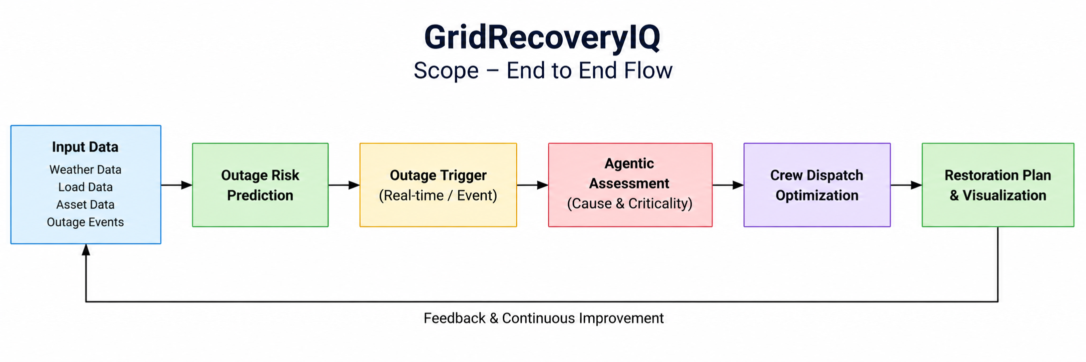
Project Title - GridRecoveryIQ
Scope

Slide 6
Project Title - GridRecoveryIQ
Literature Review
Sharma et al. (2024) — Machine Learning for Power Outage Prediction During Hurricanes
2. Predicting Power Outage During Extreme Weather Events with EAGLE-I and NWS Datasets (IEEE, 2023)
3. Zhang et al. (2023) — Outage Management of Hybrid AC/DC Distribution Systems
4. Wu et al. (2022) — Robust Coordination of Repair and Dispatch Resources for Post-Disaster Service Restoration

Slide 7
Project Title - GridRecoveryIQ
Summary of Literature…. Calibri body -36
ML can predict power outages using weather and historical outage data.
Weather conditions are key factors in outage-risk prediction.
Research supports AI-based outage assessment and identification of affected grid areas.
Optimization methods can improve crew allocation and repair sequencing.
Existing studies often treat prediction and restoration separately.
GridRecoveryIQ integrates prediction, assessment, optimization and restoration into one workflow.

Slide 8
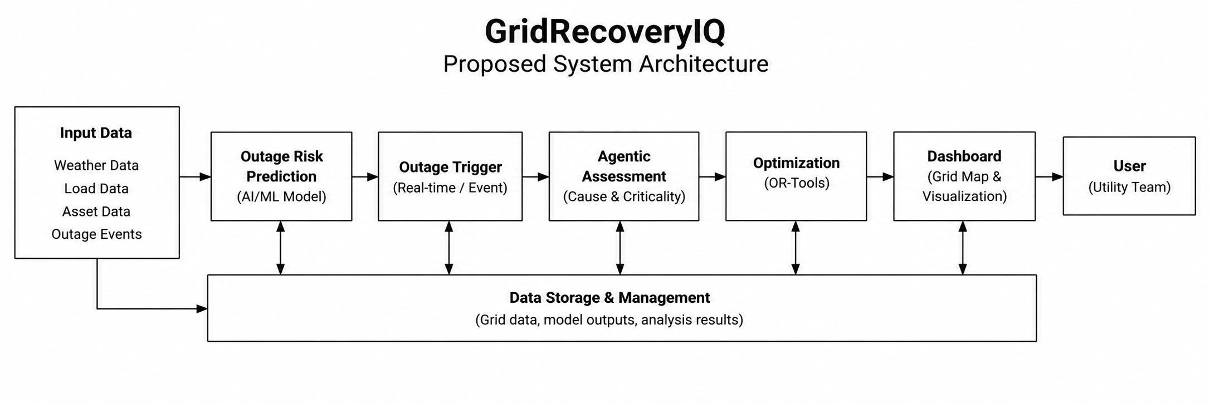
Project Title - GridRecoveryIQ
Additional Information
Proposed System Architecture

Slide 9
Project Title - GridRecoveryIQ
Modules to cover
Module 1 — Grid Data Acquisition & Preparation
  Collection and preparation of weather, load, asset and outage-event data.
Module 2 — Outage Risk Prediction
  Development of an AI/ML model to estimate outage probability or risk.
Module 3 — Outage Trigger & Scenario Simulation
  Generation or detection of outage scenarios to initiate the recovery workflow.
Module 4 — Agentic Outage Assessment
  Multi-agent analysis of outage cause, criticality and operational conditions.

Slide 10
Module 5 — Crew Dispatch Optimization
  Optimization of crew allocation and dispatch priorities using OR-Tools.
Module 6 — Restoration Sequencing
  Generation of an optimized sequence for restoring affected grid components.
Module 7 — Interactive Grid Dashboard
  Visualization of grid status, outage locations, criticality, crew assignments and restoration progress.

