Slide 1


M.Tech Program
Advanced Industry Integrated Programs
Jointly offered by University and LTIMindTree
Review 1
QualitySentinel AI
- Multimodal Construction Quality Investigation & Prevention Platform
Rushikesh Nirmal
ID: T9932
Knowledge partner | Implementation partner

Slide 2
Project Title - Calibri body 18
Introduction
Construction defects are often identified through site observations or photographs, but identifying a defect is only the first step.
The major challenge is to determine:
What happened? → How serious is it? → Why did it happen? → How can it be prevented?
QualitySentinel AI is proposed as a multimodal AI platform that combines:
Site photographs
Supplier / material information
Quality test measurements
Historical project records

Slide 3
Project Title - Calibri body 18
Objective
To build a multimodal AI platform that detects construction defects from site
photos, assesses quality risk, investigates root causes using multi-agent LLMs, and recommends preventive actions.
Key Objectives
1. Defect Detection
2. Risk Assessment
3. Root-Cause Investigation
4. Prevention Recommendation

Slide 4
Project Title - Calibri body 18
Scope
Data Integration
Construction site photographs
Supplier and material information
Quality and test measurements
Historical defect and project records
AI / ML Pipeline
Image → Defect Detection → Risk Scoring → Root-Cause Analysis → Prevention
Application Layer
FastAPI backend
React-based dashboard
Defect and risk visualization
Investigation and recommendation interface

Slide 5
Project Title - Calibri body 18
Literature Review
Construction Defect Detection
Chow et al. (2021), Automation in Construction
Construction-Site Visual Compliance
Wang & El-Gohary (2024), Automation in Construction

Slide 6
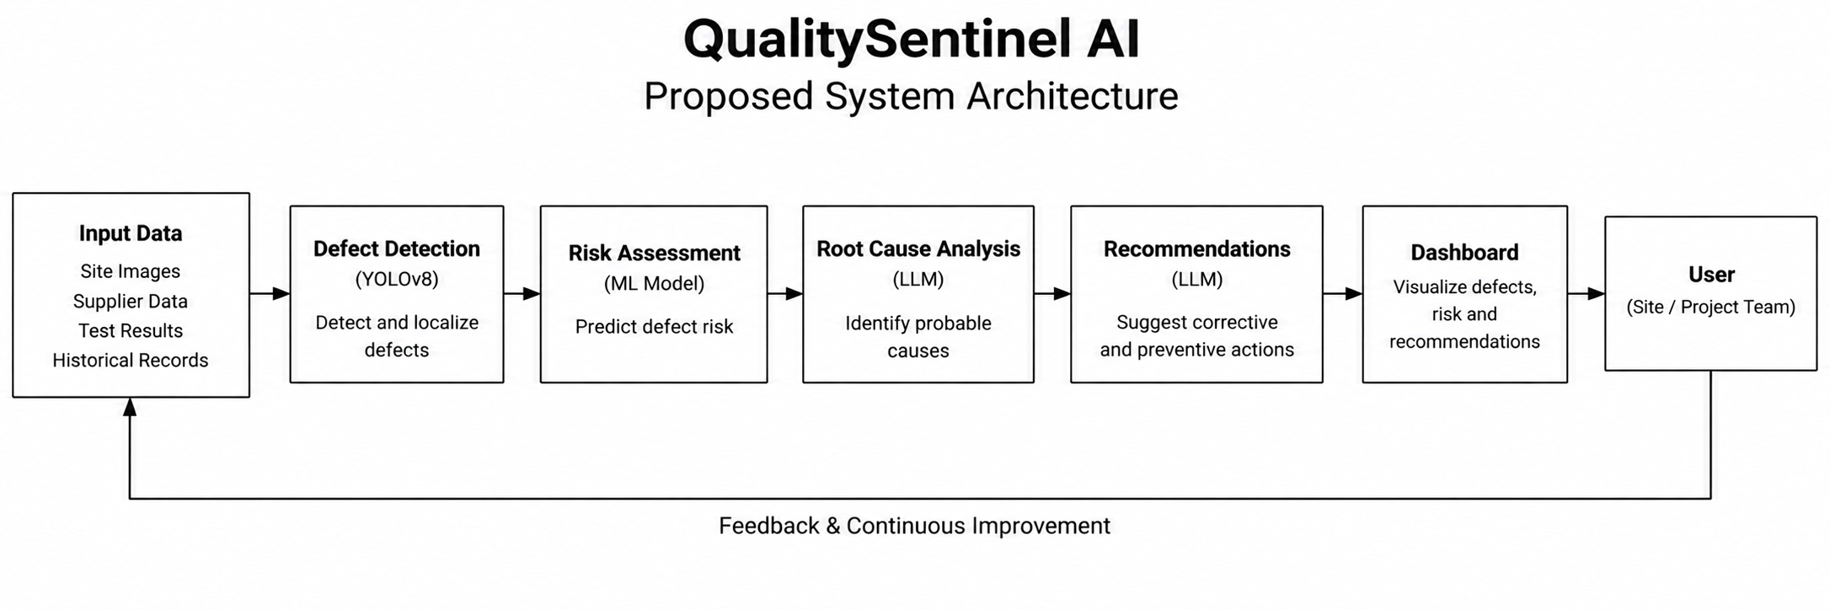
Project Title - Calibri body 18
Proposed System Architecture
Calibri body 28

Slide 7
Project Title - Calibri body 18
Modules to cover
Module 1 — Data Acquisition & Preparation
  Collection, cleaning and preparation of site images, supplier data, test data and historical project records.
Module 2 — Construction Defect Detection
  YOLOv8-based detection and localization of construction defects from site photographs.
Module 3 — Quality Risk Assessment
  XGBoost-based prediction of quality risk with SHAP-based explanation of important contributing factors.

Slide 8
Module 4 — Multi-Agent Root-Cause Investigation
  Use of multiple LLM agents to analyse defect evidence and investigate probable root causes.
Module 5 — Preventive Action Recommendation
  Generation of preventive recommendations based on identified defects, risks and root causes.
Module 6 — Dashboard & Deployment
  Integration of the complete pipeline into a React and FastAPI application with MLflow and Docker support.

