Slide 1
CISA Known Exploited Vulnerabilities (KEV) Prediction
Team Members: Alex Anvari, Saharsh Koli, Nikhil Murdeshwar, Sankarsh Sanap, Rushikesh Ware

Slide 2
Introduction
CISA stands for Cybersecurity and Infrastructure Security Agency. It is a U.S. government agency responsible for protecting critical infrastructure from cyber threats and enhancing national cybersecurity.
Prediction Problem: Predict which CVEs are more likely to become CISA Known Exploited Vulnerabilities (KEVs) in the future.
Usefulness of Prediction: For organizations that have reached patch velocity to effectively reduce the risk of KEVs on their network, identifying vulnerabilities that may be identified by CISA as KEVs in the future will allow for further risk reduction utilizing the available patch bandwidth.
Notes:
Speaker: Nikhil

Slide 3
Related Work and Our Approach
Existing Work in KEV Prediction
EPSS (Exploit Prediction Scoring System): Predicts likelihood of exploitation but doesn't specifically align with CISA KEVs.
CVE Severity Scoring (CVSS): Provides a risk score but lacks real-world exploitation insights.
Machine Learning Models for Vulnerability Prediction: Prior research has used traditional classifiers (Random Forest, SVM) but often lacks feature integration from multiple sources.
How Our Approach is Better
Multi-source Data Integration: Combines CVE, KEV, EPSS, and CPE data for a more holistic risk assessment.
Feature Engineering: Improved data pre-processing (date-time transformation, handling missing values, CPE field expansion).
Focus on CISA KEVs: Unlike EPSS and CVSS, our model is directly aimed at predicting KEVs.
Better Risk Prioritization: Helps organizations allocate patching resources more effectively by identifying high-risk vulnerabilities earlier.
Notes:
Speaker: Nikhil

Slide 4
Dataset Source
Original Multi-File Dataset including CVE, KEV, EPSS, and CPE data available here: https://www.kaggle.com/datasets/francescomanzoni/vulnerability-management-datasets?resource=download
Combined Dataset Single CSV: https://drive.google.com/file/d/129SuzhErVnuI7ah69ZJq7MEQKZqfQNzx/view?usp=sharing
Credits:
Common Vulnerabilities and Exposure (CVE) data from the Department of Commerce National Institute of Standards and Technology (NIST) National Vulnerability Database (NVD)
Cybersecurity and Infrastructure Security Agency (CISA) Known Exploited Vulnerability (KEV) Program
Cyentia Institute’s Exploit Prediction Scoring System (EPSS)
Kaggle User Francesco for aggregating data from the above sources
Notes:
Speaker: Alex

Slide 5
Subset of the Dataset
cve_id | base_severity | base_score | exploitability_score | impact_score | epss_score | epss_perc | cisa_kev | attack_vector | Attack _complexity | Privileges _required | user_interaction | confidentiality_impact | integrity_impact | availability_impact | published_date | cwe_data | cpe_product
CVE-1999-0199 | CRITICAL | 9.8 | 3.9 | 5.9 | 0.01238 | 0.85273 | FALSE | NETWORK | LOW | NONE | NONE | HIGH | HIGH | HIGH | 2020-10-06T13:15Z | ['CWE-252'] | glibc
CVE-1999-0236 | HIGH | 7.5 | 3.9 | 3.6 | 0.0028 | 0.6818 | FALSE | NETWORK | LOW | NONE | NONE | HIGH | NONE | NONE | 1997-01-01T05:00Z | ['CWE-200'] | http_server
CVE-1999-0239 | HIGH | 7.5 | 3.9 | 3.6 | 0.00132 | 0.49016 | FALSE | NETWORK | LOW | NONE | NONE | HIGH | NONE | NONE | 1998-01-01T05:00Z | ['CWE-178'] | fasttrack_server
CVE-1999-0426 | CRITICAL | 9.8 | 3.9 | 5.9 | 0.00265 | 0.65502 | FALSE | NETWORK | LOW | NONE | NONE | HIGH | HIGH | HIGH | 1999-03-01T05:00Z | ['CWE-276'] | suse_linux
CVE-1999-0783 | MEDIUM | 5.5 | 1.8 | 3.6 | 0.00042 | 0.05059 | FALSE | LOCAL | LOW | LOW | NONE | NONE | NONE | HIGH | 1998-06-16T04:00Z | ['CWE-59'] | freebsd
CVE-1999-1127 | HIGH | 7.5 | 3.9 | 3.6 | 0.74227 | 0.98348 | FALSE | NETWORK | LOW | NONE | NONE | NONE | NONE | HIGH | 1999-12-31T05:00Z | ['CWE-772'] | windows_nt
CVE-1999-1152 | HIGH | 7.5 | 3.9 | 3.6 | 0.00579 | 0.78017 | FALSE | NETWORK | LOW | NONE | NONE | HIGH | NONE | NONE | 1998-06-03T04:00Z | ['CWE-307'] | microcom_6000_firmware
CVE-1999-1324 | CRITICAL | 9.8 | 3.9 | 5.9 | 0.0034 | 0.71246 | FALSE | NETWORK | LOW | NONE | NONE | HIGH | HIGH | HIGH | 1999-12-31T05:00Z | ['CWE-307'] | openvms_vax
19 Total Fields, CPE Field Expanded to 11 for total of 29 Fields
Notes:
Speaker: Alex A small subset of the dataset will be shown here.
Response/Outcome Variable: KEV status
Predictor Variables: CVE details, EPSS score, etc.

Slide 6
Data Pre-processing
Date-Time Transformation:
Reformatted published_date to YYYY-MM-DD HH:MM:SS.
Extracted Date and Time as separate columns.
Handling Missing Values:
Converted empty strings to NA for accurate missing value detection.
Removed columns with over 90% missing values.
Column Cleanup:
Removed irrelevant columns such as Unnamed and excessive CPE data.
CPE Data Combination & Splits:
Combined multiple CPE-related columns (e.g., cpe_part, cpe_vendor, cpe_product) to form a unified CPE field.
Split combined CPE data into relevant parts for better analysis.
Notes:
Speaker: Rushikesh

Slide 7
Objective
Primary Goal: Predict which CVEs (Common Vulnerabilities and Exposures) are likely to become CISA Known Exploited Vulnerabilities (KEVs) in the future.
Usefulness: Helps organizations prioritize vulnerabilities to patch based on the likelihood of being flagged by CISA as KEVs, improving risk management and security.
Outcome Variable: KEV status (whether a CVE will be marked as KEV or not).
Predictor Variables: CVE details, EPSS (Exploit Prediction Scoring System), CPE (Common Platform Enumeration) data, attack vectors, and other vulnerability-related metrics.
Notes:
Speaker: Rushikesh

Slide 8
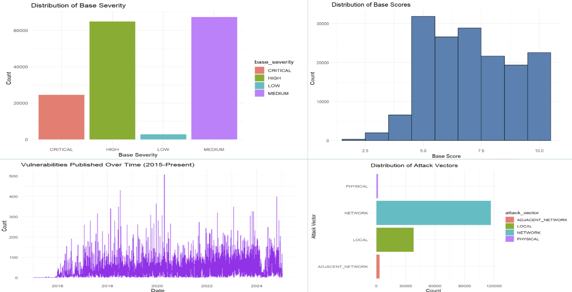
Exploratory Analysis for the Data
Notes:
Speaker: Saharsh

Slide 9
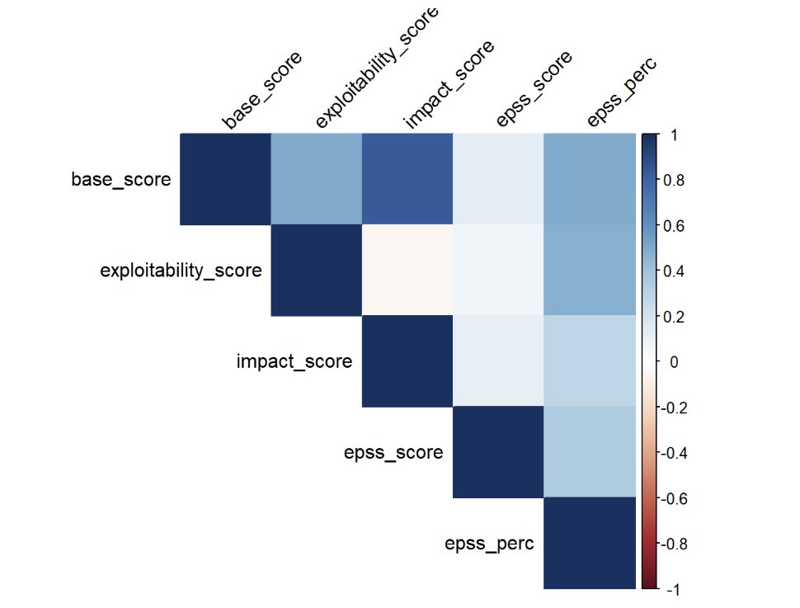
Correlation After Initial Review
Notes:
Speaker: Saharsh

Slide 10
Conclusion
Summary: We aimed to predict which CVEs are likely to become CISA Known Exploited Vulnerabilities (KEVs), using a combination of CVE, EPSS, CPE, and other relevant data.
Approach: By integrating multiple data sources and applying advanced feature engineering, our model focuses on providing better risk prioritization for organizations.
Impact: The model helps organizations prioritize patching efforts, reducing the risk of cybersecurity attacks by identifying critical vulnerabilities early.
Next Steps: Continue refining the model and evaluate its performance with real-world data to improve prediction accuracy and reliability.
Notes:
Speaker: Sankarsh

Slide 11
Questions?

