Slide 1

AIT 580: Analytics: Big Data to Information
Title: Analysis of Drug Overdose Death Rates in the United States
Rushikesh Shivajirao Ware
(G01477377)

Slide 2
Dataset Description and Research Questions
Dataset Overview:
Our study utilizes a comprehensive dataset from the U.S. Department of Health & Human Services, covering drug overdose deaths in the U.S. from 1999 to 2018.
I chose this dataset because it provides a wide scope of data that is essential for understanding how drug overdose impacts various demographics and how these impacts have evolved over time.
Research Questions:
How have drug overdose death rates evolved over time across the nation?
What demographic factors influence the variability in these rates?
Which specific drugs are most frequently implicated in these fatalities?
Methods Overview:
Data Source: "Analyzed comprehensive overdose death data from the U.S. Department of Health & Human Services, spanning 1999 to 2018."
Statistical Techniques: "Applied linear and enhanced regression models to examine trends and demographic impacts."

Slide 3
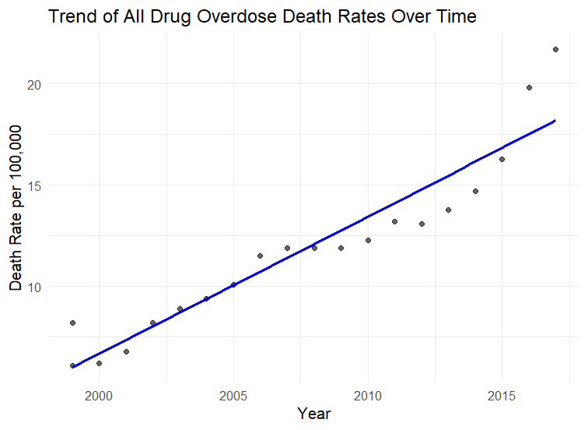
Overall Trends
Overall Increase in Overdose Deaths:
Data analysis reveals a marked increase in overdose deaths, highlighting a national crisis.
Linear regression models indicate a significant positive trend year over year.

Slide 4
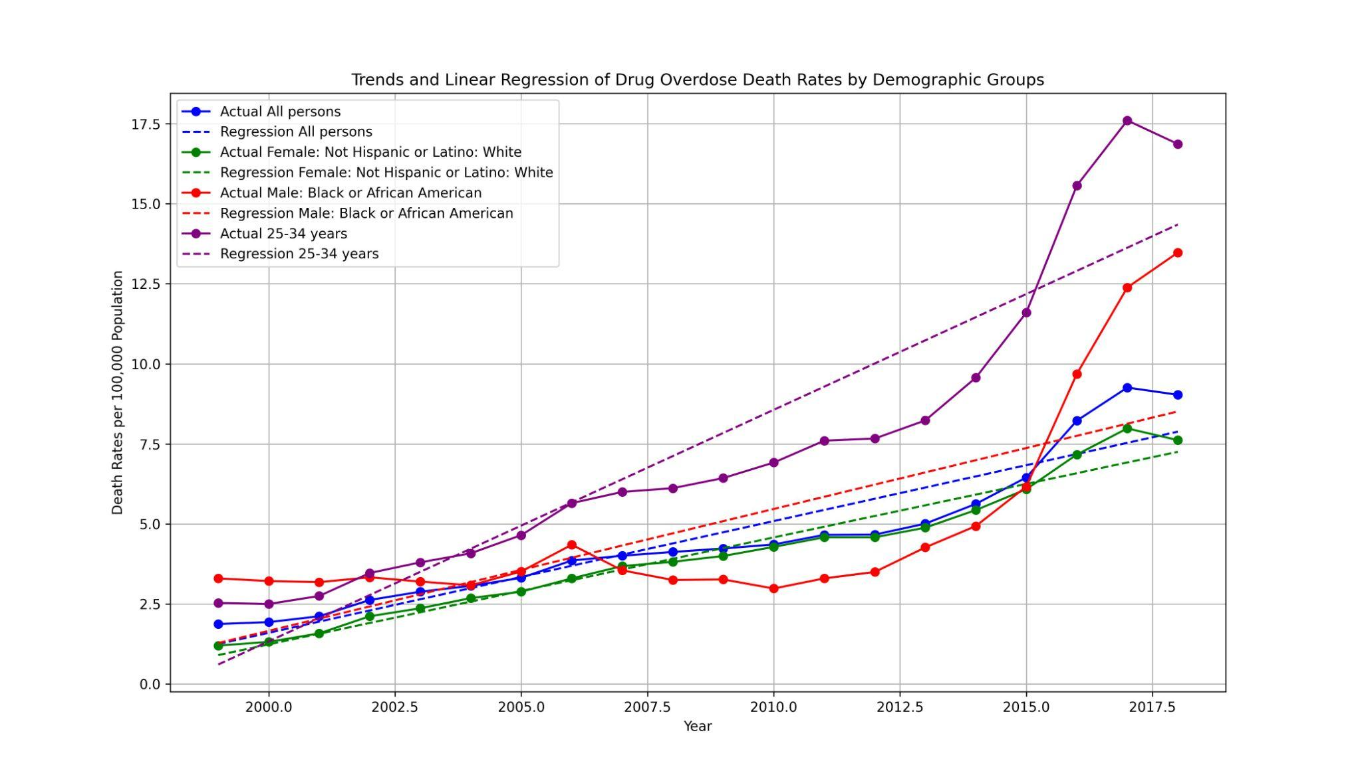
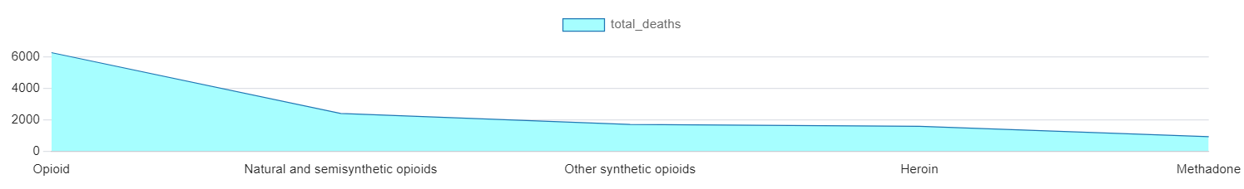
Specific Drug Trends and Regression Model
Insights
Impact of Demographic Factors:
Regression models show varying overdose death rates across different demographics.
Age, particularly the 25-34 bracket, and race, with non-Hispanic whites most affected, are significant factors.
Specific Drug Involvement:
A deeper dive into the data shows synthetic opioids, like fentanyl, are the most implicated in the increase in deaths.

Slide 5
Conclusion and Next Steps
Concluding Insights:
Our study has confirmed a critical rise in drug overdose deaths, influenced heavily by demographics and the emergence of synthetic opioids.
Effective public health responses must focus on high-risk groups and the regulation of potent synthetic opioids.
Recommendations for Action:
Enhance surveillance and intervention strategies, specifically targeting the most affected demographics.
Advance policies to curb the spread and impact of fentanyl and similar substances.

