Slide 1
SHIELD AI
Next-Generation In-Browser Phishing, Quishing & Homoglyph Countermeasure System
CORE CAPABILITIES AT A GLANCE
• On-Demand 'Squeeze' Sidebar: Sider AI-inspired physical viewport compression calc(100% - 420px)
• Interactive Snipping Tool: Canvas-cropped bounding box analysis powered by Gemini 3.5/3.8 Flash Vision
• Quishing Matrix Defense: Direct 2D QR decoding (jsQR + Jimp) with recursive 10-hop redirect tracing
• Brand Typosquatting Engine: Detection of homoglyphs like 'rnicrosoft.com' with enforced 98/100 risk floors
• Active Countermeasures: Autonomous Scam-Baiter Bot, Ask Shield Copilot & Forensic SOC Incident PDF Export
TCET HACKATHON 2026 | ENTERPRISE & CONSUMER CYBERSECURITY TRACK

Slide 2
01 // THE THREAT CONTEXT
The Evolving Threat Landscape: Why Traditional Antivirus Fails
3.4 Billion
Daily Phishing Messages
Attackers now use LLMs to clone brand styles with flawless grammar and persuasive context.
FLAW OF LEGACY TOOLS:
Static database lookups have an 8-48 hour delay. Attackers switch infrastructure in minutes.
78% Spurt
Quishing (QR Phishing)
Attackers embed malicious URLs inside QR codes in emails and flyers, completely bypassing text firewalls.
FLAW OF LEGACY TOOLS:
Static database lookups have an 8-48 hour delay. Attackers switch infrastructure in minutes.
0-Day Domains
Homoglyph Lookalikes
Deceptive domains like 'rnicrosoft.com' (rn -> m) exploit visual perception before blacklists can detect them.
FLAW OF LEGACY TOOLS:
Static database lookups have an 8-48 hour delay. Attackers switch infrastructure in minutes.

Slide 3
02 // PRODUCT VISION
The Solution: A Real-Time, Multimodal In-Browser Defense Agent
⚡ Non-Intrusive Zero-Friction UI
Squeeze Sidebar compresses host website viewport margin without popups or obscuring page controls.
👁️ Multimodal Visual OCR
Interactive Snipping Tool feeds cropped sub-images directly to Gemini Vision to detect fake branding & urgent traps.
🔍 Recursive Redirect Traversal
Traces shortlinks (bit.ly, tinyurl) up to 10 HTTP HEAD hops deep to find the unmasked destination.
🤖 Active Countermeasures & Recovery
Autonomous Scam-Baiter wastes attacker resources; Recovery Wizard gives step-by-step account hardening.

Slide 4
03 // FRONTEND ARCHITECTURE
Engineering Innovation: On-Demand 'Squeeze' Sidebar
Why Most Security Extensions Get Uninstalled
❌ Invasive Popups: Float over input forms, closing whenever the user clicks outside.
❌ Screen Distortion: Standard modal alerts lock the entire tab and frustrate users.
✅ The Squeeze Model: Modeled after Sider AI & REC Note. Dynamically compresses the host page.
• CSS Viewport Manipulation: Toggles width: calc(100% - 420px) and margin-right: 420px.
• 0.28s Smooth Cubic-Bezier Transition: Zero jarring layout jumps.
• Complete Iframe Sandboxing: The sidebar is isolated from host DOM scripts and malicious tampering.
Sidebar Component Layout
+--------------------------------+-------------------+
| HOST WEBPAGE | SHIELD SIDEBAR |
| (calc(100% - 420px)) | (420px fixed) |
| | |
| Forms, buttons, and links | [ Auto-Scan: ON ] |
| remain 100% clickable while | [ Scan Area (Snip)]
| Shield sits beside them | |
| | VERDICT: 98/100 |
| [ Suspicious Login Box ] | [ BLOCKED: RED ] |
| | |
| | Ask Copilot / PDF |
+--------------------------------+-------------------+

Slide 5
04 // COMPUTER VISION
Interactive Snipping Tool: Multimodal Vision at the Click of a Button
1. User Trigger
Clicks 'Scan Area' in the sidebar. The host page dims with crosshair cursor listeners.
2. Canvas Bounding Box
User drags over suspicious form. Extension uses captureVisibleTab + offscreen canvas to slice the exact rectangle.
3. Context Extraction
Simultaneously harvests surrounding DOM text nodes, button captions, and form input names.
4. Gemini Vision OCR
Multimodal LLM verifies logo authenticity, deceptive countdowns, and unverified credential harvesting.

Slide 6
05 // THREAT ENGINE
Stopping Quishing (QR Attacks) & Brand Homoglyphs
Quishing Matrix Engine (QR Phishing)
• Problem: QR codes conceal malicious targets from standard text filters.
• Direct Bitmap Decoding: Jimp extracts RGBA pixel array; jsQR analyzes finder patterns and unmasks data bits.
• 10-Hop Redirect Unraveling: Immediately follows shorteners to the final payload server.
• High Precision Distinction:
- Legitimate menus/support: 0 / 100 (Safe)
- KYC / credential harvesting QR: 95-98 / 100 (Critical Threat)
Brand Homoglyph Engine (Typosquatting)
• The rn -> m Attack: 'www.rnicrosoft.com' appears identical to Microsoft on mobile & desktop screens.
• Regex Normalization Pipeline:
- rn -> m (rnicrosoft -> microsoft)
- 0 -> o (micros0ft -> microsoft)
- 1 -> l (goog1e -> google, paypa1 -> paypal)
- Punycode detection (xn--)
• Enforced Evidence Floor: Detected typosquats are locked at 98 / 100 Risk, bypassing all attacker evasion.

Slide 7
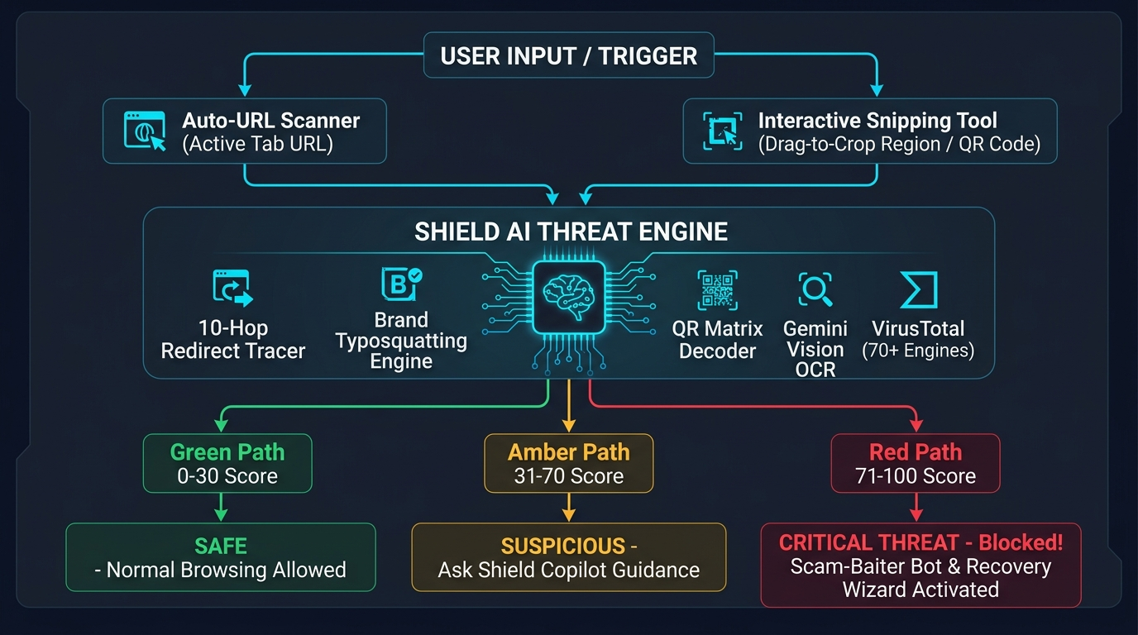
06 // SYSTEM DIAGRAM
End-to-End System Workflow Architecture

Slide 8
07 // USER DEFENSE
Beyond Detection: Active Countermeasures & Incident Response
Ask Shield Copilot
Context-aware AI assistant answers security questions in plain, reassuring language with multi-model failover (Gemini -> Groq -> Local Heuristics).
Autonomous Scam-Baiter Bot
Deploys 3 personas (Technical Glitch, Bureaucracy, Confused Customer) generating realistic friction to waste scammers' bandwidth safely.
Account Recovery Wizard
Interactive 4-step checklist (Session Kill -> Official Password Reset -> Hardware 2FA -> Device Audit) with progress synced to database.
Forensic SOC PDF Report
Exports print-ready incident documentation via jsPDF containing timestamps, 10-hop redirect chains, and AV consensus logs for IT teams.

Slide 9
08 // VERIFICATION
Empirical Validation: Rigorous 100% Pass Benchmarks
15 / 15
Visual Threat Benchmark
scripts/verify-15-images.js
• 5 Safe: 0/100 (Google/Gemini in Gmail)
• 5 Suspicious: 45-60/100 (Urgent surveys)
• 5 Dangerous: 95-98/100 (rnicrosoft.com, KYC)
8 / 8
QR Matrix Decoder Suite
scripts/verify-qr-suite.js
• Tested authentic 2D PNG bitmaps
• Distinguishes legitimate support links from quishing payloads with 100% precision
19 / 19
Automated API Unit Tests
test/api.test.js
• Express endpoints
• Redirect recursion limiters
• Typosquatting regex replacements
• Supabase RLS privacy isolation

Slide 10
09 // TEAM ROLES
Engineering Team: 3 Specialized Domains
MEMBER 1
Product Lead & UX Experience
Storytelling & Visual UI
• The 2026 Phishing Problem pitch
• Live demo of Squeeze Sidebar UI
• Ask Shield Copilot interaction
• Scam-Baiter Bot & Recovery Wizard
MEMBER 2
Extension & Computer Vision Lead
Browser Engine & OCR
• Chrome Manifest V3 & Iframe isolation
• Interactive Snipping Tool canvas crop
• Quishing QR Matrix Decoder (jsQR)
• Gemini Vision multimodal analysis
MEMBER 3
Threat Intel & Backend Lead
Networks, APIs & Security
• 10-hop redirect recursion tracer
• Typosquatting engine (rnicrosoft.com)
• VirusTotal API & Google Safe Browsing
• Supabase PostgreSQL RLS & PDF Export

Slide 11
10 // CONCLUSION & ROADMAP
The Future of In-Browser Cybersecurity
Why Shield AI Wins in the Real World
🛡️ Zero Delay: Real-time visual OCR & redirect unraveling catches zero-day threats before blacklists index them.
✨ Frictionless UX: Physical 'Squeeze' sidebar doesn't block work or get uninstalled.
🎯 High Precision: 100% accuracy on brand homoglyphs (rn -> m) and QR code quishing.
🔒 Total Privacy: Supabase Row-Level Security guarantees users only see their own scans.
⚡ Turnkey Deployment: Ready on Chrome Web Store & Vercel.
READY FOR LIVE DEMONSTRATION
Thank You, Judges!
GitHub: github.com/AAKU2107/TCET-hackathon
Live Web Console & Chrome Manifest V3 Extension Ready
We are excited to take your questions.

