Slide 1

Angelia scalp serum 50ml Anti amnesic scalp serum..
By
priyanka Gawde
Rutvi Kale

Slide 2

K
K
FORMULA TABLE :-
INGREDIENTS
WEIGHT
ROLE
Acetyl-L-Carnitine
Ashwagandha
VitaminB12
VitaminB6
Baicapil(3%)
Salicylic Acid
Potassium Sorbate
Disodium Phosphate
lavender Perfume
Glycerin
Improving memory
Anti inflammatory agent
In development of brain and nerve cells
Hair grwoth stimulator
Antidandruff
Antidepressant
Preservative
Buffer
Fragrance
Vehicle

Slide 3
Procedure:-
Dissolve Acetyl-L-Carnitine , Ashwagandha , Vitamin B12 , Vitamin B6 in Disodium phosphate buffer . Then add baicapil (3%) , Salicylic acid to this solution.
Add potassium sorbate and lavender perfume to this above solution.
And make up the volume upto 50 ml with glycerin.

Slide 4
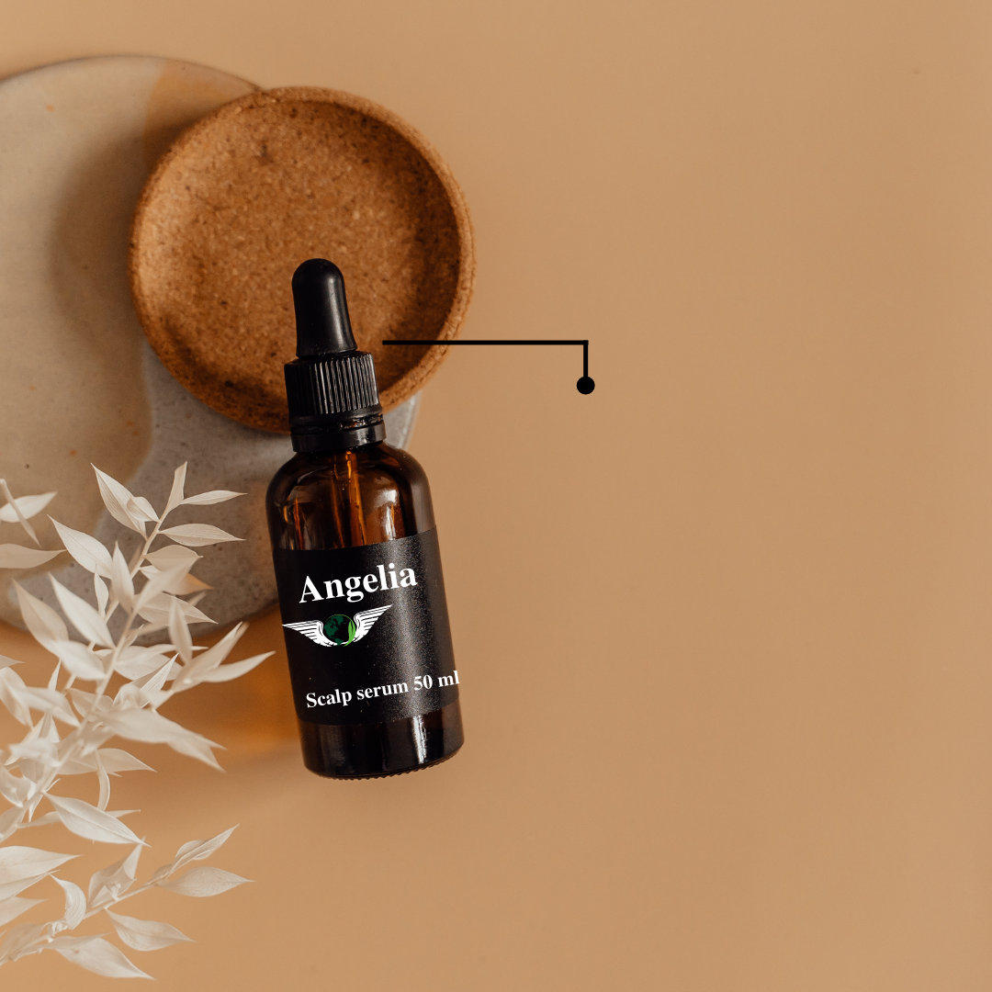
Why you choose it ?
A scalp serum acts as a hair mask for one’s hair.
It nourishes and moisturizes the skin of the scalp.
By moisturizing the scalp with serum, we can create a healthy environment for hair growth.
The market has a variety of scalp serums. But a scalp serum with a therapeutic use is something the market lacks.

Slide 5
What makes it differnt than marketed products:-
There are currently no medications available that can cure Amnesia but vitamin B supplements help to maintain general mental health. And also helps to improve memory.
Our product contains :-
Acetyl-L-caranitine
Ashwagandha
Vitamin B6
Baicapil
Vitamin B12
Salicylic acid
Potassium Sorbate
Glycerin
Disodium Phosphate
Lavender perfume.

Slide 6
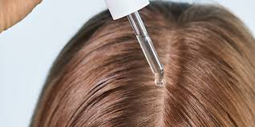
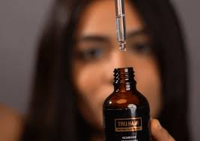
How to apply :-
Apply the product to your scalp and use the tips of your fingers to massage the product into your scalp and hair.

Slide 7
Thank you !
Any Questions ?

