Slide 1

Credit Card Financial Dashboard
-Rushikesh Jayprakash Gavhane

Slide 2

PROBLEM STATEMENT
For credit card companies, a huge volume of transaction data must be collected and analyzed to gain insights into customer behavior, fraudulent transactions, risks, and regulatory compliance. These companies need analytical and visually-oriented dashboards that can present the companies’ key financial data, their tendencies and potentialities in a simple and clear way.

Slide 3
OBJECTIVES
Visualize Key Metrics: Provide a clear visualization of important financial metrics such as total transactions, total credit extended, revenue from interest and fees, and delinquency rates.
Monitor Customer Behavior: Analyze customer spending patterns, segment customers based on credit utilization, and identify high-value customers.
Identify Trends and Patterns: Track trends over time, such as monthly transaction volumes, average transaction size, and seasonal variations.
Risk Management: Identify potential risks by monitoring delinquency rates and predicting potential defaults.
Performance Comparison: Compare performance across different segments, such as geographic regions, customer demographics, and product types.

Slide 4

END USERS
Financial Analysts
Customer Relationship Managers (CRMs)
Marketing Teams
Risk Managers

Slide 5





Technology Used
Microsoft Excel
MySQL
Power BI
Tableau

Slide 6
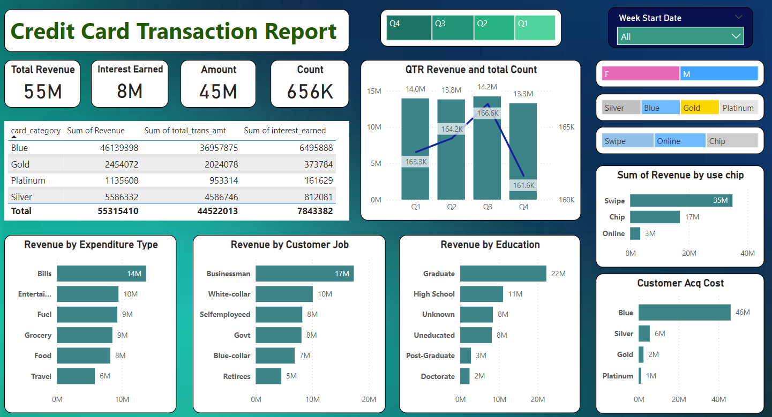
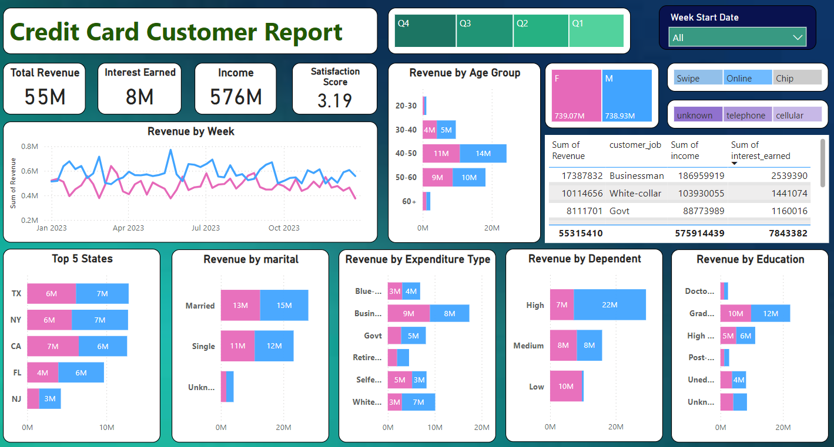
RESULTS
Project Link Below👇
GitHub Link

Slide 7
Thank you
For your Guidance which help me to enhance my knowledge.
.
.

