Slide 1
American Sign Language Detection using Machine Learning
By:
Gautham Mudunuru
Rushikesh Khamkar
(Texas Tech University)

Slide 2
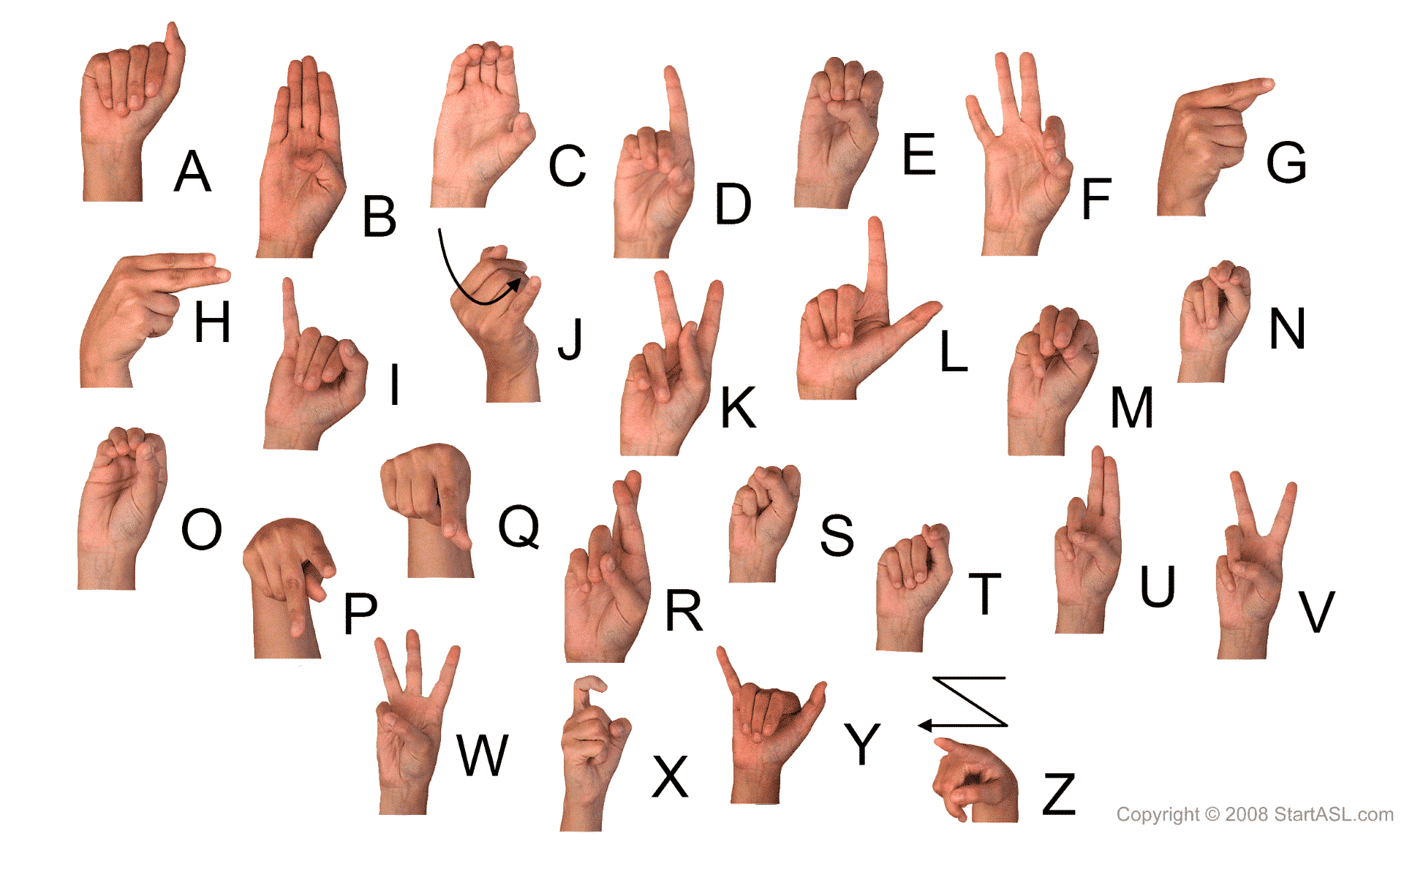
Overview
Sign Language is the only language for deaf people.
Most of the times it is difficult for them to communicate with the Society.
Specially in virtually meeting platforms like Zoom or M.S.Teams where we cannot use a sign language interpreter all the times .
Fig-1 Sign Language Alphabet [1]

Slide 3
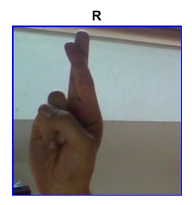
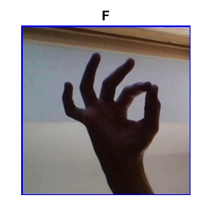
Our Approach to the Problem
To tackle this problem, we are trying to detect signs and convert them to a readable language.
We considered a machine learning approach(CNN) to solve this problem.
Real world data of fully formed words is hard to get and will take too long to train as that would be a multi-class problem with thousands of classes.
For this problem we choose to detect images of A-Z in English Alphabet.
Fig-2 Sign Language Alphabet Example Prediction[2]

Slide 4
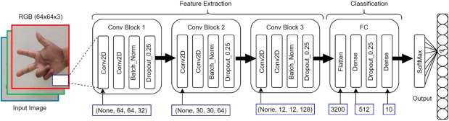
CNN Architecture
Fig-3 CNN Architecture [3]
Resizing all the images to the same size
Our architecture follows 4 Convolution and pooling layers and one fully connected layer to produce 29 different outputs.

Slide 5
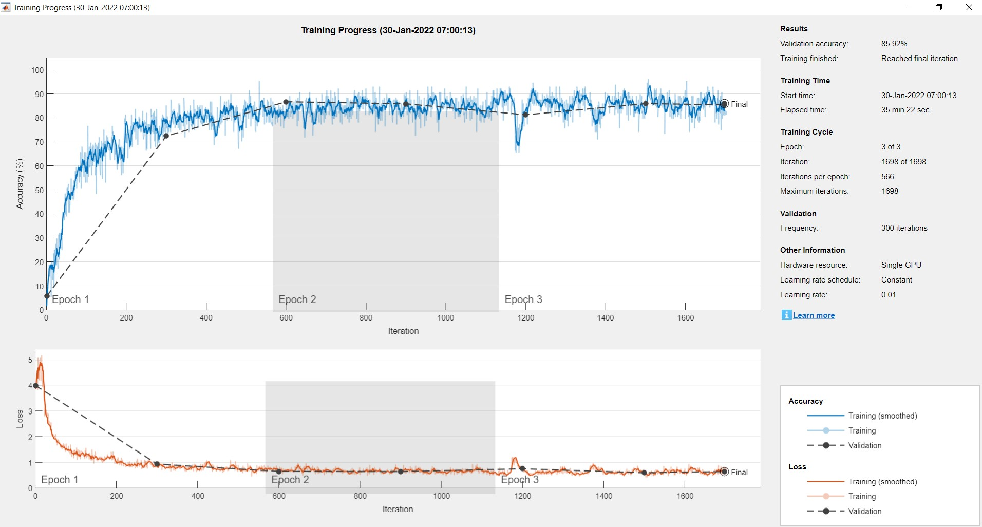
Accuracy – 85.92%, Loss – 0.65 for 3 epochs

Slide 6
References
[1] https://i.pinimg.com/originals/29/49/c9/2949c9710e63990f493c646c2ba3e290.jpg
[2] https://www.kaggle.com/grassknoted/asl-alphabet/code
[3] https://www.sciencedirect.com/science/article/pii/S2405959520301685

