Slide 1

DNYANSAGAR INSTITUTE OF MANAGEMENT & RESEARCH,
PUNE 411045
Presentation on ( Mini Project Title)
Presented By
Seat No | Student Name
7945 | Rushikesh Balu Lihinar
MCA –I SEM I
2023-024
Project Guide Name:- Aishwarya Pawar

Slide 2
Introduction
Electricity Billing System is a software-based application.
This project aims at serving the department of electricity by computerizing the billing system.
It mainly focuses on the calculation of units consumed during the specified time and the money to be charged by the electricity offices.
This computerized system will make the overall billing system easy, accessible, comfortable, and effective for consumers. To design the billing system more service oriented and simple, the following features have been implemented in the project.
The application has high speed of performance with accuracy and efficiency. The software provides facility of data sharing, it does not require any staff as in the conventional system. Once it is installed on the system only the meter readings are to be given by the admin where customer can view all details, it has the provision of security restriction. The electricity billing software calculates the units consumed by the customer and makes bills, it requires small storage for installation and functioning. There is provision for debugging if any problem is encountered in the system.

Slide 3
Proposed System
Electricity Billing System is a software-based application.
This project aims at serving the department of electricity by computerizing the billing system.
It mainly focuses on the calculation of units consumed during the specified time and the money to be charged by the electricity offices.
This computerized system will make the overall billing system easy, accessible, comfortable, and effective for consumers. To design the billing system more service oriented and simple, the following features have been implemented in the project.
The application has high speed of performance with accuracy and efficiency. The software provides facility of data sharing, it does not require any staff as in the conventional system. Once it is installed on the system only the meter readings are to be given by the admin where customer can view all details, it has the provision of security restriction.

Slide 4
Scope
Extensibility: This software is extendable in ways that its original developers may not expect. The following principles enhances extensibility like hide data structure, avoid traversing multiple Links or methods avoid case statements on object type and distinguish public and private operations.
Reusability: Reusability is possible as and when require in this application. We can update it next version. Reusable software reduces design, coding, and testing cost by amortizing effort Over several designs. Reducing the amount of code also simplifies understanding, which increases the likelihood that the code is correct.

Slide 5
Module Specification
1) Login Module: Used for managing the login details.
2) Sign up Module: Add Customer in System.
3) Admin Module: Used for managing the users of the system.
4) New Admin Module: Used for managing the users of the system.
5) Customer Module: Used for managing the details of Connections.
6) Calculate Module: Used for managing the Bill.
7) Record Module: Used for managing the Record information’s.
8) Pay Bill Module: Billing Details.

Slide 6
Hardware & Software Requirements
Hardware Requirements:
Processor : intel i3
Operating System : Windows 10
Software Requirements
Front End : Java core/swings (NetBeans)
Developing Tool :
Back End : My SQL

Slide 7
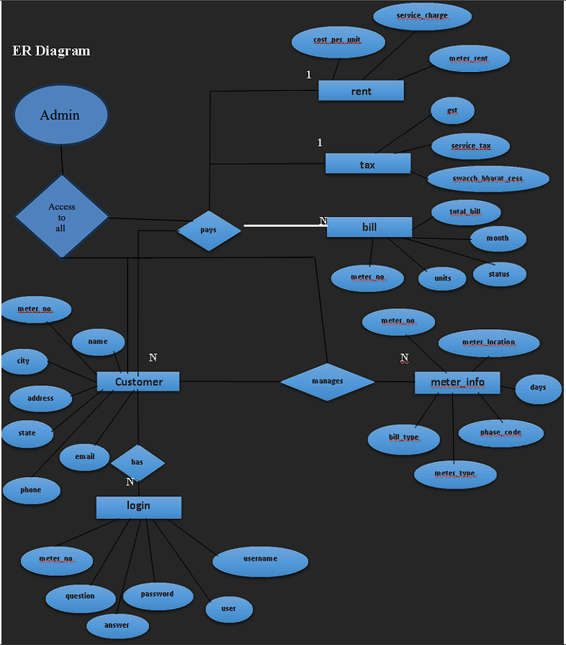
ERD

Slide 8
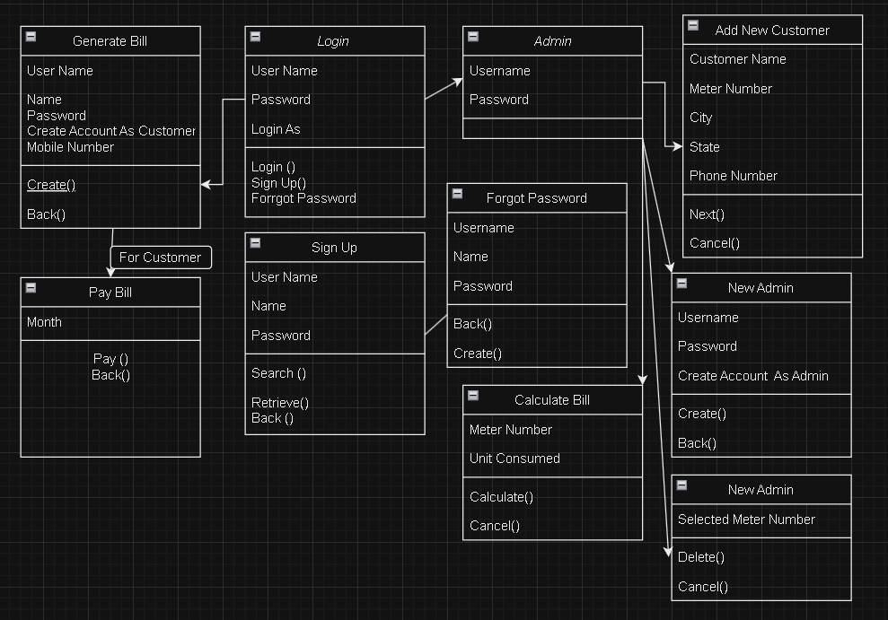
Class Diagram

Slide 9
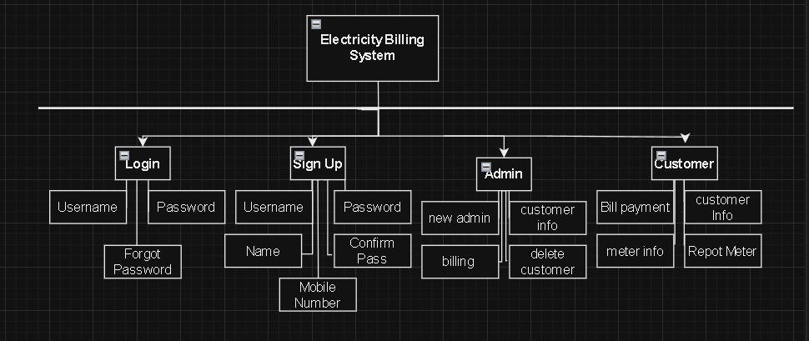
Module Hierarchy Diagram

Slide 10
Table Specification
1) Table Name: Login
Description: The login is used to store the details of login’s admin and customer with meter_no.
Primary Key: login_id
Field Name | Data Types | Size | Constraint | Description
meter no | varchar | 20 | Null | Used for save meter no
username | varchar | 30 | Null | Used for save username
name | varchar | 30 | Null | Used for save name
password | varchar | 20 | Null | Used for store password
user | Varchar | 20 | Null | Used for save user

Slide 11
Table Specification
2) Table Name: customer
Description: Information about Customer
Primary key: customer_id
Field Name | Data Types | Size | Constraint | Description
name | varchar | 20 | Null | Save customer name
meter_no | varchar | 20 | Primary key | Used to save meter number
address | Varchar | 50 | Null | Used to save customer address
city | Varchar | 20 | Null | Used to save customer city
state | Varchar | 30 | Null | Used to save customer state
email | Varchar | 30 | Null | Used to save customer email
phone | Varchar | 30 | Null | Used to save customer phone no.

Slide 12
Table Specification
3) Table Name: Tax
Description: The tax is used to store tax values
Primary key: Tax_id
Field Name | Data Types | Size | Constraint | Description
cost_per_unit | varchar | 20 | Null | Cost per unit 9/-
meter_rent | varchar | 20 | Null | Meter Rent is 47/-
service_charge | varchar | 20 | Null | Service Charge 22/-
service_tax | varchar | 20 | Null | Service Tax 57/-
swacch_bharat | varchar | 20 | Null | Swacch bharat Tax 6/-
fixed_tax | varchar | 20 | Null | Fixed Tax 12/-

Slide 13
Table Specification
4) Table Name: meter_info
Description: Store the meter information of the user
Primary key: meter_info_id
Field Name | Data Types | Size | Constraint | Description
meter_no | varchar | 20 | Multiple | Multiple meter no store
meter_location | varchar | 20 | Null | Used to save meter location
meter_type | Varchar | 20 | Null | Used to select the category of meter
phase_code | Varchar | 20 | Null | Used to phase code details
bill_type | Varchar | 20 | Null | Used to select bill type
days | varchar | 20 | Not null | Used to save days , date

Slide 14
Table Specification
5) Table Name: Bill
Description: Bill table to store electricity bill information of the user
Primary key: bill_id
Field Name | DataTypes | Size | Constraint | Description
meter_no | varchar | 20 | Multiple | Show meter no
month | Varchar | 30 | Null | Used to Which Month User Need
units | varchar | 20 | Null | Used to save sub category name
totalbill | varchar | 20 | Null | Used to show total bill
status | varchar | 20 | Null | Used to show bill paid or not

Slide 15
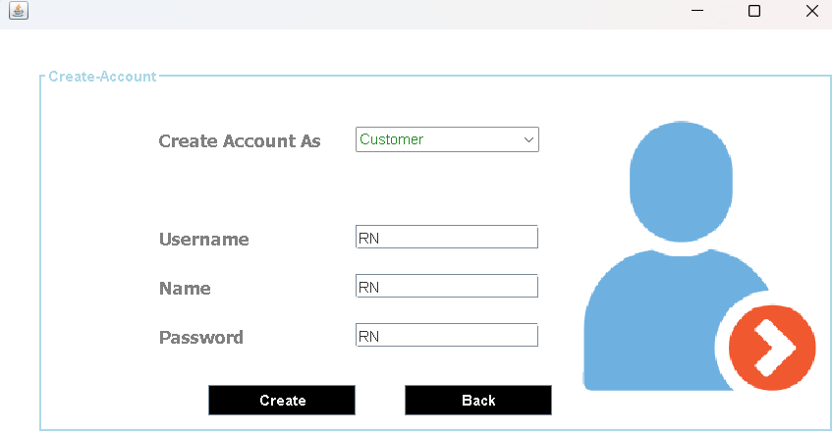
User Interface

Slide 16
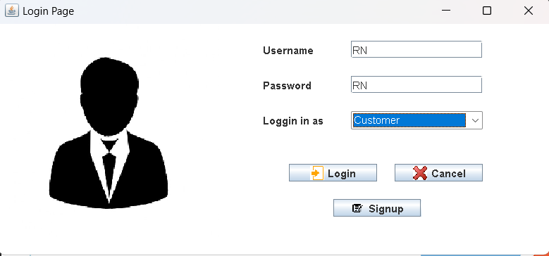
User Interface

Slide 17
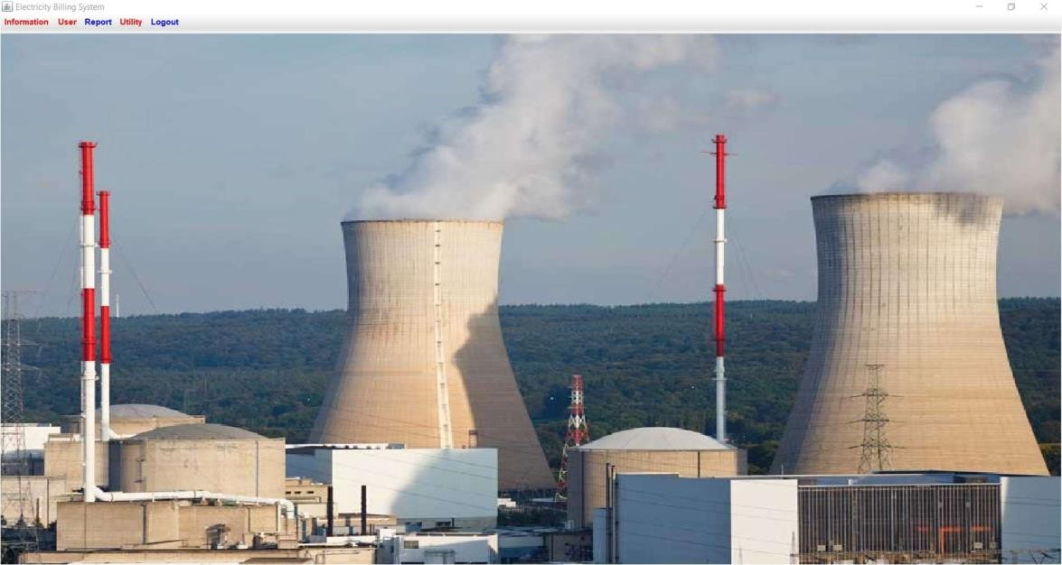
User Interface

Slide 18
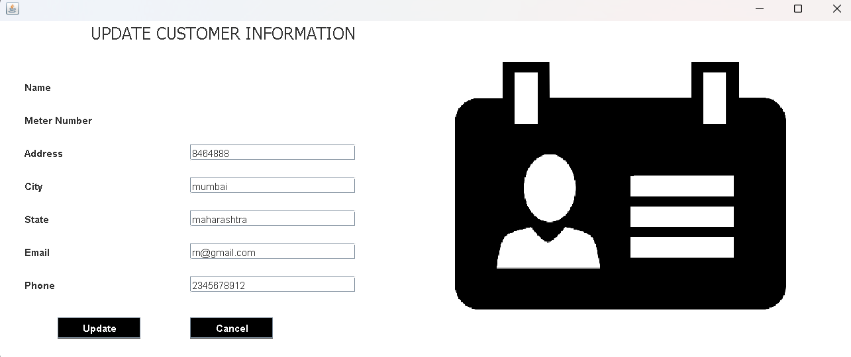
User Interface

Slide 19
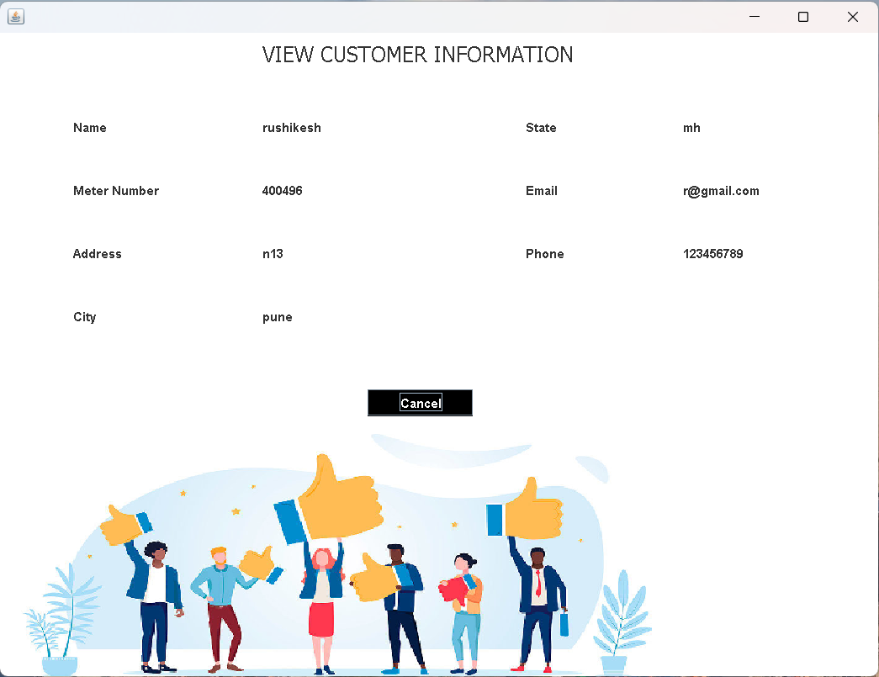
User Interface

Slide 20
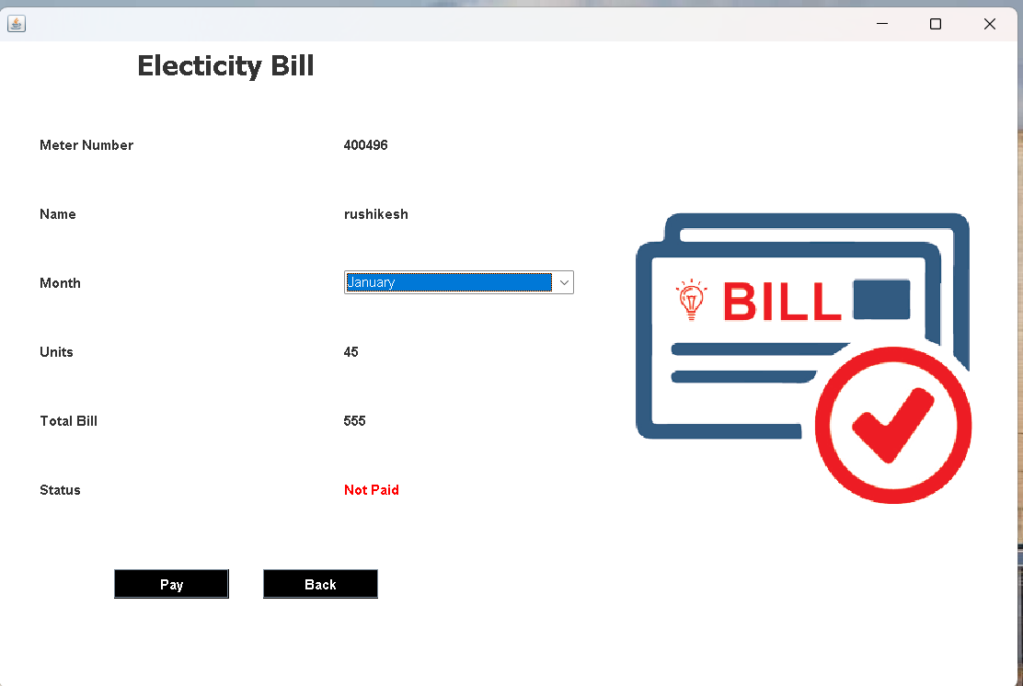
User Interface

Slide 21
Limitation & Future Enhancement
• Payment gateway not added yet
• Not fully automated (Computerized)

Slide 22
Thank You…!

