Slide 1
Automated Insight Engine:
Netflix Data Intelligence Report
End-to-End AI-Driven Reporting Pipeline for Automated Analytics

Slide 2
Executive Summary
This report analyzes 8,807 Netflix titles using a fully automated AI-powered analytics engine.
Key business and content insights are generated without manual intervention.
Key Insights:
• Movies dominate Netflix’s library.
• International Movies and Dramas lead genre distribution.
• Content growth peaked in 2019.
• TV-MA dominates the rating distribution.
• Rajiv Chilaka & Raul Campos lead in total directed titles.

Slide 3
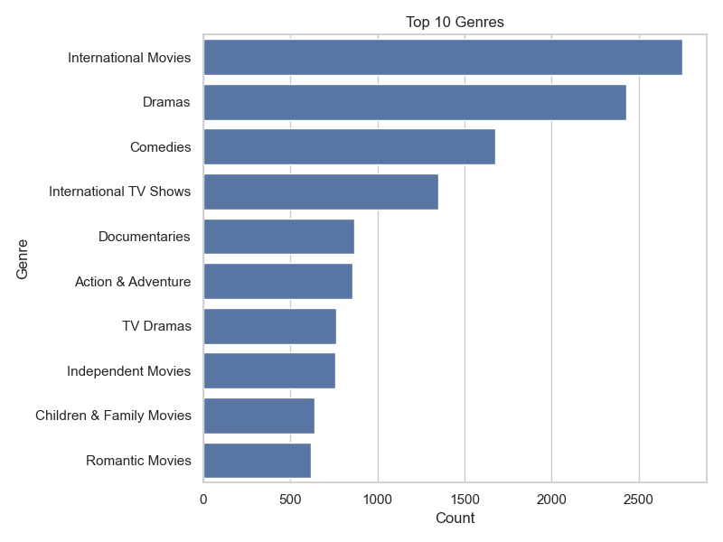
Top 10 Genres

Slide 4
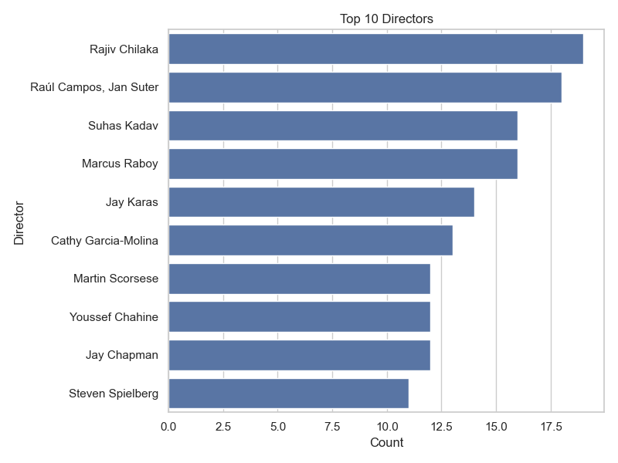
Top 10 Directors

Slide 5
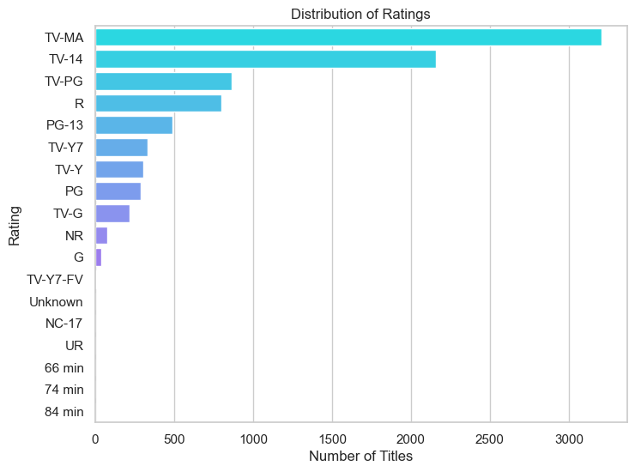
Rating Distribution

Slide 6
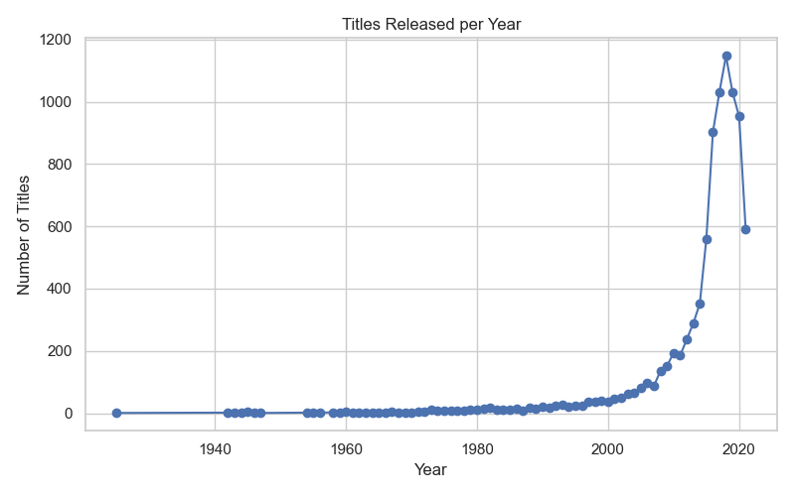
Titles Released per Year

Slide 7
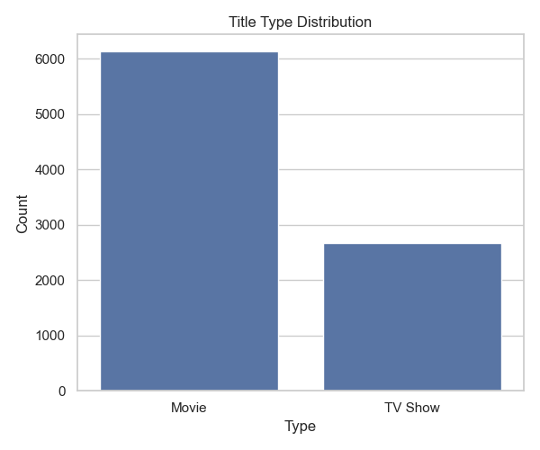
Title Type Distribution

Slide 8
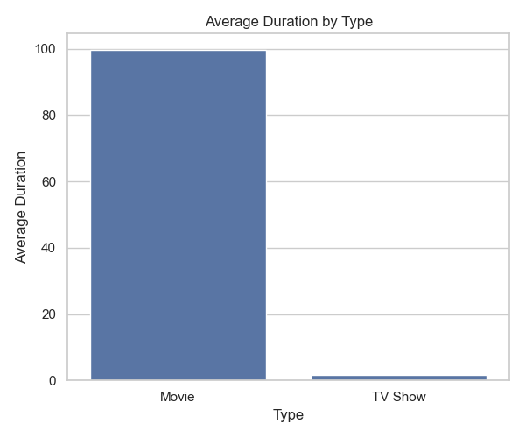
Average Duration by Type

