Slide 1

A COMPARISON OF THE ECONOMIC AND STATISTICAL SIGNIFICANCE OF TREE-BASED ENSEMBLES AND DEEP LEARNING MODELS IN BITCOIN TRADING
Rushikesh Borgaonkar
100403693

Slide 2
INTRODUCTION
Why Bitcoin?
Why LSTM & Random Forest?
Beyond Prediction?
Numerous cryptocurrencies in use
Bitcoin's unique standing due to:
Innovation
Market value
Impact on other cryptocurrencies
Importance of forecasting Bitcoin's price
Implications extend beyond a single currency
Potential insights into the larger cryptocurrency market
Random Forests:
Ease of decision trees
Effectiveness of ensemble learning
Robust and comprehensible model
LSTM networks:
Ideal for time-series data
Capability to remember long-term dependencies
Goal of the study:
Comprehensive understanding of applicability
Bridging the gap between different approaches
Ultimate Goal:
More than just price forecasts
Complete toolkit for Bitcoin stakeholders
Target Audience:
Long-term investors
Short-term traders
Academics in financial forecasting

Slide 3
Research Design & Data Handling
Research Paradigm: Positivist
Focus on objective measurements.
Empirical examination to draw conclusions.
Research Approach: Quantitative
Uses historical Bitcoin trading data.
Data Collection:
Source: Yahoo Finance.
Data Preprocessing:
Cleaning: Outliers, anomalies, missing values.
Data Split: 70% training, 30% testing.

Slide 4
Model Exploration & Comparative Analysis
Random Forest Model:
Ensemble of decision trees.
LSTM (Deep Learning Model):
Type of Recurrent Neural Network (RNN).
Efficient in handling time series data.
Comparative Analysis:
Metrics: Profitability, accuracy, RMSE, and others.
Analysis Factors: Model complexity, training time, performance, real-world applicability.
Insights:
LSTMs: Capture long-term dependencies.
Random Forest: Accuracy, interpretability, efficiency.

Slide 5
Overview of Results
Random Forest Performance
LSTM
Model Training Iterations:
Model performed consistently across different training window sizes.
Profitability:
Highest capital reached approximately $31,237,145.50.
Trading Strategy:
Implemented "long or short" trading strategy.
(Used for Short Term Trading)
Accuracy:
Accuracy from 51.89% to 78.30%.
Model Training Iterations:
Varied depending on the size of the window; larger windows took more time.
Profitability:
Capital reached approximately $19,002,979.05.
Trading Strategy:
Implemented "long or short" trading strategy.
(Used for Long Term Trading)
Window Size Sensitivity:
Performance sensitive to the size of the training window.

Slide 6
Key Papers:
Treleaven et al. 2013: Algorithmic Trading
Lessmann et al. 2015: Credit Scoring
Major Takeaways:
ML algorithms can forecast price changes down to the millisecond, enabling high-frequency trading strategies.
Credit scoring benefits from ML's ability to analyze broader data sets, increasing predictive accuracy.
ML models, especially deep learning, have become more accessible with frameworks like TensorFlow and Py Torch.
Machine Learning in Financial Computing
LITERATURE REVIEW

Slide 7
Key Papers:
Breiman 2001: Random Forest in Finance
Major Takeaways:
Random Forest amalgamates predictions from various decision trees, enhancing accuracy and reliability.
Tree-based models have been successfully applied to stock price prediction and credit risk assessment.
These models are often favored due to their ability to handle large datasets and provide interpretability.
Tree-based Ensembles in Predictive Modeling

Slide 8
Key Papers:
Sutskever et al. 2014: LSTM in Bitcoin Trading
Mnih et al. 2015: Deep Reinforcement Learning
Major Takeaways:
LSTMs, a type of RNN, excel in detecting and understanding long sequences, making them apt for time-series forecasting.
LSTMs have shown superior forecasting performance in volatile markets like Bitcoin when compared to traditional time-series models.
Deep Reinforcement Learning (DRL) offers dynamic trading strategies, adjusting to market shifts.
Deep Learning Models for Trading Analysis

Slide 9

Research Design & Data Collection
METHODOLOGY
Objective:
To evaluate deep learning and tree-based models in Bitcoin trading predictions.
Research Paradigm:
Positivist approach emphasizing empirical and objective analysis.
Data Source:
Yahoo Finance, covering 01/01/2021 to 05/07/2023.

Slide 10

Data Preprocessing & Model Selection
Data Preprocessing:
Handling missing values and outliers.
Feature Engineering (e.g., "Return").
Data normalization.
Models Selected:
Tree-based Ensemble: Random Forest
Deep Learning: LSTM

Slide 11

Model Development & Training
Random Forest:
Feature selection, data splitting, and Time Series Split.
LSTM:
Data scaling and model architecture.
Backpropagation for training.

Slide 12
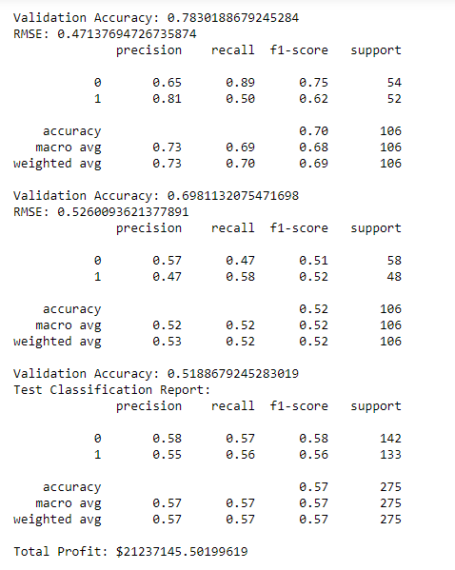
Evaluation & Comparative Analysis
Evaluation Metrics:
Accuracy, RMSE,Precision,Recall,F1 Score, Economic Indicators.
Comparative Analysis:
Complexity, Training Time, Performance.
Takeaways:
Suitability and resource implications for each model.

Slide 13
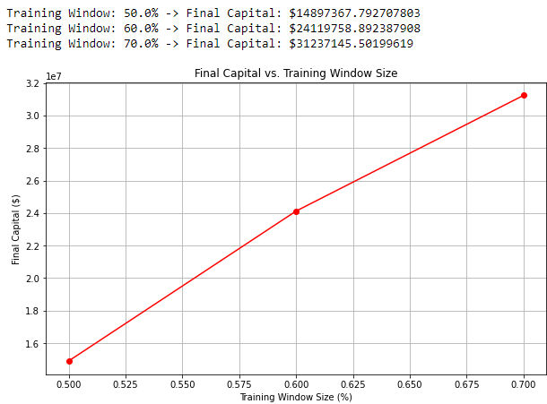
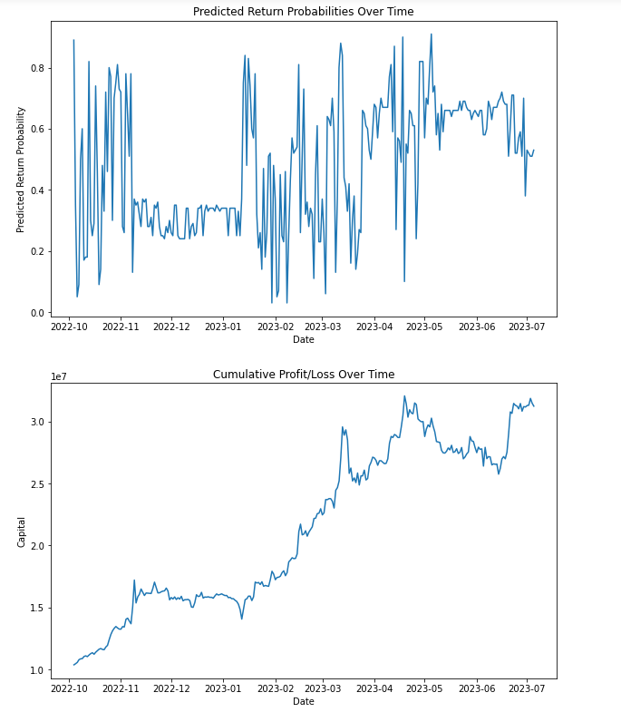
Random Forest Model Results
Model Training and Validation:
Time Series Cross-Validation (TSCV) with Multiple Training Windows (50%, 60%, 70%).
Performance Metrics:
RMSE values ranged from 0.408 to 0.806, Accuracy from 51.89% to 78.30%.
Profitability:
Best training window of 70% yielded $21.24 million in profit.
Visualization Insights:
Three key visualizations showing predicted returns, cumulative profit/loss, and final capital vs. training window size.

Slide 14
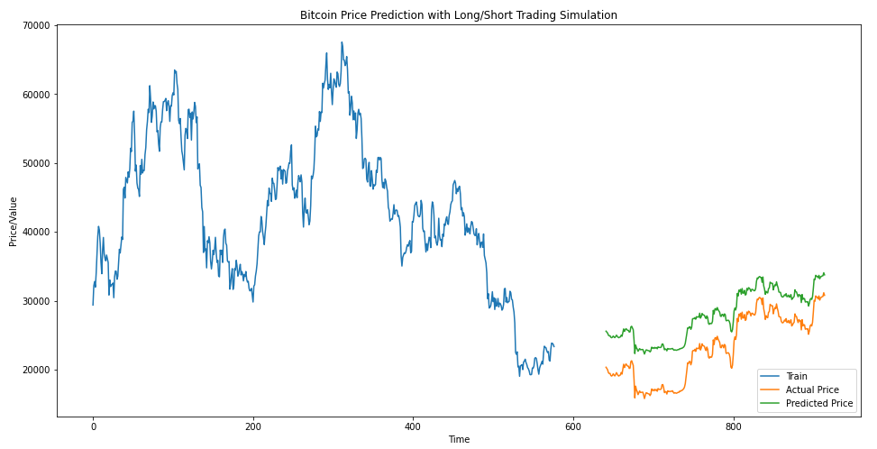
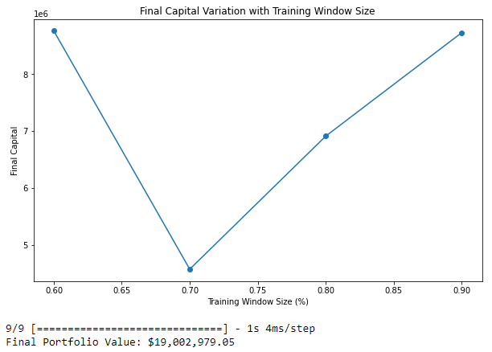
LSTM Model Results
Model Training and Validation:
Utilized various window sizes (60%, 70%, 80%, 90%).
Performance Metrics:
Multiple training iterations for optimization; portfolio value of about $19 million.
Profitability:
Predicted a profit of about $9 million with an original investment of $10 million.
Visualization Insights:
Actual vs. predicted Bitcoin prices, performance over different training window sizes.

Slide 15
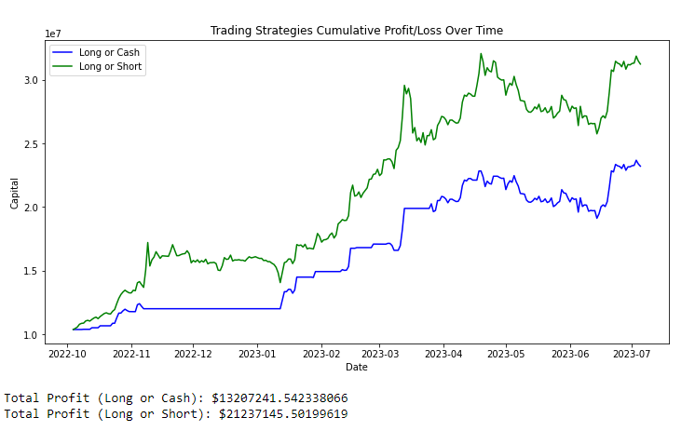
Comparative Analysis Results
Model Complexity and Training Time:
Random Forest is quicker, but LSTM captures long-term patterns.
Feature Interpretability:
Random Forest offers better feature importance metrics.
Performance Metrics:
Both models demonstrate substantial profitability but differ in adaptability to new data.

Slide 16
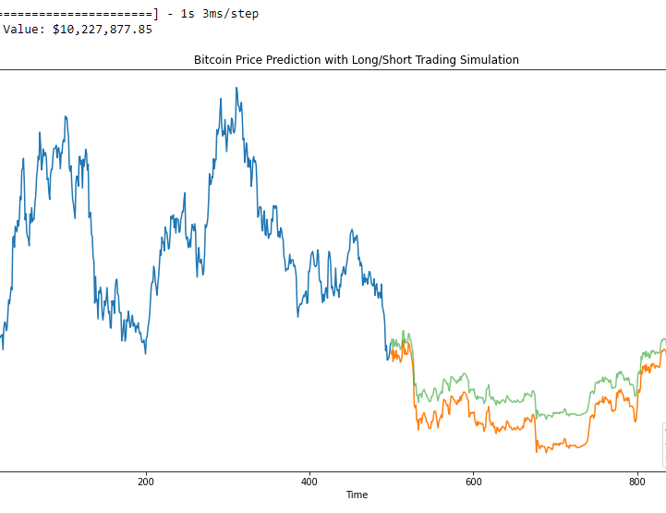
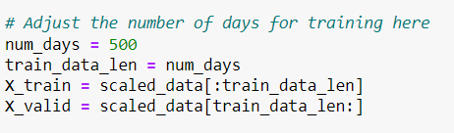
Data Splitting
Training and Validation Split:
The Training Data Is Chosen Over "num_days" for training.
The remaining data is used for validation purposes.
Data Sets Created:
X train​ for training
X valid​ for validation

Slide 17
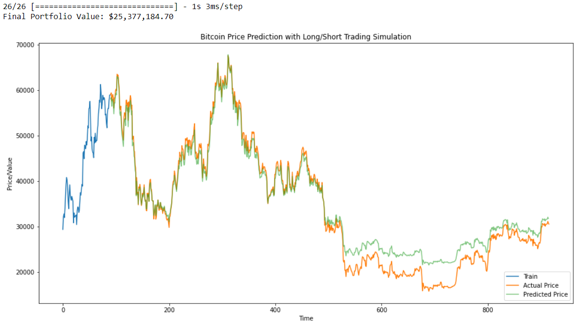
Num_Days = 90 days

Slide 18

Conclusion
Random Forest excelled in recognizing non-linear patterns.
LSTM showed robust adaptability across various training windows.
In Comparison Random Forest can be used for quick scalping trades where LSTM model can be used in High Volatile Market and for long term trades.
Practical Implications:
Both models enable trading strategies that could yield substantial profits.
Comparative Analysis:
Each model has its pros and cons, offering valuable insights for stakeholders.

Slide 19

Future Work and Limitations
Limitations:
Historical data reliance
External factors
Model interpretability
What I Would Do With More Time:
Integrate Sentiment Analysis and Blockchain Analytics.
Explore Hybrid Models combining LSTM and other architectures.
Develop real-time prediction systems for high-frequency trading.
Investigate the impact of future regulations on Bitcoin prices.

Slide 20

Thanks for your attention. Do you have any questions?

