Slide 1
Presentation Slides
To be used for creating a PowerPoint or Google Slides presentation.
---

Slide 2
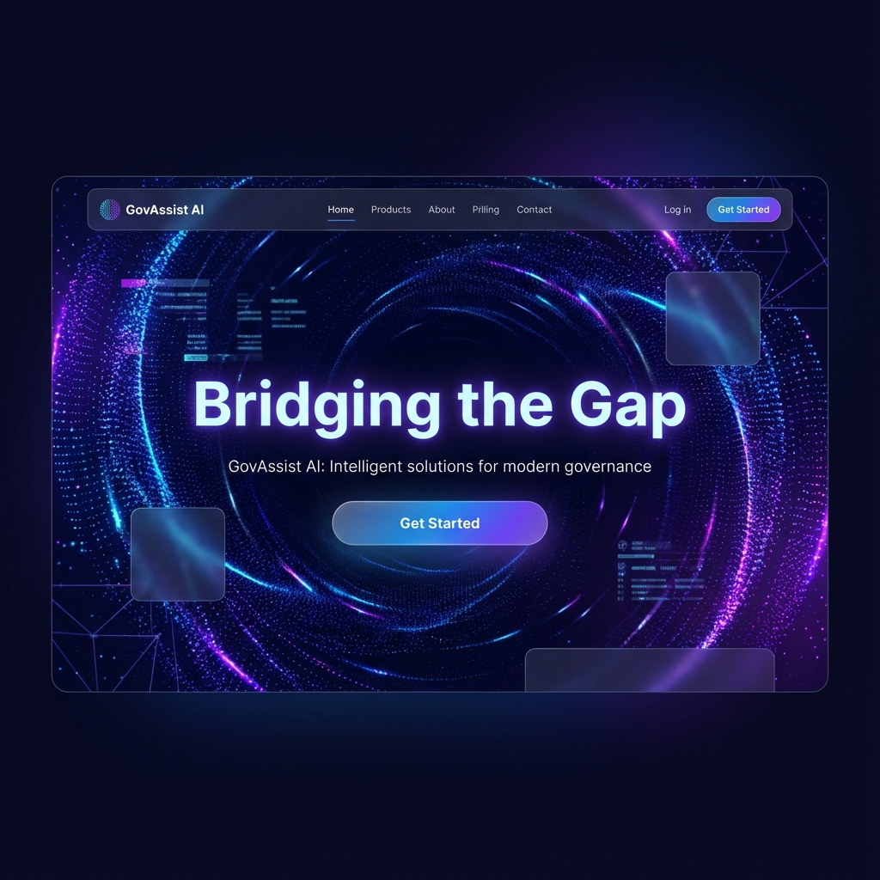
GovAssist AI
Bridging the Gap Between Citizens and Welfare Schemes
December 2025

Slide 3
The Problem
Why do we need GovAssist?
* **Information Gap:** Thousands of schemes exist, but citizens don't know which ones apply to them.
* **Language Barrier:** Official documents are often in English or complex bureaucratic language.
* **Complex Processes:** Application procedures are confusing and documentation requirements are unclear.
* **Low Literacy:** Many beneficiaries cannot type or read long textual descriptions.
---

Slide 4
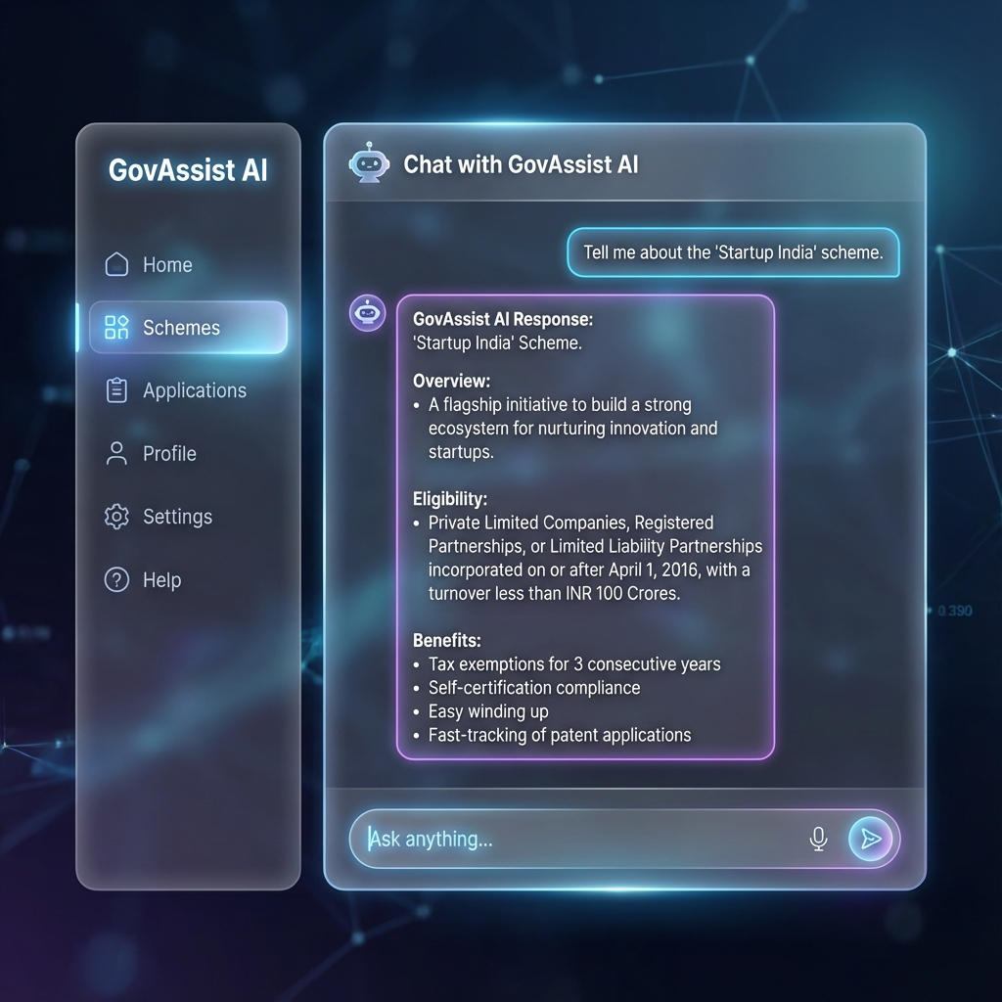
Our Solution
GovAssist AI: Your Personal Welfare Companion
* **Conversational AI:** Don't search, just ask. Talk to the AI like a human assistant.
* **Personalized:** Recommendations based on age, income, location, and caste/category.
* **Accessible:** Native support for local languages (Hindi, Marathi) and Voice interactions.
* **One-Stop Platform:** Discover, Understand, and Verify documents in one place.
---

Slide 5
Key Features (1/2)
* **🤖 Smart Chatbot:** Powered by RAG (Retrieval Augmented Generation) to provide accurate, fact-checked answers about government schemes.
* **🗣️ Voice Interaction:** Speak to the app in your local language. Powered by OpenAI Whisper for high-accuracy transcription.
* **🌐 Multi-Language Support:** Instant toggle between English, Hindi, and Marathi.
---

Slide 6
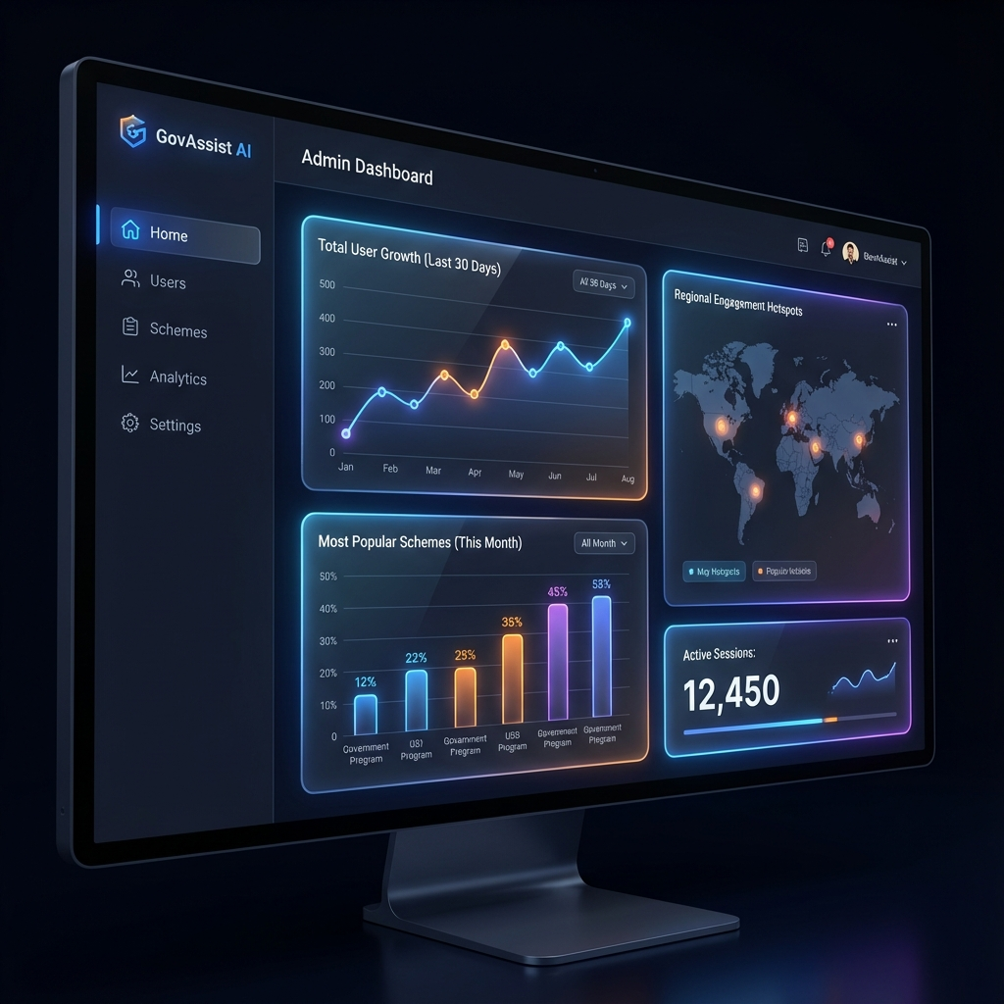
Key Features (2/2)
* **📄 Document Analysis:** Upload photos of documents (Aadhar, Income Cert) for instant validation and data extraction using OCR.
* **⌨️ Virtual Keyboard:** Built-in regional language keyboard for easy typing.
* **🛠️ Admin Dashboard:** Management portal for officials to update schemes and manage users.
---

Slide 7
Technical Architecture
* **Frontend:**
* React.js with Vite (High Performance).
* Tailwind CSS (Modern "Glassmorphism" UI).
* Framer Motion (Smooth Animations).
* **Backend:**
* FastAPI (Python) - High-speed API.
* SQLAlchemy & SQLite - Robust Data Management.
* **AI Engine:**
* Vector Search for relevant scheme retrieval.
* Whisper Model for Speech-to-Text.
---

Slide 8
User Experience (UI/UX)
* **Modern Design:** Clean, futuristic interface designed to build trust.
* **Responsive:** Works perfectly on cheap smartphones and desktops alike.
* **Simple Navigation:** No complex menus; focused on the Chat interface.
* **Visual Feedback:** Loading skeletons, success toasts, and interactive particle backgrounds.
---

Slide 9
Business/Social Impact
* **Empowerment:** Citizens become self-reliant in finding help.
* **Efficiency:** Reduces burden on government help centers by answering FAQs automatically.
* **Transparency:** Provides clear, un-biased information about benefits.
---

Slide 10
Future Roadmap
* **Phase 1 (Current):** Discovery & Information.
* **Phase 2:** Automated Form Filling & Application Submission.
* **Phase 3:** Integration with DigiLocker.
* **Phase 4:** WhatsApp Bot integration for wider reach.
---

Slide 11
Conclusion & Q&A
GovAssist AI is more than just an app; it's a step towards Digital Governance.
* **Thank You!**
* **Questions?**

