Slide 1

A Big Data Dive into the IMDb Flim Universe
GROUP DELTA MEMBERS:
RUSHIKESH SAWANT(sawant.ru@northeastern.edu)
MELIKE UZUN (uzun.me@northeastern.edu)
SNEHAL PAWAR (pawar.sne@northeastern.edu)
Course Title: ALY6110 – Big Data and Data Management
Course Number (CRN): 70362
This Photo by Unknown Author is licensed under CC BY-SA

Slide 2

SUMMARY
In this project, we embark on a data exploration of a vast IMDb dataset comprising a million records, aiming to extract valuable insights for a movie production team which wants to identify which genres , languages and other necessary factors will yeild high profiablity for a new movie. This project explores a massive IMDb dataset using Big Data technologies like Databricks and Snowflake. We extract valuable insights through data cleaning, data merging, and visualization. The outcome is an interactive Power BI dashboard showcasing key findings like movie trends, audience preferences, and filmmaker contributions.
List the technologies used:
Databricks with PySpark: For data fetching, cleaning, and preprocessing
Snowflake: As a data lake for data storage
Power BI: For creating an interactive dashboard

Slide 3

Content
Process:
Data Acquisition: Secure connection to Snowflake, extract data from source, import into Databricks
Data Cleaning: Address missing values, formatting issues, ensure data quality
Data Merging: Join relevant tables based on business requirements
Data Export/Table Creation: Send processed data back to Snowflake for storage
Visualization: Power BI dashboard displaying key insights like:
Number of viewers, movies, and languages
Movie distribution by region
Average rating and vote totals by region
Film with the highest rating and votes

Slide 4
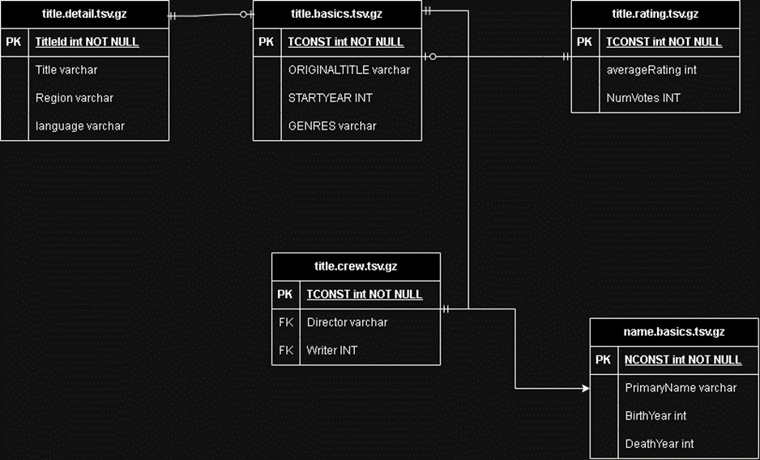
Introduction to Dataset
The IMDb Non-Commercial Datasets offer a valuable resource for Film enthusiasts and researchers, providing subsets of IMDb data for investigation and drawing insights from the films data. The dataset Consists of 1,048,576 rows compromised in various tables.
In leveraging the IMDb Non-Commercial Datasets, research is conducted to draw insights from the vast film-related information contained within the datasets. Film enthusiasts and researchers can explore trends, correlations, and patterns by analyzing key datasets such as 'title.basics,' 'title.ratings,' and 'title.principals.'

Slide 5
The workflow of data fetching, cleaning, and preprocessing in the project using Databricks and PySpark involves several key steps: 1.Utilizing Snowflake as Data Lake
2.Establish connection with Snowflake Database
3.Import Data into Databricks
4.Data Cleaning
5.Merge Tables as per Requirement
6.Export / Create a New Table within Snowflake 7.Final Connection of Snowflake to Power BI
Workflow of Data fetching, cleaning and preprocessing

Slide 6
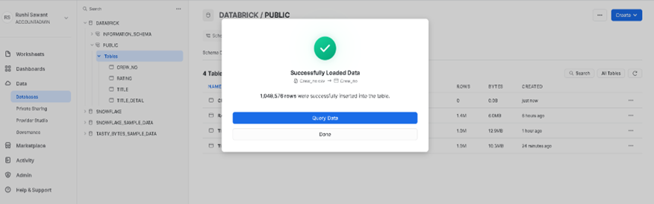
Using Sowflake as a DataLake
Uploading dataset to Snowflake as per the required Schema
Providing the right Access to users for ease of access with regards to data fetching and schema creation
In Snowflake, the process of establishing a new database involves utilizing the "Create New Schema" option within the Snowflake platform. This functionality enabled to define and designate a database, with the chosen nomenclature for this instance being "DATABRICK."

Slide 7
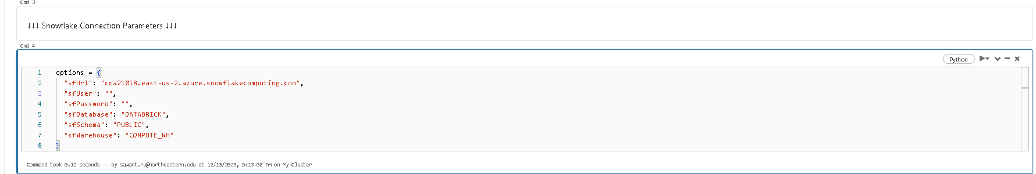
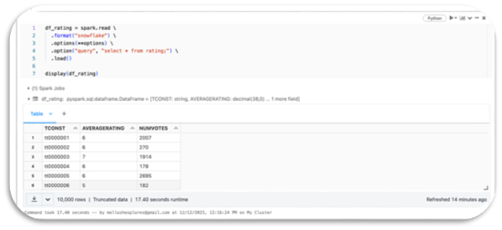
Unlocking Insights from IMDb Dataset present in Snowflake - Part1
Securely connected to Snowflake database & warehouse.
Read data from snowflake tables into Spark DataFrame.
Extracted essential info: TCONST, AVERAGE RATING, NUMVOTES.
Acquired TITLE & TITLE ID using "spark.read".
Enriched data by joining tables on matching IDs.
Consolidated data into "Final_Dataset" on Snowflake.
Cleaned & prepped data for further analysis.

Slide 8
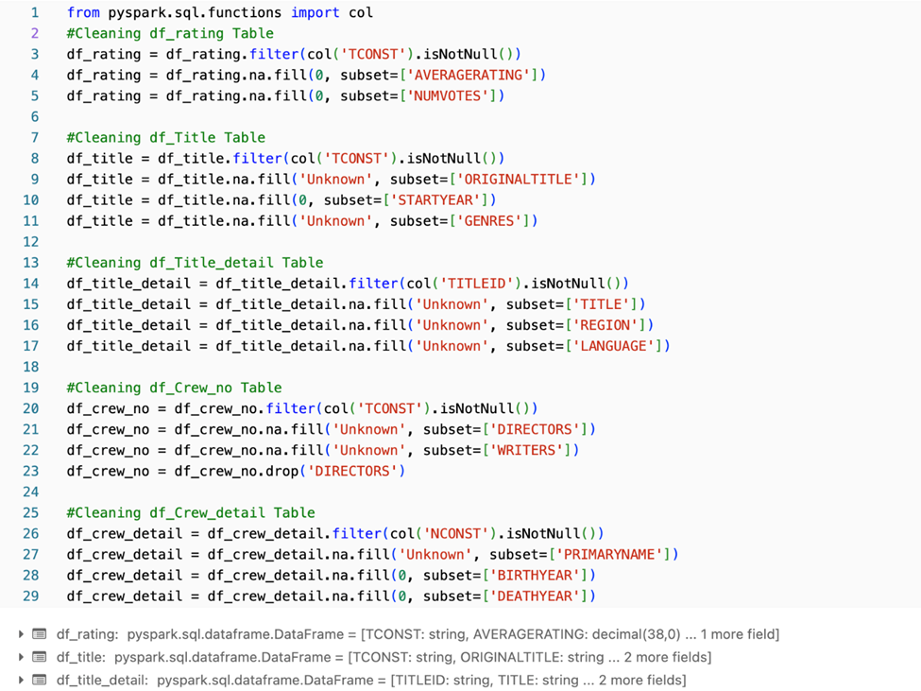
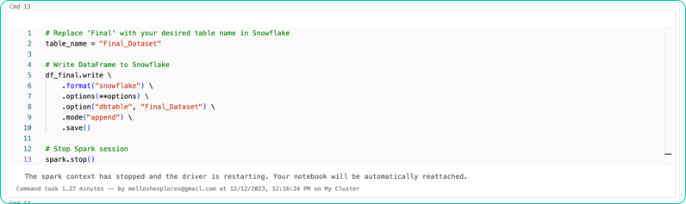
Unlocking Insights from IMDb Dataset present in Snowflake - Part 2
Securely connected to Snowflake database & warehouse.
Read data from snowflake tables into Spark DataFrame.
Extracted essential info: TCONST, AVERAGE RATING, NUMVOTES.
Acquired TITLE & TITLE ID using "spark.read".
Enriched data by joining tables on matching IDs.
Consolidated data into "Final_Dataset" on Snowflake.
Cleaned & prepped data for further analysis.

Slide 9
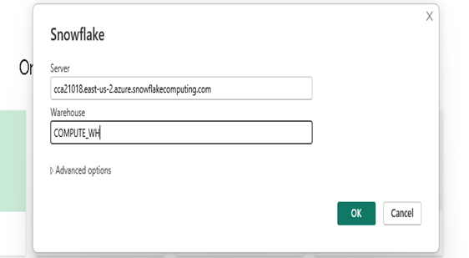
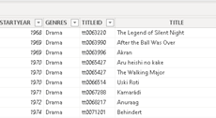
Connectivity between PowerBI and SnowFlake
We establish a connection between powerBI and Snowflake using the connector present within the PowerBI AP.
After successfully fetching the data from our dataLake which is snowflake we create a dashboard within powerBI to draw insights from the data.

Slide 10
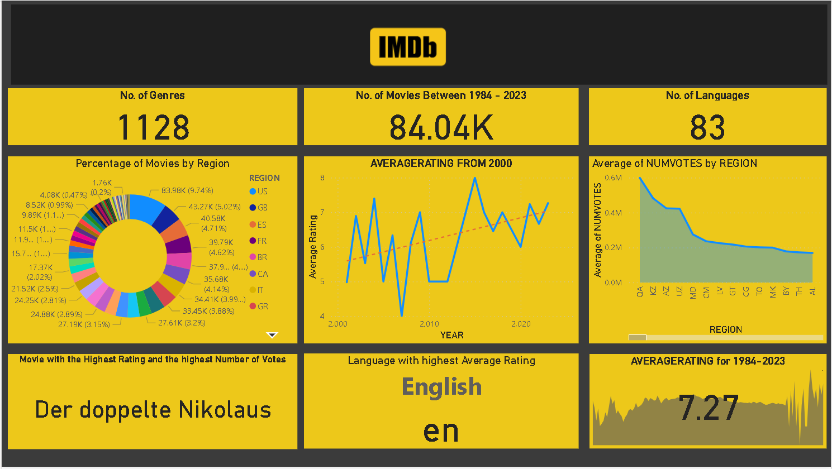
KEY FINDINGS FROM DATA VISUALIZATION USING POWER BI
Vastness of Content: Over 84,000 movies in 83 languages listed on IMDb!
Regional Dominance: US leads the pack with 9.74% of movies, followed by Canada (4.14%) and France (4.62%).
Rating Variations: See how average ratings and vote counts differ across regions. Click a country to explore its specifics (e.g., US highlighted).
Critical Acclaim: "Der doppelte Nikolaus" (1964) reigns supreme with a 9.7 rating and the most votes.

Slide 11
COMMENTS
Pros: Efficient data processing with PySpark, secure data storage in Snowflake, interactive visualization with Power BI.
Cons: Initial setup complexity, potential data quality issues, learning curve for new tools.
Challenges: Handling large datasets, ensuring data accuracy, designing effective visualizations.

Slide 12

Conclusion
Big Data research exposes significant insights from massive datasets like IMDb.
Databricks and Snowflake provide a strong and scalable data processing platform.
Power BI offers better insight communication through interactive dashboards.
This study highlights Databricks and Snowflakes connectivity and potential for boosting decision-making in the film business.
Future Directions:
Integrate additional data sources for richer insights.
Develop predictive models for movie success and audience preferences.

Slide 13

Questions Please

Slide 14
Reference:
IMDb Datasets. (n.d.). Retrieved from https://datasets.imdbws.com/
Databricks Community. (n.d.). Notebook: [Big-Data-Final-Project-Group-Delta]. Retrieved from https://community.cloud.databricks.com/?o=7746998554581331#notebook/3182721693671259/command/3182721693671260
Power BI. (n.d.). Report: [Big-Data-Final-Project]. Retrieved from https://app.powerbi.com/groups/me/reports/83dececc-b9ec-4250-9321-afbb2dd2f095/ReportSection?experience=power-bi&redirectedFromSignup=1
Snowflake. (n.d.). Snowflake | Data Warehouse Built for the Cloud. Retrieved from https://www.snowflake.com/en/
Intellipaat. (n.d.). 10 Big Data Examples: Application of Big Data in Real Life. Retrieved from https://intellipaat.com/blog/10-big-data-examples-application-of-big-data-in-real-life/
Adminran, & Adminran. (2023, April 17). What are real-life examples of the application of big data analytics? - Magnimind Academy. Magnimind Academy - Launch a new career with our programs. https://magnimindacademy.com/blog/what-are-real-life-examples-of-the-application-of-big-data-analytics/
Muskan. (n.d.). Big data in media and entertainment industry | Analytics Steps. https://www.analyticssteps.com/blogs/big-data-media-and-entertainment-industry
Selerity. (2023, November 7). Big data analytics platforms and the entertainment industry. Selerity. https://seleritysas.com/2020/10/09/big-data-analytics-platforms-and-the-entertainment-industry/

Slide 15
Thank You …

