Slide 1
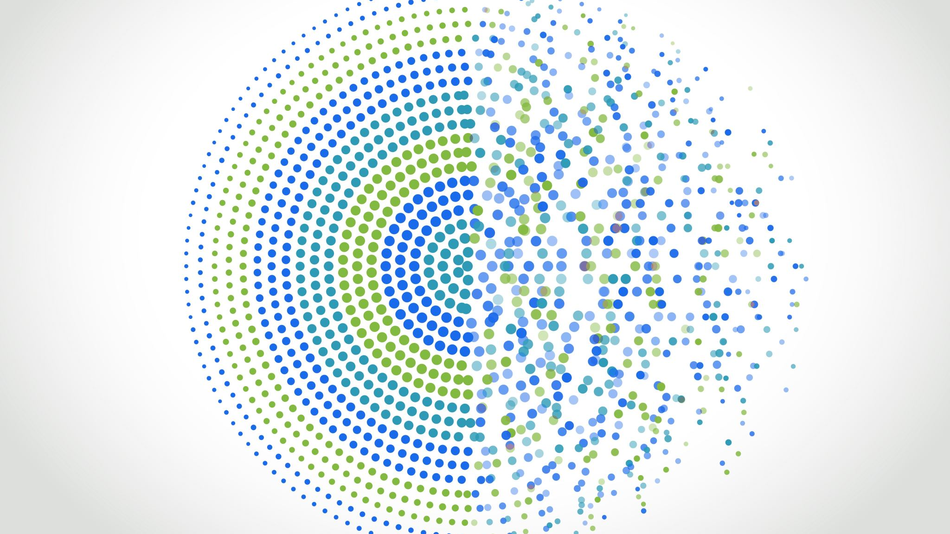
Earthquakes 1920 - 2020
Rushikesh Sawant
ALY 6000

Slide 2
overview
The dataset is of Significant Earthquakes for 100 years (1921-2020) which can give us an idea of the overall destruction and harm to life in different countries and over time and different magnitude whether the total deaths and destruction increased or decreased.
Further, the analysis can tell us about the different types of destruction caused by earthquakes, and based on that we can answer a few questions:
• Are regions close to the tectonic plate edges most affected by Earthquakes? • What is the corelation between magnitude and total death /Total Damage? • Over the past decade, which countries are the most affected by earthquakes?

Slide 3

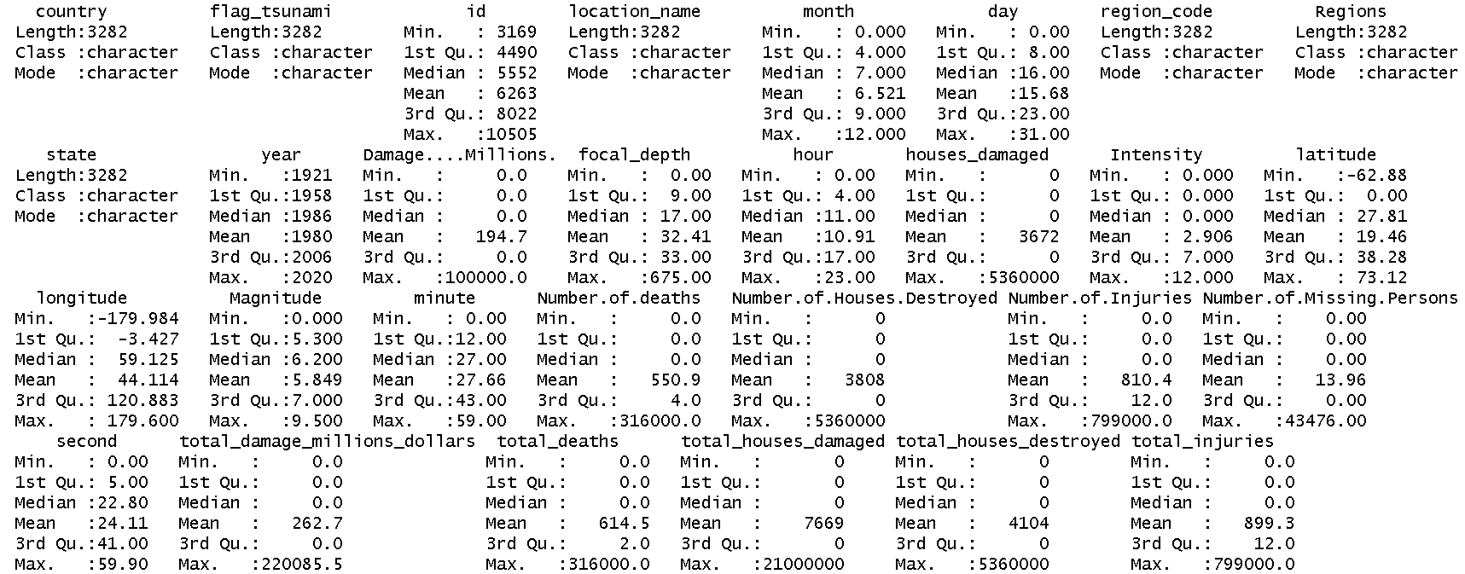
Data Summary
Data Summary The Summary of the dataset gives an idea about the total attributes i.e. 30. It shows the mean of Magnitude and duration from different earthquakes. From the summary it can be inferred the average Magnitude is of 5.8 on richter scale and an average damage of 262 million dollars.

Slide 4
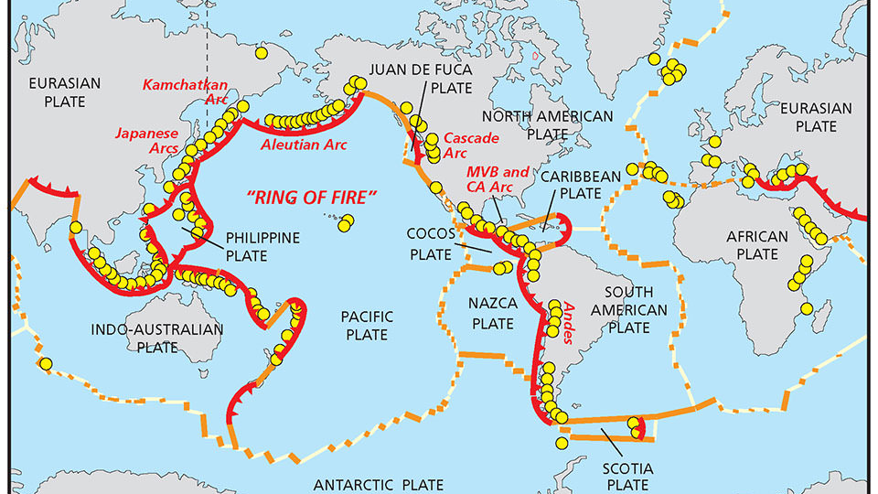
Are regions close to the tectonic plate edges most affected by Earthquakes?

Slide 5
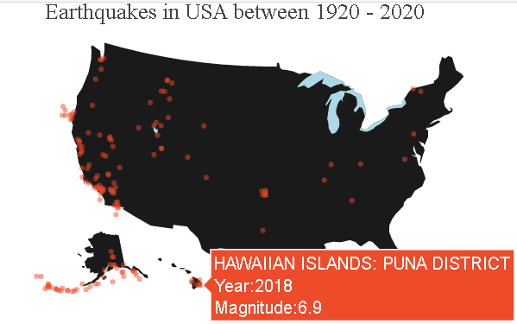
Are regions close to the tectonic plate edges most affected by Earthquakes? Majority of the earthquakes are inferred to be cased around the edges of the tectonic plates.
Considering the complete data set as the population size , will be considering the data associated with USA in the dataset as a significant sample to confirm the understanding.
The West coast of United states observes the highest number of earthquakes.
The states of California and Alaska observe the greatest number of earthquakes of any states.

Slide 6
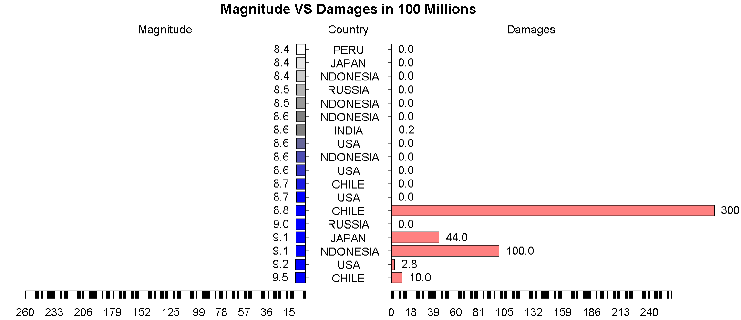
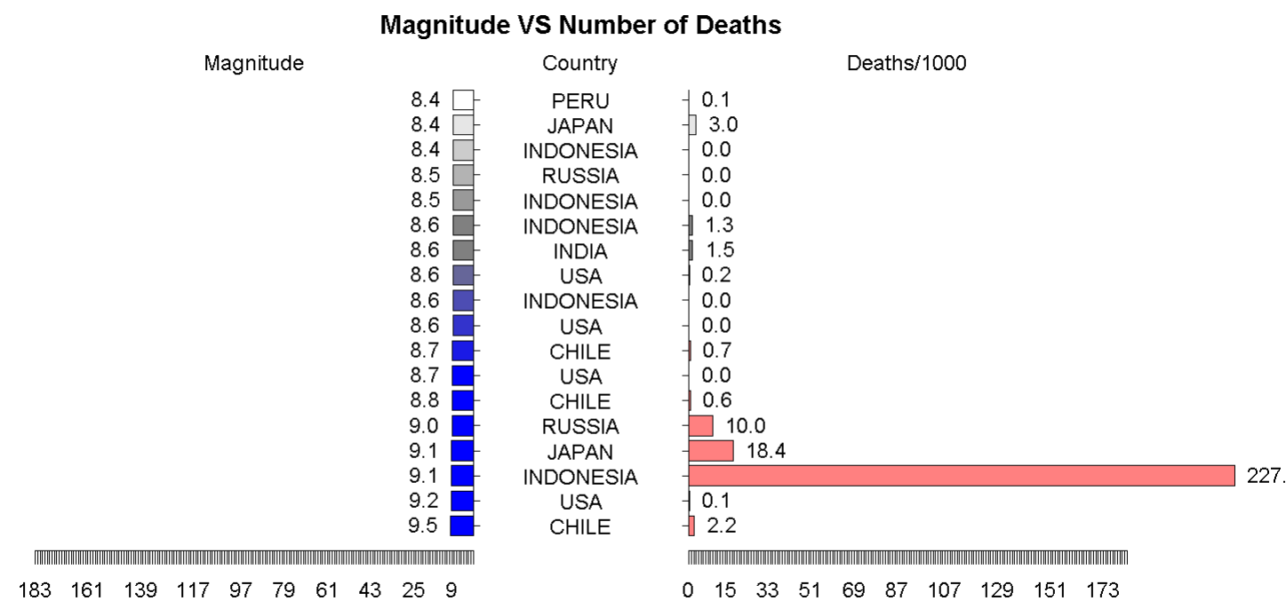
What is the correlation between magnitude and total death /Total Damage?
For a Positive Correlation, the number of deaths should increase with higher the magnitude, similarly the amount of damage in billions should increase with higher the magnitude.
From the graphs it can be inferred,
There is no Positive or Negative Correlation between the magnitude and the number of deaths.
There is no Positive or Negative Correlation between the magnitude and the amount of damage in billions.
The amount of damage and total death , further depend on external factors like population size and earthquake sustainable construction of the are under consideration

Slide 7
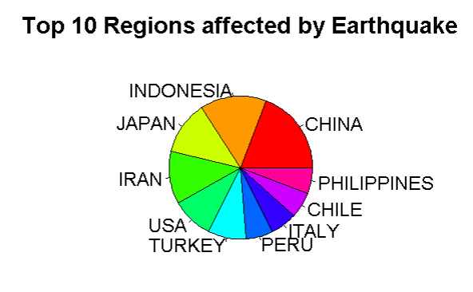
Over the past decade, which countries are the most affected by earthquakes?
Counting the Number of Earthquakes faced by the different countries and sorting them from highest to lowest
It can be inferred , China, Indonesia, Japan, Iran ,USA , Turkey , Peru, Italy, Chile , Philippines faced the highest number of Earthquakes.
All these countries , either have tectonic plates within their region or in close proximity of their borders.

Slide 8
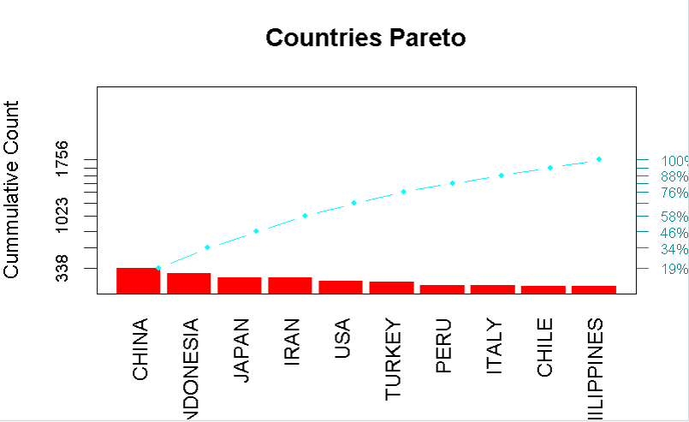
Over the past decade, which countries are the most affected by earthquakes?
From the Pareto Chart:
China faces the highest number of earthquakes in the top 10 countries facing the earthquakes. It contributes to 19% of the earthquake's world with 338 earthquakes.
Indonesia ,Japan , Iran , USA also faced a high number of earthquakes over the past decade.

Slide 9
Conclusion
Certainly, here are some possible conclusions that could be drawn from earthquake data
Earthquakes occur regularly and frequently around the world, with thousands of seismic events happening every day where China has the highest number of earthquakes over the last decade.
The majority of earthquakes are small, with magnitudes of less than 2.5
However, larger earthquakes with magnitudes of 5 or higher can cause significant damage and loss of life, especially if they occur in densely populated areas or near infrastructure however this is no corelation between magnitude and total death and damages incurred.
Earthquakes can be caused by a variety of factors, including tectonic plate movements, volcanic activity . With regions around tectonic plates being affected the most
Finally, it's important to remember that earthquakes are a natural part of the Earth's geological processes, and while they can be devastating, they are also a reminder of the planet's dynamic and ever-changing nature and we as humans should be well equipped for such natural calamities.

Slide 10
bibliography
[1] US Department of Commerce, N. O. and A. A. (2014, July 18). What is tectonic shift? NOAA's National Ocean Service. Retrieved February 14, 2023, from https://oceanservice.noaa.gov/facts/tectonics.html
[2] Michigan Technological University. (2021, October 4). Earthquake magnitude scale. Michigan Technological University. Retrieved February 14, 2023, from https://www.mtu.edu/geo/community/seismology/learn/earthquake-
[3] Relative frequency. Math is Fun. (n.d.). Retrieved February 15, 2023, from https://www.mathsisfun.com/data/relative-frequency.html
[4] Kumar, G. S. (2022, June 11). How to delete rows in R? explained with examples. Spark By {Examples}. Retrieved February 15, 2023, from https://sparkbyexamples.com/r-programming/drop-dataframe-rows-in-r/
[5] Holtz, Y. (n.d.). Ggplot2 Piechart. – the R Graph Gallery. Retrieved February 15, 2023, from https://r-graph-gallery.com/piechart-ggplot2.html
[6] Jim Lemon, B. B. (2021, September 8). Pyramid.plot: Pyramid plot in Plotrix: Various plotting functions. pyramid.plot. Retrieved February 15, 2023, from https://rdrr.io/cran/plotrix/man/pyramid.plot.html
[7] What is an earthquake and what causes them to happen? What is an earthquake and what causes them to happen? | U.S. Geological Survey. (n.d.). Retrieved February 15, 2023, from https://www.usgs.gov/faqs/what-earthquake-and-what-causes-them-happen
[8] The Science of Earthquakes. The Science of Earthquakes | U.S. Geological Survey. (n.d.). Retrieved February 15, 2023, from https://www.usgs.gov/programs/earthquake-hazards/science-earthquakes

