Slide 1
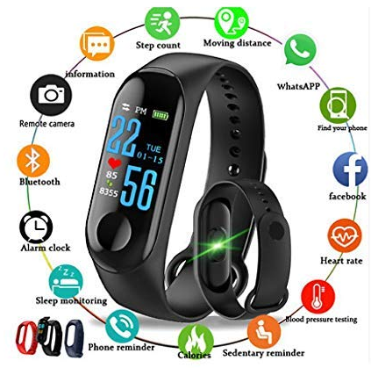

1.Introduction:-
Time management is important for every individual’s personal life and career success. It teaches how to effectively manage time and make the most out of it. There is a lot of time wasted each day, which can be put to better uses. Small changes can be made, which will effectively increase the time left at your disposal every day, this would also enable you to focus on what you are doing, without stress and strain.
Waking up at the correct point of time in the morning not only helps in waking up less tired and fully alert but also saves time during commute, if the delay caused by traffic is already taken into consideration to set the alarm time. Adequate sleep optimally impacts mental functioning and therefore impacts students’ performance during examinations or otherwise. The pattern of sleep one experiences in a 24-hour period directly correlates with physical health, mood, and mental functioning.
One goal of such technologies is to collect information that can increase users’ awareness of their sleep habits to persuade them to adopt healthier routines.
EarlyBuddy:
Smart Clock for Alarms and Routines
2.Problem Statement:-
Realizing the need of efficient management of time as well as sleep for an individual, while setting an alarm for the morning, by designing an application that reliably wakes the user while keeping them alert and focused, that too on time-every time.
3.Objectives:-
Optimizing quality of user’s life
Monitoring sleep behavior
Increasing awareness of the positive effects of adequate sleep
Recognizing heavy sleepers
5.Proposed Methodology:-
Analyzing traffic data using TOMTOM API for different time frames and routes to determine best algorithm for alarm time adjustment.
Research on various sleep-cycles of different users for heavy sleep functionality to help reduce grogginess or tiredness.
Exploring phone’s inbuilt accelerometer to determine user’s sleep activities accurately, without much battery drain.
Name of Team Members | Title | Sign
Amruta Dabholkar | EarlyBuddy: Smart Clock for Alarms and Routines
Bhavana Choudhary
Rushikesh Gajmal
Name of Team Members | Title | Sign
Amruta Dabholkar | EarlyBuddy: Smart Clock for Alarms and Routines
Bhavana Choudhary
Rushikesh Gajmal
Name of Team Members | Title | Sign
Amruta Dabholkar | EarlyBuddy: Smart Clock for Alarms and Routines
Bhavana Choudhary
Rushikesh Gajmal
Name of Team Members | Title | Sign
Amruta Dabholkar | EarlyBuddy: Smart Clock for Alarms and Routines
Bhavana Choudhary
Rushikesh Gajmal
6.Tools, Platform, Resources & Cost of Project :-
Name of Team Members | Title | Sign
Amruta Dabholkar | EarlyBuddy: Smart Clock for Alarms and Routines
Bhavana Choudhary
Rushikesh Gajmal
Name of Team Members | Title | Sign
Amruta Dabholkar | EarlyBuddy: Smart Clock for Alarms and Routines
Bhavana Choudhary
Rushikesh Gajmal
Platform: Android application
Web API’s required:
TomTom: To get the traffic data that the application requires, the application polls the API for the data on the user’s journey i.e. start and end location, and time of arrival.
Google Maps: Using the Google Maps API, the application supplies the user with a map in which they can enter their journey details.
Google Maps Geocoder: This API allows the application to convert longitude and latitude points into actual addresses, which are more understandable and user friendly.
Phone’s accelerometer: updates its X, Y, Z axis values to detect movement.
MPAndroidChart for Analysis Section
Realm Database
•Stetho for Realm Database Debugging

