Slide 1

EarlyBuddy
Team Member
01
Amruta Dhabholkar
Student
BE Project Proposal
02
Bhavna Chudhary
Student
03
Rushikesh Gajmal
Student
04
Dr. Varsha Shah
Mentor,Princippal
06/11/2019

Slide 2





EarlyBuddy
List of Contents :
Introduction
Problem Statement
Literature Review
Objectives
Implementation Plan
Realizing the need of efficient management of time.
Realizing the need of an efficient and multipurpose alarm system.
Reviewing existing system and limitations encountered.
Discussing the goals to be met while application designing.
Different phases required for project completion.

Slide 3
EarlyBuddy
List of Contents :
System requirements
System Design
Conclusion
Future scope
References
Device (mobile/tablet) supporting android version 5.0
Using TomTom API and phone’s inbuilt accelerometer.
EarlyBuddy is the one-stop solution for commuters with multiple added functionalities.
To add support for local transport and fitness wearables
Citations of various reputed papers

Slide 4
EarlyBuddy
Introduction :
Waking up at the correct point of time in the morning saves time during commute if the delay caused by traffic is already taken into consideration while setting the alarm time.
Apps designed for alarms with additional functionality like tracking user location during their journey, are available already but their features are limited.
The quality and quantity of sleep, both, help one positively and also play an important role in one’s health. A positive effect can be seen on performance due to good sleep, while a lack of sleep can affect one’s memory, alertness, cognitive functioning, learning abilities, and also immune system.
EarlyBuddy is a smart alarm app that uses traffic data and sleep-cycle analysis to wake up user at the best possible time.
Once a timeframe is entered, the application polls the API for data about the journey the user specified. If the journey is affected by delays and the user will be late, the application will wake the user up immediately.

Slide 5




EarlyBuddy
Problem Statement :
Realizing the need of efficient management of time as well as sleep while planning a commute by finding the best time to sleep and wake-up.
Designing an application that reliably wakes the user while keeping them alert and focused, that too on time-every time.
Helping heavy sleepers to wake up less tired, less groggy and fully awake, using persuasive measures like mental exercises.
Improving performance and reducing problems like sleep irregularity, grogginess, snoring, tiredness, etc., which are detrimental to a person’s personal and professional lives.

Slide 6



EarlyBuddy
Literature Review :
Existing apps track user location during their journey and remind the user to wake up before they reach their journey destination, but this feature cannot be used to ensure that the user will reach there on time and not get delayed in traffic.
Few alarm apps support functionality like mind-activities for heavy sleepers, sleep tracking using mobile sensors, weather updates, etc. but they do not analyse traffic data.
Sleep is monitored only when an alarm is set in the app
Hit and miss of TomTom API
Less accuracy of phone’s accelerometer
Inability to set different routes at once
Existing System
Limitations

Slide 7

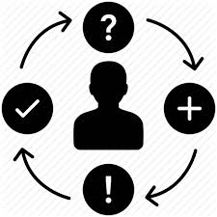


EarlyBuddy
Objectives :
Waking up at the correct point of time in the morning not only helps in waking up less tired and fully alert but also saves time during commute, if the delay caused by traffic is already taken into consideration to set the alarm time.
Quality Sleep
Awareness
Performance
Heavy sleepers
Optimizing quality of user’s waking life, including his/her productivity, immune system, creativity, vitality, and even weight.
Monitoring sleep and collecting information that can increase users' awareness of their sleep habits and persuade them to adopt healthier routines.
Good sleep can positively affect our performance, while a lack of sleep can affect our memory, immune system, cognitive functioning, learning abilities, and alertness.
Recognizing heavy sleepers and help make their mind alert in morning by including various activities to prevent snoozing, snoring or grogginess.

Slide 8
EarlyBuddy
Algorithm:
Set time or timeframe for the alarm.
Analyze sleep patterns using phone’s accelerometer based on “big” movements calculated as below.
Optionally add the journey route and daily routine activities.
Chart the analyzed sleep patterns of user on graph.
Now the alarm is added.
Heavy sleepers function to ensure they are fully awake and not snoozing.
Find the best time for the alarm from the set timeframe based on traffic analysis by TomTom API and considering any added routines.

Slide 9




EarlyBuddy
Implementation Plan :
Our project will be implemented in different phases:
Planning & Requirement
Gathering
The first phase would be to implement the basic user interface for setting an alarm which would include a clock to set time and options to add journey and routine respectively.
Design
After that we will implement the algorithm for performing accurate sleep analysis using the phone’s accelerometer.
Coding and implementation
These applications remind the user to wake up before they reach their journey destination.
Testing and bug fixing
The next phase would include adding heavy sleeper functionality to pop-up on hitting snooze.
This functionality includes activities like solving simple math problem or entering correct text to shut down the alarm.
Deployment

Slide 10



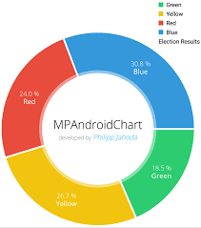
EarlyBuddy
Framework and API used :
TomTom
To get the traffic data that the application requires, the application polls the API for the data on the user’s journey
Using the Google Maps API, the application supplies the user with a map in which they can enter their journey details.
Google Maps
Realm Database
•Stetho for Realm Database Debugging
For Analysis Section
MPAndroidChart

Slide 11
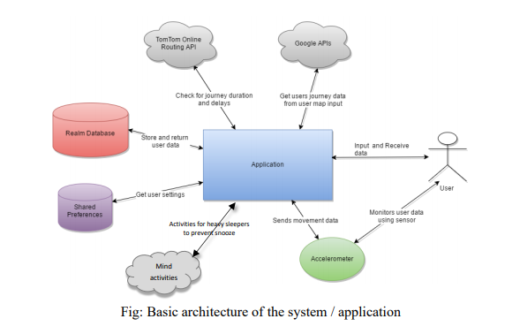
EarlyBuddy
UseCase Diagram :

Slide 12
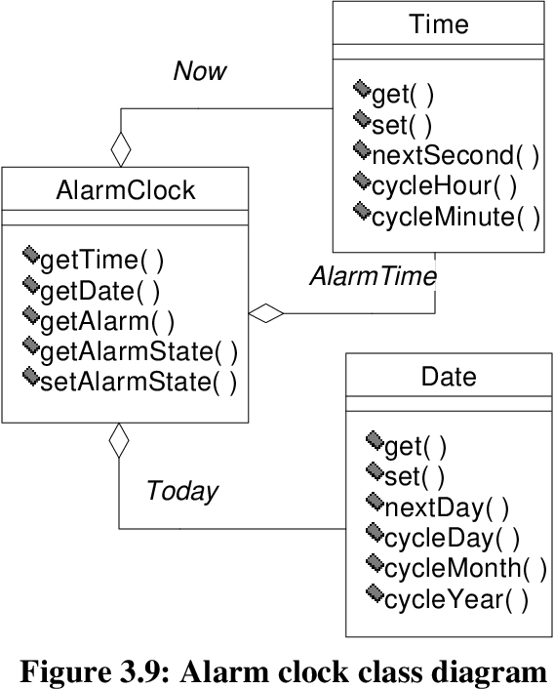
EarlyBuddy
Class Diagram :

Slide 13
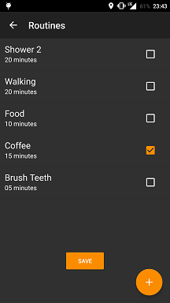
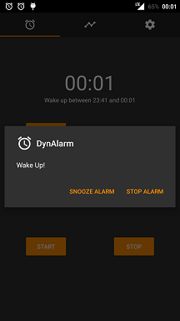

Slide 14
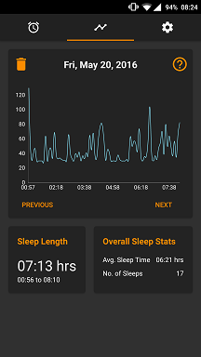
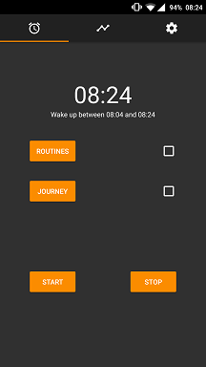
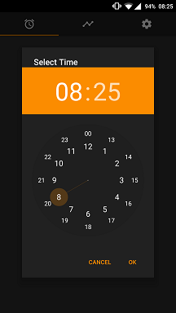
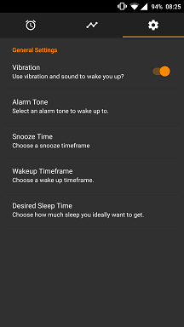

Slide 15
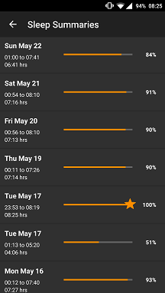
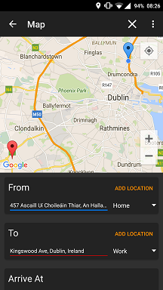

Slide 16






EarlyBuddy
Conclusion :
Sleep is a physiological process essential to life,Cognitive performance is susceptible to inadequate sleep durations, defined as fewer than 7 hours a day for adults.Inadequate sleep
decreases general alertness and impairs attention.
Sleep deprivation and symptoms related to
sleep disorders have not only been ignored but also inadequately understood.
In this project we design a system / application that can be used for bettering every individuals sleeping habits, giving them an opportunity to get maximum possible sleep and reaching destinations on time every day.
The additional functionality for heavy sleepers is widely popular in recent alarm application available.

Slide 17
EarlyBuddy
Future work;
In terms of future functionalities, we wish to implement better analysis of the sleep which would require incorporating more sensor data and integrating data from fitness bands that are widely popular nowadays.
Another feature which we couldn’t implement was the public transport aspect of the application. As future work we would like to add support for public transport facilities since it is the most popular means of transport in India.

Slide 18
Thank You !
EarlyBuddy:
Team Member of Apk:
06/11/2019
In times of prosperity friends will be plenty, in times of adversity not one in twenty.

