Slide 1

Decoding Movie Success
A Web Scraping & EDA Study on Movie Web Site
Presented by
V.Rushikesh

Slide 2
About me
I am a recent B.Tech graduate in Computer Science and Engineering (2025), driven by a passion for solving problems with logic and structure.
My strong analytical thinking naturally led me to pursue a career in Data Analytics, where I can transform raw data into meaningful insights.
While I don't have formal work experience yet, I have actively worked on personal and academic projects that reflect real-world data challenges.
Connect with me: linkedin : https://www.linkedin.com/in/veldurthirushikesh
Github : https://github.com/RushikeshVeldurthi

Slide 3
Business Problem & Use Case Understanding
A popular movie review platform hosts thousands of user ratings and reviews. However, it lacks deeper insights—such as which genres perform best, how cast members influence a film’s success, or how audiences truly respond.
Use Case: What if we could dig into this data and uncover hidden patterns? Can we identify what makes a movie a hit or a flop based on genre, ratings, votes, or cast?
These insights can:
Help production studios choose better genre-cast combinations.
Enable marketers to target the right audience.
Support filmmakers in making data-driven decisions.

Slide 4
Objective of the Project
To scrape and analyze movie data from FilmAffinity using Python, BeautifulSoup, and Pandas, and apply Exploratory Data Analysis (EDA) to:
Discover trends in genres, ratings, and audience verdicts
Understand how cast and crew influence movie performance
Deliver data-driven insights that can support decision-making in film production, marketing, and content recommendation

Slide 5
Web Scraping – Tools & Source
Tools : Python , Requests , BeautifulSoup
Process:
1. Scraped Title, Year, Rating, Votes, Director, Cast, Genres, Verdict.
2. Created structured dataset with 400+ movie entries.
3. Cleaned and stored in a Pandas DataFrame.

Slide 6
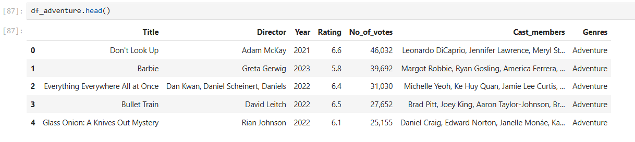
Web Scraping – Tools & Source

Slide 7
Summary of the Data
Total movies: 411
Columns: Title, Year, Rating, No_of_votes, Director, Cast_members, Genres, Verdict
Missing data: mostly clean
Verdict is a custom field created based on rating logic

Slide 8
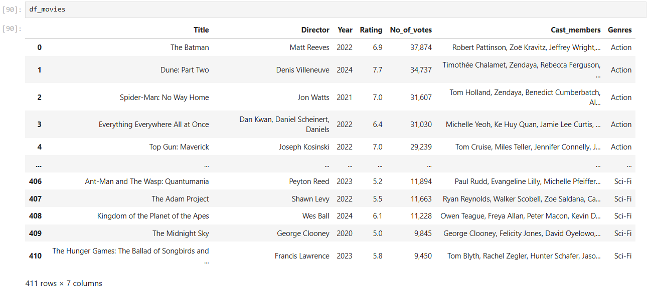
EDA – Data Cleaning

Slide 9
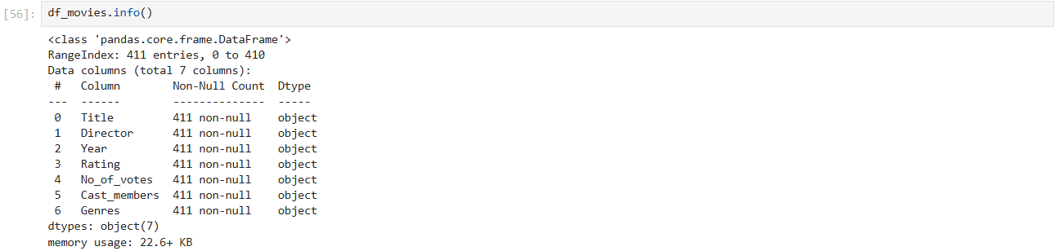
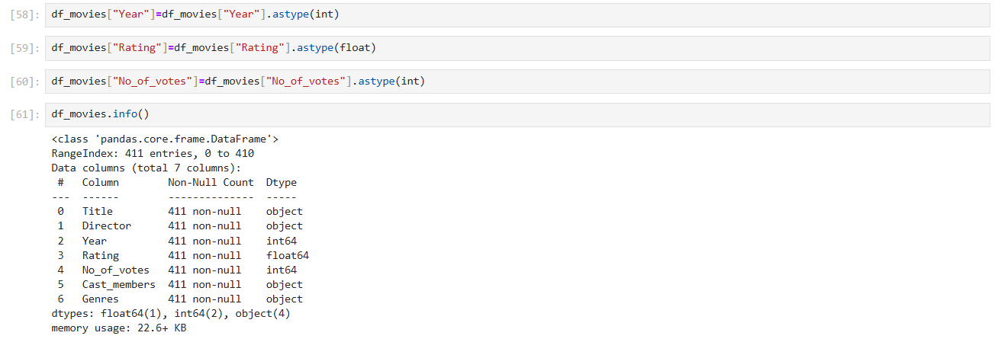
EDA – Data Cleaning

Slide 10
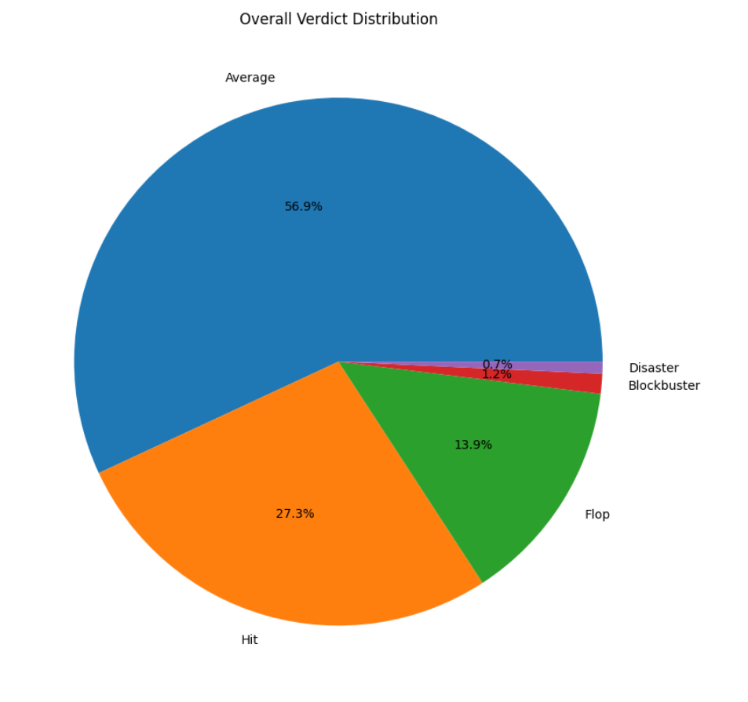
EDA – Univariate Analysis

Slide 11
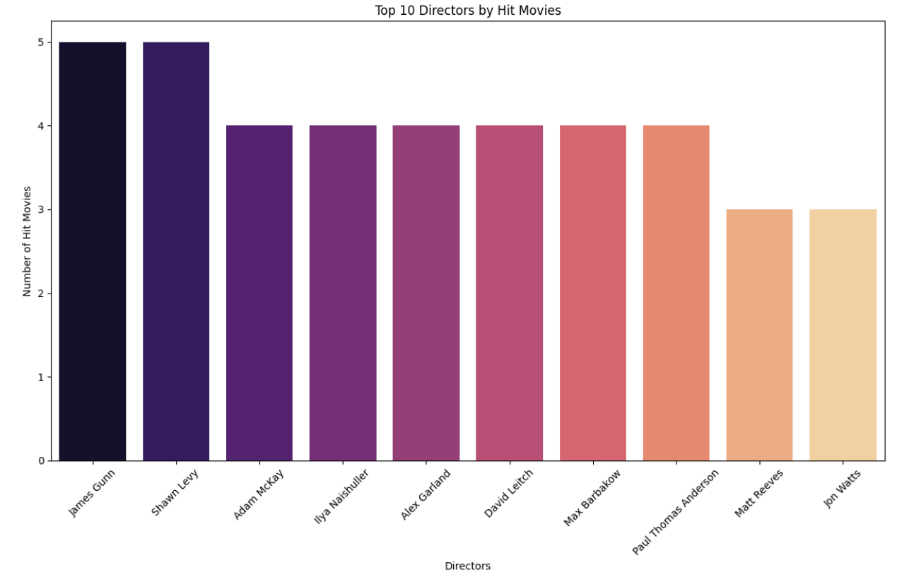
EDA – Univariate Analysis

Slide 12
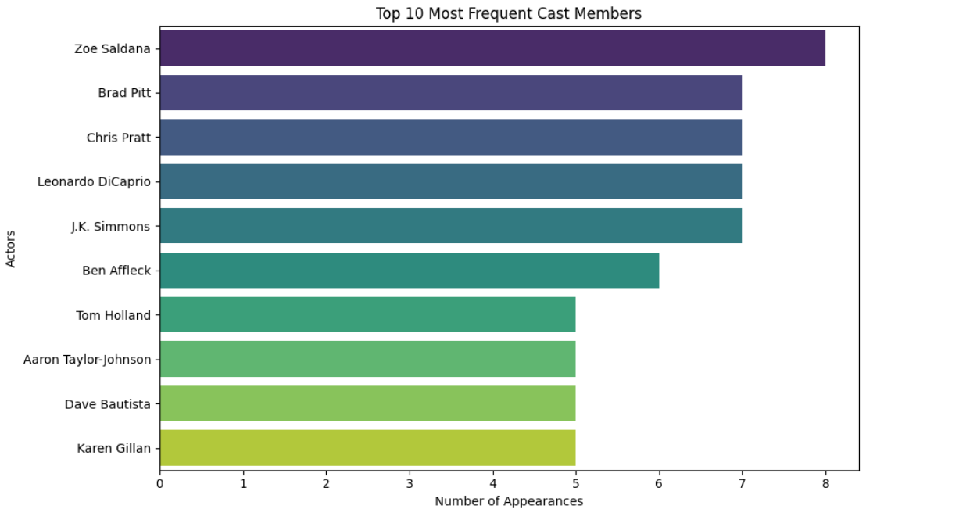
EDA – Univariate Analysis

Slide 13
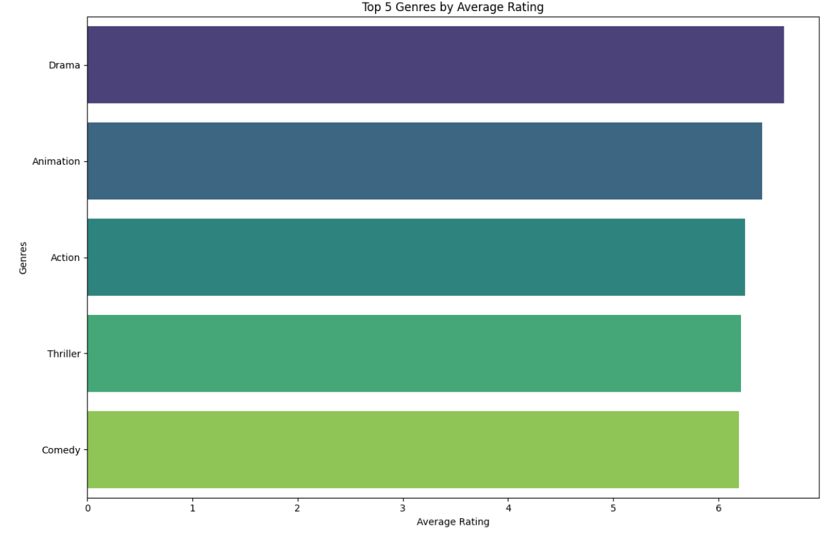
EDA – Bivariate Analysis

Slide 14
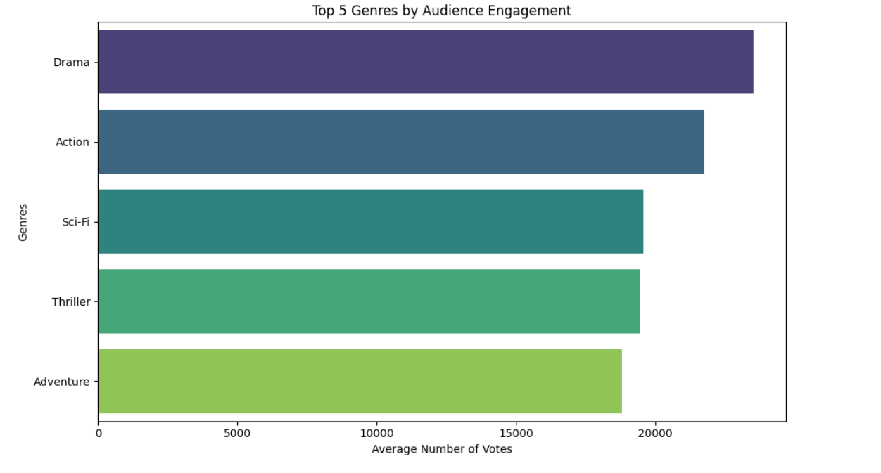
EDA – Bivariate Analysis

Slide 15
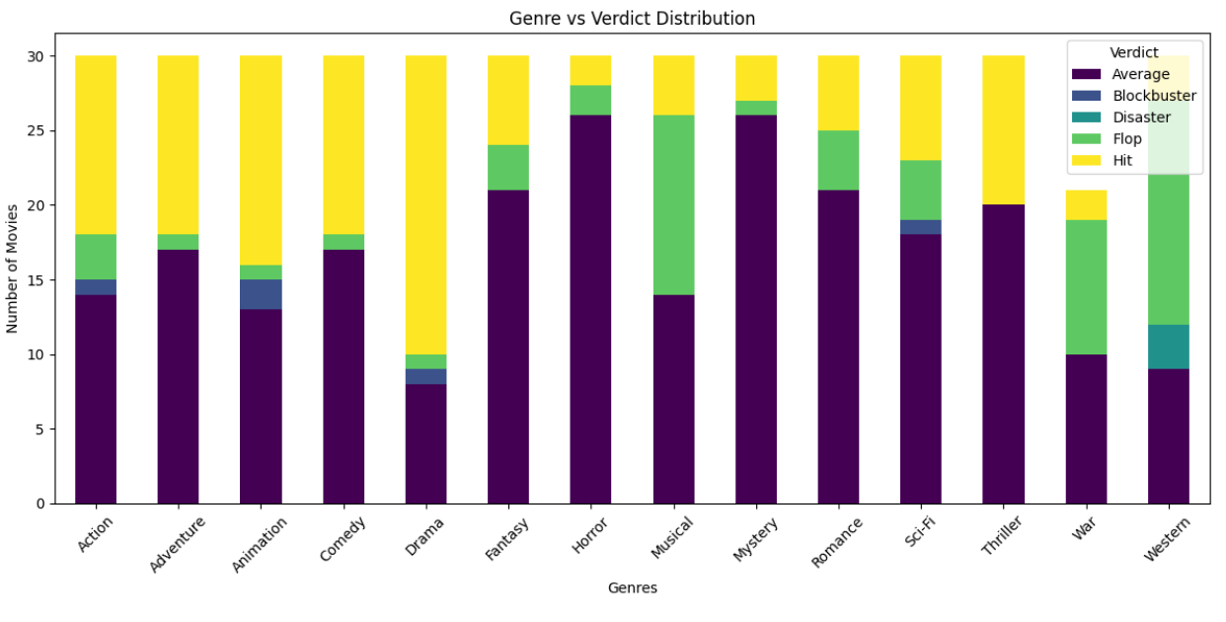
EDA – Bivariate Analysis

Slide 16
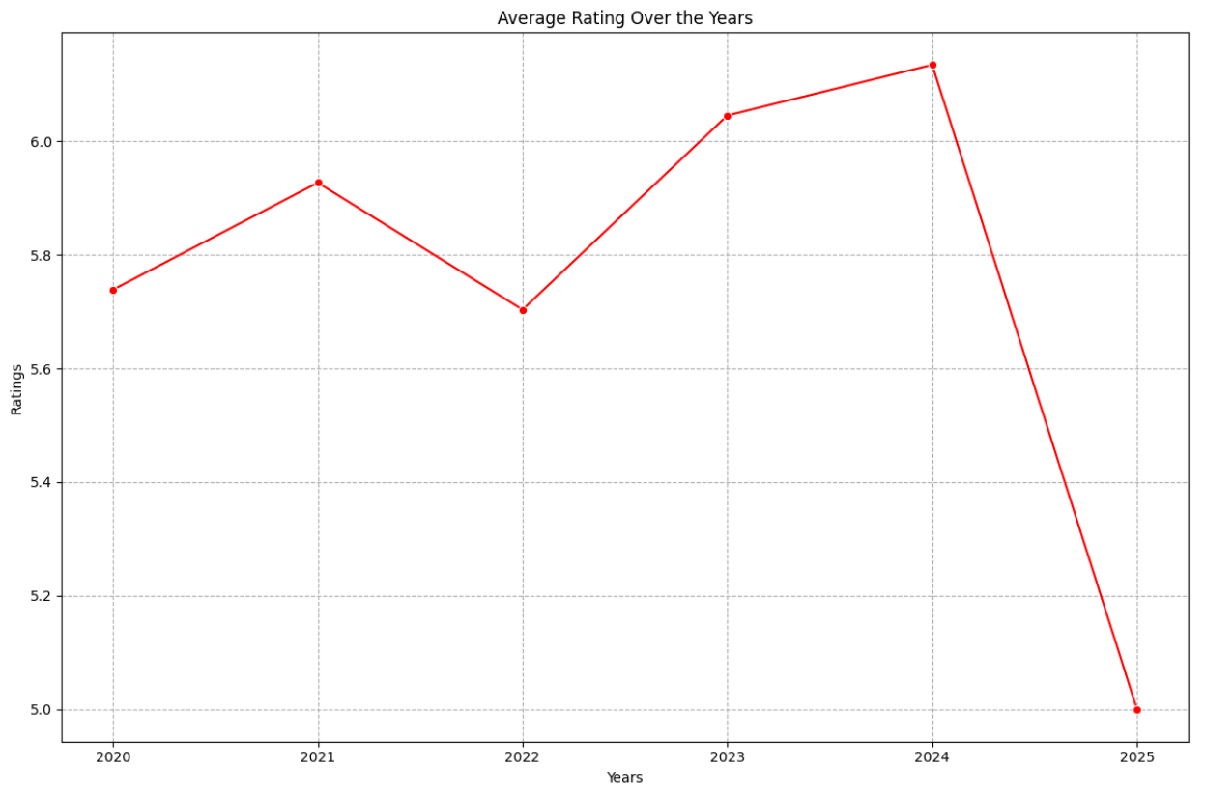
EDA – Bivariate Analysis

Slide 17
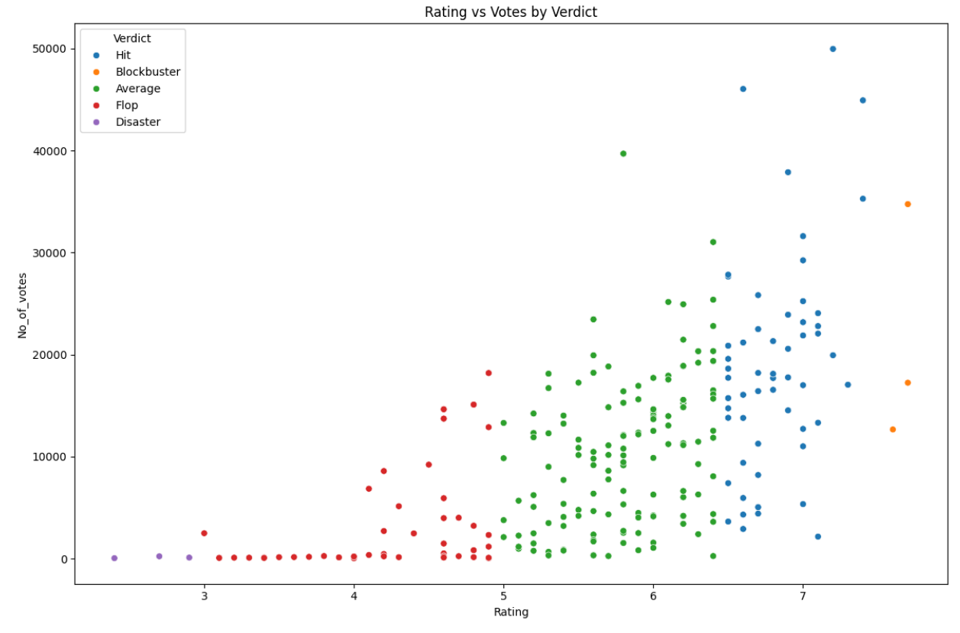
EDA – Bivariate Analysis

Slide 18
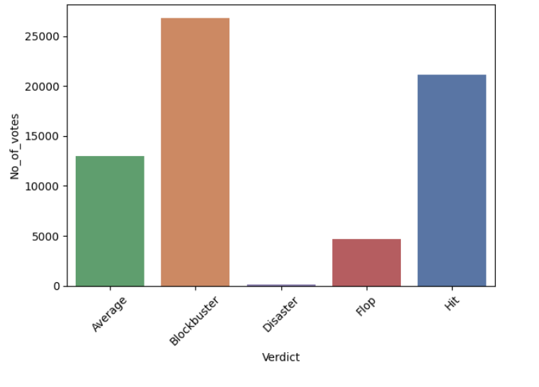
EDA – Bivariate Analysis

Slide 19
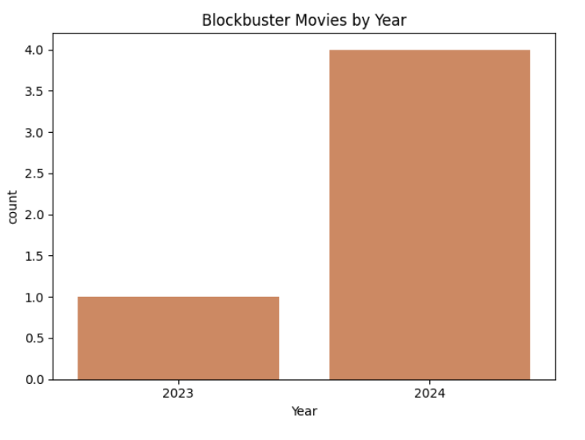
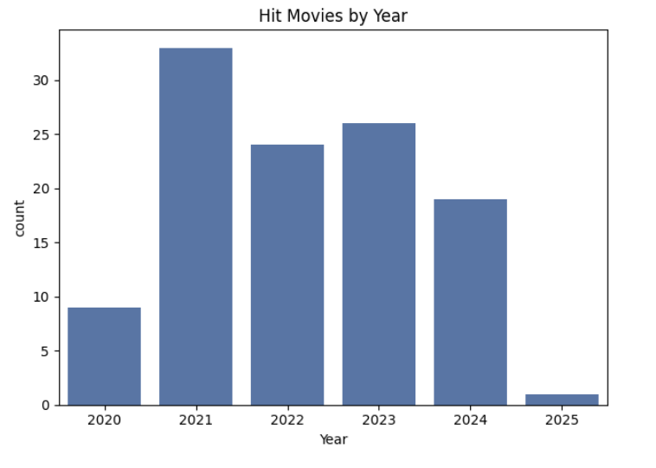
EDA – Bivariate Analysis

Slide 20
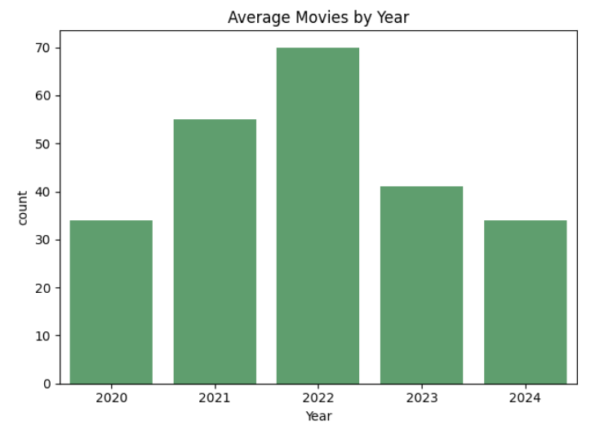
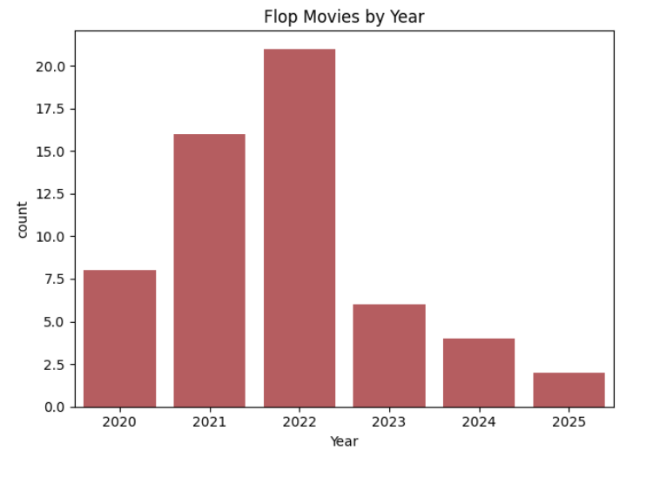
EDA – Bivariate Analysis

Slide 21
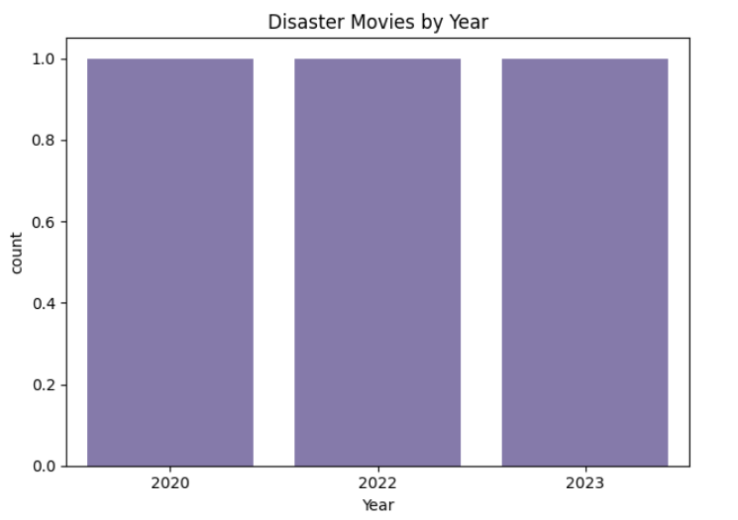
EDA – Bivariate Analysis

Slide 22
Conclusion
Through this project, I demonstrated how public movie data can be transformed into business insights using Python, web scraping, and EDA.
Drama , Action and Thriller genres consistently lead in high-rated and well-received movies, making them reliable choices for producers.
Directors and cast members who appear frequently in successful movies indicate strong audience trust and influence.
The project demonstrates how public movie data can reveal actionable insights for production studios, marketers and streaming platforms
This project not only strengthened my skills in data extraction and analysis but also showed the real-world impact of turning raw data into strategic decisions.

Slide 23
My Experience Working on This Project
This project was both engaging and insightful. Driven by a curiosity to work with real-world data, I developed a complete end-to-end pipeline using requests, BeautifulSoup, and pandas for data extraction and analysis.
This project taught me how to:
Extract structured data from a public website through web scraping
Clean, manipulate, and analyze data using Python
Visualize patterns that can drive business decisions in entertainment

Slide 24

THANK YOU

