Slide 1



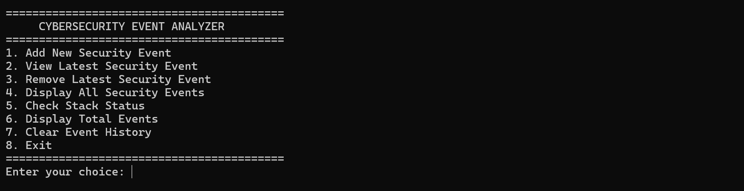
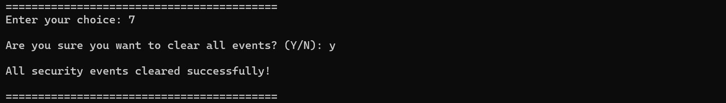
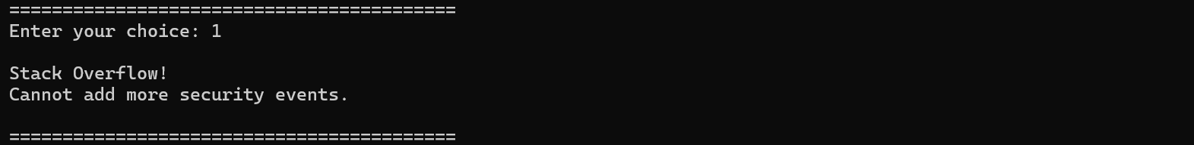
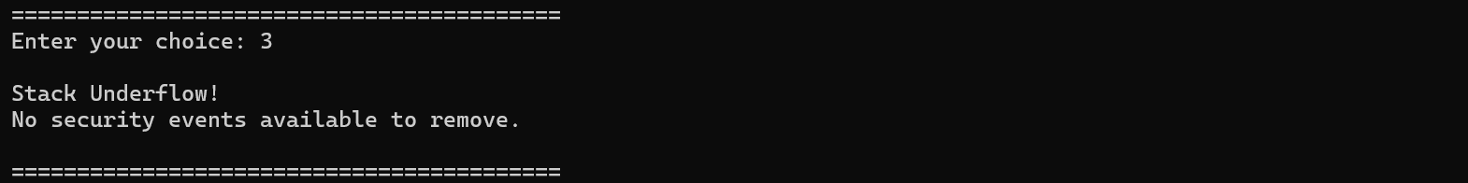
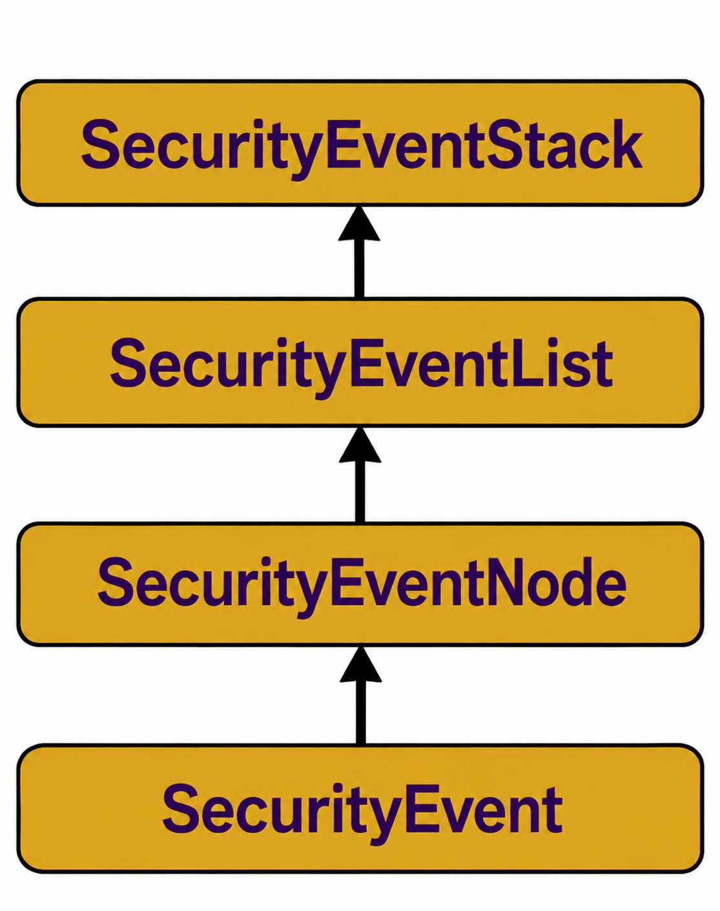
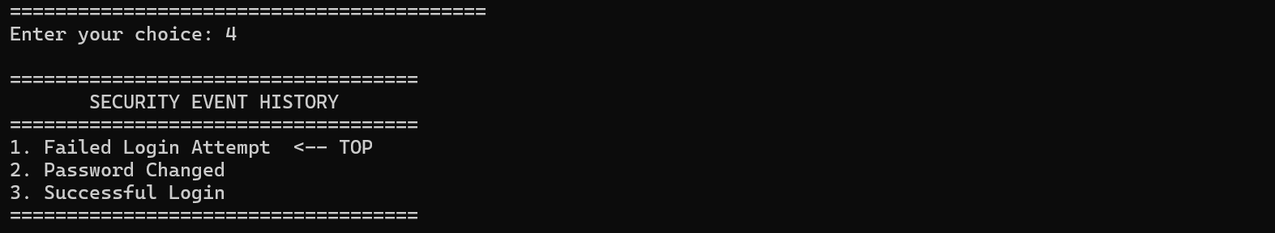
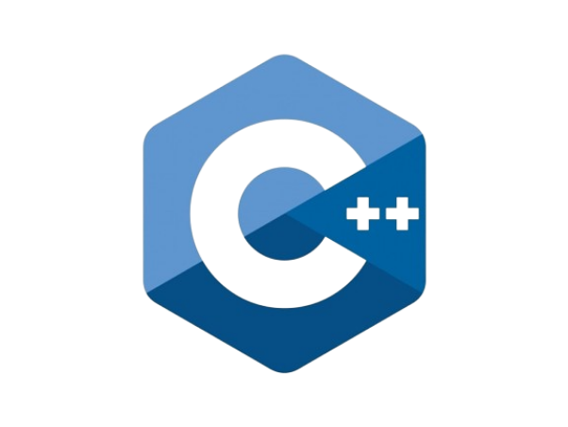


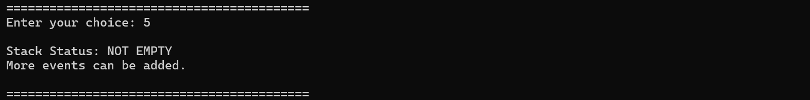
Design and Implementation of CyberStack: A C++ Stack-Based Security Event and Command History Analyzer with Applications in AI-Driven Cybersecurity and Blockchain. Rushikesh Nayak
Faculty Advisor: Dr. Victor Govindaswamy
Concordia University Chicago
Abstract
Further Future Work
Main Menu
6: Display Total Security Events-Event Counter
ABSTRACT
Field: This project, situated within the field of Computer Science, focuses on Data Structures and Algorithms (DSA), Object-Oriented Programming (OOP), and Cybersecurity. It utilizes the Stack data structure and the Last In, First Out (LIFO) principle to develop CyberStack, a C++-based Security Event and Command History Analyzer.
Purpose: The primary aim of this project is to manage security-related events, including failed login attempts, password changes, unauthorized access attempts, and suspicious system activities. The application allows users to add, view, remove, and display security events using Stack operations such as Push, Pop, and Peek. These operations have O(1) time complexity, providing efficient access to the most recent events.
Future enhancements include implementing Linked Lists for dynamic event storage, improving error handling, adding event searching, and introducing permanent security logs for auditing and investigation. Additional features could include event timestamps, automated security alerts, and integration with Security Information and Event Management (SIEM) systems.
Future enhancements using AI and Blockchain include applying Artificial Intelligence and Machine Learning to identify suspicious patterns, unusual login attempts, and potential cyber threats. Blockchain technology and cryptographic hashing could also support secure audit verification and help protect permanently stored security records against unauthorized modification.
By incorporating these future enhancements, CyberStack aims to demonstrate how fundamental data structures can support cybersecurity applications and provide a foundation for developing more advanced. intelligent,agement systems.
Linked List Implementation: Using a Linked List for dynamic storage of security events without fixed-size limitations.
Advanced Error Handling: Improving input validation and error management to ensure reliable program execution.
OOP Enhancements: Introducing additional classes to improve code organization, flexibility, and maintainability.
Security Event Searching: Adding functionality to search and retrieve specific security events efficiently.
File Management: Implementing file storage to save and access security event history.
Automated Security Alerts: Introducing alerts to notify users about suspicious activities and potential security threats.
Event Timestamps: Recording the date and time of security events for accurate tracking.
Security Reporting: Generating detailed reports to analyze security activities and identify potential risks.
displays the main menu of the Cybersecurity Event Analyzer, providing eight options to manage security events using Stack operations.
the event-counting functionality, which determines and displays the total number of security events currently stored in the Stack.
7: Clear Event History-Stack Reset Operation
1:Add New Security Event-Push Operation
the Clear operation, which removes all stored security events after user confirmation and restores the Stack to its initial empty state.
the Push operation, where a new security event is inserted at the top of the Stack following the Last In, First Out (LIFO) principle.
2: View Latest Security Event-Peek Operation
8: Stack Overflow-Capacity validation
the Peek operation, which retrieves the most recently added security event without modifying or removing any existing Stack elements.
Stack Overflow handling, where the application prevents the insertion of additional security events after reaching its predefined maximum capacity.
Linked List
Currently, the Security Event Analyzer uses a fixed-size array to store up to five security events. A future enhancement could replace this array with a Linked List to support dynamic memory allocation. This would allow the Stack to grow as needed, removing the fixed-capacity limitation and improving storage flexibility.
3 Remove Latest Security Event-Pop Operation
the Pop operation, which removes the topmost security event while maintaining the Stack's LIFO ordering.
9: Stack Underflow-Empty Stack Validation
Error Handling
Stack Underflow handling, where the application prevents the removal of security events when the Stack contains no elements.
The current application handles common errors, including Stack Overflow, Stack Underflow, and invalid menu selections. Future improvements could introduce stronger input validation, exception handling, and detailed error messages. These enhancements would improve program reliability, prevent unexpected behavior, and provide a smoother experience when users manage security events.
4 Display All Security Event-Stack Visualization
displays all stored security events in reverse chronological order, illustrating the LIFO principle by presenting the most recently added event first.
UML Organizational Chart
the successful implementation of the Cybersecurity Event Analyzer, highlighting Stack operations, LIFO principles, event management, input validation, and error handling through practical C++ execution and testing.
Object-Oriented Programming (OOP)
5 Check Stack Status-Stack Validation
Contacts
The application currently uses Object-Oriented Programming through the SecurityEventStack class, which organizes data and Stack operations. Future enhancements could introduce additional classes for security events, user management, and reporting. Applying encapsulation, inheritance, and polymorphism would improve code organization, maintainability, scalability, and the overall structure of the application.
the Stack status functionality, which evaluates whether the Stack is empty and whether additional security events can be accommodated.
Bioinformatics And Technology Laboratory (BAT Lab)
- Programming Application Implementation and Design (PAID)
Computer Science Department (CSC@CUC)
Member: Rushikesh Nayak
Advisor: Dr Visvasuresh (Victor) Govindaswamy
Email: Victor.Govindaswamy@cuchicago.edu
Address: Concordia Chicago University
7400 Augusta Street
River Forest, IL, 60305-1499
Technologies Used

