Slide 1
Department of Computer Applications
CMR Institute of Technology

Slide 2
Societal-Project
Orientation
20-11-2023
3.00 pm

Slide 3


Slide 4


Slide 5
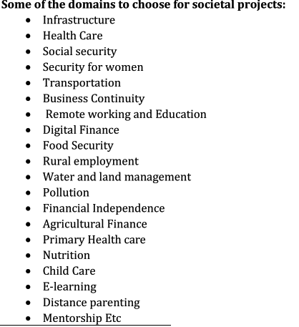

Slide 6


Slide 7
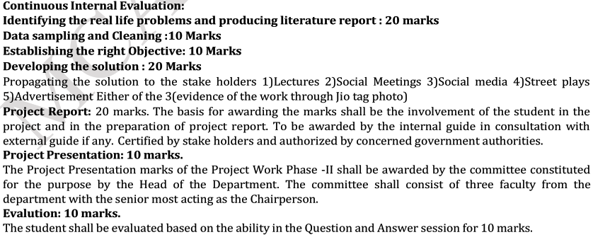
CIE

Slide 8
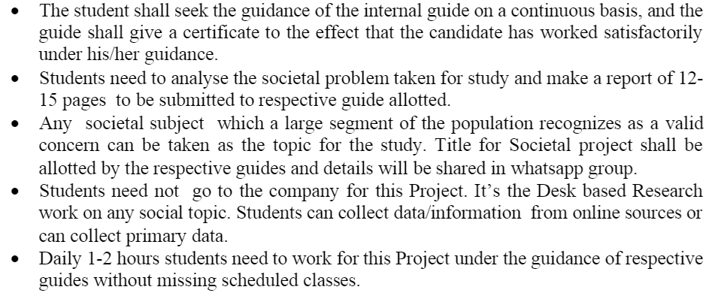
Work Procedures

Slide 9
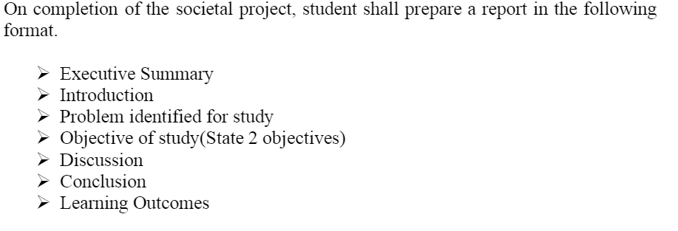
Project-Report

Slide 10
Societal Project Review Schedule
Descriptions | Review-1 23-12-2023 9.00 AM | Review-2 25-01-2024 2.00PM | Review-3 24-02-2024 9.00 AM
Contents to be presented in each review | Real time Problem related domain and Objectives Methods Relevant Literature | Data Sampling and Cleaning and analysis processes | Final Outcomes and Filed visit experience and draft document

Slide 11
Thanks

