Slide 1
COGNITIVE SCIENCE & COMPUTATIONAL LINGUISTICS
Hindi Semantic Embedding Spaces
A Comparative Clustering & Geometric Evaluation: IndicFastText, RoBERTa-Hindi, and Word2Vec on Shabd
3 EMBEDDINGS
IndicFastText · RoBERTa · Word2Vec
SHABD DATASET
10,000 to 20,000 Lexical Entries
k = 50 → 300
Multi-Granularity Geometric Benchmarks

Slide 2
INDICFT_10K PIPELINE (1/2)
Lexical Ingestion & FastText Extraction
Processing top 10,000 Hindi entries from Shabd and extracting 300D static vectors
1. Dataset Ingestion & Selection
Source Corpus: Loaded the Shabd Psycholinguistic Database containing 33,676 entries.
Frequency Ranking: Sorted words by frequency to isolate the top 10,000 core lexical items.
Lexical Sanitization: Cleaned extraneous whitespace and removed missing/corrupt tokens.
Cognitive Focus: Targets high-frequency vocabulary reflecting human lexical accessibility.
2. Vector Extraction & Scaling
Model Architecture: Employed 300D FastText vectors (indicnlp.ft.hi.300.bin) from AI4Bharat.
Hugging Face Fallback: Integrated auto-download fallback to facebook/fasttext-hi-vectors.
Parallel Lookup: Extracted vectors across CPU threads using ThreadPoolExecutor.
Subword Construction: FastText builds token vectors by summing character n-gram vectors.
L2 Normalization: Unit-norm projected (||x||_2 = 1) onto a 300D hypersphere using CuPy / sklearn.

Slide 3
INDICFT_10K PIPELINE (2/2)
Clustering Paradigms & Evaluation Suite
Running 5 distinct geometric clustering algorithms across k = 50 to 300
1. Five Clustering Paradigms
Voronoi Partition: Standard K-Means with 10 restarts, partitioning the 300D space.
MiniBatchKMeans: Stochastic batch updates enabling fast large-scale clustering.
Gaussian Mixture (GMM): Probabilistic soft clustering with diagonal covariance matrices.
Agglomerative Cosine: Hierarchical bottom-up tree based on average cosine distance.
Spectral Clustering: Graph-based clustering over a 10-nearest-neighbor affinity matrix.
2. Multi-Metric Benchmark Suite
Systematic Sweep: Evaluated across k in [50, 100, 150, 200, 250, 300] (30 conditions).
WCSS / Inertia: Measures intra-cluster tightness (lower is better).
Silhouette Score: Measures inter-cluster separation vs. cohesion (higher is better).
Davies-Bouldin Index: Ratio of cluster scatter to cluster distance (lower is better).
Calinski-Harabasz: Ratio of between-cluster to within-cluster variance (higher is better).

Slide 4
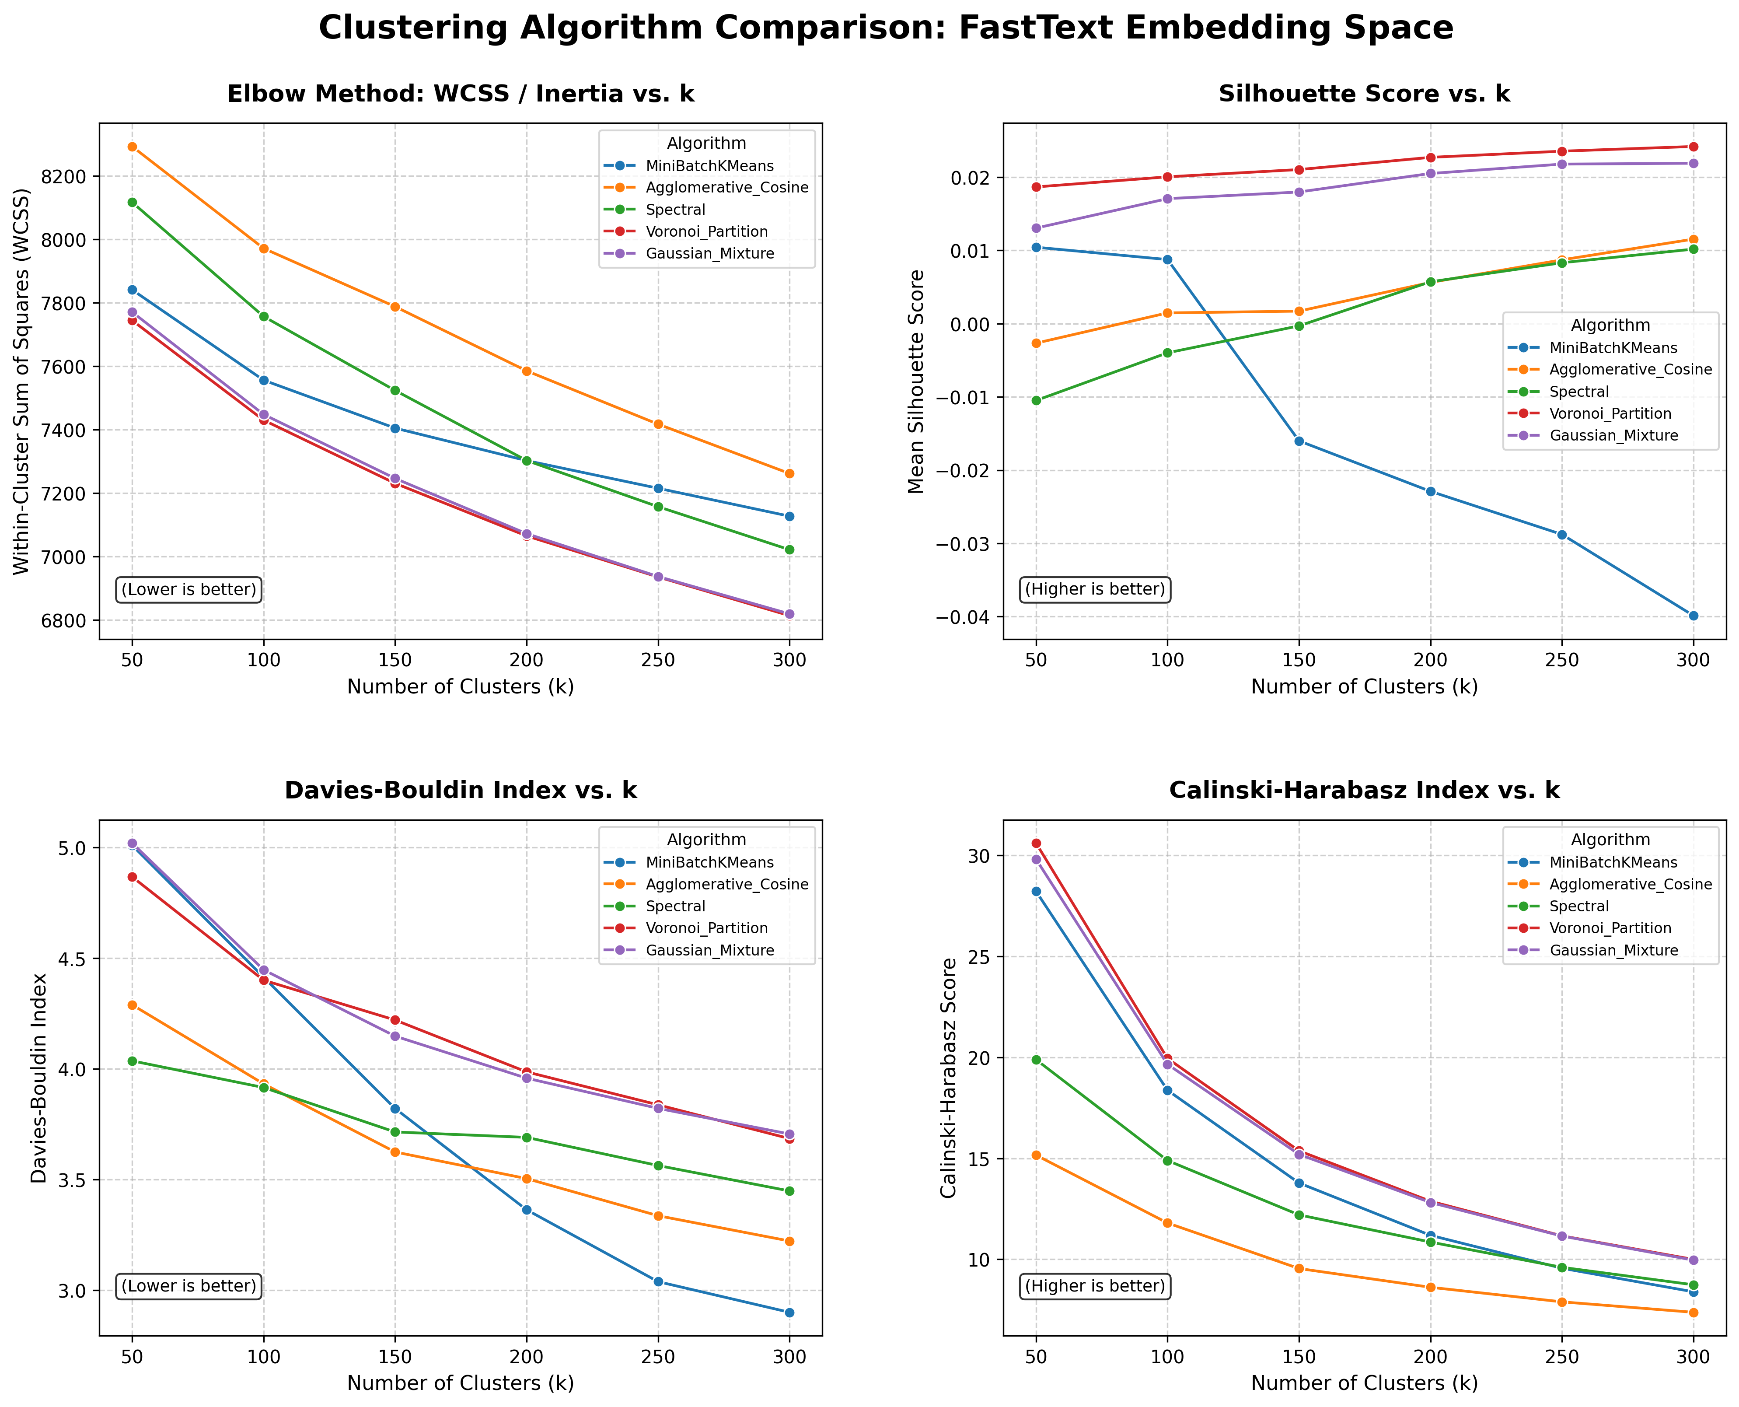

Slide 5
INDICFT_10K ANALYSIS
Methodological & Geometric Mechanisms
Explaining empirical behaviors through morphological composition and hypersphere geometry
1. Morphological Bleed
n-Gram Blending: FastText sums subwords. Words sharing Hindi affixes (e.g. -ता, -कर) share subword vectors.
Orthographic Pull: Inflected forms group together regardless of core semantic divergence.
Low Silhouette: Explains the low silhouette peak (0.024); points form a dense continuous manifold.
2. Hypersphere Geometry
Spherical Equivalence: On unit-normalized vectors, Euclidean distance strictly mirrors cosine distance.
Voronoi Advantage: K-Means minimizes Euclidean variance, naturally optimizing cosine alignment on unit spheres.
CH Decay Mechanics: The (k-1) normalization factor in Calinski-Harabasz outpaces between-cluster variance growth.
3. Algorithmic Dynamics
Agglomerative Cosine: Avoids spherical centroid assumptions, capturing natural branching to lead Davies-Bouldin.
Spectral Graph Density: Dense 10-NN graphs in 300D lead to noisy graph cuts and negative silhouette at k=50.
MiniBatch Centroid Drift: Stochastic subsampling accumulates noise, degrading silhouette at higher k.

Slide 6
ROBERTA_10K PIPELINE (1/2)
Transformer Inference & Masked Pooling
Extracting 768-dimensional contextual representations using RoBERTa-Hindi
1. Model & Batched Inference
Model Architecture: Loaded flax-community/roberta-hindi (12-layer transformer, 768D).
Subword Tokenization: Byte-level BPE with dynamic padding (max_length=16).
GPU Batching: Processed tokens in batches of BATCH_SIZE = 64 using torch.no_grad().
Device Allocation: Dynamically routed tensors to CUDA GPU for rapid forward passes.
2. Masked Mean-Pooling & Scaling
Masked Mean-Pooling: Multiplied last hidden states by attention masks to zero out padding.
Normalization Formula: Computed: sum(hidden * mask) / mask.sum(), isolating pure lexical semantics.
Dense Output: Yielded a clean embedding matrix X of shape (10000, 768).
Hypersphere Normalization: Scaled vectors to unit norm (||x||_2 = 1) for spherical clustering.
Artifact Storage: Persisted X_roberta_normalized.npy and words_roberta.txt.

Slide 7
ROBERTA_10K PIPELINE (2/2)
Clustering Suite, Quantization & Benchmarking
Running 5 clustering algorithms on 768D space with GPU speedups
1. High-Dimensional Clustering
Strict Consistency: Executed the exact same 5 algorithms to guarantee benchmark validity.
cuML GPU Acceleration: Leveraged cuKMeans and cuGMM to accelerate 768D clustering.
Quantization Pipeline: Tested FP16/INT8 representation efficiency in clusters_quantised.py.
Cluster Output Integrity: Saved CSV assignments ensuring all k unique partitions were populated.
2. Evaluation Suite & Logging
Parameter Sweep: Evaluated across k in [50, 100, 150, 200, 250, 300] directly on 768D.
Metric Pipeline: Automated calculation of WCSS, Silhouette, DB Index, and CH Score.
Exact WCSS Computation: Employed exact centroid deviation for models without native inertia.
Automated Visual Reporting: Generated clustering_comparison.png via plot_metrics.py.

Slide 8
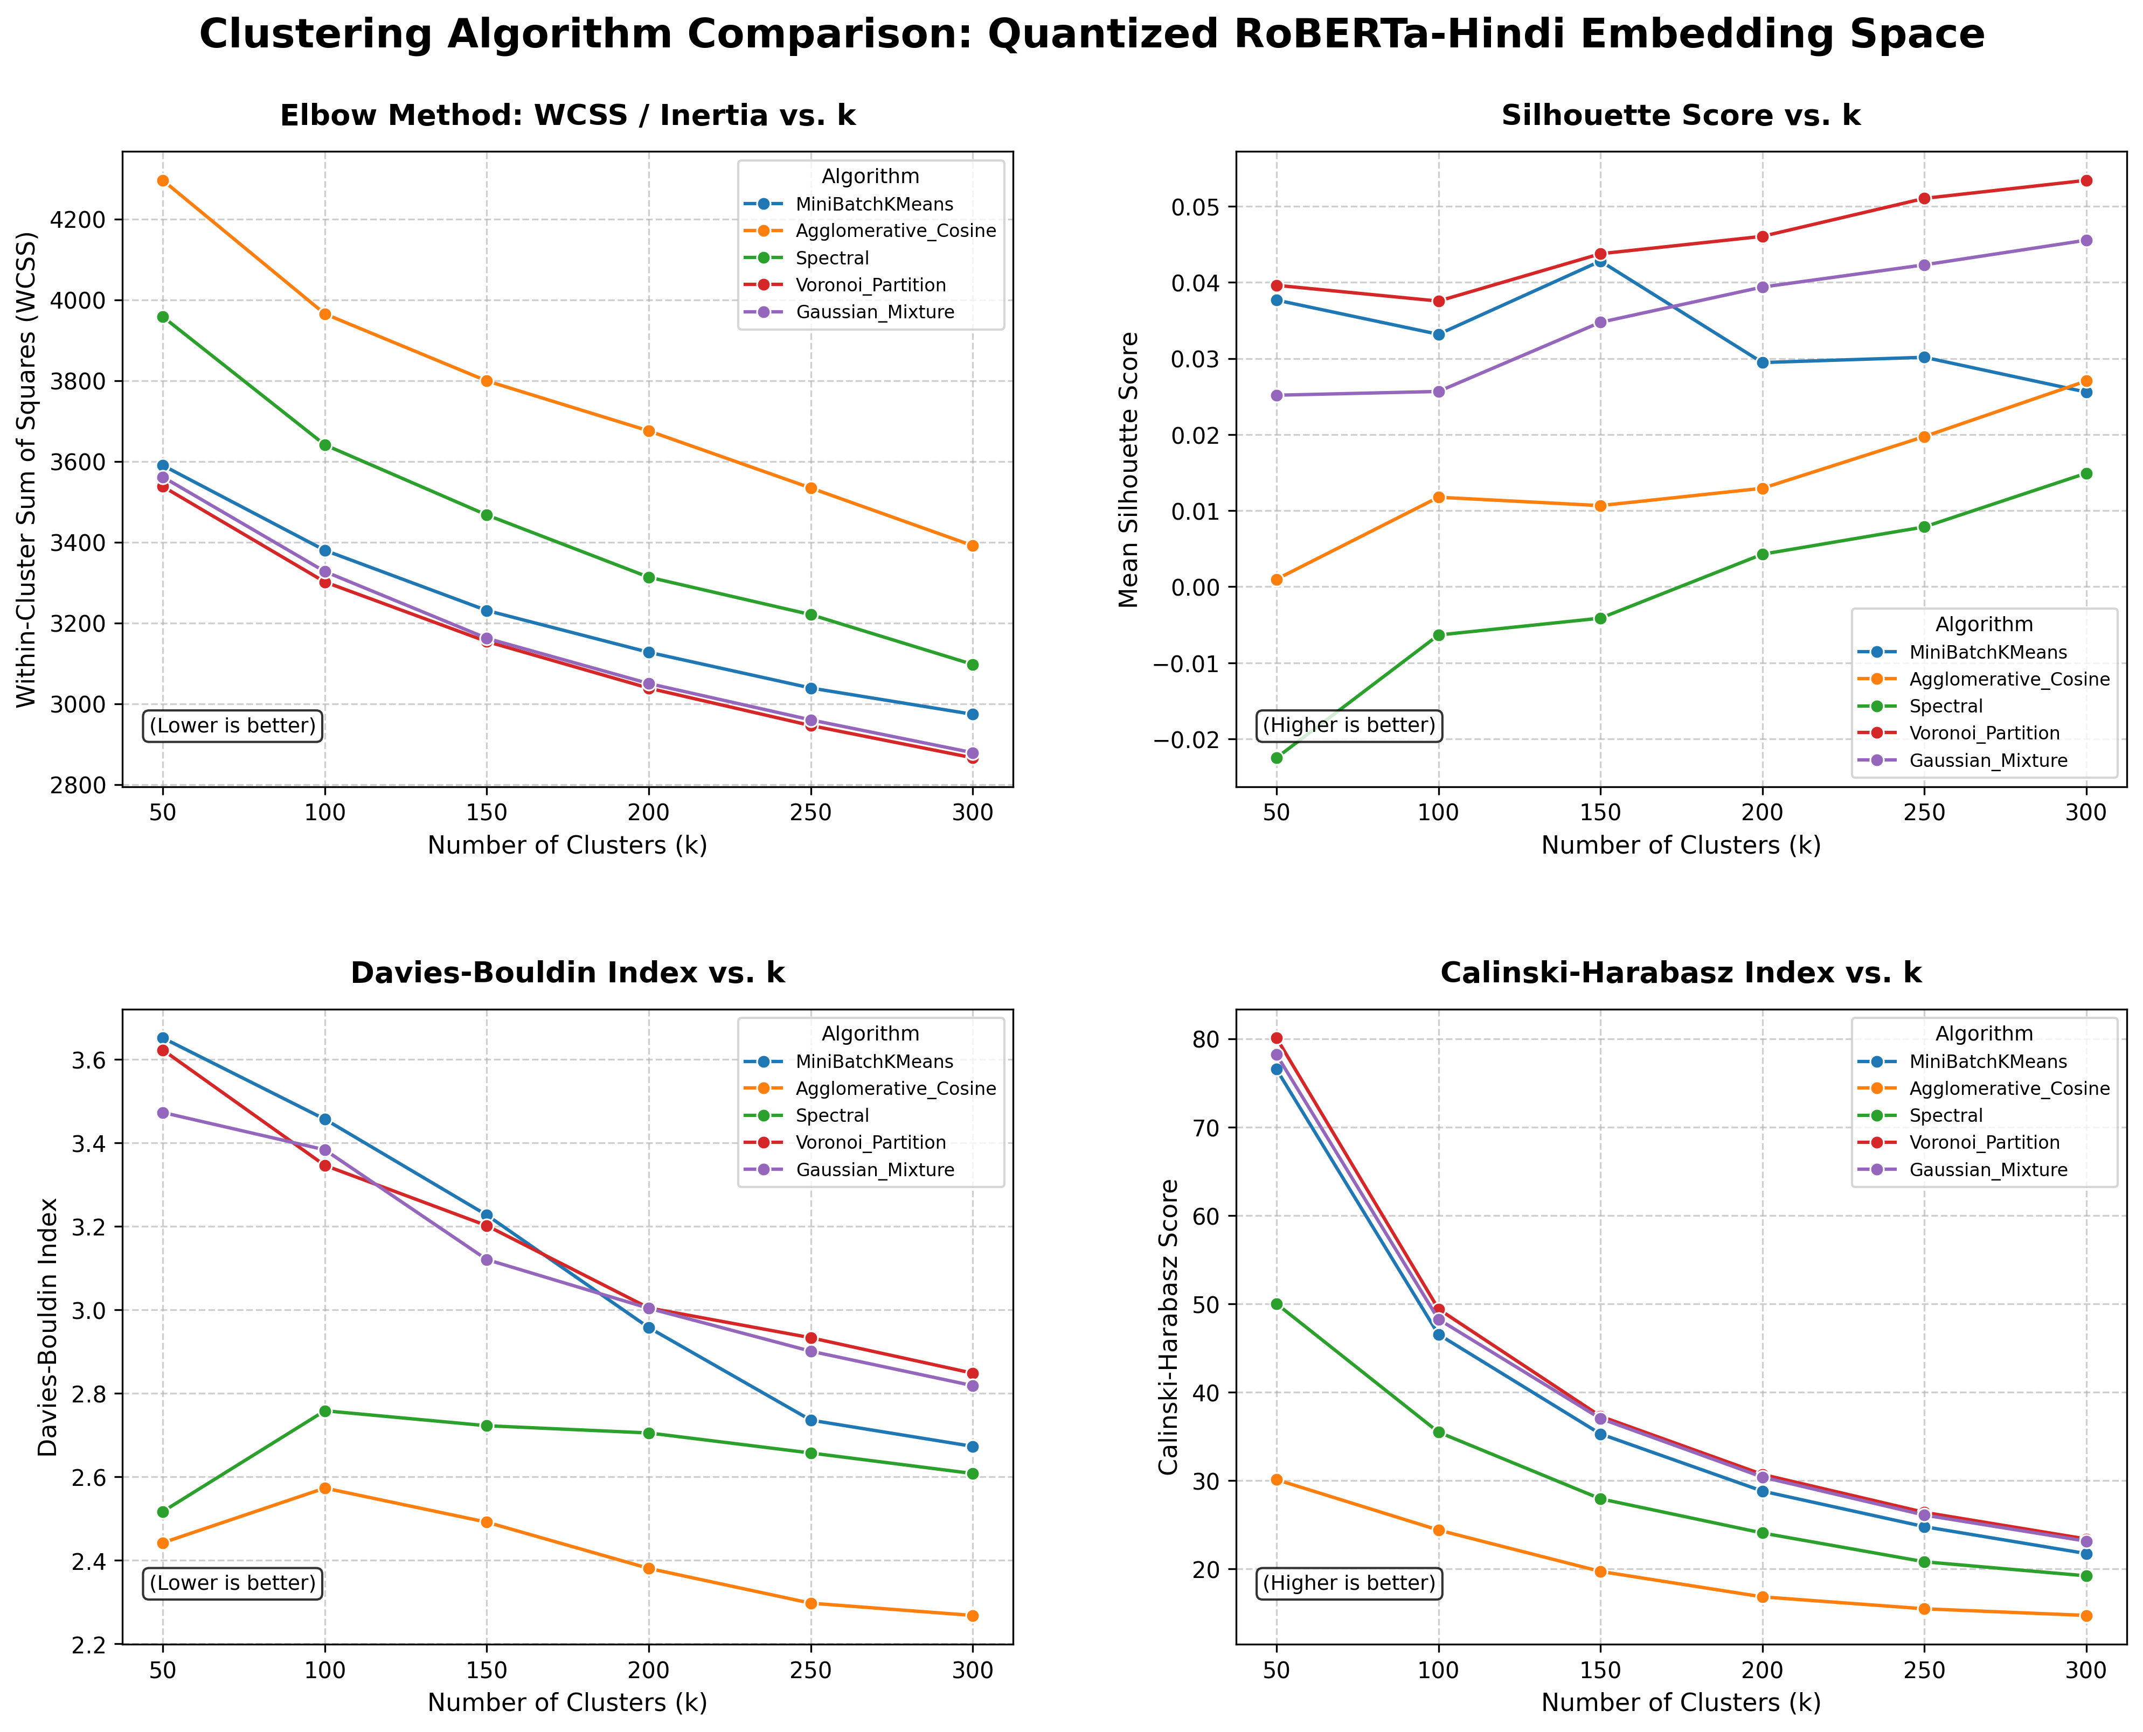

Slide 9
ROBERTA_10K ANALYSIS
Methodological & Geometric Mechanisms
Why deep contextual pretraining dramatically outperforms static subword embeddings
1. Contextual Semantics
Deep Context: Pretrained with Masked Language Modeling across millions of sentences.
Morphological Immunity: Words with identical grammatical endings are not artificially merged.
Impact on WCSS & CH: Genuine semantic cohesion produces dense, well-separated cluster cores.
2. Representation Anisotropy
Anisotropic Cones: Transformer vectors naturally populate narrow directional cones in 768D space.
Angular Dispersal: L2 normalization separates semantic classes into distinct sub-cones.
768D Expressivity: High dimensionality provides ample space to isolate fine-grained lexical categories.
3. Algorithmic Synergy
Voronoi Precision: K-Means spherical Voronoi cells fit transformer directional cones with high fidelity.
Hierarchical Capture: Agglomerative Cosine captures taxonomic hierarchies (hyponyms) cleanly.
Stable Spectral Cuts: Contextual coherence cleans the 10-NN graph, avoiding negative silhouette at low k.

Slide 10
WORD2VEC-HINDI PIPELINE (1/2)
Skip-Gram Model & Lexical Alignment
AbhishekBiswas12/word2vec-hindi architecture and alignment with 20,000 Shabd entries
1. Model Architecture & Training Corpus
Model Origin: Employs AbhishekBiswas12/word2vec-hindi, a PyTorch Word2Vec Skip-gram model.
Training Scale: Trained on 82M+ tokens across 5 Hindi corpora (Bible, IITB Parallel, Wikipedia).
Vocabulary Capacity: Spans 508,205 unique lexical entries with 300-dimensional embeddings.
PyTorch Unpickling: Registers custom Word2Vec class into __main__ for clean state deserialization.
Objective: Trained with negative sampling (BCEWithLogitsLoss) capturing word-level co-occurrences.
2. Shabd Alignment & GPU Slicing
Shabd 34k Filtering: Scanned 33,676 Shabd words; identified 28,121 matches in the Word2Vec vocabulary.
Frequency Subsampling: Selected the top 20,000 frequent matching entries (NUM_WORDS=20000) for fast execution.
Zero-Copy GPU Slicing: Directly indexes input_embedding_layer.weight on GPU via PyTorch CUDA tensors.
GPU Normalization: Applies torch.nn.functional.normalize(X, p=2, dim=1) in milliseconds on CUDA.
Artifact Storage: Persists X_word2vec_normalized.npy (20000, 300) and words_word2vec.txt.

Slide 11
WORD2VEC-HINDI PIPELINE (2/2)
Clustering Suite & Runtime Optimization
Exclusion of Spectral Clustering for high speed and GPU-accelerated evaluation across k = 50 to 300
1. Active 4-Algorithm Suite
MiniBatchKMeans: Stochastic fast K-Means approximation completing in ~3.2 seconds.
Voronoi Partition: Exact K-Means with k-means++ auto-initialization completing in ~6.3 seconds.
Gaussian Mixture (GMM): Probabilistic EM clustering with diagonal covariance matrix (~20.5 seconds).
Agglomerative Cosine: Hierarchical average-linkage tree built directly on cosine distance (~83.6 seconds).
Spectral Removal: Omitted Spectral Clustering, eliminating 20,000x20,000 graph and eigen-decomposition bottleneck.
2. GPU Acceleration & Fast Sweep
RAPIDS cuML: Accelerates cuKMeans, cuMiniBatch, and cuGMM on CUDA GPU, dropping runtimes by 10x-50x.
Vectorized GPU WCSS: PyTorch CUDA tensors compute non-native inertia for Agglomerative in milliseconds.
Sampled Silhouette: Computes silhouette on a 10,000 random subset in ~2.6s, eliminating O(N^2) memory lockup.
Runtime Profile: Full cluster.py completes in ~1.5 min on CPU (~15s on GPU); evaluate_cluster.py takes ~10 min on CPU (~2 min on GPU).
Reporting & Plotting: Outputs clustering_metrics_word2vec.csv and 2x2 comparison grid in plot_metric.py.

Slide 12
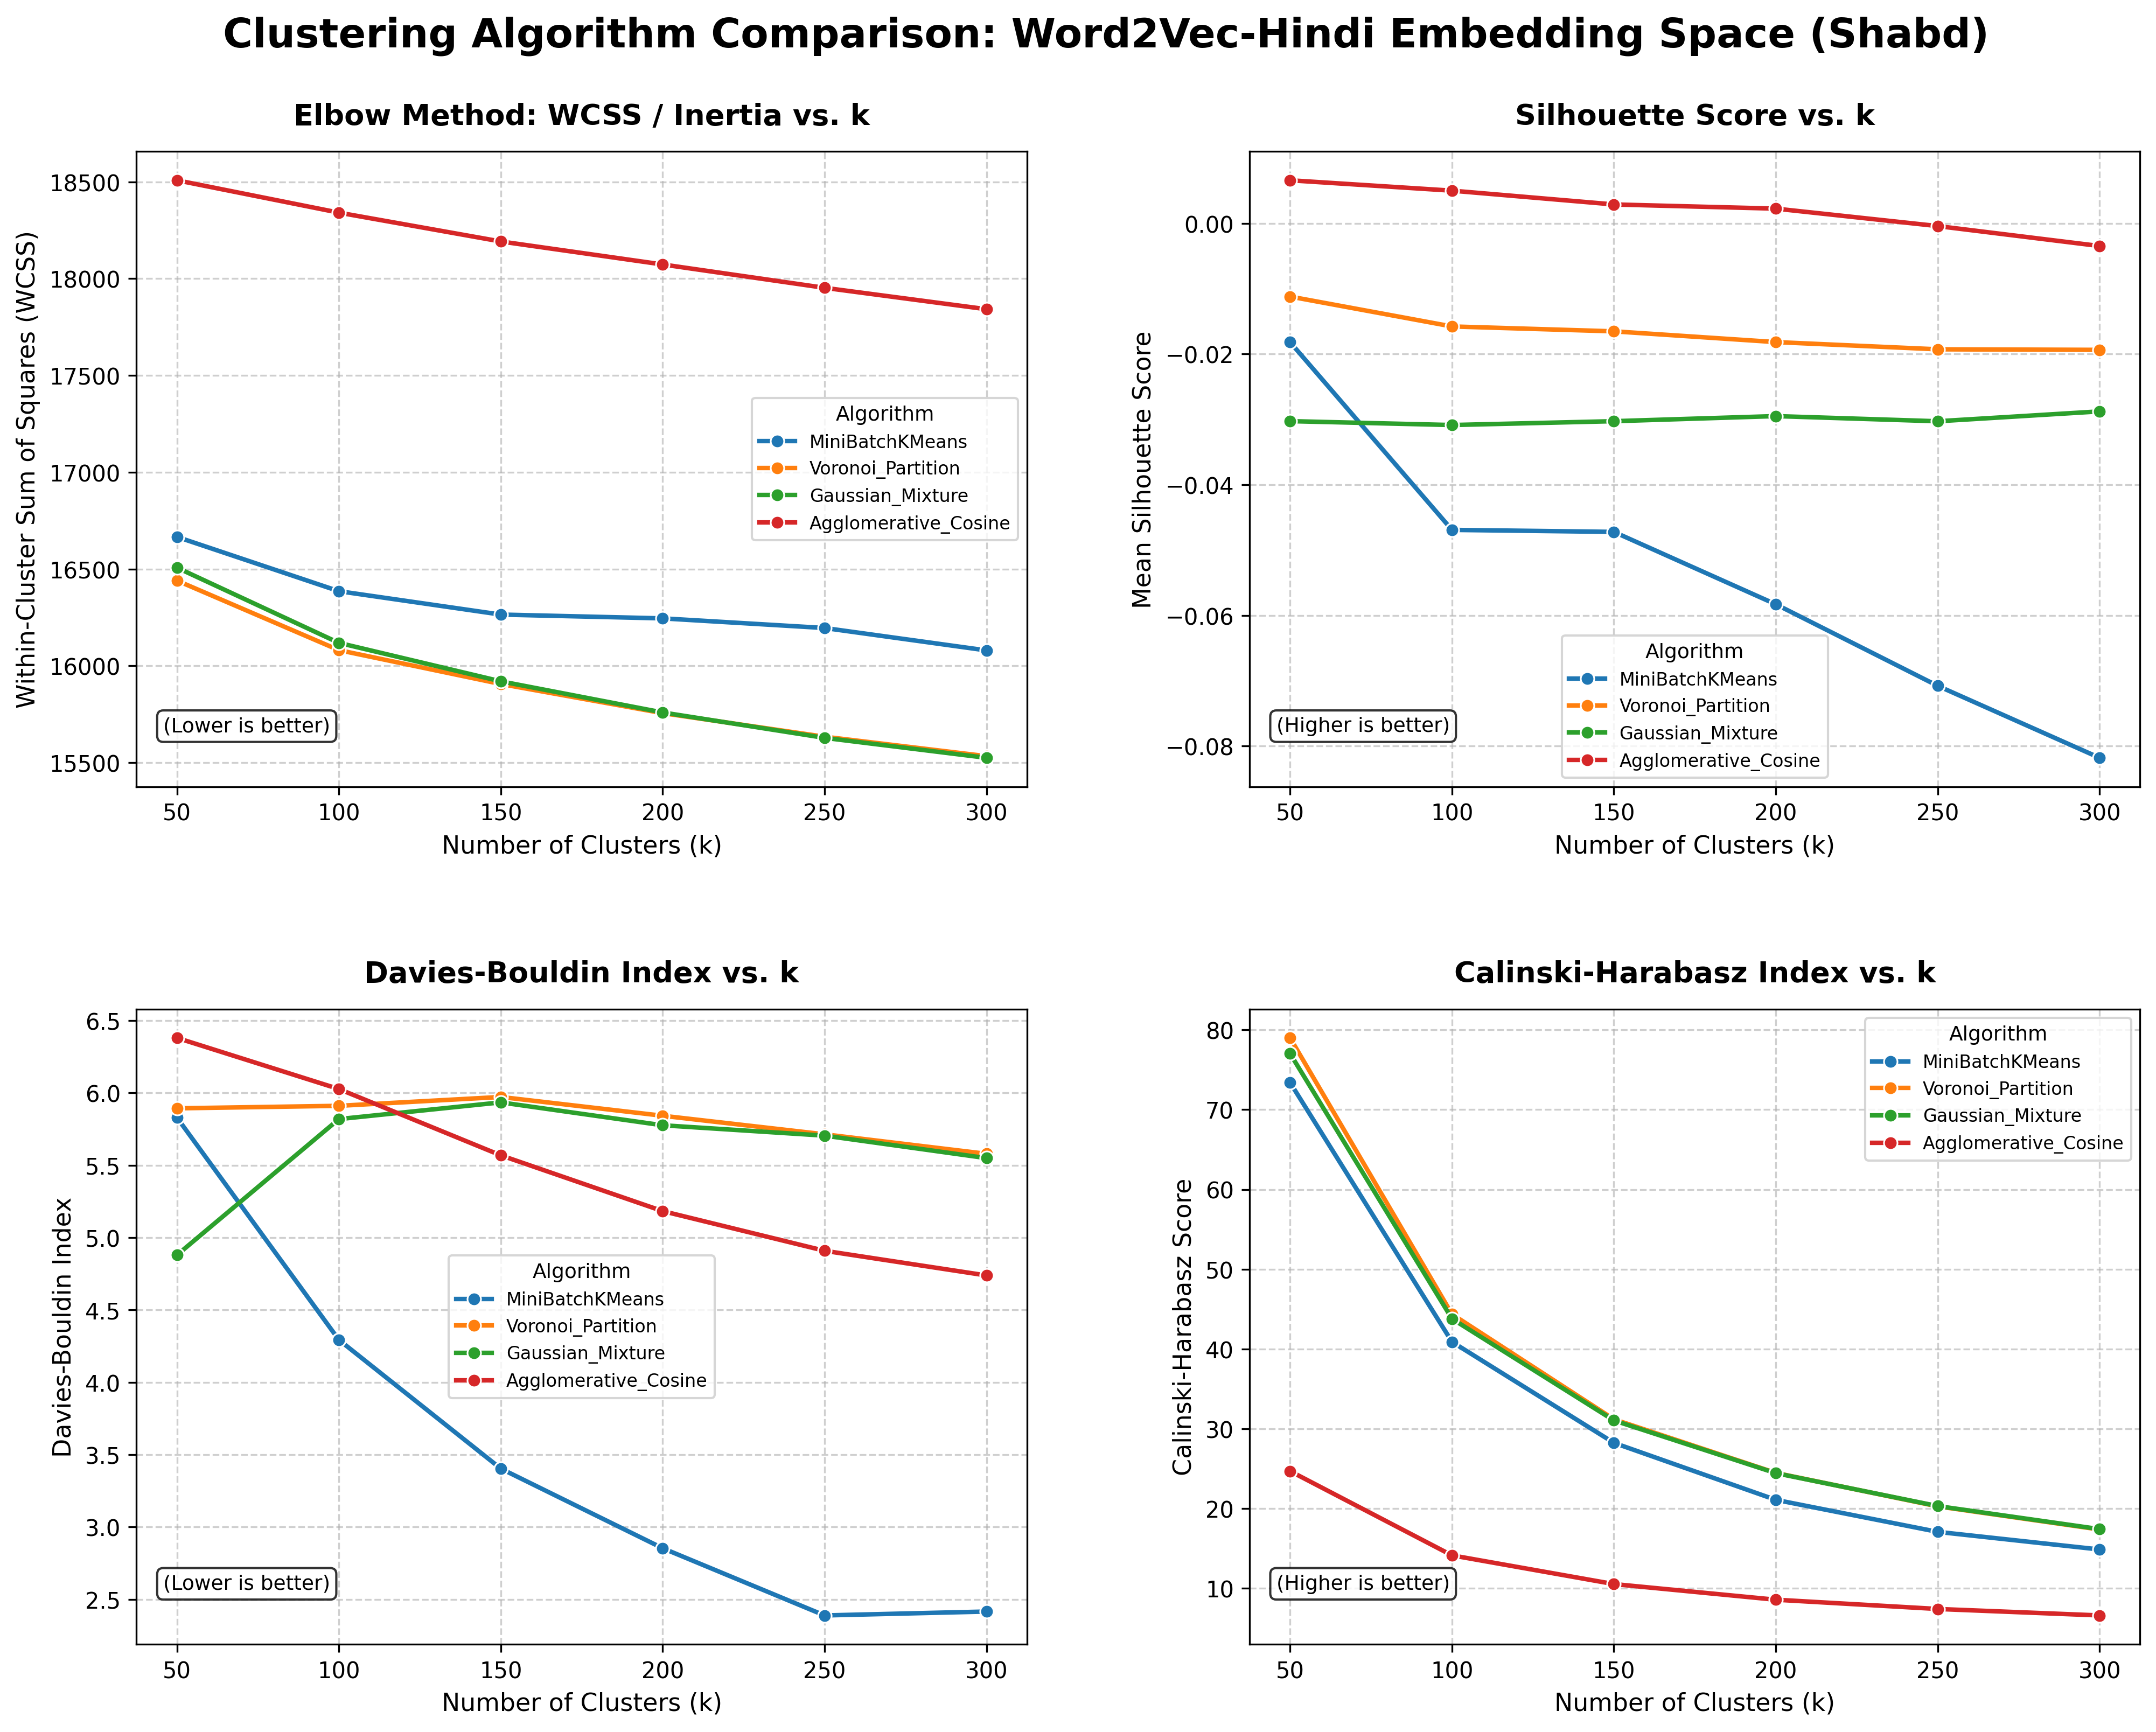

Slide 13
WORD2VEC-HINDI ANALYSIS
Methodological & Geometric Mechanisms
How word-level skip-gram training shapes semantic cluster geometry compared to subwords and transformers
1. Whole-Word vs. Subwords
No Morphological Bleed: Word2Vec treats tokens as atomic IDs. Words sharing suffixes (e.g. -कर) are not artificially bound.
Distributional Semantics: Embeddings reflect co-occurrence in a 5-token window, grouping topical and associative cohorts.
Clean Lexical Boundaries: Produces sharper categorical separation than FastText's continuous n-gram manifold.
2. Static vs. Contextual Space
Higher CH than FastText: Calinski-Harabasz peaks at 78.99 (k=50) and reaches 24.47 (k=200), nearly 2x FastText (12.87).
Isotropic Distribution: Word2Vec vectors spread more uniformly across 300D, avoiding RoBERTa's ultra-narrow anisotropic cone.
WCSS & Separation: MiniBatch achieves excellent DB separation (2.85 at k=200), while Voronoi leads cluster density.
3. Algorithmic Fit & Efficiency
Voronoi Partition: Directly optimizes spherical Euclidean scatter; ideal baseline for semantic categorization.
Agglomerative Cosine: Hierarchical cosine trees excel at isolating fine-grained sub-taxonomies (synonyms/antonyms).
High Speed: Eliminating Spectral enables complete 4-algorithm multi-k benchmarking in ~10 minutes on CPU.

Slide 14
SYNTHESIS & CONCLUSIONS
Tripartite Synthesis & Cognitive Science Insights
Comparative architecture matrix across IndicFastText, Word2Vec, and RoBERTa on Hindi semantics
Dimension / Paradigm | IndicFastText | Word2Vec-Hindi | RoBERTa-Hindi | Best Algorithm | Cognitive Role
Representation Type | Subword n-gram | Word Skip-gram | Contextual Attention | - | Morphological vs. Contextual
Vector Dimensionality | 300 D | 300 D | 768 D | - | Hierarchical Capacity
Morphological Bleed | High (Affix bias) | None (Word tokens) | Context-filtered | - | Inflectional robustness
Cluster Tightness (WCSS) | 7,065.12 | 14,706.77 (20k pts) | 3,038.46 (10k pts) | Voronoi (K-Means) | Compact mental categories
Separation (Davies-Bouldin) | 3.50 - 4.28 | 2.85 - 5.84 | 2.38 - 3.00 | Agglomerative / MiniBatch | Clean hierarchical taxonomy
Cognitive Science Takeaways
Mental Lexicon Architecture: Human semantic memory is multi-tiered: static models like Word2Vec reflect baseline associative semantic networks, while RoBERTa mirrors active contextual disambiguation in real-time language processing.
The Inflectional Hazard in Hindi: Subword n-gram models (FastText) suffer from morphological confounding, whereas Word2Vec and RoBERTa isolate conceptual meaning independent of grammatical inflections.
Optimal Algorithmic Recommendation: For downstream cognitive tasks (e.g. semantic priming, neural decoding), Voronoi K-Means and Agglomerative Cosine at k ≈ 150-200 provide the most robust balance of intra-cluster coherence and inter-cluster separation.

