Slide 1
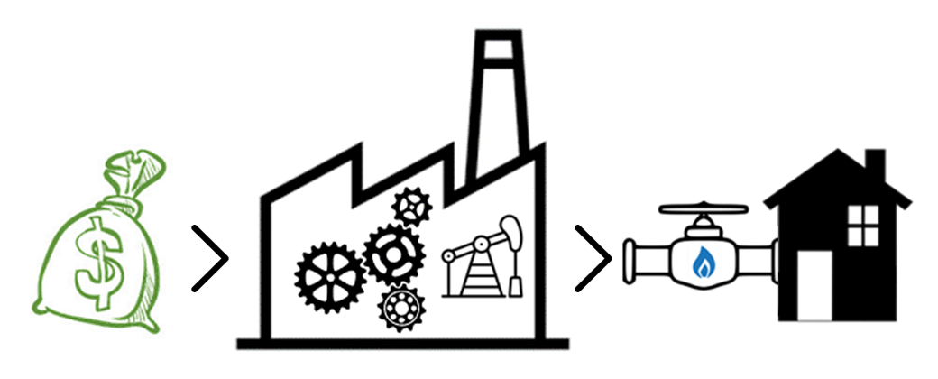
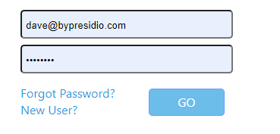
Bolt AFE
Repairs and Opportunities

Slide 2
Only users set as admin will have access to this screen (see next page)
BoltAFE
Admin
Profile
User: dave@bypresidio.com
Users
Create/Edit Categories
Create/Edit Types

Slide 3

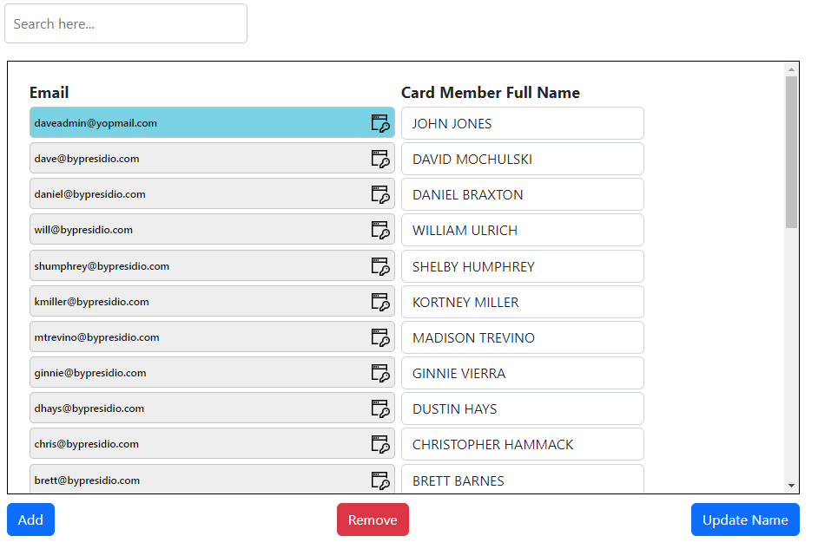
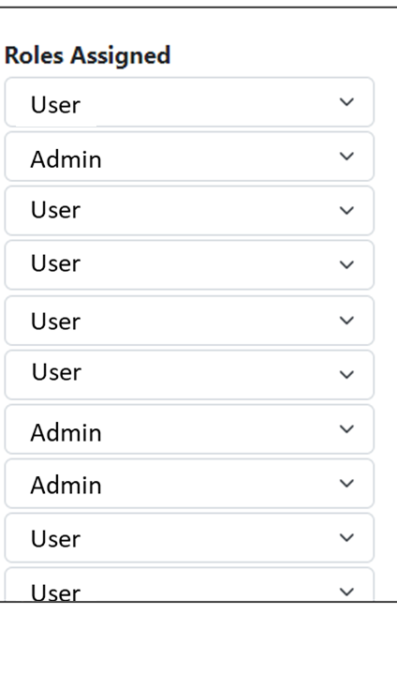

Default is 0 for a new user. Validation to verify entry is numeric. Saved in User_hdr table
Users
BoltAFE
Admin
Profile
User: dave@bypresidio.com
Same behavior as bolt expense. Going to have to add a name column to the user_hdr table
Two option combo box, User and Admin. Default is “User”. Going to have to add a role column to the user_hdr table
Approver ($)
$1,000
$1,000
$1,000
$0
$0
$500
$10
$0
$0
$500
$1,000,000
Add User
Email:
File Description
Name:
File Description
Approver ($):
File Description
Role Assigned:
Cancel
Add

Slide 4


Create/Edit Categories
If the tables are modified directly, update saves the changes. On click, a dialog box should appear asking the user if they are sure.
BoltAFE
Admin
Profile
User: dave@bypresidio.com
Is Field Required
Category | Type | Code | Gross AFE | WI | NRI | ROY | Net AFE | Oil | Gas | NGL | BOE | PO | ROR | MROI
Return Generating | Pump Repair | A | T | T | T | T | T | T | T | T | T | T | T | T
Return Generating | Tubing Repair | A | T | T | T | T | T | T | T | T | T | T | T | T
Return Generating | Gas Lift Install | A | T | T | T | T | T | T | F | T | T | T | T | T
Return Generating | Compressor Set | B | T | T | T | T | T | T | T | T | T | T | T | T
Return Generating | Swab | B | T | T | T | T | T | T | T | T | T | F | T | T
Non-Return Generating | Casing Squeeze | D | T | T | T | T | T | F | F | F | F | F | F | F
Non-Return Generating | P&A | E | T | T | T | T | T | F | F | F | F | F | F | F
Category
Return Generating
Non-Return Generating
Add
Update
Cell color changes to represent state (true, false)
Editable text box
Add
Update
Add Category
Category:
File Description
Cancel
Add
Editable text box
Add Type
Category:
Return Generating
Combo box enumerating all created categories (validation should check that at least 1 category exists)
Type:
TEST_TYPE
Code:
P
Gross AFE ($):
Working Interest (%):
Check boxes, default state is all checked
Net Revenue Interest (%):
Royalty (%):
Net AFE ($):
Gross Oil (MBO):
Gross Gas (MMCF):
Gross NGL (MBO):
Gross BOE (MBO):
Payout (yrs):
Rate of Return (%):
MROI:
Cancel
Add

