Slide 1
Super-resolution of Sentinel-2 satellite imagery
1
Reconstructing 5 m detail from 10 m imagery while keeping the band values that downstream analytics depend on
PROBLEM
INPUT AND OUTPUT
Sentinel-2 imagery is free at 10 m per pixel. Commercial imagery at 1−2 m is not. We train a CNN to reconstruct fine spatial detail from the open imagery.
That output then feeds analytics. A prediction that looks sharper while shifting reflectance corrupts every index computed from it.
Sentinel-2
128×128×4
10 m / pixel
CNN
16 res blocks
PixelShuffle ×2
SR
256×256
5 m
→
→
WHY THAT CONSTRAINT BITES
• Bands B2 blue, B3 green, B4 red, B8 near-infrared · all 10 m native
• Scale factor ×2 · 1.37 M parameters (+9.2 k for the confidence head)
• Reflectance, int16 scaled by 10000, clipped to [0, 1]
• Every metric computed on reflectance − never on an 8-bit display image
NDVI = (NIR − Red) / (NIR + Red)
Nudge NIR up 3% and Red down 2% and nobody sees a difference in the picture. NDVI moves, and every crop estimate downstream moves with it. Agriculture ministries, crop insurers and drought monitoring all run on this ratio.
WHAT THE NETWORK IS ACTUALLY DOING
The network cannot recover information the sensor never captured. It makes an informed guess from the patterns it has seen. A model that guesses can also guess confidently and be wrong, which is the standard objection to super-resolution in operational remote sensing, and the reason we added a confidence map.
WHAT WE ADD TO A STANDARD SR PIPELINE
• An observation constraint comparing the output with the INPUT, which the reconstruction loss never sees
• A confidence head, so the model reports where it should not be trusted
• A correctly specified π/2-cutoff decimation operator
Notes:
Eight slides in ten minutes, so about 75 seconds here.
Free Sentinel-2 is 10 m; sharp commercial imagery costs money. We do x2 super-resolution, 10 m to 5 m, on four bands.
What makes this more than a sharpening filter is the second paragraph. Satellite imagery feeds analytics. NDVI is a ratio of the NIR and red bands, so if super-resolution shifts those bands even slightly, NDVI shifts and crop and drought estimates shift with it. The output has to stay numerically honest as well as sharper.
The three bullets lower left are what we added after the mid-sem review, and they are what the rest of the deck is about.

Slide 2
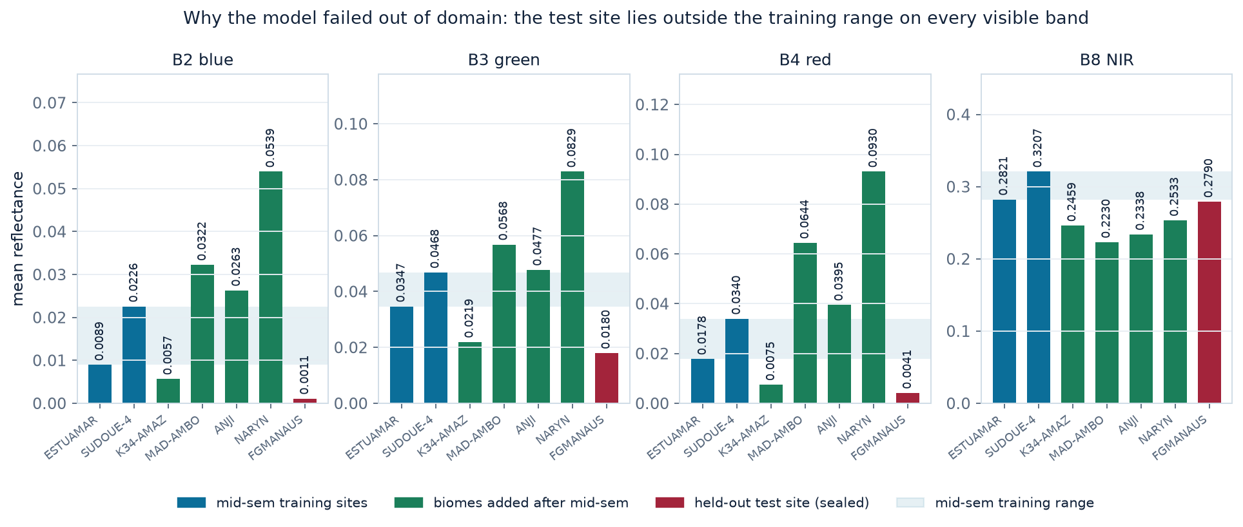
Data
2
SEN2VENµS: real captures at both resolutions, split by site so no test patch neighbours a training patch
THE DATASET
SITES AND PER-BAND REFLECTANCE
Sentinel-2 at 10 m paired with VENµS at 5 m: same place, same date, co-registered by the dataset authors.
Both sides are genuine captures. The lazy alternative is to blur and shrink sharp images to make your own low-resolution inputs. The network then learns to invert your blur, which is not the blur a real sensor produces: it scores beautifully and fails on real data.
Zenodo 14603764 · 29 sites · non-commercial licence
SPLIT PROTOCOL
Splits are by SITE, never by patch.
Patches inside one site are neighbouring crops of the same fields. A random patch split puts near-duplicates on both sides and the score stops meaning anything.
In-domain = held-out 10% of the training sites. It also selects the early-stopping checkpoint, so it is not a clean test set and is never labelled as one.
Out-of-domain = FGMANAUS, an entire site, sealed until the final score.
Site (patches) | B4 red | B8 NIR | NDVI | Role
ESTUAMAR (911) | 0.0178 | 0.2821 | 0.864 | train (mid-sem)
SUDOUE-4 (935) | 0.0340 | 0.3207 | 0.801 | train (mid-sem)
K34-AMAZ (1384) | 0.0075 | 0.2459 | 0.944 | train (added)
MAD-AMBO (1442) | 0.0644 | 0.2230 | 0.547 | train (added)
ANJI (1500) | 0.0395 | 0.2338 | 0.696 | train (added)
NARYN (1500) | 0.0930 | 0.2533 | 0.464 | train (added)
FGMANAUS (129) | 0.0041 | 0.2790 | 0.974 | TEST, sealed
AUGMENTATION
Flips and 90-degree rotations (no 'up' in a top-down view), plus mixup and cutmix applied identically at both resolutions.
Added after the review: a per-band gain drawn log-uniformly and applied to the LOW and HIGH resolution patch ALIKE. Scaling both sides leaves the pair exactly as physically consistent as it was, while removing the absolute brightness of the training distribution as something the model can lean on.
Adding biomes does not absorb the test site.
FGMANAUS red is 0.0041, still below the darkest training site. Widening the training range is not the same as swallowing the test site, and checking that is what keeps the comparison honest.
Notes:
SEN2VENuS pairs real Sentinel-2 with real VENuS captures of the same place and date. Stress that both sides are genuine: most people doing this task synthesise the low-resolution input by blurring, and then the network only learns to invert that blur.
Split by site, not by patch, because patches within a site are adjacent crops of the same fields.
The figure is the important thing here. The shaded band is the mid-sem training range. FGMANAUS, in red, sits below it on blue, green and red, and inside it on NIR. That is the entire generalisation story in one picture and slide 8 returns to it.
After the review we added biomes: K34-AMAZ is dark tropical canopy, MAD-AMBO has the brightest red of all. They widen the range in both directions. Make the honest point in the bottom box: FGMANAUS is still outside, so it is still a real test.

Slide 3
Network architecture · the backbone
3
EDSR-style residual CNN, 1.37 M parameters, upsampling once at the very end
FORWARD PATH FOR ONE PATCH
input
4×64×64
head conv
3×3, 4→64
body: 16 residual blocks
64 channels, at LOW resolution
tail
conv → PixelShuffle×2 → conv
SR output
4×128×128
→
→
→
→
long skip: body learns only what to ADD
RESIDUAL BLOCK
DESIGN CHOICES, AND WHY
out = in + 0.1 · [ conv → ReLU → conv ] (in)
The 0.1 is res_scale. Without it, 16 blocks at 64 channels diverge early in training. The addition is what lets gradients reach the first layers, so a deep stack stays trainable.
No BatchNorm anywhere
Normalising feature statistics throws away absolute intensity. For us that intensity IS the signal, since the whole point is keeping reflectance intact. EDSR dropped it for the same reason.
Upsample once, at the end
All 16 blocks run at 64×64 instead of 128×128, so the deep part costs a quarter as much.
PARAMETERS
Component | Params | Share
head conv | 2,368 | 0.2%
body, 16 residual blocks | 1,216,512 | 88.7%
tail (conv, PixelShuffle, conv) | 152,132 | 11.1%
confidence head (R4 only) | +9,232 | +0.7%
PixelShuffle, not ConvTranspose
Transposed convolution leaves checkerboard artifacts. PixelShuffle produces 4 extra channels and interleaves them into a 2× bigger grid, so there is no overlap to go uneven.
IS THIS BACKBONE THE RIGHT ONE?
L1, not L2
Squared error punishes large errors so hard that the network hedges and outputs blurry averages. L1 gives visibly sharper reconstructions.
Architecture | Params | Held-out PSNR
SRNet, 16x64 | 1.37 M | 47.609 ±0.037
SRCNN (2014) | 75 k | pending
RCAN-lite, attention | 1.53 M | pending
EDSR-large, 32x128 | 10.2 M | pending
Notes:
Standard EDSR-style backbone, and the examiner will know it, so so spend the time on why we made each choice.
Input 4x64x64 during training, head conv lifts to 64 channels, 16 residual blocks, then the tail upsamples once with PixelShuffle. The long skip means the body only has to learn the correction.
The four boxes on the right are the defensible choices. The BatchNorm one is the most important and the most specific to this project: batch normalisation discards absolute intensity, and absolute intensity is exactly the reflectance we are trying to preserve.
The bottom-left table answers the obvious objection that we only compared against bicubic. Every architecture there got the same 12,000 steps, optimiser, schedule, data and seeds. Say that out loud: an under-tuned baseline is not a baseline.
The parameter table matters for the next slide: the confidence head costs 9.2 thousand parameters on 1.37 million, which is 0.7%. That is deliberate, so nobody can argue R4 improved because it had more capacity.

Slide 4
Network architecture · heads, losses, and D
4
Each run changes exactly one component, so every comparison is an ablation rather than two unrelated systems
THE CONFIDENCE HEAD
THE RUNS: ONE CHANGE PER ROW
tail
µ : SR mean
Run | Objective | Question it answers
R0 | Bicubic ×2 | The non-learned floor
R1 | L1 | Baseline network
R2 | L1 + λ·SAM | Does a spectral term change anything?
R3 | L1 + µ·|D(SR)−LR| | Does an observation constraint help?
R4 | Laplace NLL + head | Is the predicted confidence calibrated?
features
64 ch
→
two outputs,
shared backbone
tail_logb
log b : scale
Laplace negative log-likelihood
−log p = |y − µ| / b + log 2b
Why Laplace and not Gaussian: training with L1 IS maximum likelihood under a Laplace model with a FIXED b. Letting the network predict b per pixel is the same objective with one assumption relaxed, so R4 differs from R1 by exactly that. A Gaussian head would generalise L2, the loss we already rejected for being blurry.
Why R3 is different in kind
L1(SR, HR) compares the prediction with the TARGET and never looks at the input. A term built on the INPUT therefore cannot be implied by it. If the network invents detail that was never measured, shrinking the output back to 10 m will not reproduce the Sentinel-2 image, and this term notices. L1 cannot.
Iterative back-projection (Irani & Peleg 1991); the consistency property of Wald (1997).
The pathology, and the fix
The NLL gradient on µ carries a factor 1/b, so pixels the model calls uncertain get a smaller mean gradient: hard pixels get labelled uncertain, stop being learned, and stay hard. We use β-NLL (Seitzer, ICLR 2022) at β = 1, making the mean gradient exactly sign(y − µ), identical to L1, while log b still converges to the local error magnitude.
The ablation did NOT confirm that. In-domain PSNR: β=0 43.84, β=0.5 43.85, β=1 43.68. Gradient clipping absorbs the inflation we guarded against, so β=0.5 is the better default. Our β=1 buys the lowest ENCE and is conservative on PSNR.
Controls that make these ablations
• Identical architecture, schedule, step count, data and seeds; only the objective changes
• 3 seeds per row, reported mean ± population std. A difference inside the seed spread is not a difference
• The baseline gets the same effort as the new rows − quietly under-tuning R1 is the usual way a project manufactures an improvement
DEGRADATION OPERATOR D, USED BY M5 AND R3
x2 decimation keeps only frequencies below π/2, so D needs an anti-alias filter cut there. The 2×2 box used at mid-sem leaves 18% of surviving energy above π/2. Ten filters, all cut at π/2, are swept on slide 7.
Notes:
This is what the second architecture slide buys us, and it is where the new work lives.
Left: the confidence head. One extra tail off the shared backbone, predicting log b per pixel. The line that matters is why Laplace: L1 is already maximum likelihood under a Laplace with fixed scale, so predicting the scale is the same objective with one assumption relaxed. That makes R4 a clean ablation of R1 rather than a different model. A Gaussian head would have generalised L2, which we rejected for blurriness.
The β-NLL box is worth 15 seconds: heteroscedastic NLL has a known failure mode where hard pixels get labelled uncertain and then stop being learned. At beta=1 the mean gradient is exactly L1, so the uncertainty head cannot damage the SR quality. We ran β=0 and 0.5 as an ablation to show the effect is real.
Right: the run table. Emphasise one change per row, and the controls box. If asked why R3 is not redundant the way R2 was: because L1 never looks at the input, and R3 does.

Slide 5
Results
5
Every learned row is 3 seeds, mean ± population std, scored on both regimes. Metrics on reflectance in [0, 1].
IN-DOMAIN · HELD-OUT PATCHES, TRAINING SITES
Picks the early-stopping checkpoint, so NOT a clean test set · and NOT comparable across the two blocks
Method | PSNR ↑ | SSIM ↑ | SAM ↓ | NDVI MAE ↓ | M5 ↓
R0 Bicubic ×2 | 42.159 | 0.9378 | 1.582 | 0.02810 | 0.00078
R1 CNN, L1 | 43.774 ±0.038 | 0.9506 ±0.0003 | 1.295 ±0.008 | 0.02415 ±0.00013 | 0.00464 ±0.00002
R2 CNN, L1 + λ·SAM | 43.731 ±0.050 | 0.9500 ±0.0005 | 1.292 ±0.009 | 0.02413 ±0.00018 | 0.00460 ±0.00008
R3 CNN, L1 + µ·consist | 43.717 ±0.051 | 0.9504 ±0.0005 | 1.301 ±0.010 | 0.02424 ±0.00018 | 0.00397 ±0.00006
R4 CNN, Laplace NLL | 43.680 ±0.049 | 0.9498 ±0.0004 | 1.311 ±0.012 | 0.02438 ±0.00027 | 0.00461 ±0.00007
R1a R1 + augmentation | 43.343 ±0.009 | 0.9476 ±0.0001 | 1.393 ±0.002 | 0.02524 ±0.00001 | 0.00389 ±0.00002
R1m R1, multi-biome | 43.665 ±0.007 | 0.9561 ±0.0001 | 1.586 ±0.001 | 0.02741 ±0.00002 | 0.00278 ±0.00001
R1ma R1, multi-biome + aug | 43.520 ±0.007 | 0.9551 ±0.0000 | 1.618 ±0.001 | 0.02783 ±0.00001 | 0.00241 ±0.00000
R4m R4, multi-biome + aug | 43.475 ±0.003 | 0.9550 ±0.0000 | 1.629 ±0.000 | 0.02802 ±0.00004 | 0.00249 ±0.00002
OUT-OF-DOMAIN · HELD-OUT SITE FGMANAUS
Never touched during training
Method | PSNR ↑ | SSIM ↑ | SAM ↓ | NDVI MAE ↓ | M5 ↓
R0 Bicubic ×2 | 48.013 | 0.9583 | 0.837 | 0.01256 | 0.00074
R1 CNN, L1 | 44.087 ±0.133 | 0.9145 ±0.0025 | 1.564 ±0.042 | 0.02562 ±0.00048 | 0.00521 ±0.00012
R2 CNN, L1 + λ·SAM | 43.956 ±0.098 | 0.9118 ±0.0023 | 1.568 ±0.026 | 0.02565 ±0.00083 | 0.00529 ±0.00009
R3 CNN, L1 + µ·consist | 44.699 ±0.191 | 0.9256 ±0.0028 | 1.437 ±0.043 | 0.02345 ±0.00081 | 0.00448 ±0.00013
R4 CNN, Laplace NLL | 43.719 ±0.139 | 0.9076 ±0.0026 | 1.594 ±0.042 | 0.02759 ±0.00139 | 0.00539 ±0.00013
R1a R1 + augmentation | 45.857 ±0.055 | 0.9370 ±0.0007 | 1.159 ±0.005 | 0.02166 ±0.00045 | 0.00395 ±0.00004
R1m R1, multi-biome | 47.067 ±0.083 | 0.9421 ±0.0005 | 0.967 ±0.024 | 0.01456 ±0.00034 | 0.00398 ±0.00009
R1ma R1, multi-biome + aug | 47.609 ±0.037 | 0.9461 ±0.0004 | 0.861 ±0.010 | 0.01361 ±0.00024 | 0.00348 ±0.00001
R4m R4, multi-biome + aug | 47.480 ±0.075 | 0.9461 ±0.0007 | 0.879 ±0.019 | 0.01432 ±0.00037 | 0.00357 ±0.00008
READING THE TABLE
Compare DOWN the out-of-domain table only. FGMANAUS is the same sealed 129 patches for every row. The in-domain split comes from the TRAINING sites, and the multi-biome rows train on six sites rather than two, so their in-domain column is a different, more varied set and is NOT comparable with the rows above it.
M5 rewards blur: bicubic invents no detail, so shrinking it back down reproduces the input and it wins that column by construction. Read M5 next to PSNR and SSIM, and note it depends on D (slide 7). A change smaller than the seed spread is not a change.
Notes:
Do not read the tables aloud. Point at three things.
One: in-domain the network clearly beats bicubic, so the pipeline is sound.
Two: out of domain the mid-sem model LOSES to bicubic. That is the finding we came back from the review with, and slide 8 explains it and shows what fixed it.
Three: R2 is indistinguishable from R1, which is the ablation the mid-sem argument predicted analytically.
Say the M5 caveat before anyone asks. Bicubic topping that column is not evidence bicubic is better; it is what the metric does to blurry predictions.

Slide 6
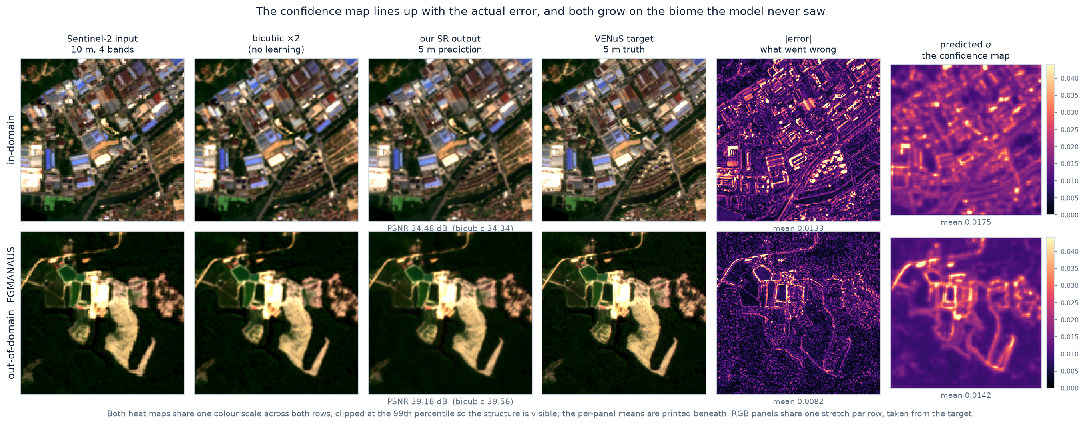
Results · what the confidence head actually produces
6
One real patch through the full pipeline, in-domain and on the unseen biome · the 2-minute demo
IS THE CONFIDENCE CALIBRATED, AND IS IT USEFUL?
WHAT EACH NUMBER IS FOR
• AUSE − rank pixels by σ, drop the worst; does error fall as fast as an oracle?
• AUSE/band − same, ranked INSIDE each band. Pooled AUSE flatters us (97% of top-quartile σ is NIR, simply 30× brighter). Quote this one.
• ENCE − is the stated spread the observed spread?
• Cv − does σ VARY? A constant map scores a perfect ENCE and is useless. Read the two together.
• PICP90 − does the 90% interval cover 90%? Laplace quantile, not a Gaussian z.
Why not the free 3-seed ensemble? It LOSES: AUROC 0.35, below chance, vs 0.76 for the head, and its disagreement does not rise on the unseen biome at all (×1.00). All three seeds learned the SAME prior, so they are identically wrong there. disagreement only sees what members disagree ABOUT.
Method / regime | AUSE ↓ | AUSE/band ↓ | ENCE ↓ | Cv ↑ | ρ ↑ | PICP90
R4 head in-domain | 0.174 | 0.353 | 0.0406 | 0.989 | 0.575 | 0.917
R4 head FGMANAUS | 0.163 | 0.334 | 0.2835 | 1.236 | 0.570 | 0.875
R4m head in-domain | 0.203 | 0.317 | 0.0906 | 0.846 | 0.530 | 0.919
R4m head FGMANAUS | 0.119 | 0.452 | 0.2431 | 1.136 | 0.677 | 0.959
3-seed ensemble in-domain | 0.329 | 0.506 | n/a | n/a | 0.389 | n/a
3-seed ensemble FGMANAUS | 0.275 | 0.352 | n/a | n/a | 0.445 | n/a
Notes:
This is the demo. Two minutes, walked left to right, and it is pre-rendered so nothing can fail on the projector.
Top row is in-domain. Sentinel-2 input, bicubic, our output, the VENuS truth. Then the two heat maps: actual absolute error, and the confidence map the network predicted without ever seeing the truth. Point out that they light up in the same places, mostly on edges and field boundaries, because edges are where super-resolution has to guess.
Bottom row is the rainforest site the model never trained on. Both maps get brighter. The model is more wrong AND it says so.
Then the table. The pairing to emphasise is ENCE with Cv: a model that predicts one constant σ everywhere can score a near perfect ENCE while telling you nothing about where the error is. Cv catches that, which is why Levi report them together and so do we.

Slide 7
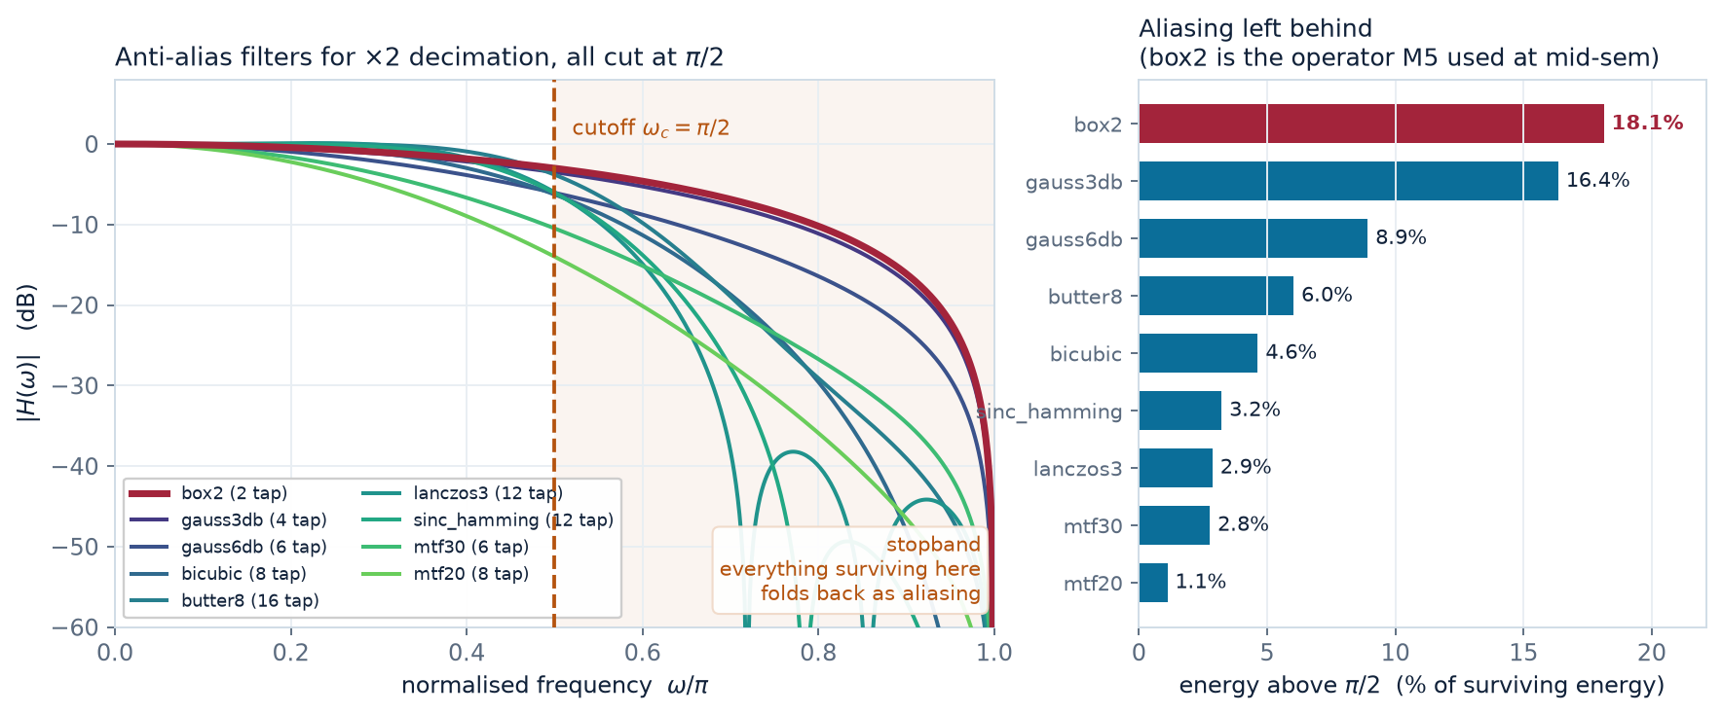
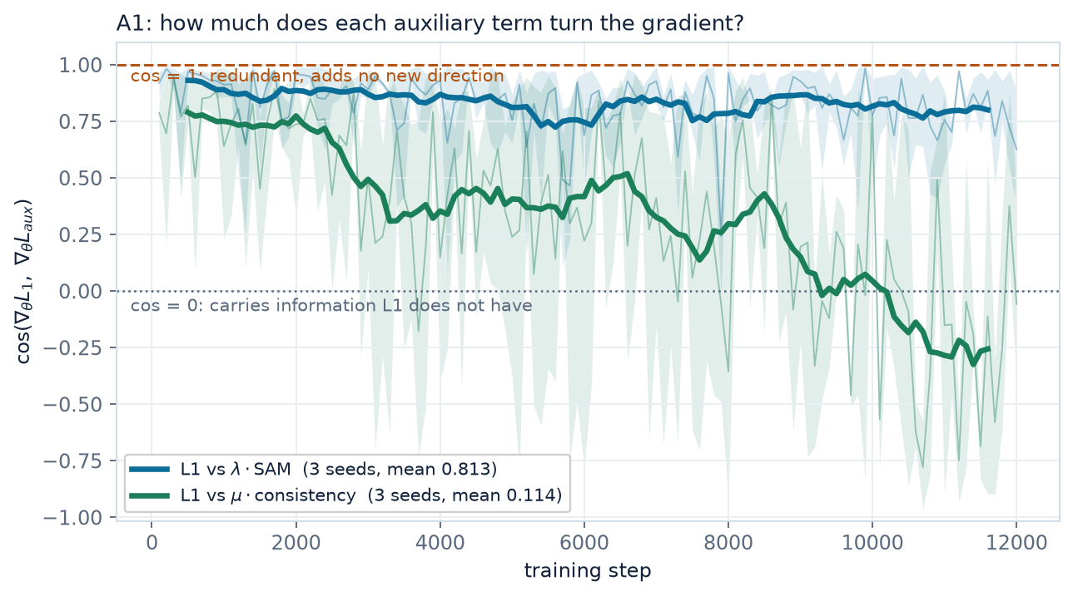
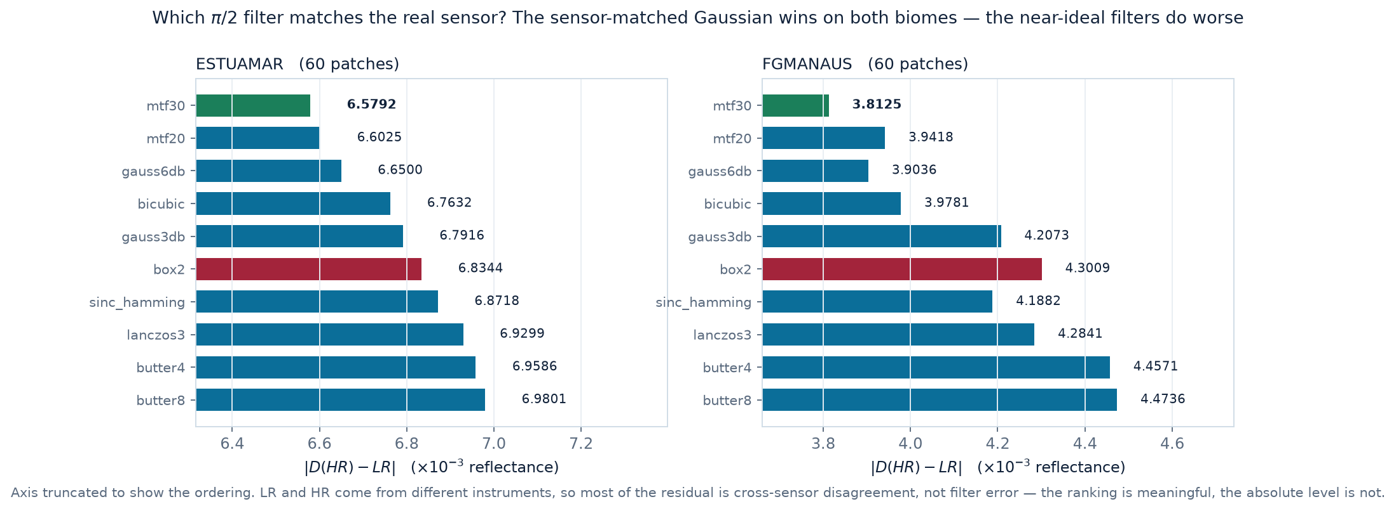
Analysis · do the extra terms do anything?
7
A verbal objection turned into two measurements: gradient alignment, and the sensitivity of M5 to an operator nobody had justified
THE ARGUMENT WE HAD TO ANSWER
THE DECIMATION OPERATOR, AT π/2
SAM(a · p, t) = SAM(p, t) for every a > 0
SAM is scale-invariant, so it only sees the DIRECTION of a pixel's 4-band vector. L1 constrains every band of every pixel, which forces the direction too. Both bottom out at the same parameter setting, so λ·SAM introduces no new optimum. That is settled analytically, not by experiment, and we concede it.
It leaves open whether the term still bends the optimisation PATH on the way there. That is measurable, and nobody had measured it.
A1 · GRADIENT ALIGNMENT, AND WHAT IT PREDICTED
How the filter choice reaches a reported number
Decimating by 2 keeps only frequencies below π/2; everything above folds back as aliasing. M5 is DEFINED through D, so the filter was silently shaping a column already on our results table. The 2x2 box is -3 dB at π/2 but only -8.3 dB at 0.75π, and leaves 18.1% of surviving energy in the stopband. A sensor-matched Gaussian leaves 1.1%.
WHICH FILTER MATCHES THE REAL INSTRUMENT?
Term | Predicted | cos(∇L1, ∇aux) | OOD effect
λ·SAM | redundant: shares L1's optimum | 0.81 ± 0.17 | none, inside seed spread
μ·consist | independent: uses the INPUT | 0.11 ± 0.59 | better on all 5 metrics
SAM stays flat at 0.81 for all 12,000 steps. Consistency starts aligned, crosses zero near step 10,000 and ends NEGATIVE: late in training it pulls away from the target's biome-specific prior and toward the measurement, which holds on any biome, and that is what carries it across sites. (Yu et al., NeurIPS 2020.)
Best on real pairs: ESTUAMAR mtf30 (4% better than box2) · FGMANAUS mtf30 (11% better than box2)
Notes:
Left half is the mid-sem contribution, folded in here because the required structure has no methodology slide.
The objection was that SAM cannot add anything L1 does not already contain, and it is correct: SAM is scale-invariant, so it shares L1's optimum. We concede that analytically. But sharing an optimum and changing the path you take are different claims, and only the first is settled by the argument. So we measured the second: differentiate the two terms separately every 100 steps and take the angle between the gradient vectors.
SAM comes out at 0.81, so mostly redundant, exactly as the analysis predicted. The consistency term is the interesting comparison, because it is the one term that looks at the input.
Right half is the filter study. The point to land: this is not cosmetic. M5 is defined through D, so an unjustified 2x2 box was shaping a number we had already reported. All ten filters are cut at π/2 and differ only in how cleanly they get there.
If asked how the phase was handled: avg_pool puts output samples at half-integer positions, so every kernel is designed on a half-integer grid, and the unit test is that the 2-tap case reproduces avg_pool2d exactly.

Slide 8
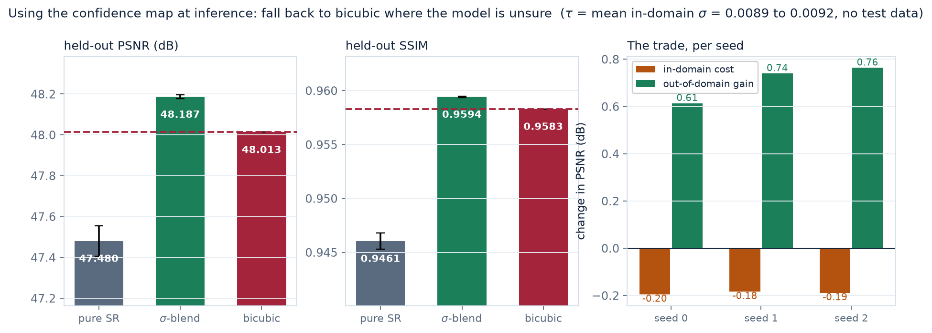
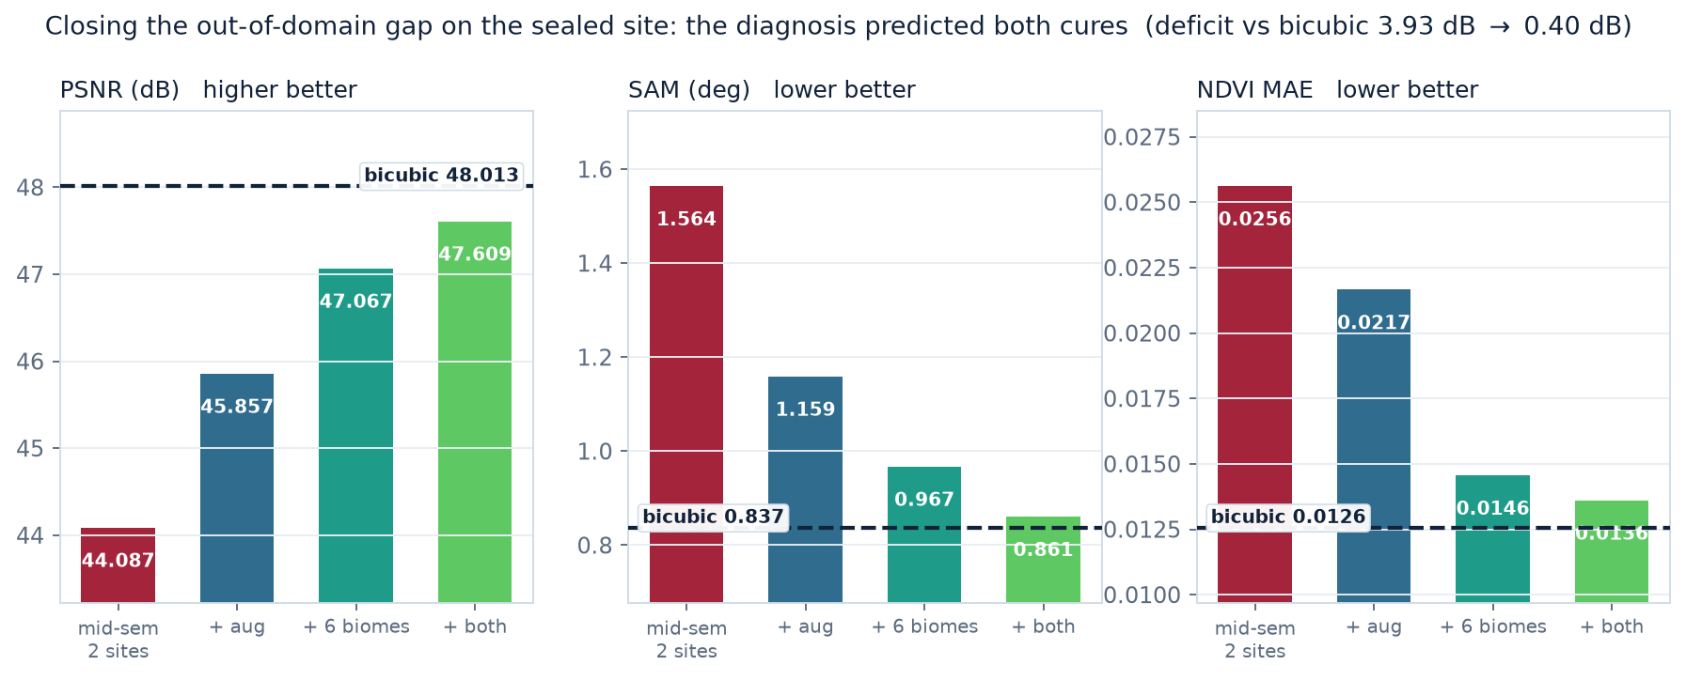
Analysis · generalisation and trust
8
The mid-sem failure, its diagnosis, what fixed it, and how the confidence head closes the gap to bicubic
THE FAILURE, AND THE ARITHMETIC BEHIND IT
USING THE CONFIDENCE MAP, NOT JUST REPORTING IT
The model applies a brightness prior learned from European coast and farmland to Amazon rainforest.
For R1, the mid-sem model, mean signed error on the test site is +0.0025, +0.0050, +0.0030 on blue, green, red and +0.0001 on NIR: the three visible bands are biased UP and NIR is not. Against a true red of 0.004 a +0.003 bias is a 75% relative error.
true NDVI = (0.279 − 0.004)/(0.279 + 0.004) = 0.972 biased = (0.279 − 0.007)/(0.279 + 0.007) = 0.951
A shift of 0.021, which matches the measured NDVI degradation. The explanation is quantitatively consistent, not hand-waving. Bicubic has no learned prior, so it has no bias to carry across.
CLOSING THE GAP ON THE SEALED SITE
THE CONFIDENCE HEAD EARNS ITS PLACE
Blend the output toward bicubic where σ is high and the model beats bicubic on the held-out site: PSNR 48.187 ±0.009 against 48.013, SSIM 0.9594 against 0.9583. All three seeds win.
τ is not tuned on the test set. It is fixed to the model's own mean σ in-domain (0.0089 to 0.0092 across seeds), which reads as “trust the network where its uncertainty is typical of training”. Sweeping τ on validation fails instead, because in-domain the network already beats bicubic and so validation always prefers to blend less.
It is a trade, not a free lunch: -0.20 dB in-domain for +0.71 dB out of domain. SAM and NDVI improve over pure SR but stay behind bicubic.
The same σ also flags the shift unaided: AUROC 0.75.
CONCLUSIONS
• The confidence head is what closes the gap. Blending toward bicubic where σ is high beats bicubic out of domain on PSNR (48.187 vs 48.013) and SSIM (0.9594 vs 0.9583), with no retraining and no test-set tuning.
• The spectral loss term was redundant with L1. Conceded analytically, then measured: gradient alignment 0.81, and no metric moved outside the seed spread.
• The back-projection term compares the output with the INPUT, and it carries across sites: +0.61 dB PSNR and -8% NDVI error out of domain. Its gradient cosine sits near zero and swings widely, which is how a term carrying information L1 cannot see behaves.
• The mid-sem model failed across biomes because it learned an absolute brightness prior. Diagnosed to the band and to the NDVI arithmetic.
• Decimating at a π/2 cutoff changes a metric we had already reported: the 2×2 box leaves 18.1% of energy to alias, and the sensor-matched Gaussian models the real instrument best.
WHAT THE AUGMENTATION DID, MEASURED
A per-band gain applied identically to the LOW and HIGH resolution patch leaves the pair physically consistent while removing absolute brightness as something the model can lean on.
It works on the bands it was aimed at. Signed bias on FGMANAUS (×10⁻³): blue 2.50 → 1.34, green 5.00 → 2.27, red 3.00 → 2.04.
Concede the rest: NIR moves +0.10 → -2.84, so the visible-band prior is roughly halved rather than removed and some error is redistributed into NIR. Every out-of-domain metric still improves.
Notes:
Close on the arc: a negative result, diagnosed, then turned into something useful.
Left: the mid-sem failure. Give the mechanism, not the verdict. It applies a +0.003 brightness prior learned from European farmland; the bias lands on the three visible bands and not on NIR; and the NDVI arithmetic runs 0.972 against 0.951, a shift of 0.021, matching what we measured. Being able to show that chain is what makes it a diagnosis.
Then why the augmentation targets exactly that: scaling both sides of the pair by the same gain is physically consistent, and it removes absolute brightness as a thing the model can lean on.
Right: the headline. The confidence head separates the unseen biome from in-domain patches by predicted σ alone. The model has not been told the truth and has not been told the site changed; it infers that it is out of its depth. In operational remote sensing the standard objection to super-resolution is hallucination, and this gives an operator a threshold for discarding the pixels the model does not stand behind.
If asked what is next: train across more biomes still, and threshold on σ to produce a reject option with a measured error-coverage curve.

