Slide 1
Super-resolution of Sentinel-2 satellite imagery
Reconstructing 5 m detail from 10 m imagery while preserving spectral fidelity | NNDL course project
PROBLEM
Sentinel-2 imagery is openly available at 10 m per pixel; commercial imagery at 1–2 m is costly. The objective is to train a CNN that reconstructs fine spatial detail from the open imagery while preserving the band values on which downstream analytics such as NDVI depend.
INPUT AND OUTPUT
DATA
Sentinel-2 patch
128 × 128 × 4
10 m / pixel
CNN
16 residual blocks
+ PixelShuffle ×2
Super-resolved patch
256 × 256 × 4
5 m / pixel
SEN2VENµS
Sentinel-2 patches (10 m) paired with VENµS acquisitions (5 m) of the same location and date.
• Real acquisitions at both resolutions, not synthetic blur
• Zenodo 14603764, 29 sites, non-commercial licence
• 1,846 patches from ESTUAMAR and SUDOUE-4: 1,661 for training, 185 held out
• 129 patches from FGMANAUS, held out from training
Reflectance: int16 scaled by 10000, clipped to [0, 1].
→
→
• Bands: B2 blue, B3 green, B4 red, B8 near-infrared, 10 m native
• Upscaling factor ×2, 1.37 M parameters
• Loss: L1, with a spectral term evaluated as an ablation
Notes:
Framing, about 1 minute.
Sentinel-2 provides 10 m pixels at no cost; commercial imagery at 1 to 2 m is expensive. The task is to reconstruct the finer detail from the open imagery.
The reason this is more than a sharpening operation: the output feeds analytics. A network that raises apparent sharpness by shifting band values corrupts NDVI and every estimate derived from it.
The dataset pairs two real sensors, so training does not rely on synthetically blurred inputs.

Slide 2
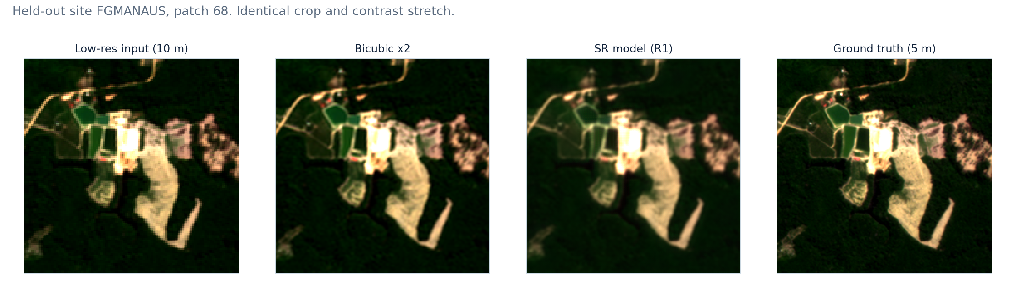
Evaluation protocol
Each low-resolution patch has a corresponding high-resolution capture of the same location. All scores are computed against that reference.
PARTITIONING
Splits are defined by site. Patches within a site cover adjacent ground, so a patch-level split would place near-duplicates in both partitions. Ten percent of the patches from the training sites are held out as an in-domain test set, and a third site is held out entirely as an out-of-domain test set.
METRICS
IN-DOMAIN TEST SET
Metric | Quantity | Better
M1 PSNR | Reconstruction error | higher ↑
M2 SSIM | Local structure, edges and texture | higher ↑
M3 SAM | Spectral angle distortion across bands | lower ↓
M4 NDVI MAE | Error in the derived vegetation index | lower ↓
M5 |D(SR)−LR| | Agreement with the input measurement | lower ↓
Method | PSNR ↑ | SSIM ↑ | SAM ↓ | NDVI ↓ | M5 ↓
Bicubic | 42.159 | 0.9378 | 1.582 | 0.02810 | 0.00078
CNN L1 | 43.774 ±0.038 | 0.9506 ±0.0003 | 1.295 ±0.008 | 0.02415 ±0.00013 | 0.00464 ±0.00002
CNN L1+λSAM | 43.731 ±0.050 | 0.9500 ±0.0005 | 1.292 ±0.009 | 0.02413 ±0.00018 | 0.00460 ±0.00008
• The network exceeds bicubic by +1.61 dB PSNR and improves both spectral metrics.
• Bicubic interpolation is the standard non-learned reference. Out-of-domain results are on slide 5.
Bicubic interpolation introduces no high-frequency content, so its downsampled output closely reproduces the input. M5 therefore favours blurred predictions and must be interpreted alongside M1 and M2.
QUALITATIVE COMPARISON: IDENTICAL CROP AND STRETCH
Notes:
Evaluation protocol, about 1 minute.
The dataset is paired, so every prediction is compared against a real capture of the same location rather than judged by eye.
The partitioning point is worth stating explicitly: patches inside one site overlap in land cover, so a random patch split would place near-duplicate patches in both partitions and inflate the score.
M5 requires a caveat. It is minimised by adding no detail at all, which is why bicubic scores best on it. It is only informative when read together with M1 and M2.
Do not spend time on the table here. State that the network scores below bicubic on this site and that slide 5 accounts for it.

Slide 3
Methodology and contribution
Why the proposed spectral loss term is redundant, and what is measured in its place
SAM(a · p, t) = SAM(p, t) for every a > 0
SAM is invariant to scaling of the predicted vector, so its minimum coincides with the minimum of L1.
ANALYTICAL ARGUMENT
A1 · GRADIENT ALIGNMENT
• L1 constrains every band of every pixel, which forces the spectral angle to zero without an additional term
• Both terms reach zero at the same parameter setting, so λ · SAM introduces no additional optimum
• The term reweights an existing error signal without adding a constraint. The same reasoning applies to an NDVI loss term
cos ( ∇L1 , ∇SAM )
The two terms are differentiated separately every 100 steps and the angle between the resulting gradient vectors is recorded.
• cos = 1: the SAM gradient is parallel to the L1 gradient
• cos = 0: orthogonal, supplying information L1 does not
• cos < 0: the two gradients oppose each other
Gradient-conflict diagnostic from multi-task learning (Yu et al., NeurIPS 2020).
PLANNED EXTENSION
L1 compares the prediction with the target only. A back-projection term compares the prediction with the input (μ · |D(SR) − LR|) and therefore constrains a quantity that is absent from L1. In remote sensing this is the consistency property of Wald's protocol (1997).
Notes:
Methodology, about 1.5 minutes. This slide responds to the review.
Begin by accepting the objection. The earlier proposal was L1 + lambda * SAM, and the objection was that SAM duplicates L1. That is correct. SAM is invariant to scaling of the predicted vector, so it depends only on the direction of a pixel's four-band vector. L1 already constrains every band of every pixel. Both reach zero at the same parameter setting, so SAM introduces no additional optimum.
Then separate the two claims. Sharing an optimum is one claim and is settled analytically. Altering the optimisation path is a second claim, and it had not been measured. A1 measures it.
If asked why the term was not simply removed: removing it leaves the objection unquantified. Measuring it costs one additional backward pass every hundred steps.
On the planned extension: back-projection is independent of L1 because it involves the input, which does not appear in L1(SR, HR). The references are Irani and Peleg (1991) and Wald (1997), so the method is established rather than new. State clearly that it is specified and not implemented.
Caveat if pressed: the target is VENuS and the input is Sentinel-2, so D(HR) approximates LR but is not equal to it; the measured mean absolute difference is 0.0057. The two terms are therefore in partial conflict, and back-projection is expected to reduce PSNR.

Slide 4
Experiments and benchmarks
Each row differs from the preceding row in a single component
RUNS
CONTROLS
Run | Method | Purpose | Status
R0 | Bicubic ×2 | Non-learned reference | complete
R1 | CNN, L1 | Baseline network | 3 seeds
R2 | CNN, L1 + λ · SAM | Effect of a spectral loss term | 3 seeds
R3 | CNN, L1 + μ · consistency | Effect of an observation constraint | specified
R4 | R3 + uncertainty head | Calibration of predicted confidence | specified
• λ fixed at 0.1, selected on in-domain results
BENCHMARK
• Bicubic interpolation is the standard non-learned reference
• Absolute PSNR depends on the dataset and band selection; the controlled difference between rows is the quantity of interest
REPLICATION
R2 is expected to produce only a small change. Differences below the run-to-run standard deviation cannot be separated from initialisation noise, so R1 and R2 are each run with three seeds.
EVALUATION REGIMES
Each run is scored on an in-domain test set and on the held-out site FGMANAUS. The first indicates whether the model performs the task; the second indicates whether performance is retained under a change of land cover. The two results differ.
Notes:
Experiment design, about 1 minute.
Five runs, each differing from the previous one in a single component. R0 to R2 are complete with three seeds each. R3 and R4 are specified and not implemented.
Emphasise the controls. R1 and R2 share architecture, seeds, step count, schedule and data, so any difference is attributable to the loss. R1 received the same tuning budget as R2.
On replication: the claim under test is that R2 produces little change. A difference below the run-to-run standard deviation cannot be distinguished from initialisation noise, which is why three seeds are used rather than one.
On the two regimes: the in-domain test set is held-out patches from the training sites, so it measures whether the model performs the task on terrain of the kind it was trained on. FGMANAUS is a different site entirely and measures transfer across land cover.

Slide 5
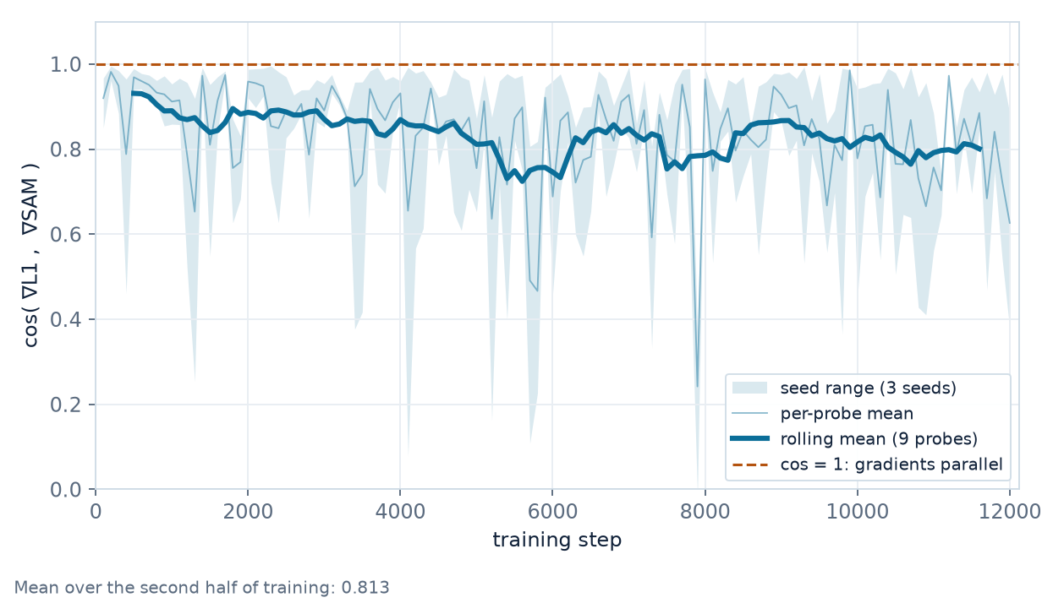
Results
Six training runs. Three seeds each for R1 and R2, scored on both evaluation regimes.
IN-DOMAIN TEST SET: HELD-OUT PATCHES, TRAINING SITES
A1: GRADIENT ALIGNMENT DURING TRAINING
Method | PSNR ↑ | SSIM ↑ | SAM ↓ | NDVI ↓ | M5 ↓
Bicubic | 42.159 | 0.9378 | 1.582 | 0.02810 | 0.00078
CNN L1 | 43.774 ±0.038 | 0.9506 ±0.0003 | 1.295 ±0.008 | 0.02415 ±0.00013 | 0.00464 ±0.00002
CNN L1+λSAM | 43.731 ±0.050 | 0.9500 ±0.0005 | 1.292 ±0.009 | 0.02413 ±0.00018 | 0.00460 ±0.00008
OUT-OF-DOMAIN: HELD-OUT SITE FGMANAUS
Method | PSNR ↑ | SSIM ↑ | SAM ↓ | NDVI ↓ | M5 ↓
Bicubic | 48.013 | 0.9583 | 0.837 | 0.01256 | 0.00074
CNN L1 | 44.087 ±0.133 | 0.9145 ±0.0025 | 1.564 ±0.042 | 0.02562 ±0.00048 | 0.00521 ±0.00012
CNN L1+λSAM | 43.956 ±0.098 | 0.9118 ±0.0023 | 1.568 ±0.026 | 0.02565 ±0.00083 | 0.00529 ±0.00009
FINDINGS
• In-domain, R1 exceeds bicubic by +1.61 dB PSNR and improves both spectral metrics, which confirms that the implementation is correct.
• On the held-out site, R1 falls 3.93 dB below bicubic. The training sites are European coastal and agricultural terrain; FGMANAUS is tropical rainforest, where the blue and red bands are four to eight times darker than the training range. The model applies a positive bias of approximately 0.003 reflectance to the visible bands, a relative error near 75% on red, which propagates to NDVI.
• R2 is not distinguishable from R1: PSNR differs by -0.13 dB against a seed standard deviation of 0.13 dB. Mean gradient alignment is 0.81. The SAM metric does not improve under SAM training.
Notes:
Results, about 1.5 minutes, then questions.
Present the in-domain table first. The network exceeds bicubic on PSNR, SSIM and both spectral metrics, which establishes that the implementation is correct. State this before the second table.
The out-of-domain table shows the network below bicubic on all five metrics. The cause is measured. Per-band mean reflectance is ESTUAMAR [0.009, 0.036, 0.019, 0.280], SUDOUE-4 [0.022, 0.046, 0.033, 0.318], FGMANAUS [0.001, 0.018, 0.004, 0.279]. Rainforest canopy absorbs almost all visible light, so blue and red fall outside the training range. The mean signed error per band on the test site is [+0.0025, +0.0050, +0.0030, +0.0001]: the visible bands are biased upward and the near-infrared band is not. In-domain the same bias is five to ten times smaller.
The NDVI arithmetic, if requested: (0.279 - 0.004) / (0.279 + 0.004) = 0.972 against (0.279 - 0.007) / (0.279 + 0.007) = 0.951, a shift of 0.021, which matches the measured degradation.
Summary: the model has learned a brightness prior from European land cover and applies it to rainforest. Bicubic has no learned prior.
On M5: bicubic is lowest in that column by construction. State this before it is raised.
The in-domain test set is held-out patches from the two training sites, so it measures performance on the kind of terrain the model was trained on, not transfer.
Next steps: train across multiple biomes, and implement R3 and R4.

