Slide 1

AI reinvention made real
Accenture Innovation Challenge 2026
VOUCH · VELOCITY GATE

Slide 2
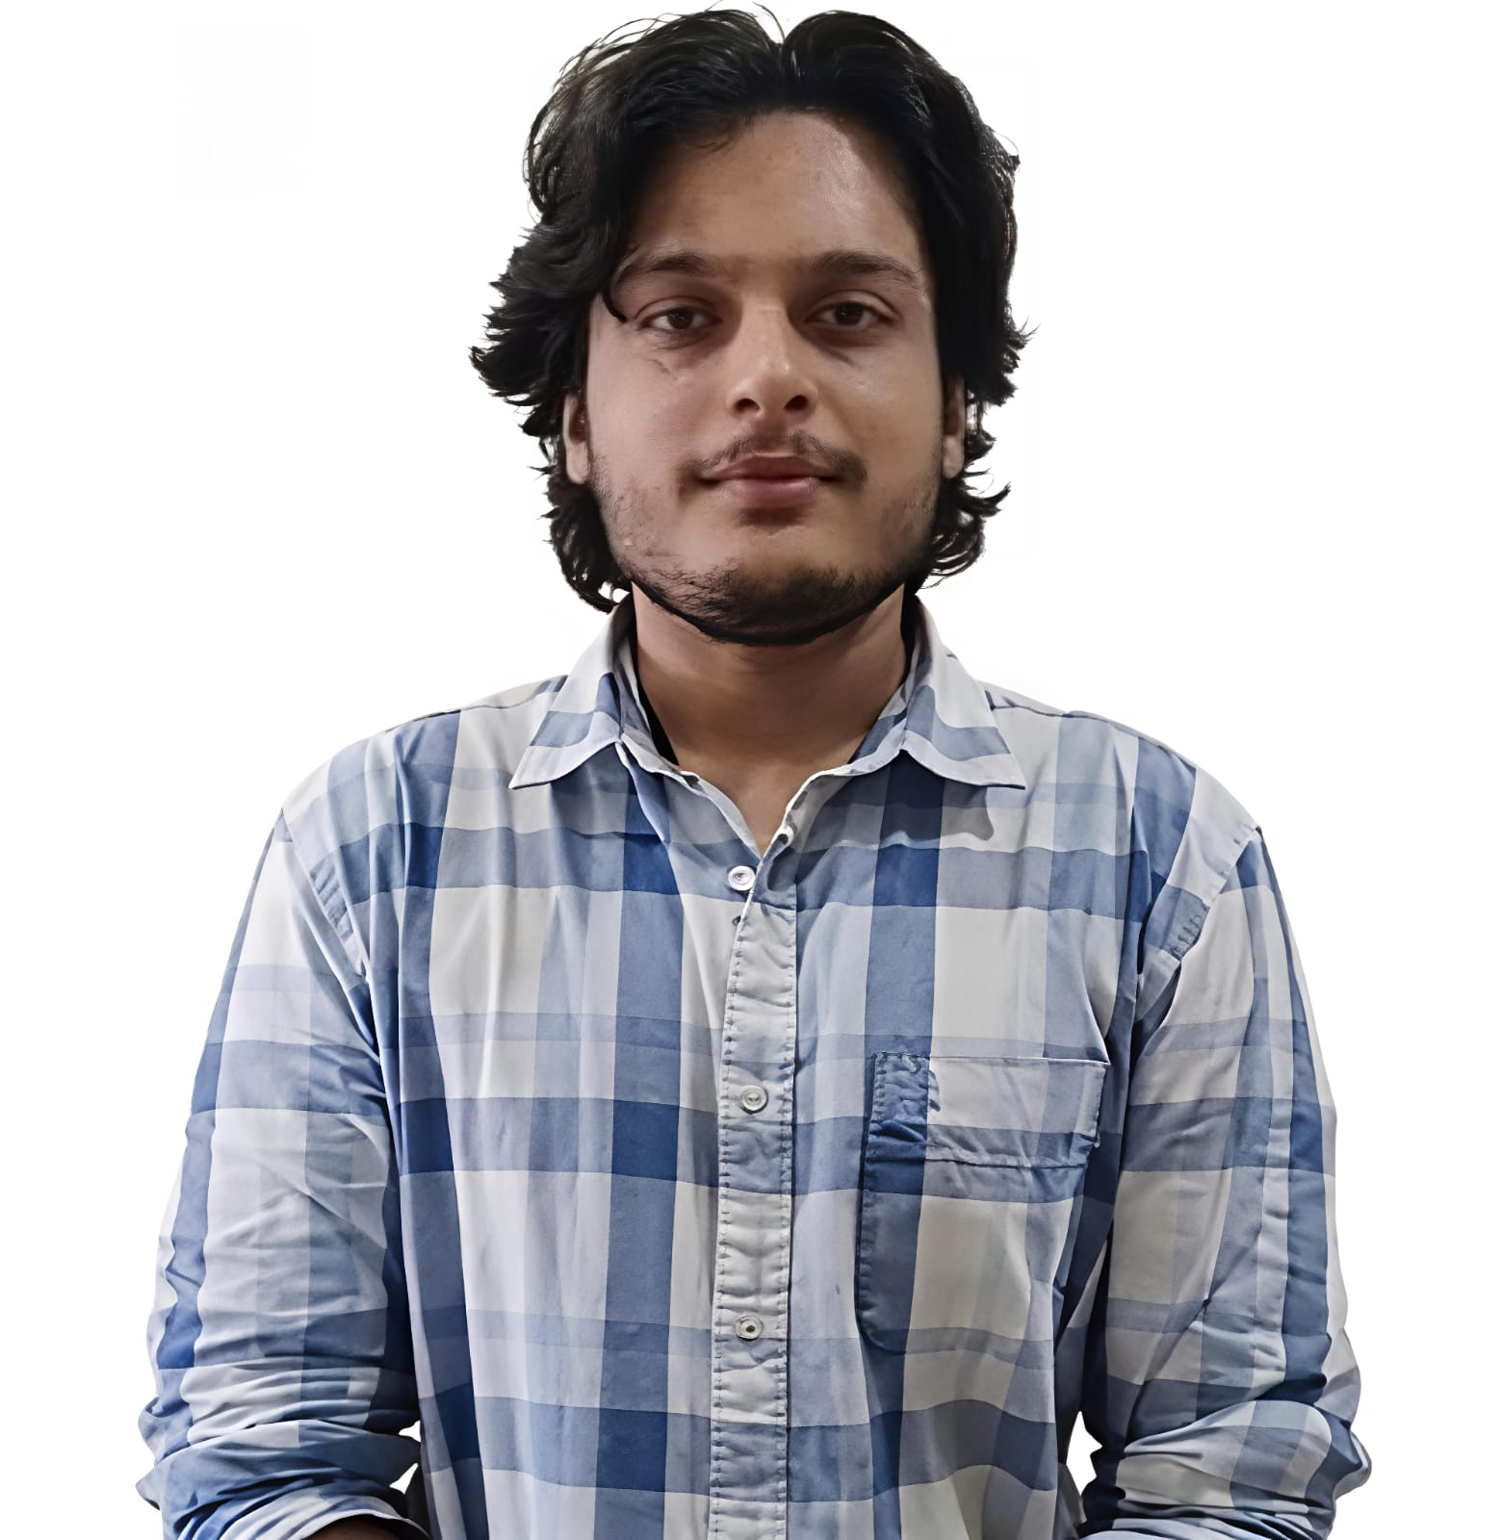


Team details
TEAM NAME: Velocity Gate | PROBLEM STATEMENT 1: ControlPlane.ai
Rushil Jain (Team Leader)
Mayank Tiwari
College: National Institute of Technology Karnataka, Surathkal
Stream: Electronics and Communication Engineering
Year of graduation: 2028
College: National Institute of Technology Karnataka, Surathkal
Stream: Civil Engineering
Year of graduation: 2028
Somyak Mohanta
College: National Institute of Technology Karnataka, Surathkal
Stream: Computer Science and Engineering
Year of graduation: 2028

Slide 3
EXECUTIVE SUMMARY
Autonomy should be earned, not granted.
An enterprise deploying AI agents today chooses between two costly options. Grant broad authority and absorb whatever goes wrong. Or place a person in front of every action and lose the speed the automation was bought for.
79.4%
Vouch is a third option. It estimates how likely each AI response is to be wrong, weighs that against what the proposed action would cost if it were wrong, and releases only what the agent's own measured record supports.
of AI responses were approved with no human involvement
0
35 ms
1,466
incorrect refunds reached a customer
added to each response
live AI responses evaluated
Measured across every response the system released on its own
About a tenth of the time it takes to blink. The check is not felt
Generated by a production model, then scored and routed end to end
One control layer. Three outcomes: release it, verify it further, or hand it to a person.

Slide 4
THE PROBLEM
A confident answer is not a verified one.
Generative AI produces text that reads as authoritative whether or not it is correct. That is tolerable while the output is only text on a screen. It stops being tolerable the moment a workflow acts on it: money moves, personal data crosses a boundary, or a person makes a decision on the strength of it.
THE OPERATING TENSION
Move faster, but only as far as the evidence reaches.
FOUR PEOPLE CARRY THE CONSEQUENCES
1
AI platform owner
One place to connect, whatever model sits behind it.
2
Operations owner
More cases resolved without a queue, and a cap on the downside.
3
Risk and compliance
Boundaries that hold, policy that varies by region, a record for every call.
4
Human reviewer
The reply, the evidence, the action and the reason, on one screen.

Slide 5
WHY GENERIC CHECKING FAILS
No single checking rule fits every use case.
Each difficulty below is drawn from the brief, and each shaped a specific design decision.
THE REAL COMPLEXITY
HOW VOUCH ANSWERS IT
A chatbot, an internal copilot and a decision tool carry different risk and latency budgets
Policy is set for each use case while the underlying mechanism stays identical
Bias, hallucination and privacy overlap inside the same sentence
Signals are scored side by side and priced together, not sorted into one category
There is often no reliable real-time truth to check a claim against
Checkable claims go to the systems of record; the remainder is priced as uncertainty
Over-flagging causes alert fatigue, under-flagging creates liability
The threshold follows from the cost of being wrong rather than being chosen by hand
Agents that take actions compound risk across a conversation
Authority is granted per action and per value, never per conversation
Regulation differs by geography and continues to change
Policy is configuration, and fixed limits sit outside anything that can be earned
The model is consumed through an API, so its internals are closed
Vouch reads only inputs and outputs, so any provider can be substituted

Slide 6
HOW IT WORKS
Four steps, on a loop, around every response.
01
Sense
Check the stated facts against the systems of record, and score grounding, privacy, policy and prompt injection.
02
Price
Work out what it costs if this is wrong: the amount at stake, and whether the action can be undone.
03
Decide
Weigh that cost against what this agent has already earned on this exact job at this size of money.
04
Learn
Wait for the confirmed outcome, then widen or withdraw the authority accordingly.
expected cost = probability of error x cost of the action

Slide 7
A DECISION, IN FULL
Confidence is not permission.
The gate reads three numbers and returns one route. Nothing else influences the decision.
P(error)
x exposure
vs budget
= route
How likely it is wrong
Cost if it is wrong
What it has earned
Release, verify, or hand over
THE SAME REQUEST, AT TWO AMOUNTS
REFUND OF INR 60
REFUND OF INR 1,96,485
The chance of being wrong is 0.2 per cent, the amount is small and the refund can be reversed. This agent has a proven record at this size, so the expected cost lands inside it.
The reply is written with exactly the same confidence. But a refund this large belongs to a separate record, and the expected cost runs past what the agent has earned there.
Released automatically. No person involved.
Sent to a person, with the evidence attached.

Slide 8
WHAT IS NEW
Four departures from the usual safety layer.
1
Risk is priced, not labelled
A conventional checker returns safe or unsafe. Vouch multiplies the chance of error by the cost of the action, so an identical response can be released in one context and held in another.
2
Authority is earned from outcomes
Permissions are not configured by an administrator. They are a measured record, held separately for each agent, action and value band, and they shrink when results get worse.
3
The costly check is bought only when it can change the answer
A second, slower model is invoked for genuinely borderline cases rather than for every response, so verification cost and delay track difficulty instead of volume.
4
Failure always reduces autonomy
Any component that goes missing makes the system more conservative, never less. An outage cannot silently widen what the agent is allowed to do.

Slide 9
POLICY BY USE CASE
Same machinery. Different dials.
The brief assumes an enterprise running several AI use cases at once. Each gets its own risk tolerance and latency budget without a separate system being built for it.
Customer support
Internal knowledge
Decision support
Customer facing, acts on money
Employee facing, mostly reading
Regulated, a person is accountable
CHECKS
CHECKS
CHECKS
Grounding, policy, privacy
Source support, PII, injection
Bias, grounding, policy, PII
LATENCY POSTURE
LATENCY POSTURE
LATENCY POSTURE
Fast: checks overlap generation
Fastest: no action to price
Slower by design: deeper checks
TRUST SCOPE
TRUST SCOPE
TRUST SCOPE
Per action and value band
Per domain and source set
Per decision class and region
Verification depth is itself a setting: skip the second model, call it only for borderline cases, or apply it to every action that has a consequence.

Slide 10
ARCHITECTURE
It sits between the agent and what it can touch.
VOUCH
ENTERPRISE AI
Inspect, price, decide
ENTERPRISE SYSTEMS
Any model or agent
Tools, workflows, people
• Deterministic checks
• Parallel risk sensors
• Second model when needed
• Per-task trust ledger
Inline, not after the fact
Checks run beside generation
Every decision is recorded
The check happens before the action reaches a system, so a wrong answer is stopped rather than reported.
Risk scoring overlaps the model writing its reply, so most of the work costs no extra waiting time.
The response, evidence, action, reason, provider path and latency are written to an audit log that cannot be edited in place.

Slide 11
MEASURED EVIDENCE
What the prototype did, and what it means.
A production AI model answered 1,466 real customer requests about refunds. Vouch scored and routed every one of them. The model can be replaced without changing anything below.
79.4%
of responses released with no human involvement
The share of work that stops consuming review capacity
0
incorrect refunds released to a customer
The autonomy above was not bought by letting errors through
INR 17,27,616
of refunds paid out under earned authority
Real money moved by the agent alone, inside its proven record
0.018
calibration error
When it says an answer is 5% likely wrong, it is wrong about 5% of the time
35 ms
added to a response, at the middle of the range
Imperceptible to a customer; the model itself takes seconds
302
responses held back for a person
Concentrated where the consequence or the uncertainty was largest
Reported alongside the two acceptance checks the prototype does not yet pass: borderline-case coverage and top-band sample size are still short.

Slide 12
SCALE
The design scales on volume, use cases and cost.
79,400
VALUE EQUATION
avoided reviews x loaded review cost
+ value of faster resolution
of 100,000 monthly decisions clear without a mandatory review, at the route mix measured here. Human attention returns to the remaining 20,600.
- control cost - remaining error loss
WHAT MAKES IT SCALE
Volume
Use cases
Spend
Governance
Most checks are deterministic or run beside generation, so cost per decision stays roughly flat as traffic grows.
A new workflow is a policy entry, not a new system. The gate, ledger and audit trail are shared.
The expensive second model is reserved for borderline cases, so verification cost tracks difficulty rather than volume.
One audit trail and one policy layer serve every agent, so compliance effort is paid once.

Slide 13
RISKS AND CONTROLS
When something breaks, autonomy only goes down.
RISK
CONTROL
Truth arrives late or conflicts
Wait out the evidence window, and weigh sources by strength
The system flags too much
Calibration, borderline analysis, and a forced-review sample
A sensor or provider fails
Decide conservatively, cap the wait, retry once and stop
Policy or the model drifts
Fingerprint the configuration, and promote only through gates
Privacy and regional rules vary
Fixed invariants, and policy the server owns
Reviewers begin rubber-stamping
The human route carries the evidence and the arithmetic
No track record can override a fixed safety boundary.

Slide 14
ADOPTION
Start it watching. Let it earn the rest.
WEEKS 1-2
One agent, one system of record, one outcome feed. It decides, and nothing acts on those decisions.
Connect
WEEKS 3-6
Check the probabilities against what actually happened, and put the reviewer screen in front of reviewers.
Validate
WEEKS 7-10
Let it act on small reversible things, where the record already clears the promotion gates.
Constrain
WEEKS 11-13
Open one more value band. Decide whether a second use case is worth doing.
Expand
Calibration, retained loss, review reduction, latency and operator acceptance.
PILOT GATE

Slide 15
Thank you
VOUCH
Our build of ControlPlane.ai. To vouch for someone is to put your name behind what they are about to do. This does it action by action, on evidence.

