Slide 1
Chapter 4: Threads

Slide 2
Thread
Basic unit of CPU utilization
Thread consist of thread id, program counter, register set, stack
Thread shares with other threads belonging to the same process its code section, data section, and other operating-system resources, such as open files and signals.
A process can have a single thread of control. If a process has multiple threads of control, it can perform more than one task at a time.

Slide 3
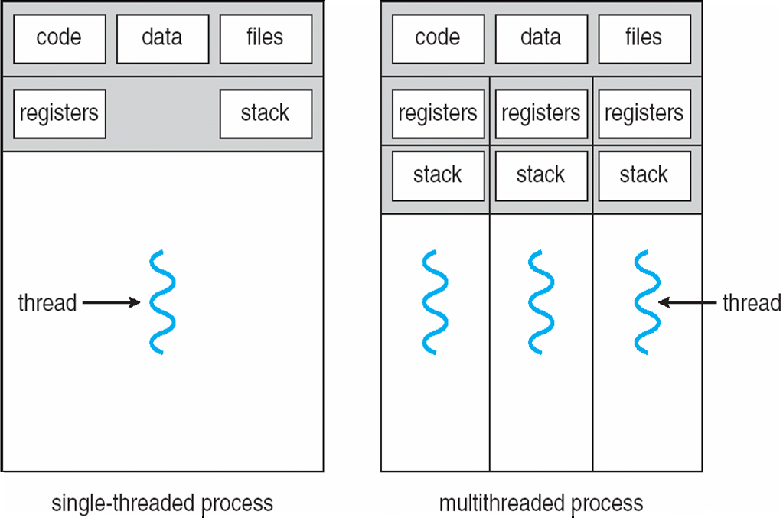
Single and Multithreaded Processes

Slide 4
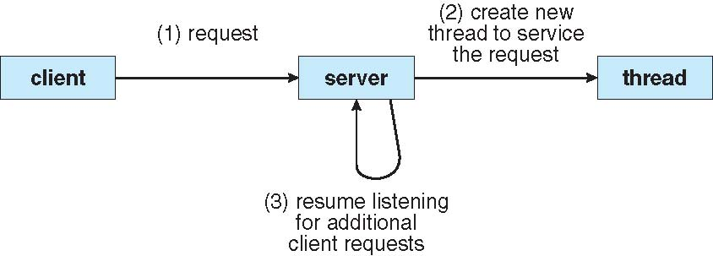
Multithreaded Server Architecture

Slide 5
Benefits
Responsiveness:
Multithreading an interactive application may allow a program to continue running even if part of it is blocked or is performing a lengthy operation, thereby increasing responsiveness to the user.
Resource Sharing:
threads share the memory and the resources of the process to which they belong by default.
Processes may only share resources through techniques such as shared memory or message passing. Such techniques must be explicitly arranged by the programmer.

Slide 6

Benefits (Contd…)
Economy
Because threads share the resources of the process to which they belong (thread is a light-weight process)
it is more economical to create and context-switch threads.
Allocating memory and resources for process creation is costly.
much more time consuming to create and manage processes
Scalability
The benefits of multithreading can be greatly increased in a multiprocessor architecture, where threads may be running in parallel on different processors. (increases parallelism)

Slide 7
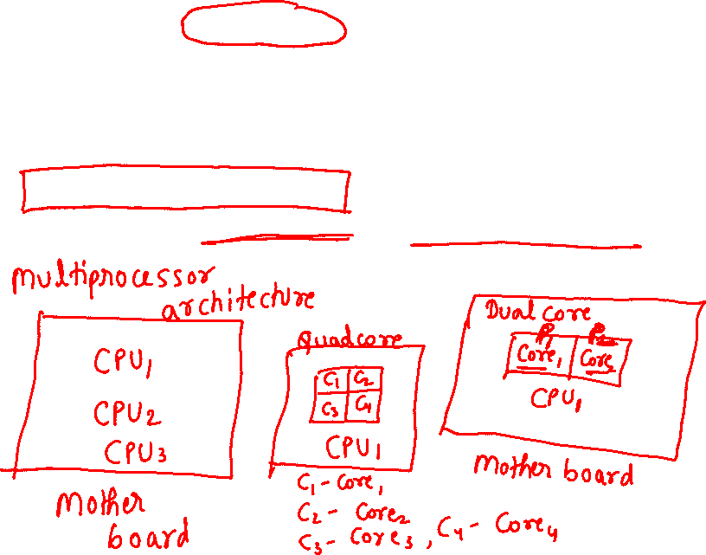
Multicore Programming
place multiple computing cores on a single chip, where each core appears as a separate processor to the operating system
Multithreaded programming provides a mechanism for more efficient use of multiple cores and improved concurrency

Slide 8
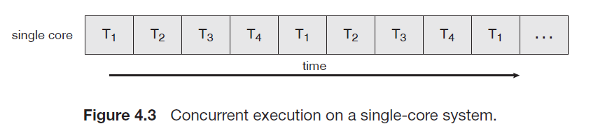
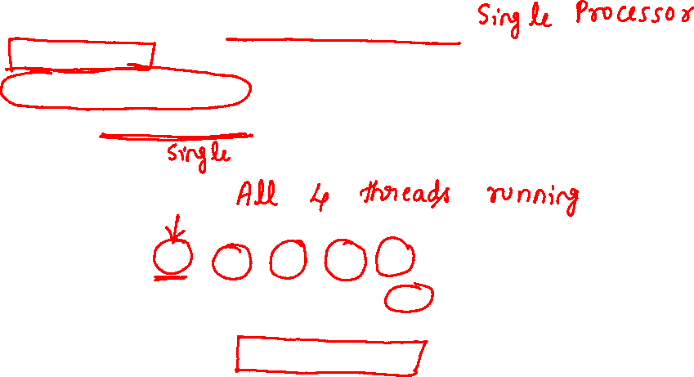
On a system with a single computing core,
Concurrency merely means that the execution of the threads will be interleaved over time
as the processing core is capable of executing only one thread at a time.

Slide 9
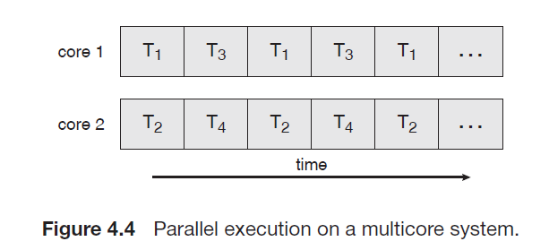
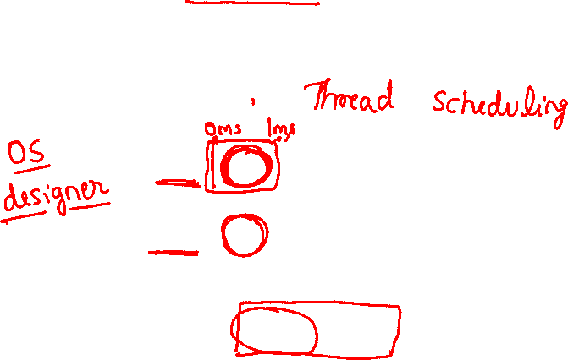
On a system with multiple cores, however,
concurrency means that the threads can run in parallel,
as the system can assign a separate thread to each core

Slide 10
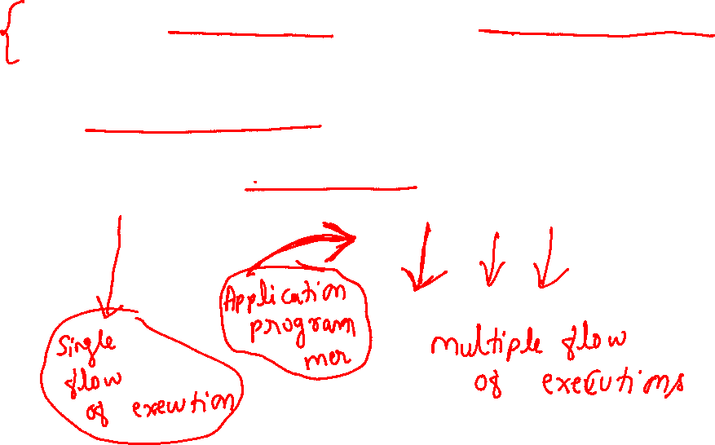
Designers of operating systems must write scheduling algorithms that use multiple processing cores to allow the parallel execution.
For application programmers, the challenge is to modify existing programs as well as design new programs that are multithreaded to take advantage of multicore systems.

Slide 11
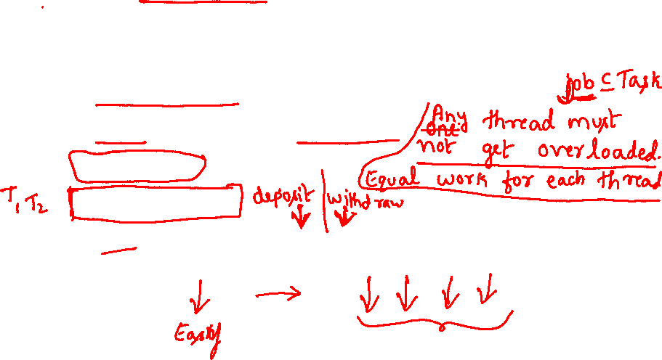
Multicore Programming
five areas present challenges in programming for multicore systems are:
Dividing activities: concurrent tasks run in parallel
Balance: equal work of equal value
Data splitting
Data dependency
Testing and debugging: many different execution paths makes testing and debugging difficult

Slide 12
Multithreading Models
threads may be provided
either at the user level, for user threads,
or by the kernel, for kernel threads.
User threads are managed without kernel support, whereas
kernel threads are supported and managed directly by the operating system.
Ultimately, a relationship must exist between user threads and kernel threads.
Three common ways of establishing such a relationship.

Slide 13
Multithreading Models
Many-to-One
One-to-One
Many-to-Many

Slide 14
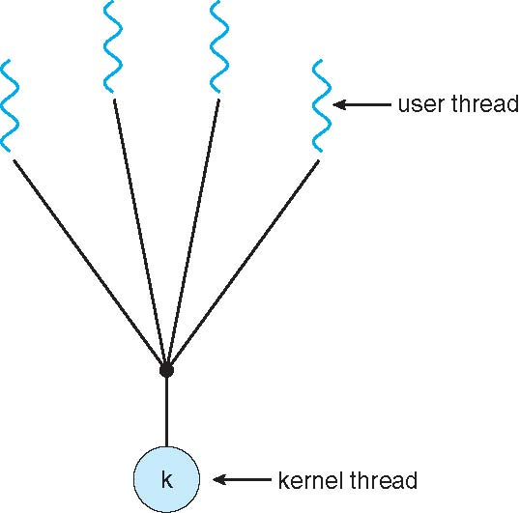

Many-to-One Model
The many-to-one model maps many user-level threads to one kernel thread.

Slide 15
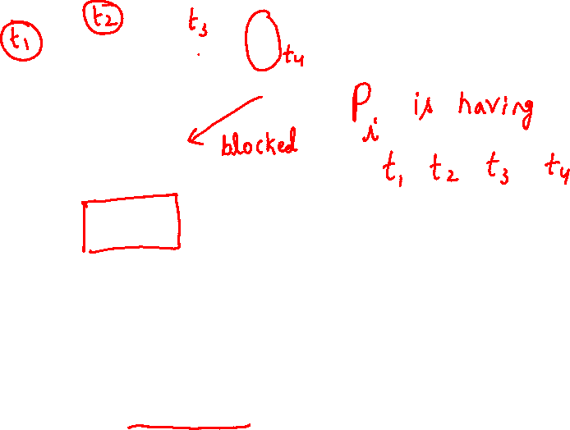
Many-to-One Model
The entire process will block if a thread makes a blocking system call.
only one thread can access the kernel at a time
multiple threads are unable to run in parallel on multiprocessors

Slide 16
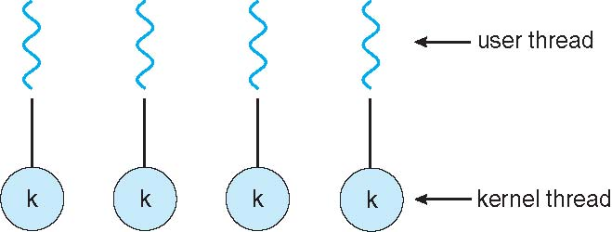

One-to-one Model
maps each user thread to a kernel thread
It provides more concurrency than the many-to-one model by allowing another thread to run when a thread makes a blocking system call; it also allows multiple threads to run in parallel on multiprocessors.
The only drawback to this model is that creating a user thread requires creating the corresponding kernel thread.

Slide 17
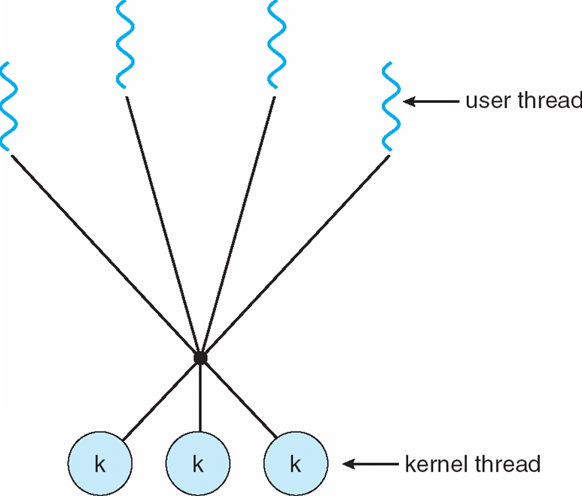

Many-to-Many Model
multiplexes many user-level threads to
a smaller or equal number of kernel threads.
The many-to-many model suffers from neither of these shortcomings: developers can create as many user threads as necessary, and the corresponding kernel threads can run in parallel on a multiprocessor. Also, when a thread performs a blocking system call, the kernel can schedule another thread for execution.

Slide 18
4.4 Threading Issues
4.4.1 The fork() and exec() System Calls
4.4.2 Cancellation
4.4.3 Signal Handling
4.4.4 Thread Pools
4.4.5 Thread-Specific Data

Slide 19
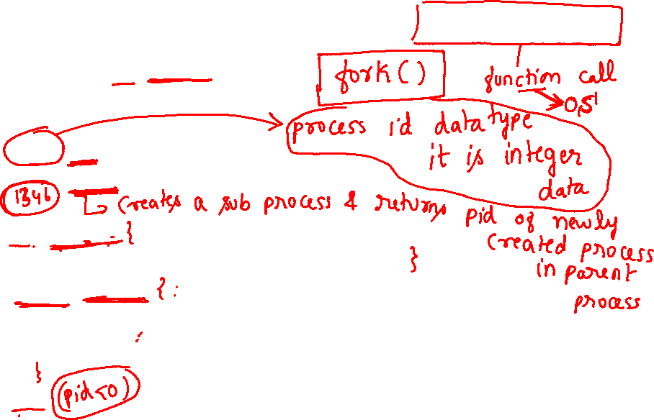
4.4.1 The fork() and exec() System Calls
#include <sys/types.h>
main()
{
pid_t pid;
pid = fork(); //Creates a child process
if (pid == 0)
cout<<“\n I’m the child process”;
else if (pid > 0)
cout<<“\n I’m the parent process. My child pid is %d”<<pid;
else
cout<<“Error in fork”;
}

Slide 20
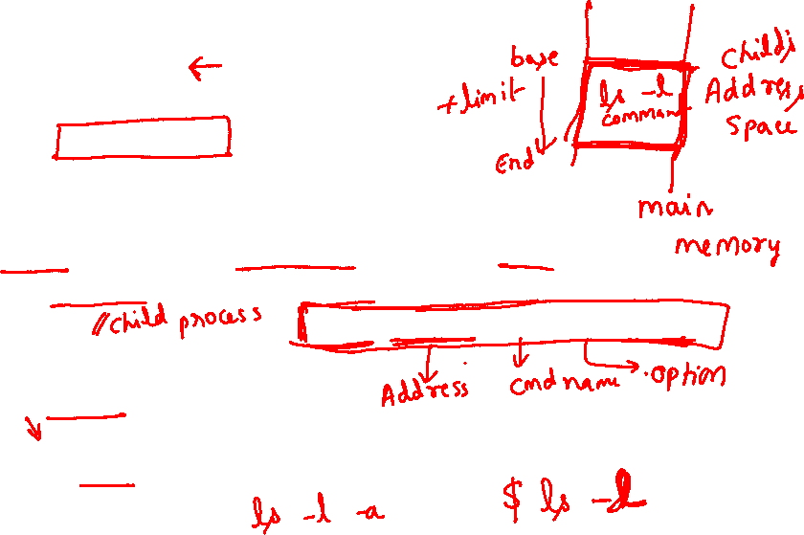
exec system call
#include <stdio.h>
#include <unistd.h>
#include <stdlib.h>
#include <sys/types.h>
#include <sys/wait.h>
main(void) {
pid_t pid = 0; int status; pid = fork();
if (pid == 0) { cout<<"I am the child.\n“;
execl("/bin/ls", "ls", "-l",NULL);
}
if (pid > 0)
cout<<"I am the parent, and the child is %d.\n“<<pid;
if (pid < 0) cout<<“In fork():“;
}

Slide 21
4.4.1 The fork() and exec() System Calls
The semantics of the fork() and exec() system calls change in a multithreaded program.
Does fork() duplicate only the calling thread or all threads?
Some UNIXes have two versions of fork(one that duplicates all threads and another that duplicates only the thread that invoked the fork() system call.)
exec() usually works as normal – replace the running process including all threads

Slide 22
4.4.2 Thread Cancellation
Thread Cancellation is the task of terminating a thread before it has completed.
For example, if multiple threads are concurrently searching through a database and one thread returns the result, the remaining threads might be cancelled
Thread to be canceled (killed) is target thread

Slide 23
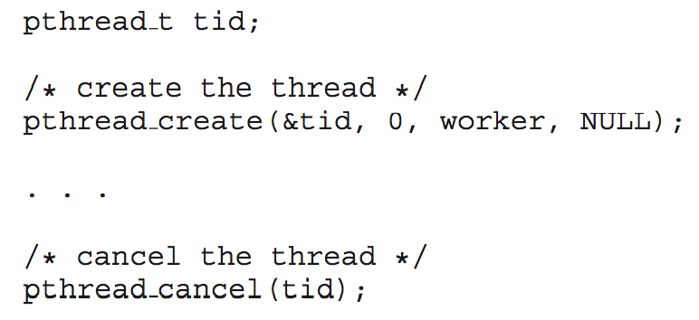
4.4.2 Thread Cancellation
Two general approaches:
Asynchronous cancellation terminates the target thread immediately
Deferred cancellation allows the target thread to periodically check if it should be cancelled at thread cancellation point. The cancellation point is the time where the thread could be safely be cancelled.
Pthread code to create and cancel a thread:

Slide 24
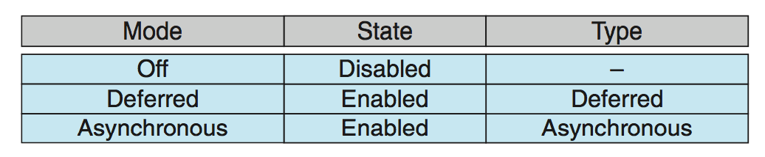
4.4.2 Thread Cancellation (Cont.)
Invoking thread cancellation requests cancellation, but actual cancellation depends on thread state
If thread has cancellation disabled, cancellation remains pending until thread enables it
Default type is deferred
Cancellation only occurs when thread reaches cancellation point
To establish a cancellation point use the system call, pthread_testcancel()
Then cleanup handler is invoked(release resources)

Slide 25
4.4.3 Signal Handling
Signals are used in UNIX systems to notify a process that a particular event has occurred.
A signal handler is used to process signals
Signal is generated by particular event
Signal is delivered to a process
Examples of synchronous signals include illegal memory access and division by 0. If a running program performs either of these actions, a signal is generated. Synchronous signals are delivered to the same process that performed the operation that caused the signal.
When a signal is generated by an event external to a running process, that process receives the signal asynchronously. Examples of such signals include terminating a process with specific keystrokes (such as <control><C>) and having a timer expire

Slide 26
4.4.3 Signal Handling
Signal is handled by one of two signal handlers:
A default signal handler
user-defined signal handler
Every signal has default handler that kernel runs when handling signal User-defined signal handler can override default

Slide 27
4.4.3 Signal Handling
Handling signals in single-threaded programs is straightforward: signals are always delivered to a process.
However, delivering signals is more complicated in multithreaded programs
Handling signals in multi-threaded programs:
Deliver the signal to the thread to which the signal applies.
Deliver the signal to every thread in the process.
Deliver the signal to certain threads in the process.
Assign a specific thread to receive all signals for the process.
Eg:Some asynchronous signals—such as a signal that terminates a process (<control><C>, for example)—should be sent to all threads.

Slide 28
4.4.4 Thread Pools
Unlimited threads could exhaust system resources, such as CPU time or memory.
One solution to this problem is to use a thread pool.
The general idea behind a thread pool is to create a number of threads at process startup and place them into a pool, where they sit and wait for work.
Thread pools offer these benefits:
1. Servicing a request with an existing thread is usually faster than waiting to create a thread.
2. A thread pool limits the number of threads that exist at any one point. This is particularly important on systems that cannot support a large number of concurrent threads.

Slide 29
4.4.5 Thread-Specific Data
Threads belonging to a process share the data of the process
In Some situations, each thread might need its own copy of certain data.
Such thread’s own copy of data is referred as Thread-Local Storage (TLS)
For example, in a transaction-processing system, we might service each transaction in a separate thread. Furthermore, each transaction might be assigned a unique identifier. To associate each thread with its unique identifier, we could use thread-specific data.

