Slide 1
SPRING BOOT
PRESENTATION
RUSHIL pATEL [22000270]

Slide 2
WHAT IS
SPRING BOOT ?

Slide 3

What is
Dependency injection ?

Slide 4
Types of
architecture

Slide 5

What is
Monolithic architecture ?

Slide 6
What is
Microservice
architecture ?

Slide 7
SPRING VS SPRING BOOT
Comprehensive framework for Java applications.
Extensive manual configuration required.
No embedded server by default.
Slower due to complexity.
Simplifies development of Spring applications.
Auto-configuration based on classpath.
Comes with an embedded server (e.g., Tomcat).
Faster with minimal setup.

Slide 8
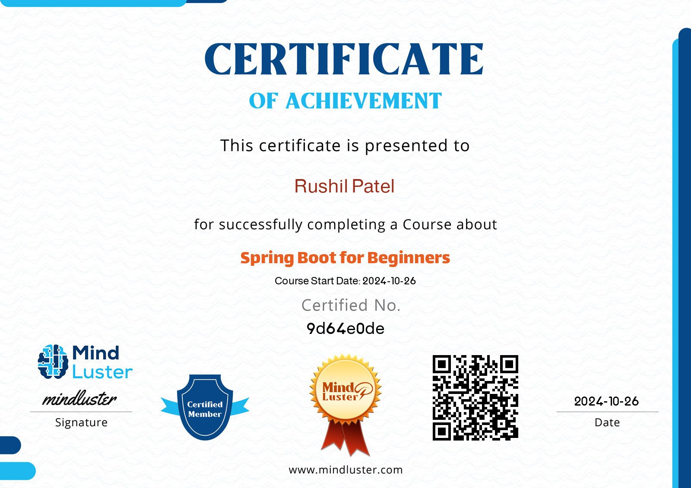

Slide 9
Thank you

