Slide 1


PARUL INSTITUTE OF TECHNOLOGY
FACULTY OF ENGINEERING & TECHNOLOGY
PARUL UNIVERSITY
B.Tech 5th Semester Minor project presentation
“HAND GESTURE AND MOTION DETECTION”
Presented by:
Krish Virani (2203051247009)
Rushil Shah(2203051247013)
Jainish Jadhav (2203051247012)
Nischal Raj (2203051247008)
Supervisors:
PARUL INSTITUTE OF TECHNOLOGY, PARUL UNIVERSITY
NAME OF THE INSTITUTE, PARUL UNIVERSITY

Slide 2
Content of Presentation
Introduction
Abstract
Problem Statement
Literature Review (if any)
Proposed Methodology
Project Module
Use case diagram/ER diagram/Flow diagram
Hardware and software Requirement
Excepted Outcome of the Project
Limitation
Conclusion and Future Work
References
PARUL INSTITUTE OF TECHNOLOGY, PARUL UNIVERSITY
NAME OF THE INSTITUTE, PARUL UNIVERSITY

Slide 3
Introduction
Hand detection and motion control are cutting-edge technologies that have revolutionized human-computer interactions. They enable computers to understand and respond to hand movements and gestures, allowing users to interact with digital systems in a natural and intuitive manner
Gesture Recognition:
Hand Detections and Tracking:
Deep learning
Python Libraries and Tools:
PARUL INSTITUTE OF TECHNOLOGY, PARUL UNIVERSITY
NAME OF THE INSTITUTE, PARUL UNIVERSITY

Slide 4
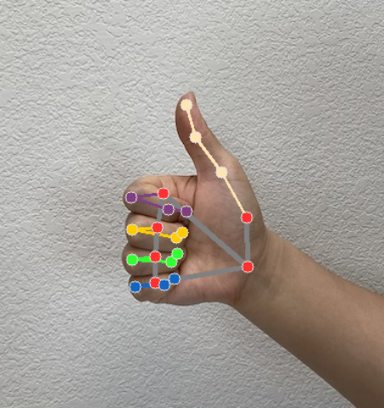
Introduction
How It Works?
After hand detects the python libraries will go through the images and mark key points on it.
Based on the location of points (in X and Y coordinates) we get the motion can be monitorized.
Using pyautogui (library in python) we can perform clicks, scroll events, and mouse control.
PARUL INSTITUTE OF TECHNOLOGY, PARUL UNIVERSITY
NAME OF THE INSTITUTE, PARUL UNIVERSITY

Slide 5
Abstract
This project explores an advanced hand gesture and motion control system implemented using Python.
The system is designed to detect and track human hands in real-time.
Once the hands are detected and tracked, the system utilizes Python libraries like PyAutoGUI or pynput to translate hand movements into system-level actions.
Users can interact with applications and interfaces using natural gestures and movements, creating an immersive and intuitive control experience.
PARUL INSTITUTE OF TECHNOLOGY, PARUL UNIVERSITY
NAME OF THE INSTITUTE, PARUL UNIVERSITY

Slide 6
Problem Statement
In today's technologically advanced world, there is a growing demand for intuitive and hands-free human-computer interaction systems.
Traditional input methods such as keyboards and mice have limitations when it comes to natural, immersive, and accessible interactions.
Hand detection and motion control systems have the potential to revolutionize how users interact with computers, gaming consoles, virtual reality (VR) environments, and various electronic devices.
PARUL INSTITUTE OF TECHNOLOGY, PARUL UNIVERSITY
NAME OF THE INSTITUTE, PARUL UNIVERSITY

Slide 7
Project Modules
Data collection module
Hand Detection Module
Gesture Recognition Module
Data Preprocessing Module
PARUL INSTITUTE OF TECHNOLOGY, PARUL UNIVERSITY
NAME OF THE INSTITUTE, PARUL UNIVERSITY

Slide 8
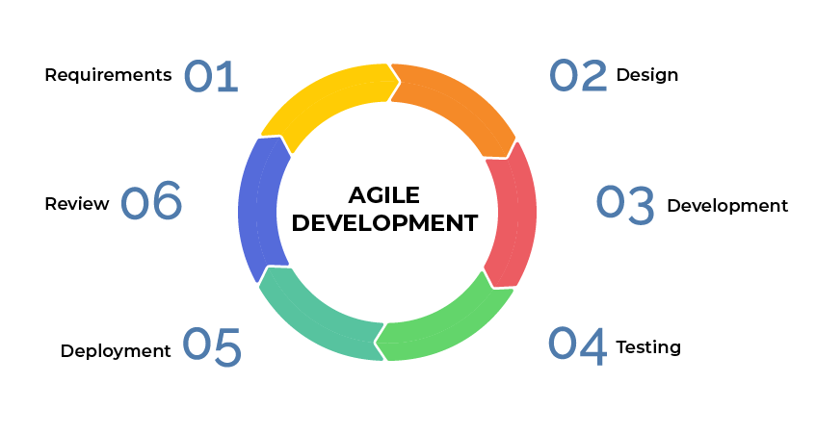
Project Model
PARUL INSTITUTE OF TECHNOLOGY, PARUL UNIVERSITY
NAME OF THE INSTITUTE, PARUL UNIVERSITY

Slide 9
Hardware and software Requirement
Project category : Desktop Prompt
Tool / language : Python
Processor : U series – high end (intel)
PARUL INSTITUTE OF TECHNOLOGY, PARUL UNIVERSITY
NAME OF THE INSTITUTE, PARUL UNIVERSITY

Slide 10
Conclusion and Future Work
Gesture-based Authentication:
Investigating the use of hand gestures as a biometric authentication method for secure access to devices or applications.
2. Low-power Implementations:
optimizing the system to run efficiently on low-power devices, such as smartphones or embedded systems
3. Gesture Learning:
Incorporating self-learning capabilities, where the system can learn and adapt to new gestures from user interactions
PARUL INSTITUTE OF TECHNOLOGY, PARUL UNIVERSITY
NAME OF THE INSTITUTE, PARUL UNIVERSITY

Slide 11
Limitation
Gesture Ambiguity
Limited Range and Field of View
Processing Power
Normal system can provide 30 to 40 fps in normal cam while the hand detects it suddenly drops about 4 to 5 fps
PARUL INSTITUTE OF TECHNOLOGY, PARUL UNIVERSITY
NAME OF THE INSTITUTE, PARUL UNIVERSITY

Slide 12
Expected Outcome of the Project
Integration with Target Applications:
Real-Time Motion Control:
Accurate Hand Gesture Recognition:
Standard inputs without hardware
PARUL INSTITUTE OF TECHNOLOGY, PARUL UNIVERSITY
NAME OF THE INSTITUTE, PARUL UNIVERSITY

Slide 13
References
1. OpenCV
https://docs.opencv.org/
2. Media PIPE
https://google.github.io/mediapipe/solutions/hands
3. Youtube
PARUL INSTITUTE OF TECHNOLOGY, PARUL UNIVERSITY
NAME OF THE INSTITUTE, PARUL UNIVERSITY

