Slide 1

CSE400 - FUNDAMENTALS OF PROBABILITY IN COMPUTING
Milestone-2
Section-1
Group-7
Intelligent Transportation system

Slide 2

ADAPTIVE TRAFFIC SIGNAL CONTROL USING LAS VEGAS ALGORITHM
Intelligent Transporation System
Application Domain
Going beyond the qualitative descriptions, the project models the probabilistic behavior of 4 cross intersection for signal synchronization.
Real-World Context
The uncertainty is inherent and is mathematically characterized by the arrival of vehicles randomly, random fluctuations in the development of queues, random extension of green-time and also variations in the vehicle speeds that characterize Indian traffic behavior.
Intrinsic Uncertainty

Slide 3
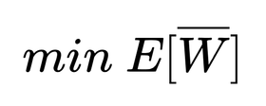
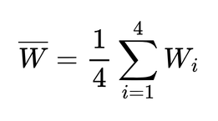
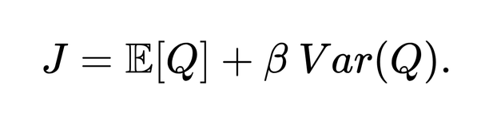
OBJECTIVE AND SCOPE
Objective
The primary objective is to minimize the expected average waiting time per lane: , where
Additionally, it aims to minimize a risk-aware objective function that penalizes congestion variability:
Estimated
Decided
The system decides green light durations using a Las Vegas randomized extension mechanism and dynamically selects the scheduling direction S(t) based on queue proportions.
The system approximates the constant queue length and the likelihood of the escalation of the congestion.

Slide 4
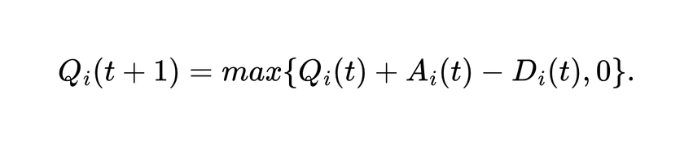

SYSTEM OVERVIEW
End-to-end system pipeline
The controlled Markov-process is represented by the system state, X(t) = (Q(t), S (t)). Time is represented in signal cycles t=0,1,2,...].
Major Components & Data Flow:
A multivariate arrival vector A(t) injects into the intersection during cycle t.
Queue Evolution: Queues evolve as a function of time as follow:
Departures: here the service rate and the allocated green time act as constraints for departures Di(t).
Scheduling: A randomized scheduling function outputs a conditional PMF to select the next direction based on current queue proportions.

Slide 5

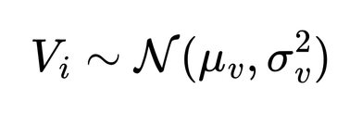

SOURCE OF UNCERTAINTY
Environmental Variability
Measurement Noise
Vehicle speeds vary largely in Indian traffic.
Traffic shifts between peak and non peak hours
It is modelled as normal distribution as follow :
It is captured using time varying arrival rate parameter
Modeling & Data Uncertainity
Relies on the M/M/1 steady-state approximation.
Assumes traffic remains strictly stable, meaning
Assumes independent arrivals across directions, which may miss real-world urban correlations

Slide 6
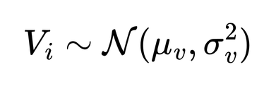

KEY RANDOM VARIABLES AND THEIR ROLES
Vehicle Arrival (Ai(t)):
It represents the number vehicles arriving in the direction i at time period t
Queue Length (Qi(t)):
It is the queue length at the start of cycle t, this dictates the transition of the system state
The waiting time per lane, derived from the expected queue length using Little's Law.
Waiting Time (Wi):
The random speeds at which the vehicles arrive modeled by
Vehicle speed Vi:
The randomized time extension applied to the green phase.
Green-Time Extension ( ):

Slide 7
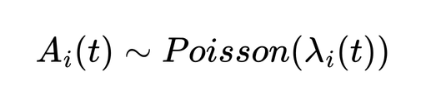
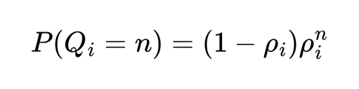
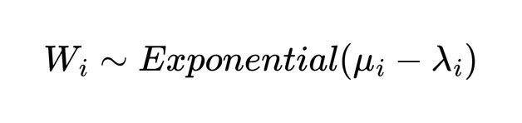
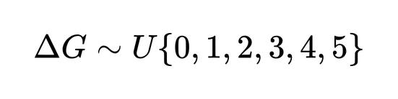
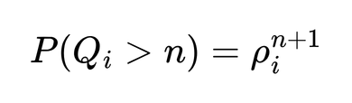
PROBABILISTIC MODELS AND ASSUMPTIONS
Probabilistic Models Used
Arrivals: Time-varying Poisson process,
Queue Length: Geometric distribution at steady-state,
Waiting Time: Exponential distribution
Green-Time Extension: Uniform distribution,
Justification
Assumptions
The geometric queue model perfectly highlights congestion risks
The system acts as a controlled Markov process, meaning the next state depends only on the current state.
As traffic intensity nears 1, the tail probability
increases sharply
Arrivals are fully independent across all four intersection approaches.

Slide 8
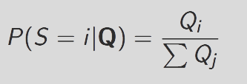
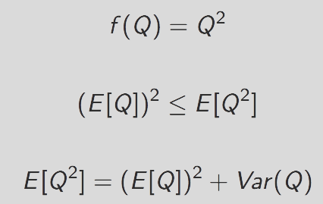
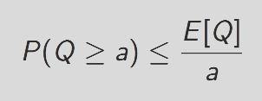
PROBABILISTIC REASONING AND INFERENCE LOGIC
Scheduling Rule
Jensen Inequality:
Inference logic

Slide 9


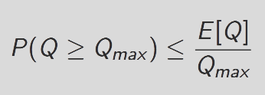
OPERATIONALIZING PROBABILISTIC REASONING IN THE PROJECT
Queue Update
Risk Evaluation
Safety Bound:
Mean Congestion
Variance
Tail Probability bound
95th percentile waiting time
Evaluation Metrics

Slide 10
CURRENT LIMITATIONS AND CONCEPTUAL GAPS
Limitations
Conceptual gaps
Poisson assumptions may oversimplify
Independence across direction
Markove bound is loose
No adaptive learning
No dynamic green switching

Slide 11
PLANNED REFINEMENTS AND ROLE COORDINATION
Planned Refinements
Role Coordination
Full simulation experiments
Compare risk-sensitive vs mean-only objective
Sensitivity analysis on λ
Parameter tuning for β
The GitHub manager created a repo
Structured it in the format required, which is clear and easy to read

Slide 12
SUMMARY OF GROUP-LEVEL UNDERSTANDING
We understand:
Random Variables in our project
PMF and CDF
Jensen & Markov inequality
Overall,
Stochastic modeling with risk and safety guarantees for Indian urban traffic control

Slide 13
THANK YOU

