Slide 1

The Asset Consultancy

Slide 2
Project Details:
Project Title : The Asset Consultancy
Project ID: 46414
Group Size: 2
Name Of Developers : Janki Kansara(120170107024)
Rushin Naik (120170107046)
Project Type: IDP
Company Name: Sculptsoft

Slide 3
Index:
1) Abstract
2) Technology Used
3) System Architecture
4) Current Scenario
5) New Flow
6) Project Need
7) Core Features and Benefits
8) What’s New
9) Diagrams
10)Implementation of Big Data
11) Future Scope
12) Conclusion
13) Bibliography/References

Slide 4
Abstract:
The Asset Consultancy involves the analysis/prediction of current and future price of real-estate commercials and buildings. The goal is to conduct that depending on analysis/prediction made for the prices of property, whether the customer should invest his money on that property or not. Upon examination of the results, it can be inferred if investing money on the estate would bring out a positive outcome or a negative one, and hence makes the customer aware about the advantages/flaws of investing at the particular place. Data will be fetched from different pre-requisites and compiled at one place producing analysis by an algorithm using Hadoop application and its different internal structures, which would be implemented in Java language.

Slide 5
Technology Used:
Software Used
Operating System: Windows 7 32 bit Professional, Linux Ubuntu
Web Server: Apache Tomcat Server 8.0.15.0
Server side Application Software: NetBeans IDE 7.0.1 or 8.0.2
Languages: Java Script, HTML/CSS, Java, JSP
Data Base: SQL Server Management Studio
Client Browsers: Google Chrome Or Firefox
Java Software : JDK 1.8.0_66
Hadoop 2.7.1
Hive 1.2.1
Sqoop 1.4.6
Netbeans IDE 8.0.2
MYSQL Workbench 6.2
Linux OS/Linux OS environment on windows

Slide 6
Hardware Used
3 Ghz Quad core processor
8 GB RAM
Ethernetcard

Slide 7
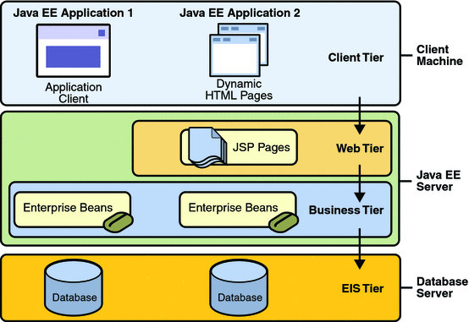
System Architecture:
Java Application Architecture:

Slide 8
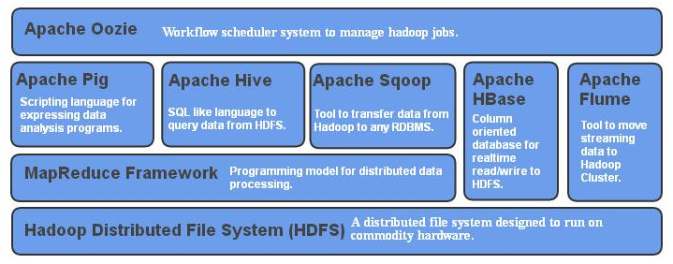
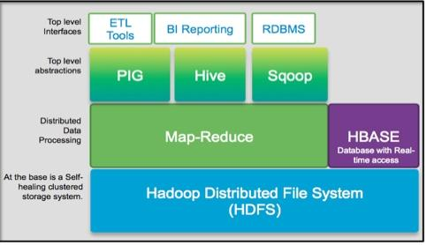
Hadoop Architecture:

Slide 9
Current Scenario:
Confusion
Giving Money to Agents
Decision to Invest
Lack of Authenticity Of Agents
Lack of Information

Slide 10
New Flow:
The Asset Consultancy
Agent, Customer & Property
Property and Agent Ratings
Analysis & Prediction
Group Interaction

Slide 11
Project Need:
To get authentic data about the upcoming trend from the past years pricing of real estate.
To improve the agent-customer connectivity.
To get an idea about the scenario at personal level rather than just following what the agent says.
To save money making decisions by yourself.
To make investment more precisely and smartly.
Improve awareness about the market trend.
To get approximate value of one’s own property after few years.

Slide 12
Core Feature and Benefits:
To provide the latest data of the price fluctuations taking place in real estates by referring to the past years data.
It also provides facility of creating groups to interact with other customers and agents.
The data for the next few years can be analyzed and summarized, which will give a better idea to the customer. The property can be recognized more deeply with better prospects.
Authenticated data- All at One place.

Slide 13
What’s new?
Yearly prediction of real estate pricing from the past and current scenario. This new application provides the facility for prediction of the prices of the assets and give an idea about the trend of the value of properties.
Users can create group and discuss about different properties with agents. The agent can give notifications to multiple customers and also other agents through the group feature. This facility promotes customer-agent interaction.
There other features worth mentioning like the user can get alerts about the latest updates of the particular property, easy and user friendly search of multiple properties and simple interface.
The system not only allows to view the graphical form of the trend, but also allows the user to save the report of the analysis and prediction to the disc.

Slide 14
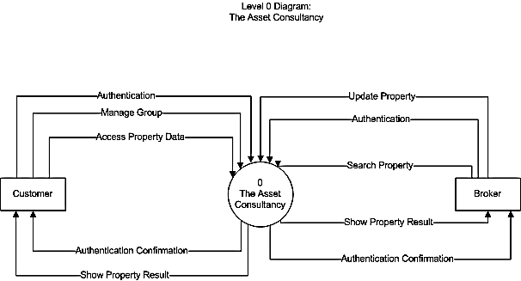
Context Level Diagram
Data Flow Diagram:

Slide 15
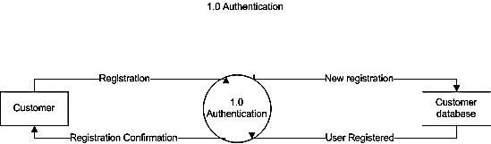
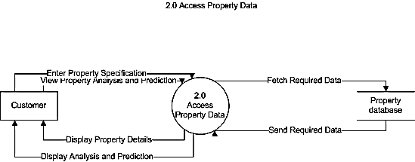
Level-1:

Slide 16
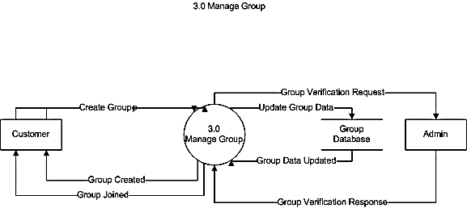
Level-1:

Slide 17
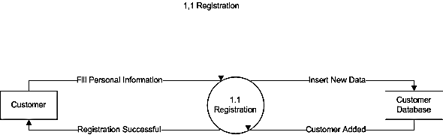
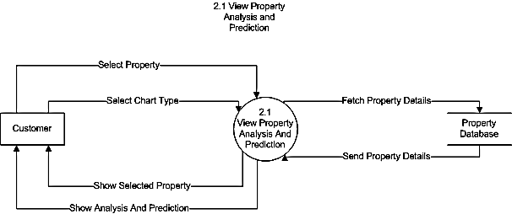
Level-2:
Level-2:

Slide 18
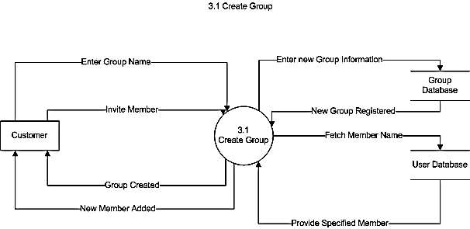
Level-2:

Slide 19
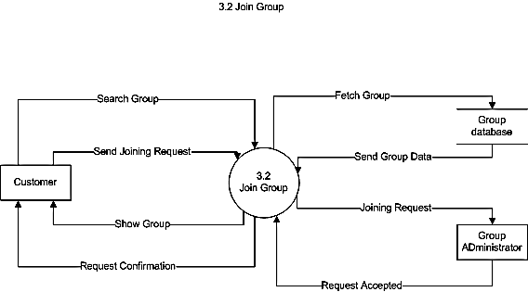
Level-2:

Slide 20
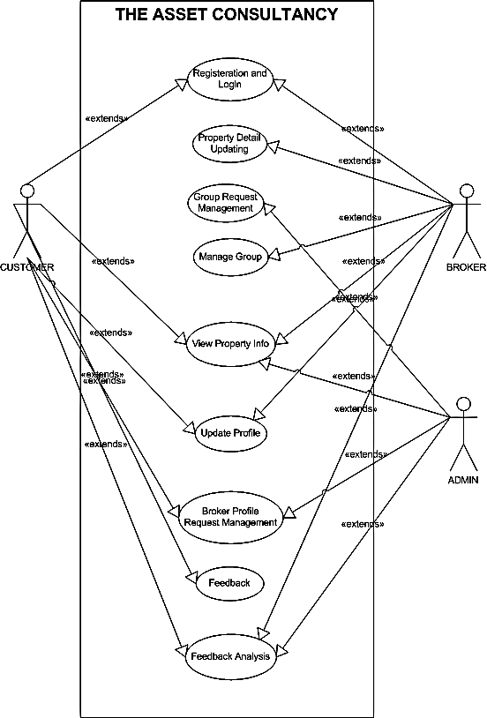
Use Case Diagram:

Slide 21
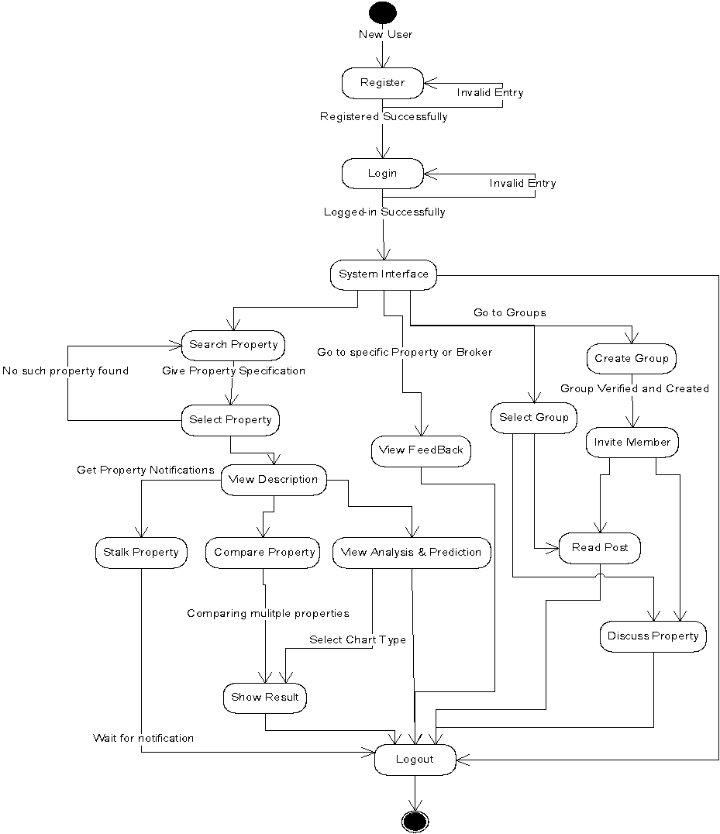
State Transition Diagram:

Slide 22
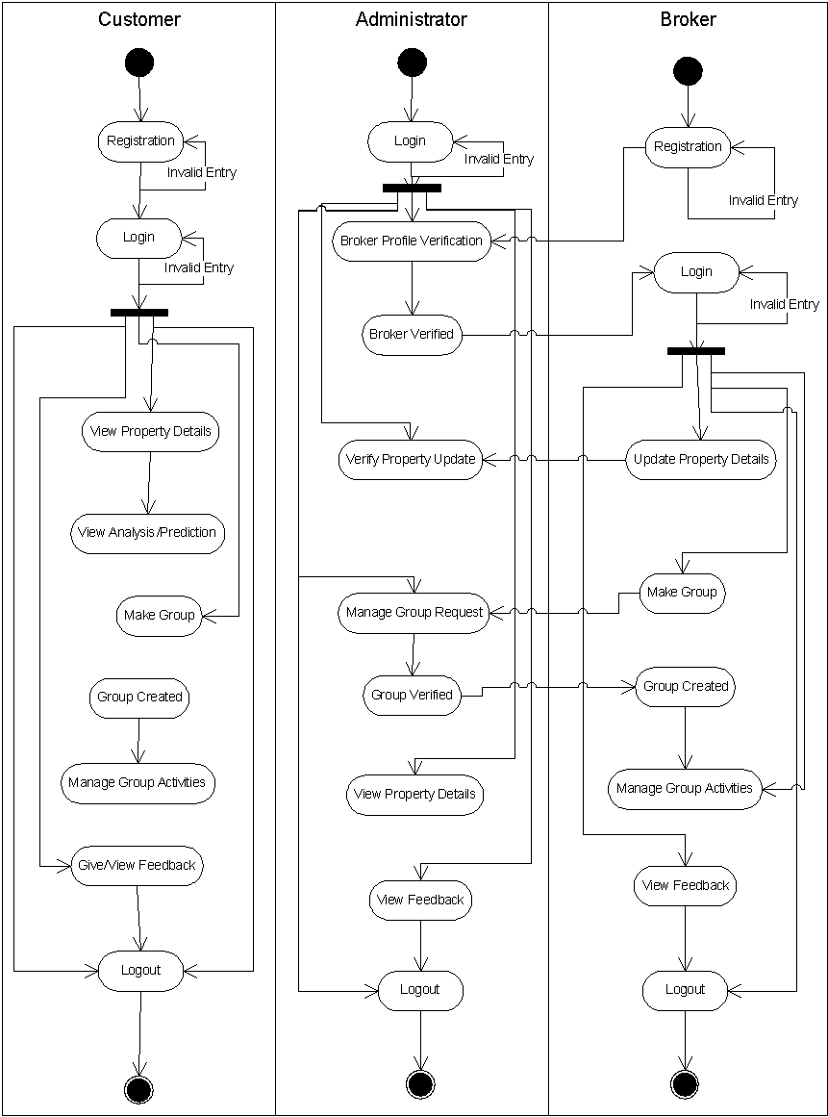
Activity Diagram:

Slide 23
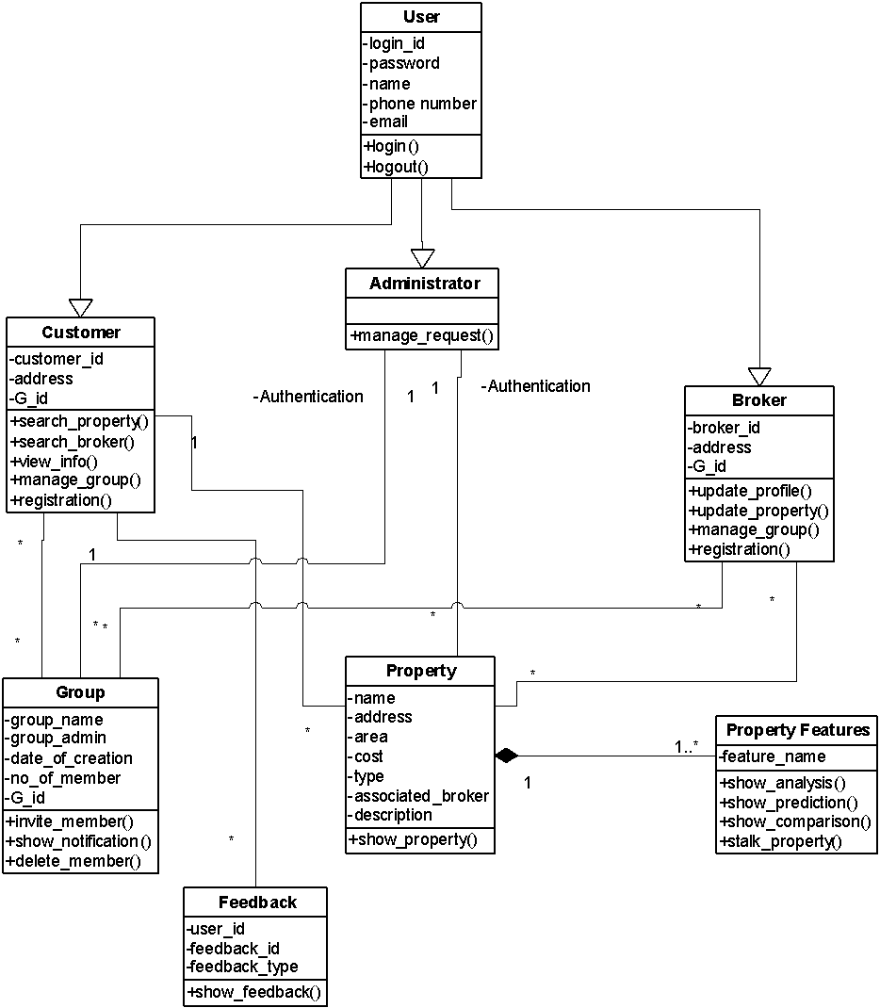
Class Diagram:

Slide 24
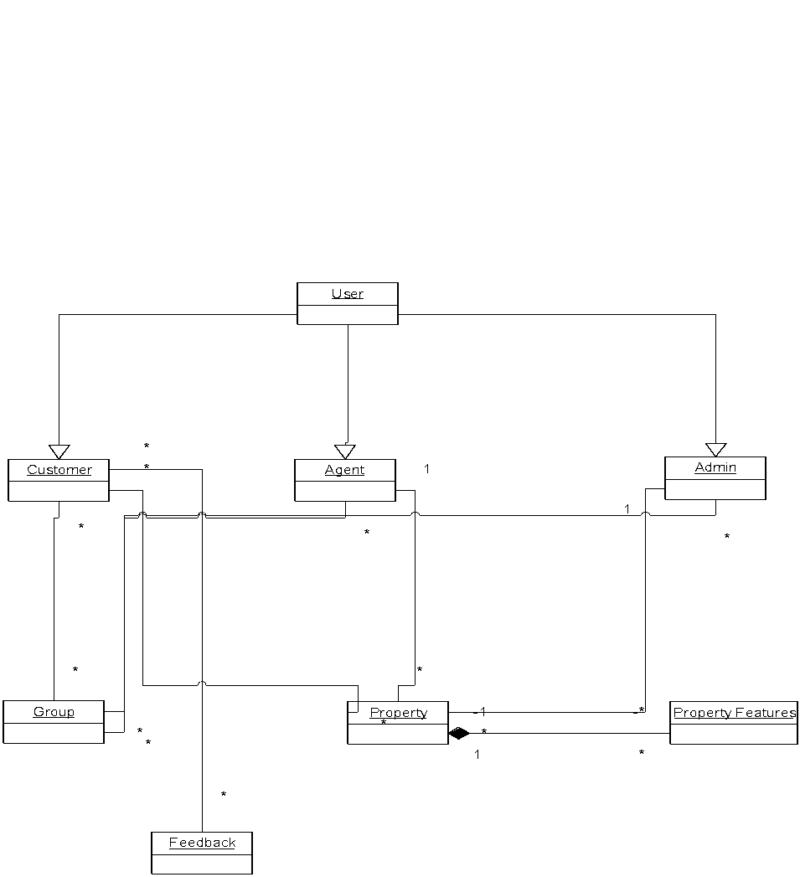
Object Diagram:

Slide 25
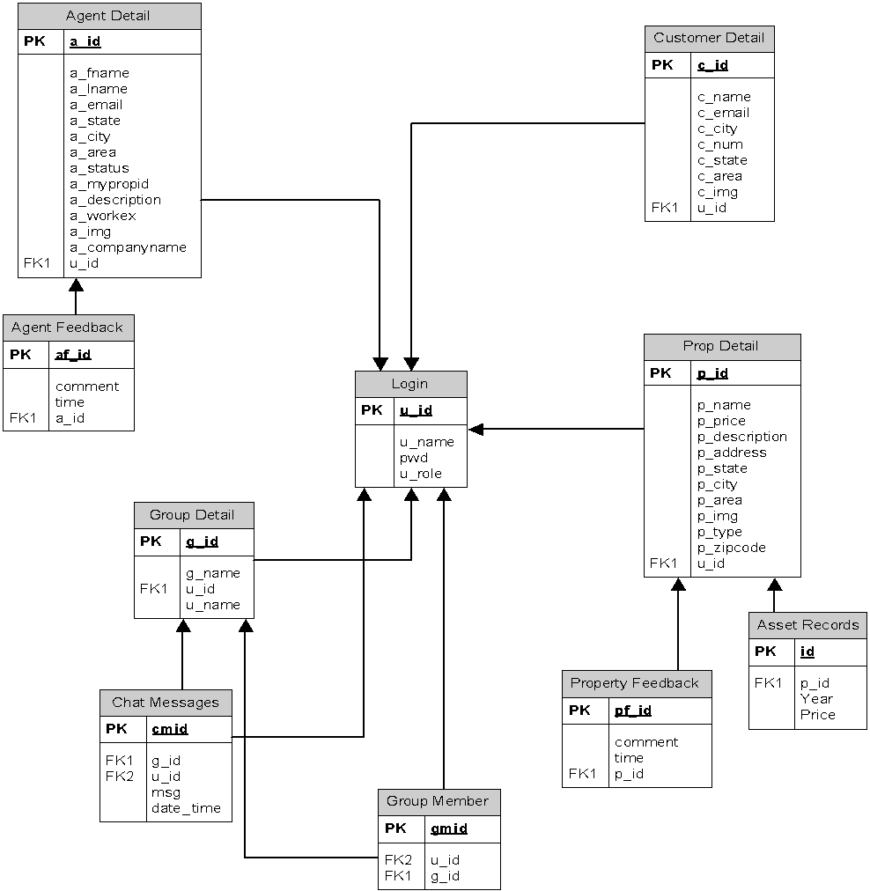
E-R Diagram:

Slide 26
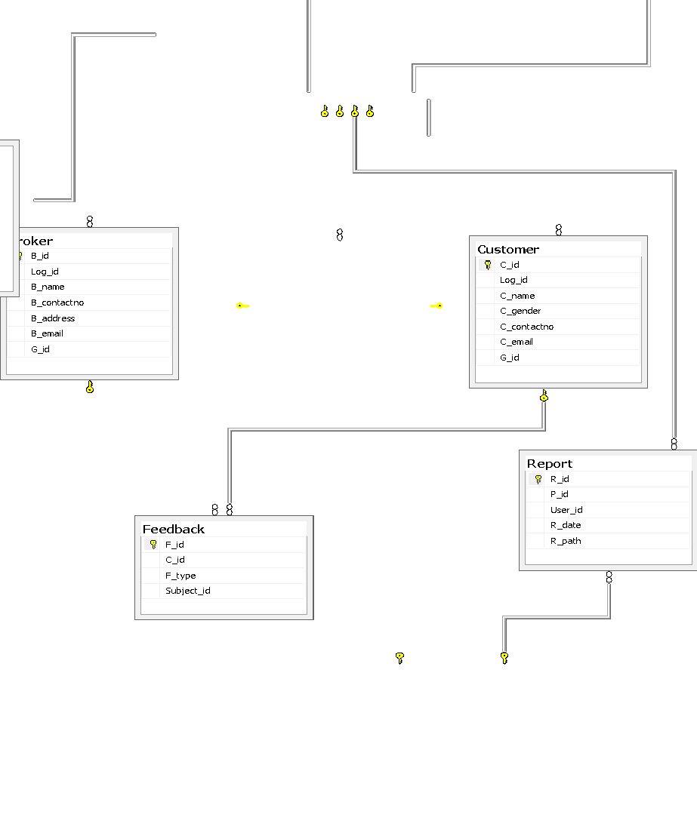
Relationship Database Diagram:

Slide 27
Data Dictionary:
Property:
Field | Data Type | Constraints | Description
P_id | Int | Primary key | Unique identity of property.
P_name | Varchar(50) | Not null | Name of property.
P_location | Varchar(200) | Not null | Address of the property.
P_size | Int | Not null | Area of property in sq. meter.
P_type | Varchar(50) | Not null | Features of property.
Associated_agent | Varchar(50) | Allow null | Agent handling the property.
Description | Varchar(500) | Not null | Summary about the property.

Slide 28
Customer:
Field | Data Type | Constraints | Description
C_id | Int | Primary key | Unique identity of customer.
Log_id | Int | Foreign_id | Login id.
C_name | Varchar(50) | Not null | Name of customer.
C_gender | Varchar(10) | Not null | Gender of customer.
C_contactno | Varchar(50) | Not null | Contact number of the customer.
C_email | Varchar(50) | Not null | Email id of the customer.
G_id | int | Allow null | The id of group the customer has joined
Agent:
Field | Data Type | Constraints | Description
A_id | Int | Primary key | Unique identity of agent.
Log_id | Int | Foreign key | Login id.
A_name | Varchar(50) | Not null | Name of agent.
A_contactno | Varchar(50) | Not null | Contact number of agent.
A_address | Varchar(50) | Not null | Address of agent.
A_email | Varchar(50) | Not null | Email id of agent.
G_id | int | Allow null | Id of the group the agent has joined.

Slide 29
Group:
Field | Data Type | Constraints | Description
G_id | Int | Primary key | Unique identity of the group.
G_name | Varchar(50) | Not null | Name of group.
G_admin | Varchar(50) | Not null | Administrator of the group.
No_of_members | Int | Not null | Number of members in the group.
Log_id | int | Not null | The login id of the members in the group.
G_date | Date | Not null | Date on which the group was created.
Feedback:
Field | Data Type | Constraints | Description
F_id | Int | Primary Key | Unique identity of feedback.
C_id | Int | Foreign Key | Customer who gave the feedback.
F_type | Varchar(50) | Not null | Property feedback or agent feedback.
Subject_id | int | Not null | Agent id or Property id about which the feedback is posted.

Slide 30
Report:
Field | Data Type | Constraints | Description
R_id | Int | Primary Key | Unique identity of analysis and prediction report.
P_id | Int | Foreign Key | Property about which the report is generated.
User_id | Int | Foreign Key | The user who issued the report.
R_date | Date | Not null | Date on which the report was generated.
R_path | Varchar(100) | Not null | Path for the reports.
Login:
Field | Data Type | Constraints | Description
Log_id | int | Primary key | Unique identity used for login.
Username | Varchar(50) | Not null | Username of the user.
Password | Varchar(20) | Not null | Password for login
User_type | Varchar(10) | Not null | Type of user: Customer, Agent, Admin

Slide 31
Implementation of Big Data
Big Data is used to reduce the large amount of data existing in the database.
This data(mostly existing in the row format) is then processed inside hive and sqoop to synchronize the data.
Then after, the whole data fetched from the database is reduced using MapReduce Technique of Hadoop.
Thousands of rows are shorten up to 50-100 rows and hence we get a reduced format of the infinite rows.
Hence these rows will produce the data required by the program and will present them in chart format.

Slide 32
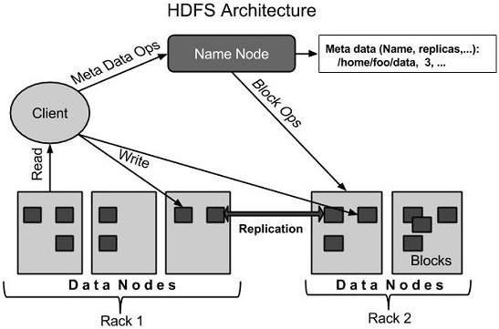

Slide 33
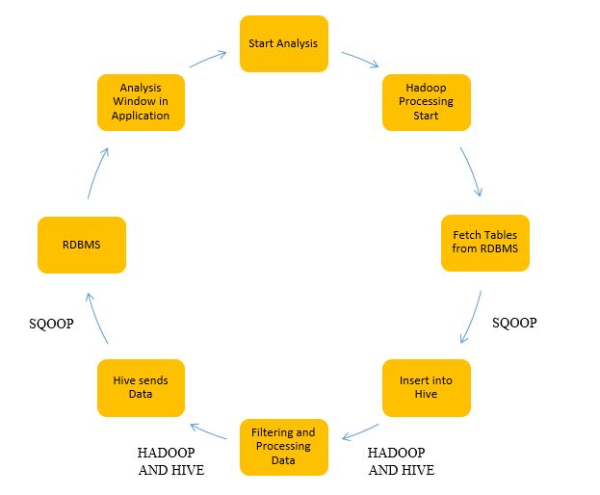
The chart format usually is shown in the following manner:

Slide 34
Sqoop Functionality
Sqoop is used in our project to transfer data between Hadoop and relational databases. The data is imported from MySQL into the Hadoop Distributed File System (HDFS), transformed in Hadoop MapReduce, and then exported back into an RDBMS.
Sqoop automates most of this process, relying on the database to describe the schema for the data to be imported. Sqoop uses MapReduce to import and export the data, which provides parallel operation as well as fault tolerance.

Slide 35
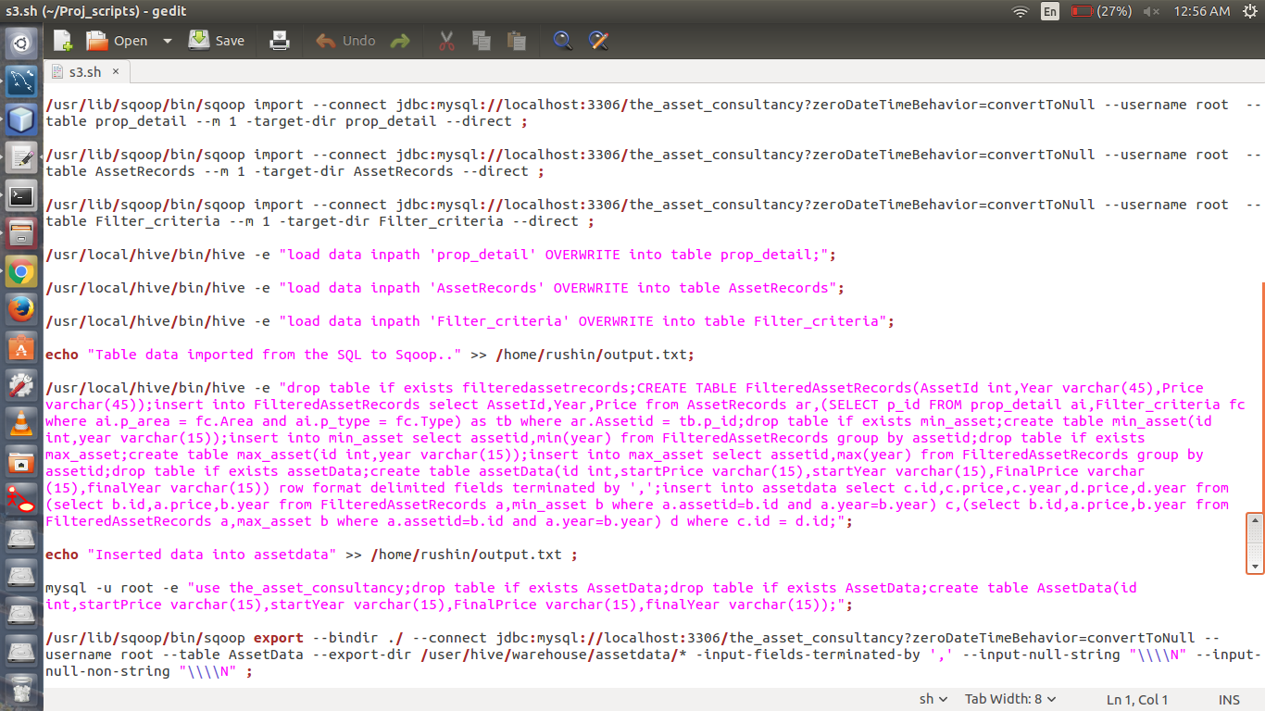
Sqoop Code:

Slide 36
Hive Functionality
Hive defines a simple SQL-like query language, called QL, that enables users familiar with SQL to query the data. At the same time, this language also allows programmers who are familiar with the MapReduce framework to be able to plug in their custom mappers and reducers to perform more sophisticated analysis that may not be supported by the built-in capabilities of the language. QL can also be extended with custom scalar functions (UDF's), aggregations (UDAF's), and table functions (UDTF's).
Hive functionality is basically used in our project to process the fetched tables from the database and create new tables in the hadoop database.

Slide 37
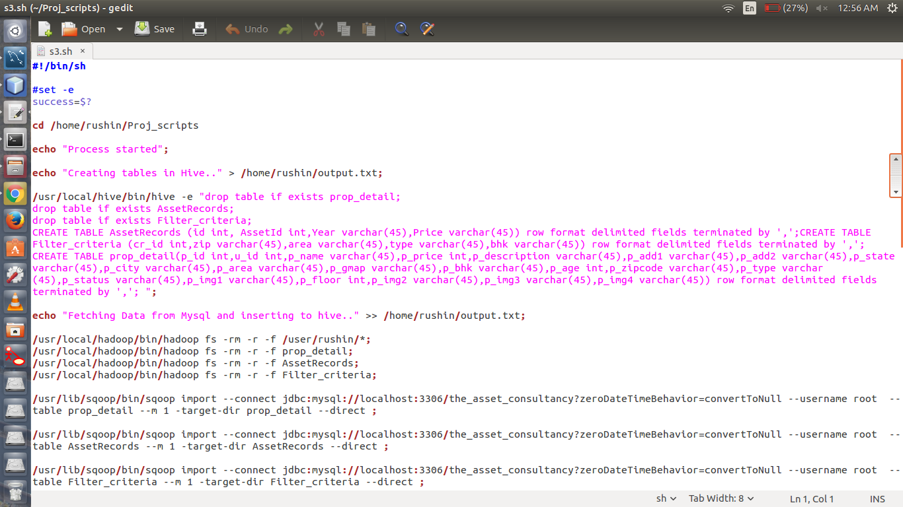
Hive Code

Slide 38
Criteria Fetch
We have set a particular criteria for the function to fetch the data from the database table just as below:
This query is used to fetch the particular data from the database of MYSQL and hence the processing of the function takes place according to this criteria that has been set.
The query is written and run externally by hadoop and after it has been completely processed, the script is called from the database of the tables.

Slide 39
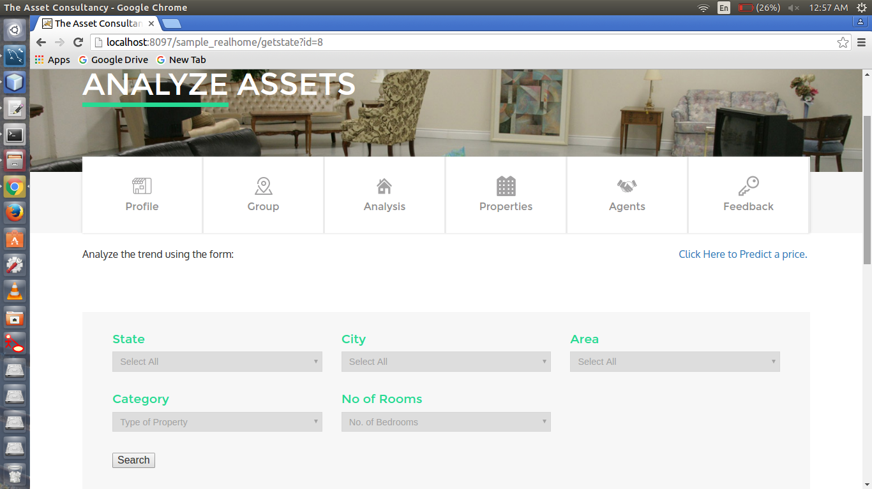
Criteria Fetch

Slide 40
Script Call
As soon as the criteria is fetched, the relevant script is called from the database table which is used to implement in the servlet and java script pages.
The script that is fetched, contains all the information which is required by the database to implement sqoop and hive functions.
Script is basically the Query that is fetched to implement in the Hadoop.

Slide 41
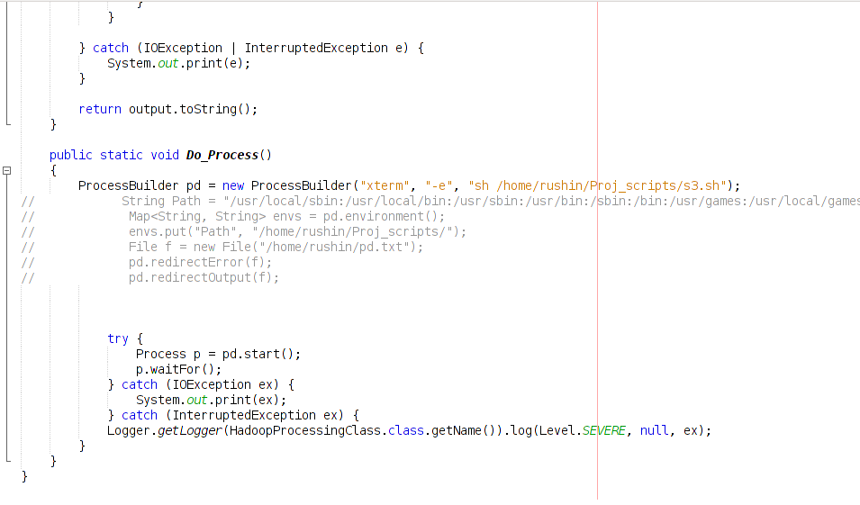
Script Call

Slide 42
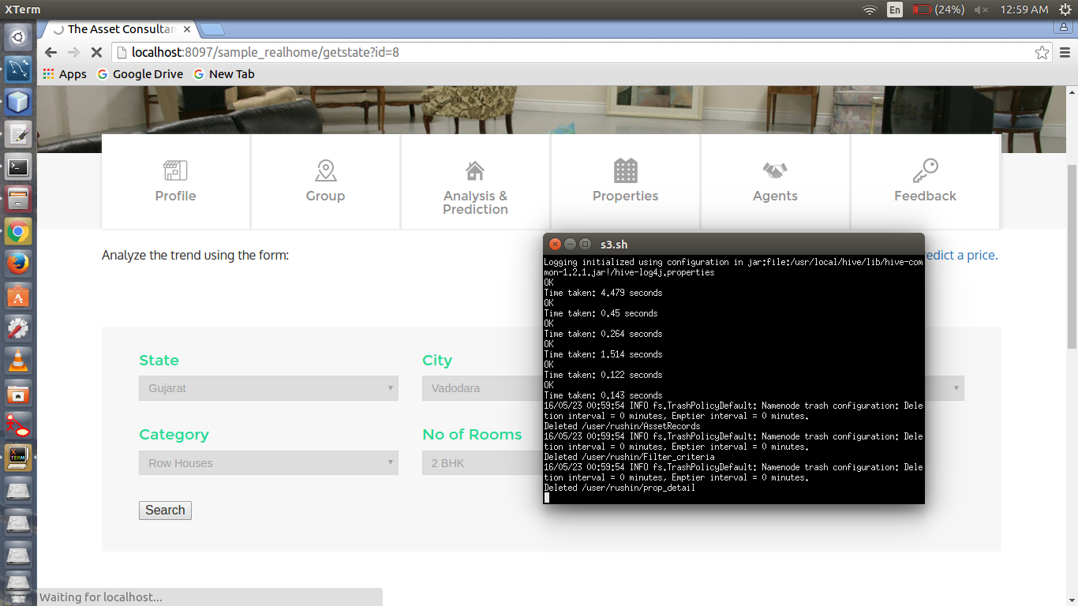
Script Execution

Slide 43
Future Scope
The new features related to personal advice from the adviser can be added to the system. Customer can personally ask questions to the advisers and get the doubts cleared.
More precise evaluation of parameters can be done to provide accurate analysis. Better algorithms can be designed to get better results about the prediction of prices.
A feature of audio searching with voice recognition can also be implemented to make system better and make it easy to go for the users.
Furthermore, property area ranking can also be shown twice in every month. Such feature will create a better idea in mind of the customer about which area is to be selected for investment.
Features that include Stalk Property and Comparison of two or more properties can be added to make the customers aware about which property is best out of both and to keep track of the properties they like.

Slide 44
Conclusion
In conclusion, it can be foreseen that if the project is implemented, it is going to be of much help the people who would like to analyze the market of real estate by oneself. The features would avail the user to know the trend and thus come to a decision about the property statistics. Though many other systems would be competing this system, but once the limitations are eliminated or the future enhancements are implemented it would be one of the best in the segment of asset market.

Slide 45
Bibliography/References
Books:
Object oriented Analysis and Design using UML by
Michel R. Blaha and James R. Rambaugh
The Complete Reference, Java 2 (Fourth Edition), Herbert Schild, TMH.
Websites:
www.magicbricks.com
www.99acres.com
www.propchill.com
www.google.com
www.tutorialspoint.com

